Slide 1
INDIA ON THE GLOBAL STAGE
A Data-Driven Comparison: UPA Era (Manmohan Singh, 2004–2014) vs NDA Era (Narendra Modi, 2014–2026)
HDI · Poverty · Unemployment · Corruption · Terrorism · Press Freedom · Pollution · Passport Power · Rupee vs USD
Sources: UNDP · World Bank · Transparency International · IEP · RSF · IQAir · Henley & Partners · RBI

Slide 2
What This Deck Covers
1
Methodology & verified data sources
2
Human Development Index (UNDP)
3
Poverty & Unemployment (World Bank / ILO)
4
Corruption Perceptions Index (Transparency International)
5
Terrorism & Press Freedom (IEP / RSF)
6
Pollution — PM2.5 (IQAir)
7
Passport Power (Henley Index)
8
Rupee vs Dollar (RBI)
9
Overall scorecard & key takeaways

Slide 3
Methodology — Verified Global Sources
Indicator | Publisher (world-recognized)
Human Development Index | UNDP — Human Development Report Office
Poverty Rate | World Bank — Poverty & Inequality Platform
Unemployment Rate | ILO Modelled Estimates / World Bank
Corruption Perceptions Index | Transparency International
Global Terrorism Index | Institute for Economics & Peace (IEP)
Press Freedom Index | Reporters Without Borders (RSF)
Air Quality (PM2.5) | IQAir World Air Quality Report
Passport Power | Henley & Partners (IATA data)
INR vs USD | Reserve Bank of India (RBI)

Slide 4
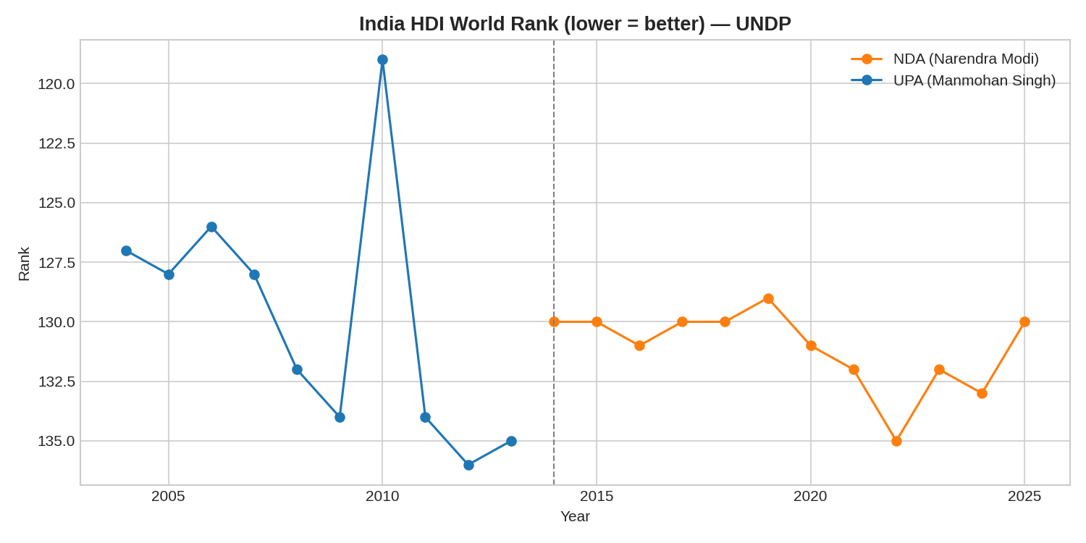
Human Development Index Rank (lower = better)
Source: UNDP Human Development Report — rank out of 189–193 countries.

Slide 5
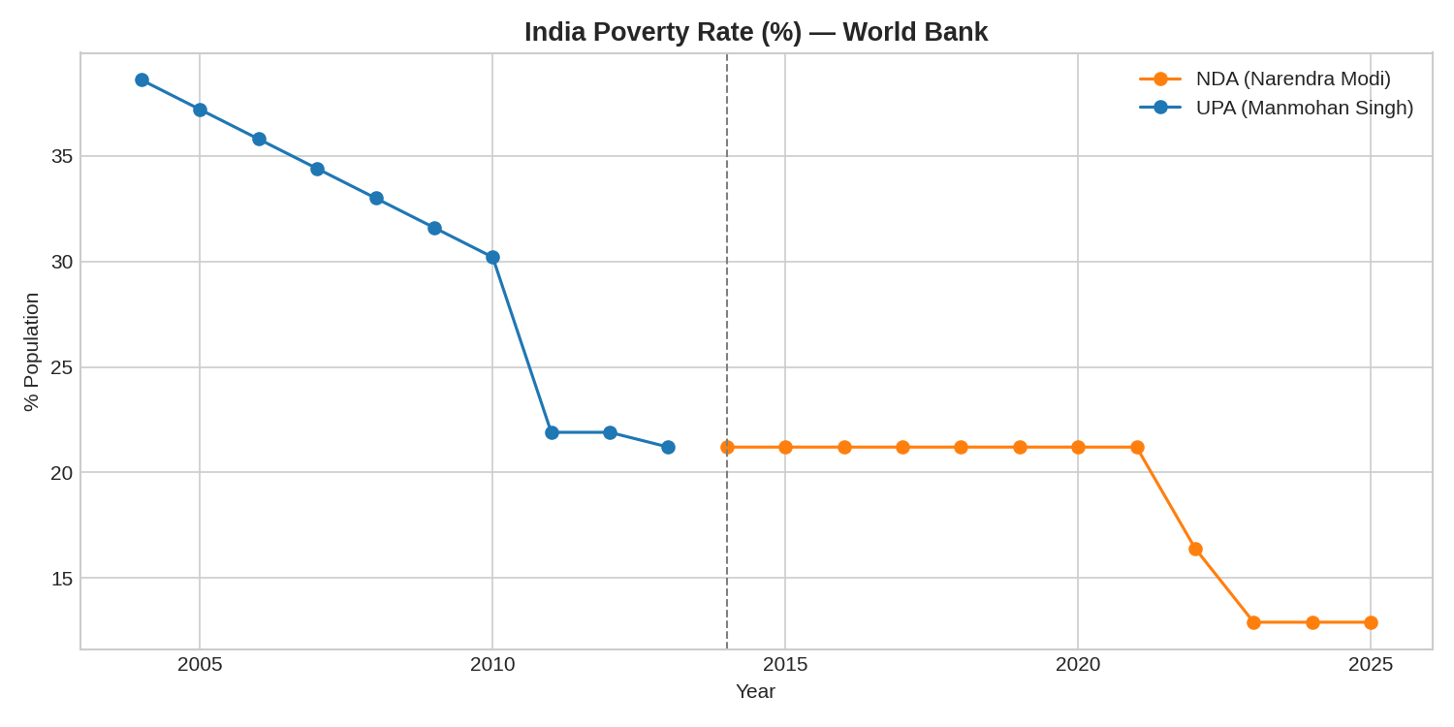
Poverty Rate (%)
Source: World Bank Poverty & Inequality Platform — % of population below poverty line.

Slide 6
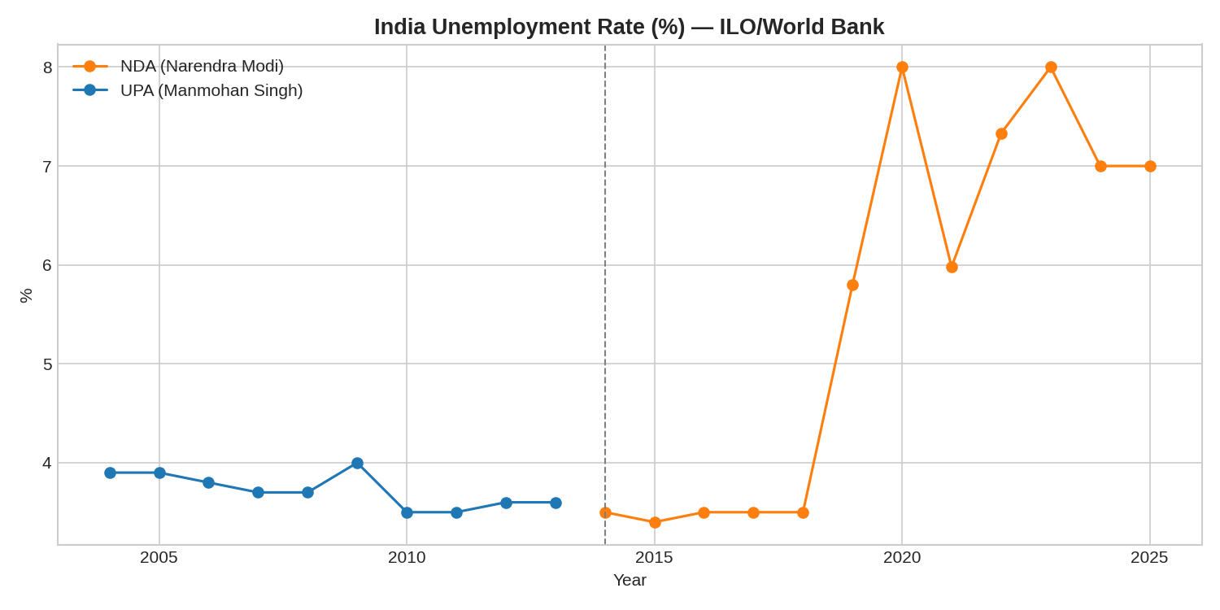
Unemployment Rate (%)
Source: ILO Modelled Estimates / World Bank. Spike in 2020 reflects COVID-19 lockdowns.

Slide 7
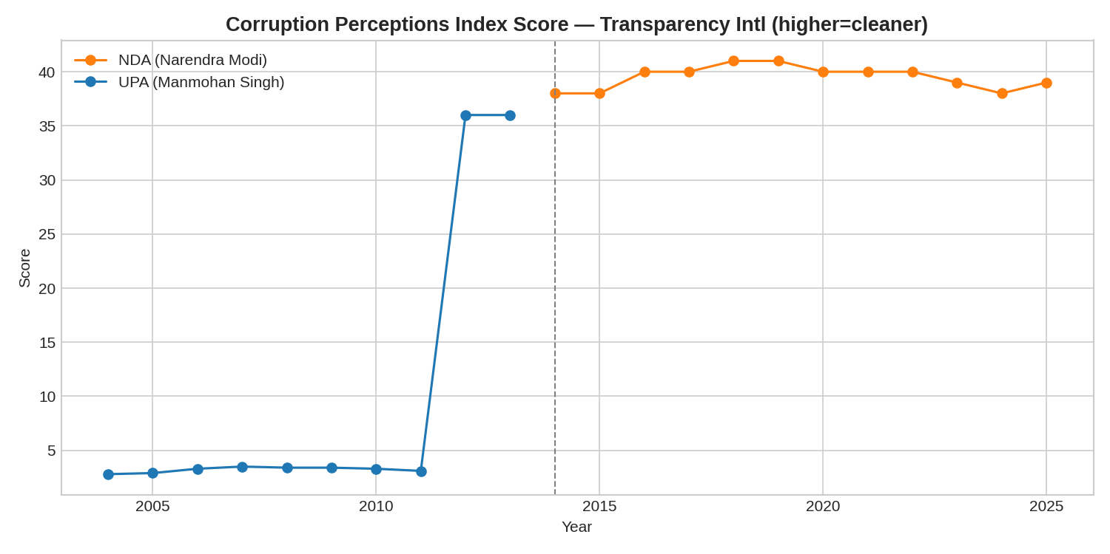
Corruption Perceptions Index Score (higher = cleaner)
Source: Transparency International. Scale: 0-10 till 2011, 0-100 from 2012.

Slide 8
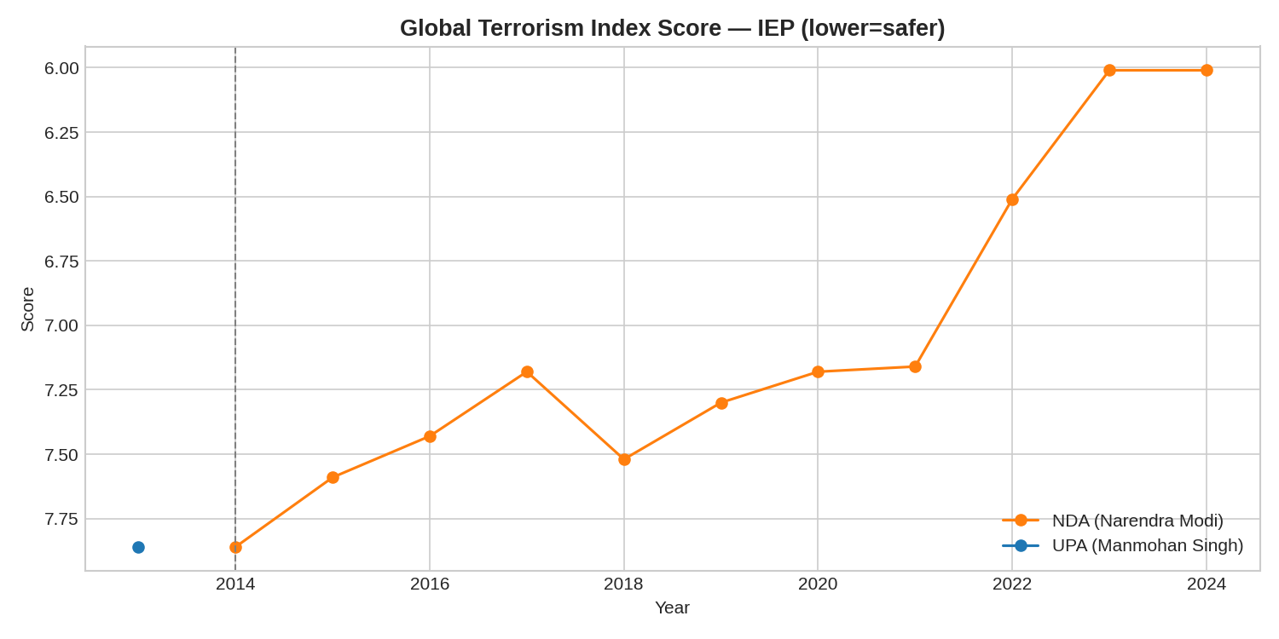
Global Terrorism Index Score (lower = safer)
Source: Institute for Economics & Peace. Index began publication in 2012.

Slide 9
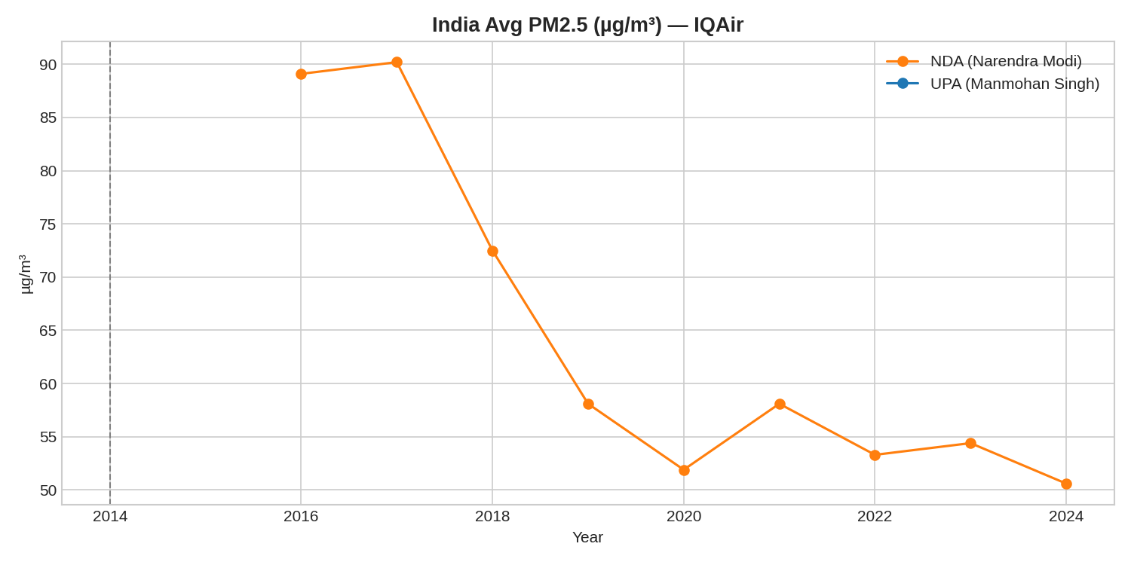
Average PM2.5 Pollution (µg/m³)
Source: IQAir World Air Quality Report. WHO safe limit: 5 µg/m³.

Slide 10
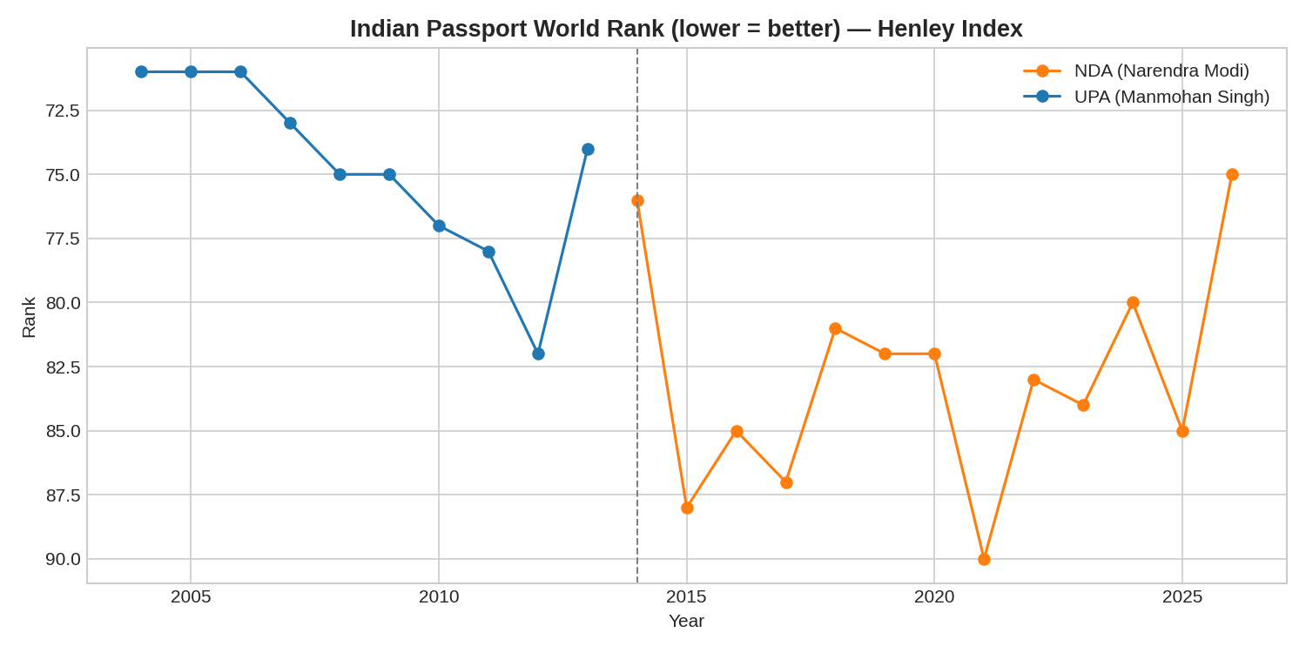
Indian Passport World Rank (lower = better)
Source: Henley Passport Index (Henley & Partners, based on IATA data).

Slide 11
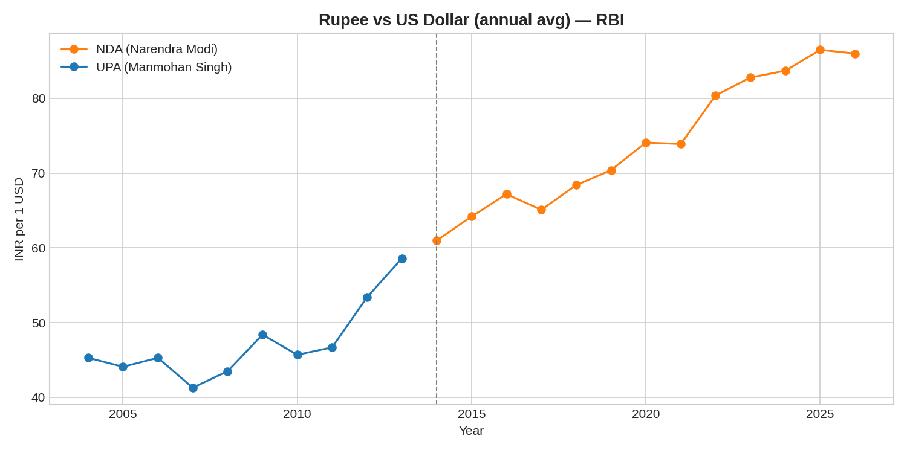
Rupee vs US Dollar (Annual Average)
Source: Reserve Bank of India (RBI). Depreciation reflects global & domestic macro factors, not government policy alone.

Slide 12
Overall Scorecard — Era Averages
Metric | UPA Avg (2004-13) | NDA Avg (2014-26)
HDI Rank (↓ better) | 129.9 | 131.1
Poverty Rate % | 30.7% | 16.1%
Unemployment % | 3.7% | 6.0%
Corruption (CPI score, ↑ better) | ~32 (rescaled) | 39.5
Passport Rank (↓ better) | 74.7 | 82.9
INR per USD | 47.2 | 74.1
Note: figures are descriptive averages, not causal attributions to either government — many indices reflect global, methodological, and structural factors beyond any single administration's control.

Slide 13
Key Takeaways
Poverty rate has fallen sharply across both eras, with the steepest declines reflected in newer World Bank nowcasts.
Unemployment rose post-2018 (PLFS methodology change) and spiked during COVID-19 (2020-21).
Corruption Perceptions Index score improved on the rescaled 0-100 metric, though India's rank still sits in the bottom half globally.
The Rupee depreciated from ~₹45/USD (2004) to ~₹86/USD (2026) — a long-term trend common to most emerging-market currencies, not unique to either era.
India's passport rank has fluctuated between 71st (best, 2006) and 90th (worst, 2021, COVID era) — broadly stable, not a one-directional trend.
HDI rank has been fairly stable (119th-136th) due to frequent UNDP methodology revisions — direct year-to-year comparison needs caution.

Slide 14
Thank You
Full dataset, SQL database, Python analysis & Excel workbook available in the project repository.
Prepared as a Data Analyst / Data Scientist portfolio project · 2026

