Slide 1
Automated Timetable Generator

Slide 2
The Team
ABHAY GARG
ADITI NEGI
SIMPLE PRASAD
181B007
181B013
181B216
SUPERVISED BY - MRS. BABITA TIWARI

Slide 3
Introduction
Time Table Scheduling has been in human requirements since all thought of managing time effectively.
In early days, time table scheduling was done manually , which takes a lot of effort and time.
Complexity increases when the number of constraints or amount of data increases.
In such cases perfectly designed timetable is preferred.

Slide 4
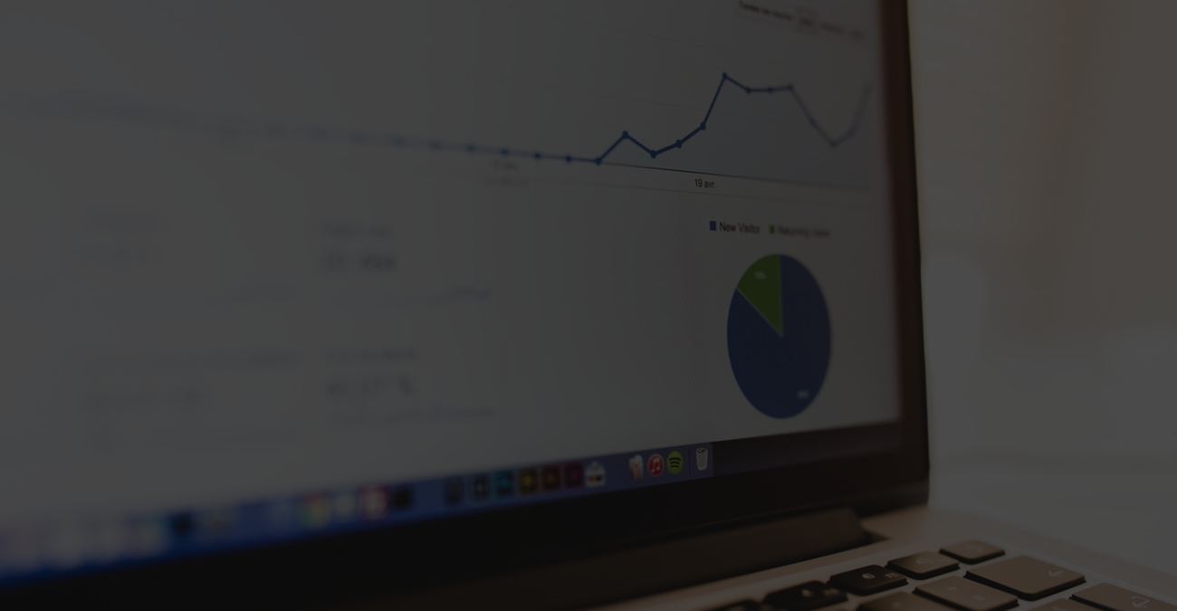
Objective
Sometimes there are limited number of faculties, each faculty teaching more than one subject. So now the timetable needed to schedule the faculty at provided time slots in such a way that their timings do not overlap and the time table schedule makes the best use of all faculty subject demands.

Slide 5
The Problem
The Solution
If any student or staff entry is wrongly made then the maintenance becomes very difficult.
Increased transaction leads to the increased source document and hence maintenance becomes difficult.
Using customized algorithm for this purpose.
In our Timetable Generation algorithm we propose to utilize a timetable object.

Slide 6

The Technology :
Genetic Algorithm

Slide 7
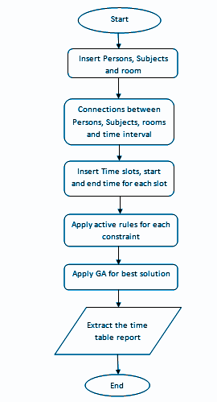
Flow Chart
Figure 1

Slide 8
Feasibility Study
Our project is technically, economically, operationally and behaviourally feasible since all the requirements are satisfied.

Slide 9
REQUIREMENT ANALYSIS
Software Requirements:
JAVA
Database
SQL Lite3
HTML 5
Cascading style sheets (CSS)
JavaScript
Hardware Requirements:
Core i5
1 Gigabyte Free Disk Space
1 Gb RAM

Slide 10
Screenshots...

Slide 11
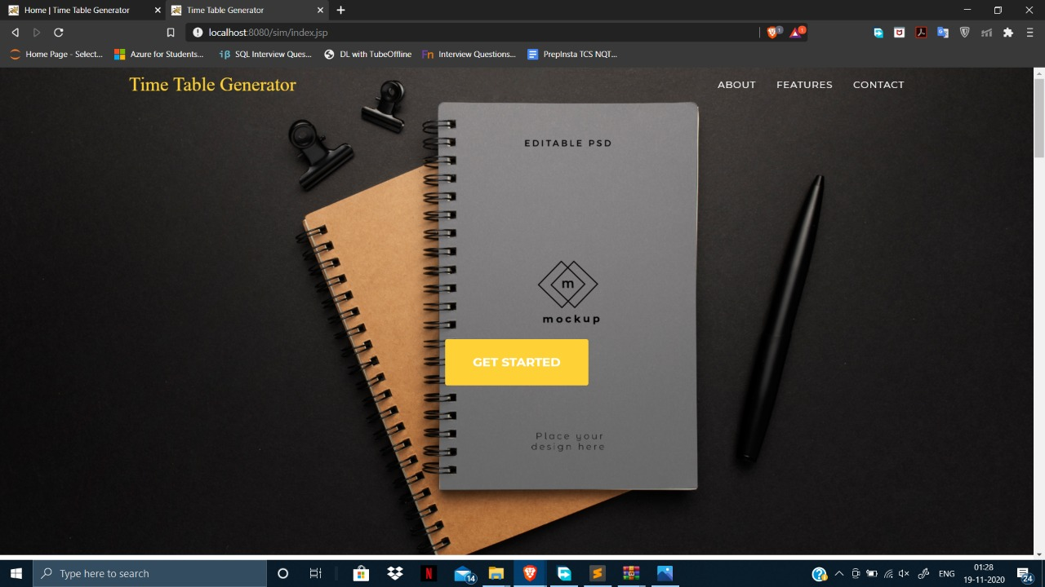
MAIN PAGE

Slide 12
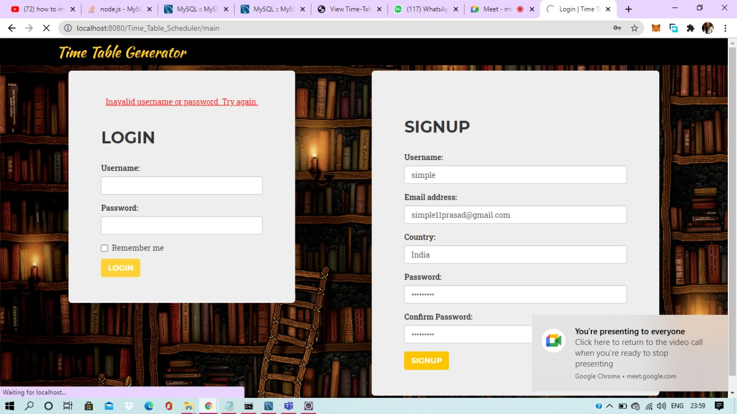
LOGIN PAGE AND SIGNUP PAGE

Slide 13
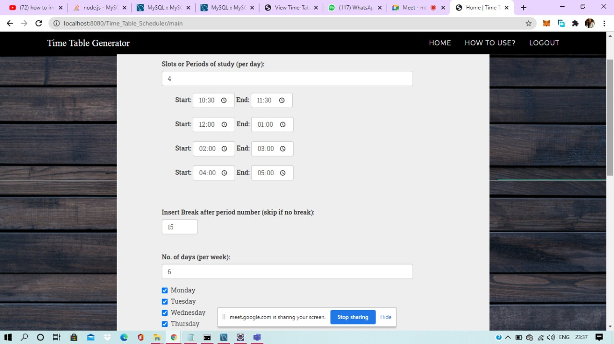
TO ADD CONSTRAINTS

Slide 14
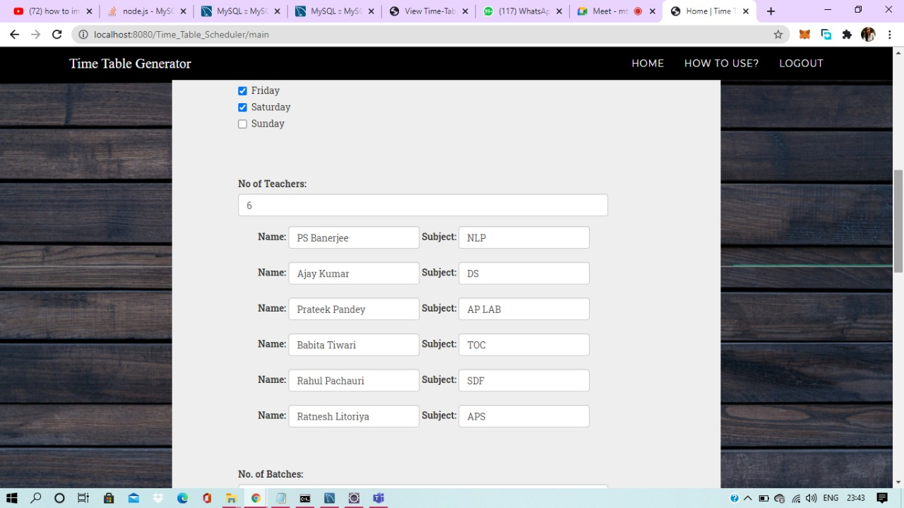
TO ADD CONSTRAINTS

Slide 15
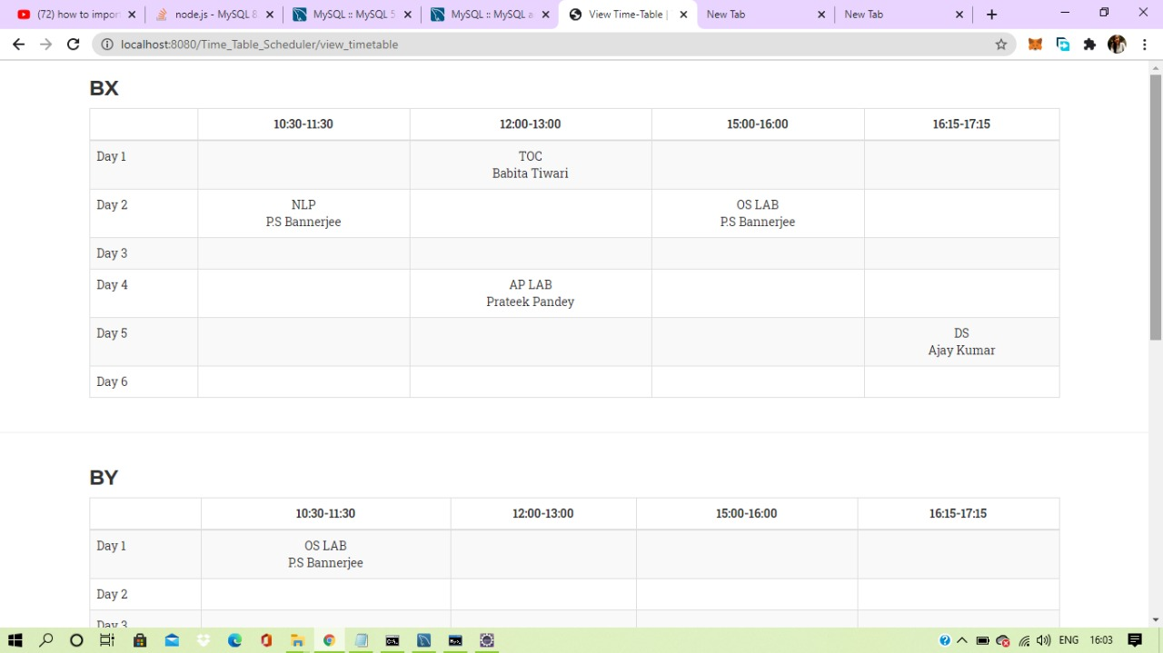
Generated Timetable View(1)

Slide 16
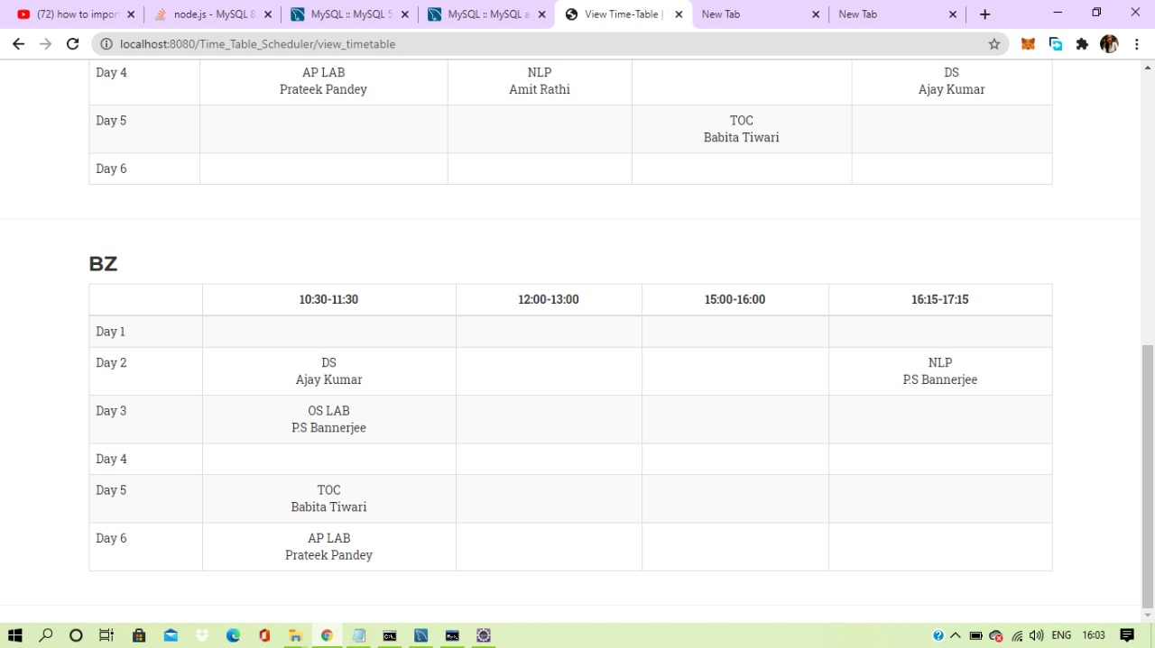
Generated Timetable View(2)

Slide 17
Further Refinement
We have used the basic concepts of Genetic Algorithm in our project. We created the Website for generating the TimeTable. We firstly thought of creating an application but unable to do so because of the unresolvable problems.
Goal - We have completed our Automated TimeTable Generation Project through Webpage Deployment and we will be creating Multi-Platform Native Application(getting the successful view on Android, iOS, Windows, etc)

Slide 18
THANK YOU !

