Slide 1
Generating Sequences Using RNN
Presentation By Team 24:
Karan Negi (2021201039)
Ziyad Naseem (2021201021)
Hussain Kagdi (2021201077)

Slide 2
OverView
To build a LSTM Model which can be used to generate sequences of characters based on the inputs provided.
To build a LSTM Model which can be used to generate sequences of words based on the inputs provided.

Slide 3
RNN
Recurrent Neural Network (RNN) are a class of neural networks that are helpful in modeling sequence data.
The output from previous step are fed as input to the current step.
RNN has hidden layer(s) which remembers some information about a sequence.

Slide 4
LSTM
Long Short-Term Memory (LSTM) networks are a modified version of recurrent neural networks, which makes it easier to remember past data in memory.
There are three Gates which are present in the LSTM network: input gate, forget gate, output gate.
Input gate — discover which value from input should be used to modify the memory.
Forget gate — discover what details to be discarded from the block. It is decided by the sigmoid function.
Output gate — the input and the memory of the block is used to decide the output.

Slide 5
Dataset Description
The dataset which we used for our project is Penn TreeBank Dataset which consist of approximately 5100345 words.
We used this dataset for training our network and split the dataset for the validation set too.

Slide 6
Models
Model 1: Character Level Single Layer RNN Model
Model 2: Character Level Single Layer LSTM Model
Model 3: Character Level Single Layer LSTM Model with Regularisation
Model 4: Character Level Multi Layer LSTM Model
Model 5: Word Level Single Layer RNN Model
Model 6: Word Level Single Layer LSTM Model
Model 7: Word Level Multi Layer LSTM Model
Model 8: Word Level Multi Layer LSTM Model with Regularisation

Slide 7
Model Definitions
Model - Sequential
Layers
Embedding: Input - vocabulary size
No. of neurons: Character level RNN and LSTM - 128
Word level RNN and LSTM - 500
Regularization: Gaussian Noise with standard deviation of 0.075
Dense: Output,activation - softmax
Optimizer - adam
Loss - Categorical cross entropy

Slide 8
Results For Char Model
Model | Epochs | Validation Loss
Single Layer RNN | 10 | 2.4935
Single Layer LSTM | 10 | 2.4984
Single Layer LSTM with Regularisation | 10 | 2.5189
Multi Layer LSTM | 10 | 2.0480

Slide 9
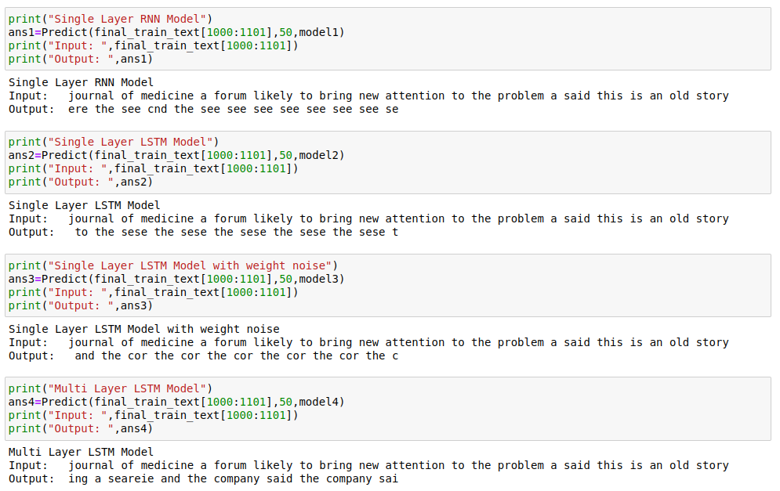
Predictions for Character Model

Slide 10
Results For Word Model
Model | Epochs | Validation Loss
SIngle Layer RNN | 10 | 6.9339
Single Layer LSTM | 10 | 9.3454
Multi Layer LSTM | 10 | 8.3972
Multi Layer LSTM with Regularisation | 20 | 6.8400

Slide 11


Predictions for Word Model

Slide 12
Analysis
Obviously, the word level models performs better than the character-level models as it predicted more meaningful sentences compared to character-level.
Multi-layer LSTM performs slightly better than Single-layer LSTM.
The validation loss drops when we add gaussian noise to model but the predictions are not so good.

Slide 13
THANK YOU

