Slide 1
Census Api
Brett, Negin, matt, julio

Slide 2
US population increase between 2011 & 2016
2011
2016
315.3 M
326.5 M

Slide 3
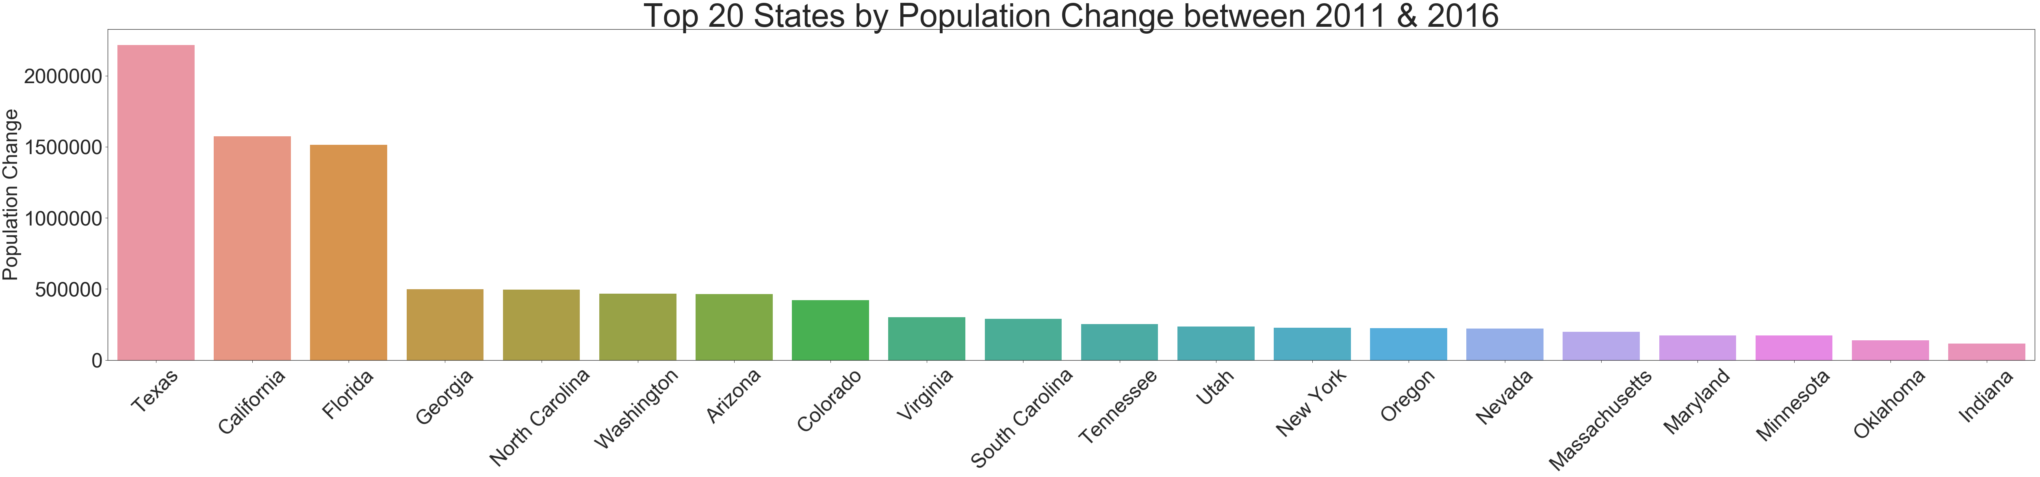
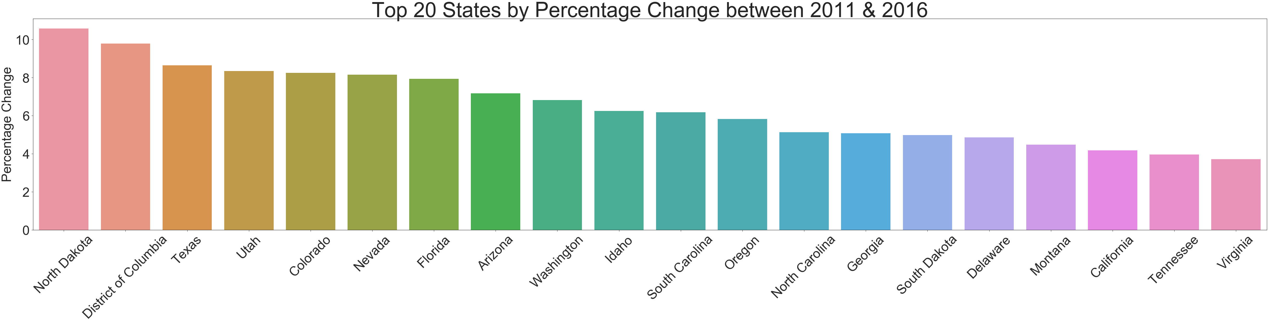
TX, CA and FL, top the list of States with the highest population increase between 2011 and 2016
The population increase in the top 3 was greater than 1M. All other States had population increases below 500k
At 10.6% and 9.8%, ND and DC, respectively, top the list of top 20 States by percentage change
TX remains in the top 3 States by Population and Percentage change
CA drops to 18th place on the percentage change scale

Slide 4
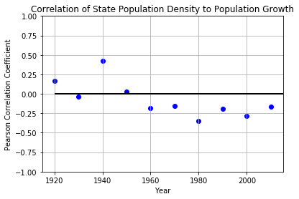
Population change vs density

Slide 5
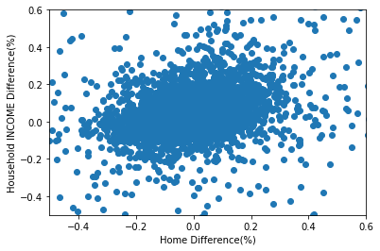
Income vs change in median home price

Slide 6
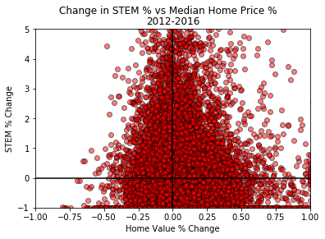
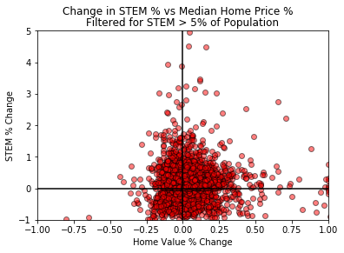
Correlation of Home Values and STEM Professionals

Slide 7
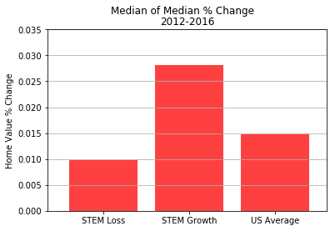
Correlation of Home Values and STEM Professionals

