Slide 1
RPA Onboarding Process
Project realised by
Chelarescu Bogdan & Negrea Andrei

Slide 2
The whole process
The user uploads an image of his ID in .jpg format
The user uploads his Resume in .pdf format
The user runs the program
The user completes the data form that pops
The program scrapes the ID
The program scrapes the CV
The program inserts the extracted data into an excel file
The program sends two notification emails to the HR and IT department

Slide 3
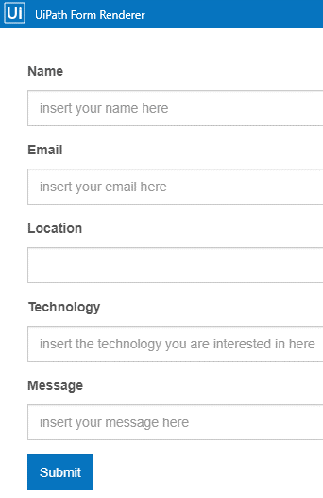
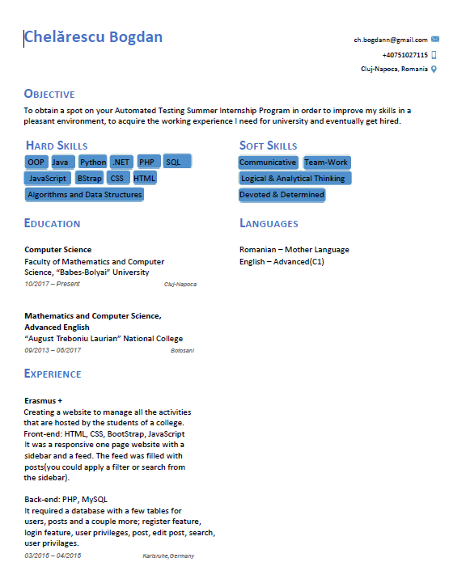
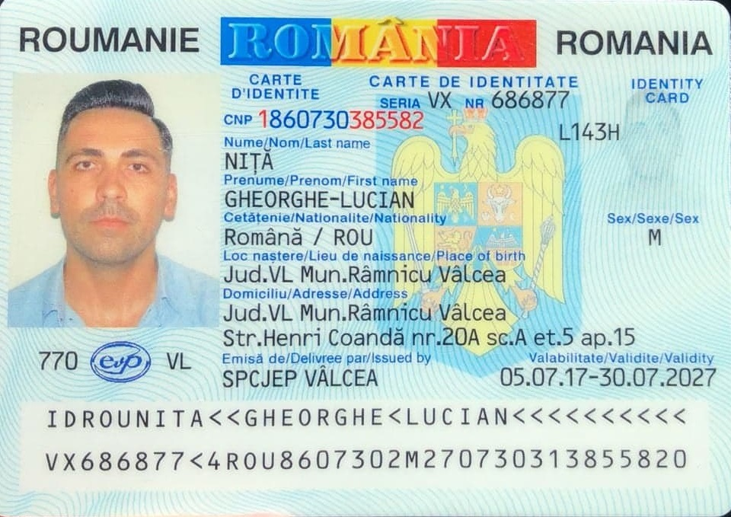

Slide 4
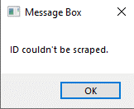
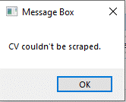
Things that could go wrong
No ID file uploaded No CV file uploaded

Slide 5
To conclude
The program is designed to automatize the onboarding process of a new employee in an efficient way, taking care of scraping, extracting and inserting his data into an excel document and also notifying the HR and IT department.
It is important this process is automated due to its simple and repeated tasks that would take much longer to be performed by people.

