Slide 1
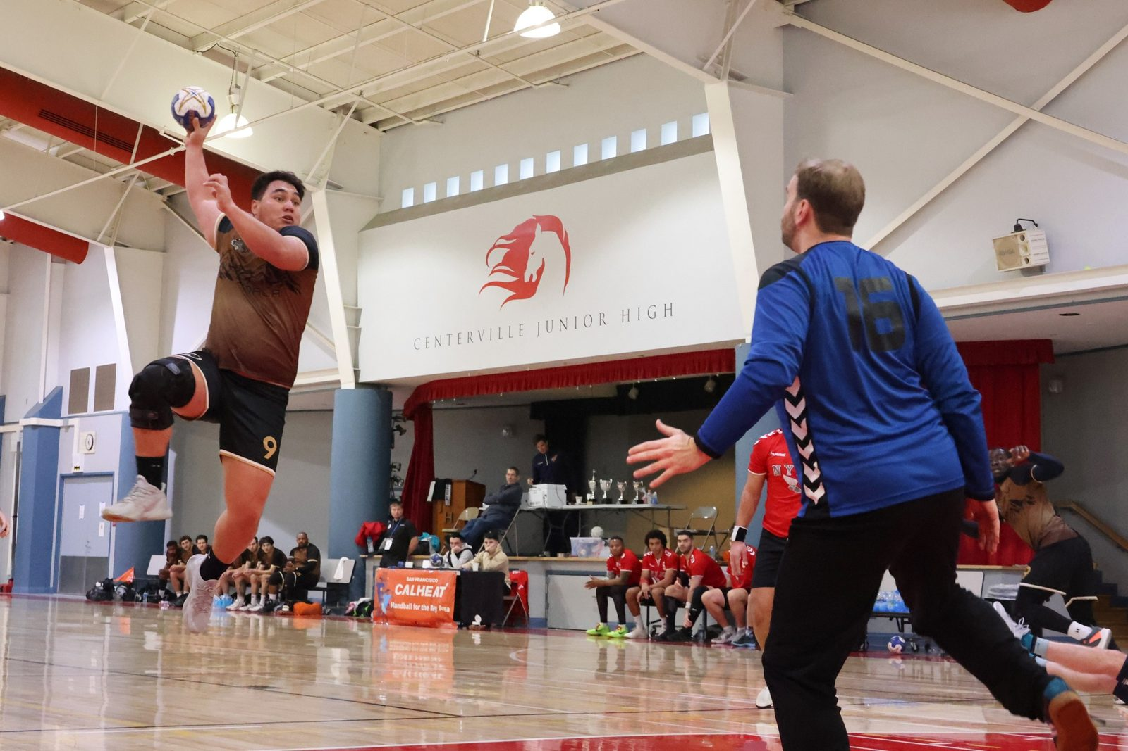


SAN FRANCISCO CALHEAT PRESENTS
Partnership Opportunities · 20th Edition
January 29 – February 1, 2027 · Fremont, California · Streamed nationwide

Slide 2
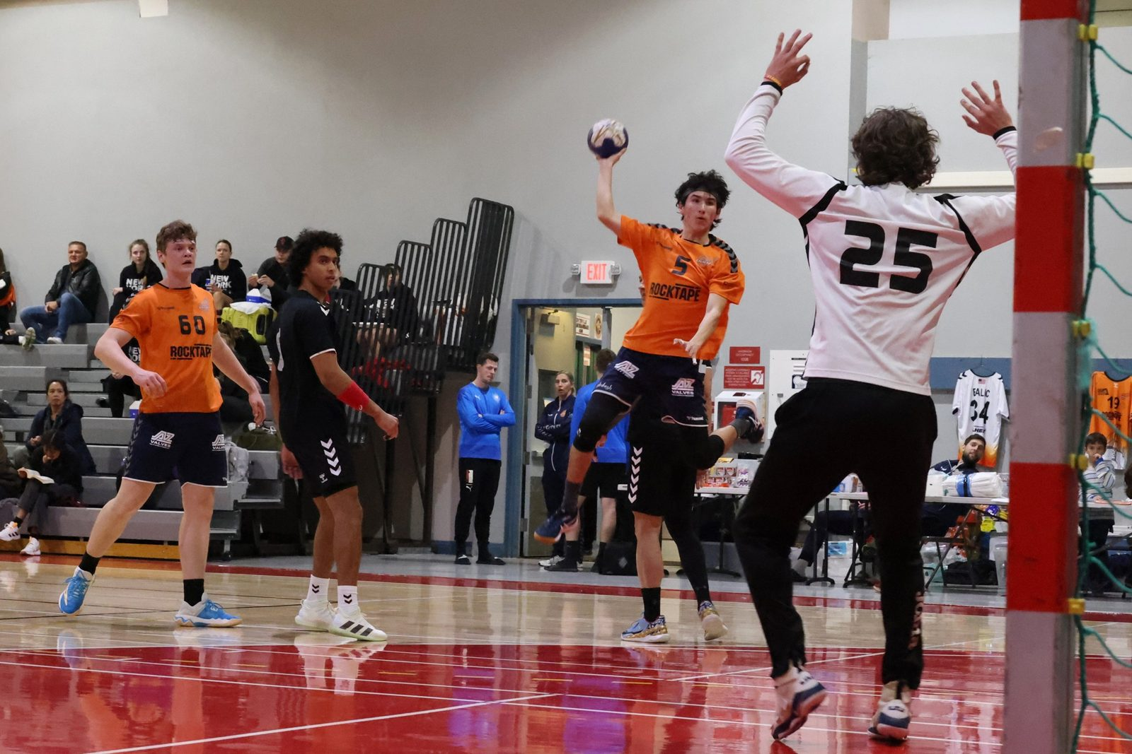
THE EVENT
The nation’s longest-running handball tournament
Since 2007, the California Cup has brought together elite men’s and women’s club teams from across the U.S., Canada and beyond. Now in its 20th edition, CalCup is hosted by San Francisco CalHeat — a Bay Area club and 501(c)(3) nonprofit — and streamed nationwide across three days of competition.
20
~200
Years running
Athletes / year
Elite men’s & women’s divisions, played to IHF rules.
13
4
Elite clubs
Days of play
CALIFORNIA CUP XX
Partnership Prospectus

Slide 3




WHY PARTNER
Reach an engaged national audience
Nationwide live stream
Every game streamed on YouTube across three days, plus post-event highlights — logo exposure well beyond the venue.
~200 athletes + families
A tight, engaged community of players, clubs and supporters travelling from across North America.
A genuine national stake
CalCup is a USA Team Handball ‘Wild Card’ qualifier for the US Nationals Elite division.
Support a nonprofit mission
CalHeat is a 501(c)(3) reinvesting proceeds into grassroots and youth handball.
CALIFORNIA CUP XX
Partnership Prospectus

Slide 4

THE ASK
A simple, affordable sponsorship
What your support covers
SPONSORSHIP
Venue & facilities
$1,500
Three days of gym rental and setup.
Referee travel
to $2,000
Bringing certified officials to Fremont.
On-site physiotherapy
per sponsor
A professional recovery station for every athlete.
Keeps registration affordable for teams travelling from across North America.
Event logistics
Streaming, tables, awards and operations.
CALIFORNIA CUP XX
Partnership Prospectus

Slide 5

RECOGNITION
What sponsors receive
Website presence
On-stream exposure
Event announcements
Your logo on the tournament website, seen by every participant and visitor.
Logo on the 3-day nationwide live stream and post-event highlight reels.
Recognition in venue announcements and event communications.
Venue banner
Player feature
Community goodwill
Banner display inside the gym across all three days (sponsor-provided).
Optional player photo or quote to tell your brand’s story.
Association with a trusted, volunteer-run nonprofit growing the sport.
CALIFORNIA CUP XX
Partnership Prospectus

Slide 6
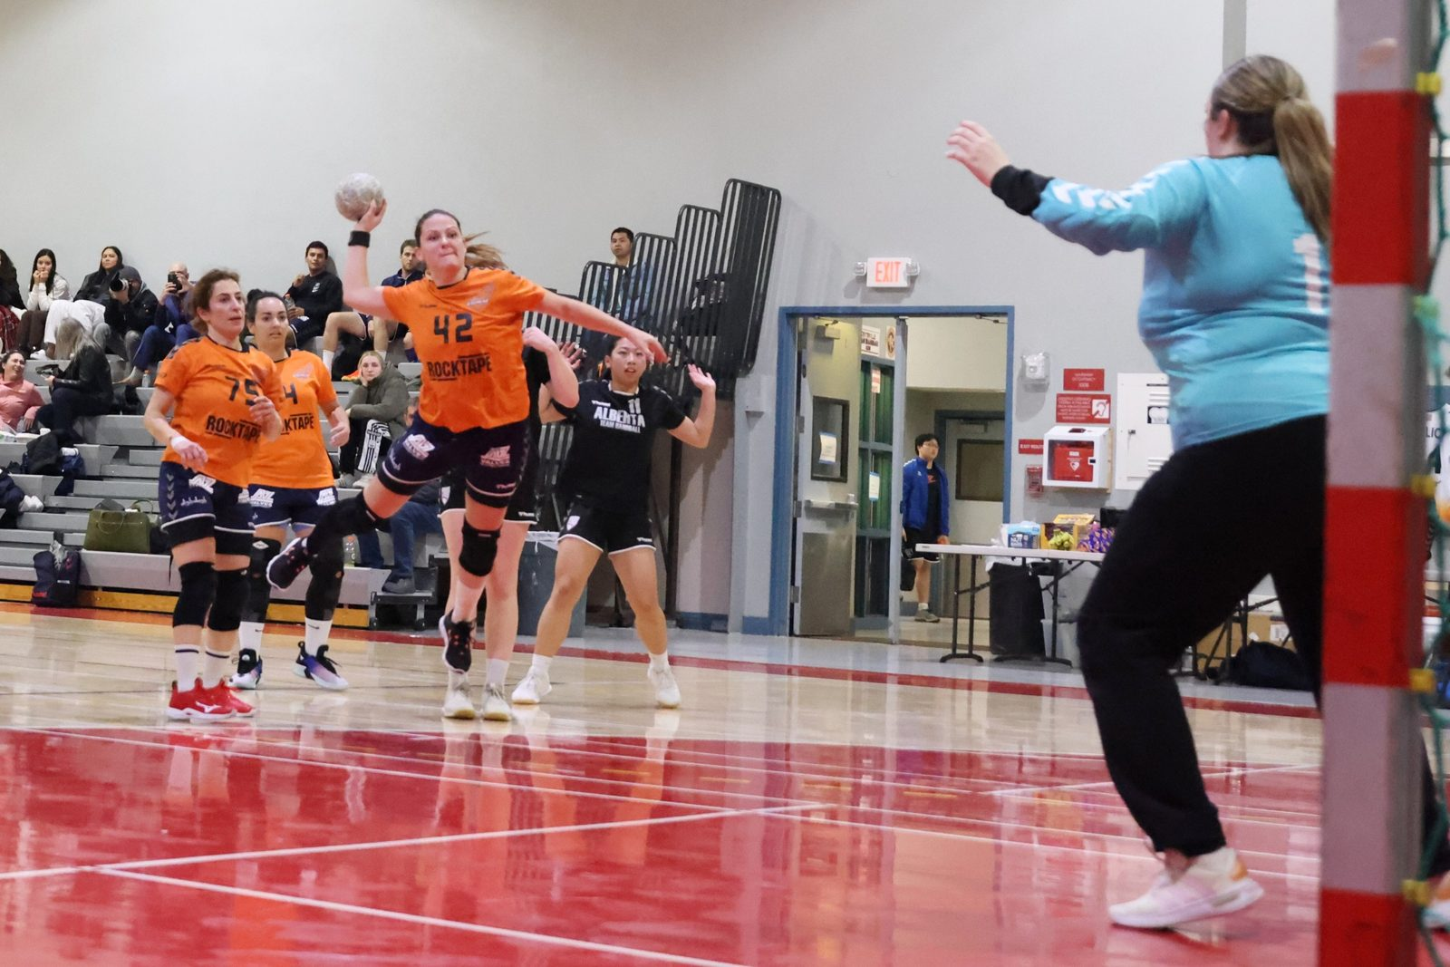
OUR HOST
San Francisco CalHeat
A Bay Area handball club and 501(c)(3) nonprofit since 2012. Each year around 200 athletes from across the U.S. and Canada compete in elite men’s and women’s divisions — many starting in CalHeat’s grassroots youth programs, some now chasing the Olympic dream for LA 2028.
2007
First California Cup hosted by CalHeat
2012
CalHeat becomes a 501(c)(3) nonprofit
2026
19th edition — ~200 athletes
2027
20th edition — two decades of elite handball
CALIFORNIA CUP XX
Partnership Prospectus

Slide 7

Become a 2027 partner
Join us in delivering a world-class event and growing handball in America. We’ll tailor recognition to fit your brand.
calcup@calheat.com
calheat.com · calcup-2027.netlify.app
Scan for the live site

