Slide 1
Analytics with NRT Intelligence on Azure
Azure Discovery Days 2019
Patrick El-Azem
Cloud Solution Architect, Microsoft
LinkedIn: pelazem

Slide 2
Agenda
8:00 – 9:00AM: Check In, Welcome
9:00 – 11:00AM: Session Presentation
11:00 – 11:15AM: Break
11:15AM – 4:15PM: Hands-On Labs
12:00 – 1:00PM: Lunch
4:15 – 4:30PM: Wrap-up, Q&A

Slide 3
About Today
You:
Are Technical; data, dev, architect, …
Do NOT need to be an Azure expert
Pre-Requisites: None
We will provide you with Azure resources (or use your own)
There is nothing to install on your laptop
Format: 25% Presentation / 75% Hands-On
Lab docs = very detailed guidance
Several proctors are here to help

Slide 4
All materials for today (docs, labs):
https://aka.ms/danrt
Provision Azure environment for labs:
https://aka.ms/danrt-0129
→ Please note: lab environments will be deleted after 10 hours.
If you have an existing Azure subscription and want to keep what you build today, you do not need to work in the lab environment. If you work in your own Azure environment, please ensure you are complying with your organization’s applicable policies and constraints.
Notes:
All resources for today’s event are at the first link, which points to a public github repository which we will keep updated as this event evolves. For example, when new Azure capabilities are released, we may change the technologies or procedures used in this event.
The second link is valid only for today. Please use it to provision an Azure environment that you can use for all the hands-on labs today. These environments will be deleted after ten (10) hours, so please ensure that you preserve anything you do there that you do not want to lose. Remember that you can access the lab docs for this event anytime at the top link.

Slide 5
Lab Scenario (fictional!)
Two taxi companies (Yellow and Green)
Years of historical trip data as CSV; always received in batch, long after trip
No connection to customers, no way to address negative experiences
Decision to do Proof of Concept (PoC):
Deploy connected devices to taxis (use a device stream simulator in the PoC)
Stream trip data – no more CSVs/batches
Get customer feedback with payment
See negative customer experiences right away to enable quick response
Enable unified analytics on historical and new streaming data
Minimize operational, admin, infrastructure overhead – cloud and PaaS
Your mission: deploy a functional all-PaaS architecture for this scenario
Notes:
The scenario for our labs today is as follows.
You are a technical architect. You are working with two taxi companies, Yellow and Green. These taxi companies have been in business for several years, and have extensive historical taxi trip data which they receive in periodic batches of CSV files, well after the trips. Because their data changed formats over the years, they have difficulty doing historical analysis.
The companies have decided to unify their trip data format; to deploy connected devices to all their taxis so that trip information is streamed wirelessly into their environment, and so they can get rid of batches of CSV files; and to request customer comments at payment time. Additionally, the companies would like to know right away when customers have bad taxi trips, so that customer support can reach out to the customers right away instead of risking bad public reviews and social media posts.
They need to keep all their historical data, and they need traditional business intelligence reports to work on both their historical data as well as the new streaming data from the taxi devices.
The taxi companies operate very lean due to competitive pressure. The new data estate has to require minimum maintenance and administrative overhead. Because of this, Platform as a Service (PaaS) technologies are preferred wherever possible.
In today’s labs, you will build and run an architecture that accomplishes all these goals.

Slide 6
Lab Overview
You will build a simple, end-to-end lambda architecture
You will work in Azure and Power BI
You will gain experience with several Azure technologies
Our goal: realistic to finish all the labs today
Labs are very detailed and step-by-step
Not open-ended “from scratch, figure it out” hack event (we do those too!)
After today: build on labs, experiment, try other technologies
Made a lab better? How about submitting a Pull Request?
Notes:
The labs today will result in you building a simple lambda architecture. If you don’t know that term, we’ll discuss it shortly.
You will work with several Azure technologies as well as Power BI today. Our goal is to have you finish all the labs today without requiring deep expertise or extensive open-ended research. That’s why the lab docs are very detailed, with lots of screenshots, and spell out the various tasks and steps for you.
We hope this approach is useful to you, and we encourage you to build on these labs. Experiment, try other technologies, and if you make a lab better for future attendees to this event, please consider submitting a Pull Request! (See the link for all the materials.)

Slide 7
Lab Architecture
Notes:
This is the architecture you will build today, broken out by lab. The lab documents cover all of this in detail, but let’s review the architecture and labs here at a high level before we get into the presentation.
Overall, this is a data estate that is a form of lambda architecture. At its simplest, a lambda architecture has “hot” and “cold” data paths and analysis capabilities. We will discuss that architecture pattern and all the technologies you’ll use more shortly, but for now let’s focus on the various labs you will do.
Labs 1 and 2 are on the “cold” path, while labs 3 and 4 are on the “hot” path.
In lab 1, you’ll ingest and store a public data set into your Azure environment. That data set has some problems. You will do data engineering and ETL work in Azure Databricks to transform the raw source data into a data set suitable for further analysis, and emit that transformed data back to Azure storage.
In lab 2, you will use Azure Data Factory to ingest data from the transformed data set you built in lab 1 into a relational data mart, and then you will build traditional BI reports on top of that data mart. Today you will use Azure SQL Database for the data mart; in more elaborate architectures, you might have an MPP data warehouse here (such as Azure SQL Data Warehouse) plus an OLAP service (such as Azure Analysis Services) in addition to relational data marts. But for today, we are keeping it simple so that we have time for the later labs.
In lab 3, you will work on an inbound data stream. You’ll deploy a simulator app that generates a stream of events. You’ll deploy stream ingestion using Azure Event Hubs. And you’ll add stream enrichment; each message in the stream will be enriched by a serverless Azure Function, which will call an Azure AI service – the Text Analytics Cognitive Service – to perform text analytics and enrich each message with the result of that analysis. You’ll then forward the enriched message on to another stream ingestion endpoint.
In lab 4, you will perform simple stream analytics using Azure Stream Analytics to accomplish two tasks.
First, you will write all the stream data to cold path storage, where the existing historic data is stored. This is to accomplish the goal of analytics over all data – historic as well as new streaming.
Second, you will also send events meeting a certain qualifier on to a streaming dashboard, for rapid visualization of events needing a quick response. Specifically, you will send events where the customer sentiment is negative to a streaming dashboard, so that the taxi companies’ customer support can react right away.
Remember that if you do not finish all the labs today, you have access to all the lab docs at the main materials link shown earlier.

Slide 8
Lab Environment
If you use the Azure environment provided for today:
A Windows VM is provided – access via RDP
You do not HAVE to use the VM but it can be useful for:
Lab 2: if you decide to use SQL Server Management Studio instead of the Azure portal SQL query explorer, it is pre-installed on the Lab VM
Lab 2: Power BI Desktop is pre-installed on the Lab VM
Lab 3: deploy the device simulator to the Lab VM, not your laptop
Remember: Azure lab environments will be deleted after 10 hours
Notes:
The labs today will result in you building a simple lambda architecture. If you don’t know that term, we’ll discuss it shortly.
You will work with several Azure technologies as well as Power BI today. Our goal is to have you finish all the labs today without requiring deep expertise or extensive open-ended research. That’s why the lab docs are very detailed, with lots of screenshots, and spell out the various tasks and steps for you.
We hope this approach is useful to you, and we encourage you to build on these labs. Experiment, try other technologies, and if you make a lab better for future attendees to this event, please consider submitting a Pull Request! (See the link for all the materials.)

Slide 9


Your vision. Your cloud.
Notes:
Let’s do a quick technical overview of the Microsoft Azure cloud platform. This won’t be an exhaustive review; please see the Resources at the end of this deck for much, much more.

Slide 10
Why consider cloud?
Traditional datacenter
Expensive, vertically integrated hardware
Complex and time-consuming scalability
Overloaded IT teams with isolated security and management
Siloed infrastructure and DevOps teams
Cloud
Industry-standard hardware
Elasticity to scale up and down instantly
No need to worry about underlying cloud infrastructure and its security
Service-focused DevOps
Cloud adoption on the rise
62%
use cloud as a platform for modernizing IT environments
87%
plan to integrate their on-premises datacenter with public cloud
$266B
public cloud market by 2021
Notes:
Why do organizations consider cloud? Why would an organization like our scenario’s taxi companies go hybrid cloud, or even cloud first?
Traditional datacenters have long served us well. But there is a significant hardware cost, both to provision and to maintain and scale it. IT teams have to handle everything from power and cooling all the way up to deploying software and patches. When many teams in an organization depend on datacenter infrastructure, siloed communications can negatively affect the organization’s agility.
Public cloud is built on industry-standard hardware, and generally customers do not need to worry about the details of the underlying hardware. Cloud provides elasticity to scale up and down rapidly, and allows organizations to adopt a service- and capability-centric technology operations model, and to adjust the balance between cap ex and op ex flexibly and quickly.
Cloud adoption is on the rise. The public cloud market is growing rapidly as organizations realize the benefits of adding, or moving to, cloud.

Slide 11


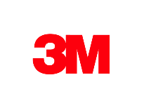
























>95% of Fortune 500 use Microsoft Azure
Notes:
Over 95% of the Fortune 500 are already using Microsoft’s public cloud platform, Azure.

Slide 12
Azure. Cloud for all.
Productive
Hybrid
Intelligent
Trusted
Notes:
Azure. Cloud for all.
These 4 pillars represent the value proposition for Azure.
Productive
Get unparalleled productivity with integrated tools across data, dev/ops, serverless computing, machine learning and artificial intelligence, and more.
Hybrid
Develop and deploy where you want, with the only consistent hybrid cloud on the market. Extend Azure on-premises with Azure Stack.
Intelligent
Create intelligent apps that delight with data-driven experiences. Go quickly from concept to release with Azure data services and artificial intelligence, from image recognition to bot services.
Trusted
Startups, governments, and >95 percent of Fortune 500s trust the Microsoft Cloud for security, privacy, transparency, and the most compliance coverage of any cloud provider. The Azure Trust Center provides a one-stop resource for compliance, certification, and security needs.

Slide 13
Unparalleled productivity
Productive
Integrated tooling
Visual Studios Third parties | DevOps
100+ services
Azure Functions Kubernetes | Logic Apps
Unified management
Single cloud | Policy
Hybrid
Intelligent
PLAN
DEPLOY
INTEGRATION
CONTINUOUS DEVELOPMENT
Trusted
CONTINUOUS
BUILD
OPERATE
Notes:
Azure offers unparalleled productivity.
Build using your platform and language of choice, including .NET, Java, Node.js, Python, and more.
Use best in class tools that you already know, including Visual Studio and Visual Studio Code.
Choose from over 100 services to architect and deploy platforms and applications. Azure provides services such as Kubernetes and other top open source technologies, to bots to serverless to big data to machine learning and AI to apps and much more. Additionally, Azure provides over 150 integration connectors for platforms like Salesforce, Dynamics, Office 365, Google services, and more.
Azure provides end to end management and monitoring. Use the Azure portal, the Azure Command Line Interface, bash, Powershell, or the REST APIs to deploy and manage resources. Use Azure Monitor for diagnostics, metrics, log analytics, and alerting across resources, and integrate it with existing security and operations management systems.

Slide 14
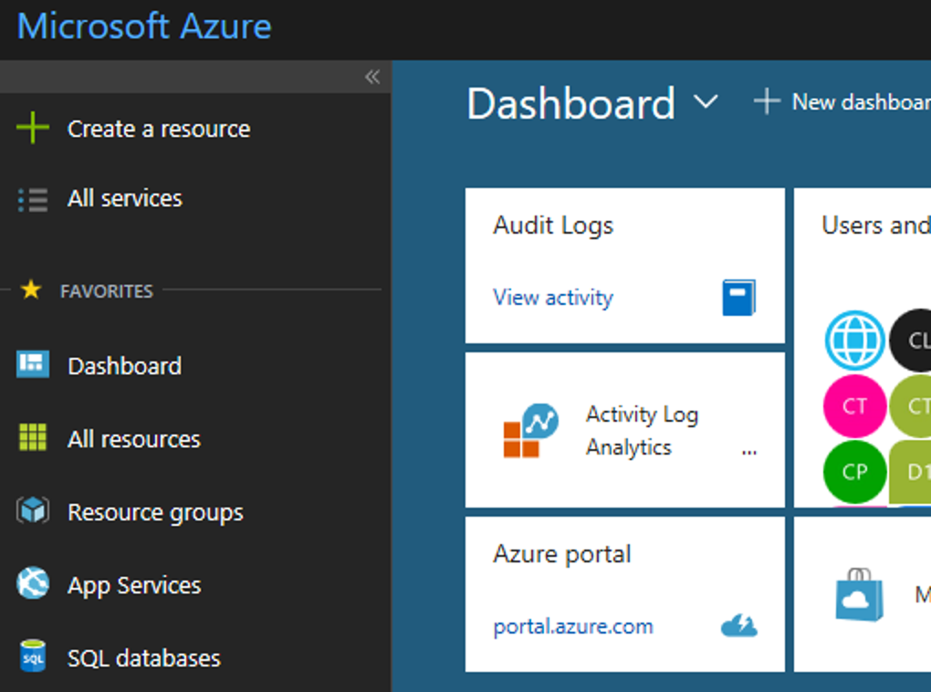
Secure and well-managed for IT
Productive
Govern
Secure
Policy management
Cost management
Security management
Threat protection
Hybrid
Azure portal
Configure
Protect
Intelligent
Update management, scripting
Automation, configuration
Backup and disaster recovery
Trusted
Monitor
App, infrastructure, and network monitoring
Log analytics and diagnostics
Notes:
Organizations need visibility, metrics and controls on every component to pinpoint issues efficiently, optimize and scale effectively, while having the assurance the security, compliance and polices are in place to ensure the velocity.
Starting in the middle with the Azure portal ---
- With Azure you get enterprise grade management capabilities built-in to the platform – all services and resources together in a single, easy-to-use portal. You can create dashboards, use the friendly search and intuitive menus, quick start resource templates, and more.
- With a single platform, you get integrated and interconnected tools and data, with unified metrics and alerts across your services. So you don’t have to go to different portals with different datasets.
- Using out-of-the-box tools (like Azure Advisor, Azure Service Health, and Cost Management + Billing), you can optimize and right-size your investment and get personalized recommendations to enhance your experience.
Looking at the 5 areas of security and management ---
Secure: While Azure is trusted and secure platform, you as a customer have your own security settings you need to manage. You also need to be able to protect your individual machines against threats and monitor the security posture of your system.
Protect: Your VMs and applications in the cloud need to be backed up and protected in the event of data loss. With disaster recovery from on-prem to the cloud, or from one cloud to another, you can avoid downtime and keep your applications up and running.
Monitor: Every operations manager and every developer needs to be able to see the health and performance of their applications, infrastructure, and network. And seeing insights across all three together in a single dashboard can save time and resources in troubleshooting and preventing issues in the future.
Configure: For managing Azure and hybrid workloads at scale, automation and configuration capabilities help you create runbooks to automate tasks, manage the configuration settings and track changes, and monitor and deploy missing updates. Additionally in Azure you can use PowerShell and Cloud Shell for command line scripting.
Govern: Many customers need a way to look across cloud resources to assess and enforce enterprise-wide standards and policy compliance for security and management. In addition, they need to manage and monitor costs for the cloud, not just in Azure but in other clouds too.
Lastly, Azure gives you the flexibility to manage your hybrid environments with most of these services. And you can choose which areas to invest more in, and how much to consume.
With Azure you have the flexibility to choose what and how to manage your IT.

Slide 15
Azure: Hybrid
The only consistent, comprehensive hybrid cloud
Productive
Azure
Cloud
Azure
DevOps
Azure Data Services
Azure Active Directory
Azure security & management
Hybrid
Platform
Data
Platform
Common
Identity
Security & Management
DevOps
Intelligent
Azure
Stack
Azure
DevOps
Server
SQL Server, MySQL,
PostgreSQL, NoSQL
Active Directory
Security & management
Trusted
Notes:
Hybrid strategy is about the continuum of capabilities across the offerings, it’s not just about the platform. Hybrid is more than just being able to move an application into the cloud. There are critical elements from identity, data, and security and management that have to be addressed.
You don’t have to be stuck in an all-or nothing choice – hybrid gives you the flexibility to move to the cloud when and how you want to.
Microsoft Azure offers consistency across your hybrid ecosystem:
Azure Stack – Azure in your data center. Same tools, same APIs.
Unified Dev/Ops - consistent CI/CD with Azure DevOps Server On-premises, including for containers and Kubernetes, and Azure DevOps in the cloud
Seamlessly distribute, manage, and analyze data across SQL Server and open-source databases in the data center, and the range of Azure Data Services.
Active Directory and Azure Active Directory enable one identity, access anywhere, directory sync
Integrate security and management

Slide 16





Azure Data Warehouse
Productive
Language APIs
Azure SQL Database
Hybrid
Azure
AI for every developer and every scenario
Intelligent
Azure Machine Learning
Cognitive Services
Trusted
Azure Bot Service
Notes:
Microsoft Azure: the cloud for intelligent solutions
In addition to having the traditional on-premises enterprise data tools—such as SQL Server—Azure provides data services that connect data to AI services.
This enables quick adoption of technologies, such as deploying a global mobile application that integrates with facial recognition services.
The ease of integration enables anyone to build solutions like that.
From bot frameworks to cognitive services, you can fundamentally change the way your business goes to market with Microsoft’s powerful AI platform

Slide 17
Comprehensive deep learning,
machine learning as a service
Productive
Hybrid
Customizable services
VS, ML STUB, Tensor, Caffe
Tools
Bots, Cognitive, ML
Infrastructure and compute
CPU, GPU, FPGA
Intelligent
Azure
Trusted
Notes:
Azure offers a comprehensive set of services, tools, and infrastructure to build AI-powered experiences.
Offerings include machine learning and deep learning services, with support for leading open-source frameworks; AI services including the Azure Bot Service and a set of pre-trained Azure Cognitive Services; and compute infrastructure powered by the latest GPUs and FPGAs for the fastest inferencing and prediction.
Azure is an open AI platform, supporting not only leading frameworks but also platforms like Hadoop, Spark, and Databricks as well as tools like Jupyter notebooks. And of course, our own Visual Studio and Visual Studio Code have full AI tooling capabilities.

Slide 18




































More certifications than any cloud provider
GLOBAL
ISO 27001
ISO 27018
ISO 27017
ISO 22301
SOC 1 Type 2
Productive
SOC 2 Type 2
SOC 3
CSA STAR
Self-Assessment
CSA STAR
Certification
CSA STAR
Attestation
Hybrid
INDUSTRY
PCI DSS
Level 1
CDSA
MPAA
FACT UK
Shared
Assessments
FISC Japan
HIPAA / HITECH Act
Intelligent
HITRUST
GxP
21 CFR Part 11
MARS-E
IG Toolkit UK
FERPA
GLBA
FFIEC
REGIONAL
Argentina PDPA
EU
Model Clauses
UK
G-Cloud
China
DJCP
China
GB 18030
China
TRUCS
Singapore
MTCS
Australia
IRAP/CCSL
New Zealand
GCIO
Trusted
Japan My
Number Act
ENISA
IAF
Japan CS Mark Gold
Spain
ENS
Spain
DPA
India
MeitY
Canada
Privacy Laws
Privacy
Shield
Germany IT
Grundschutz
workbook
Notes:
Azure leads on trust. With more certifications than any other cloud provider and our ongoing security investments, compliance and trust is a primary commitment for Microsoft.
This is only a sample of our certifications. See the Azure Trust Center (see Resources) for full details.
Trusted
Compliance and trust is not an afterthought at Microsoft.
We are leaders in this space, and help set standards for global and federal organizations around the world.
Microsoft has been talking about trust in the cloud for a while and will continue to do so.
This is only a sampling of our compliance certifications, but we run the gamut.
Azure’s strengths are around security, privacy, and transparency around how we run the cloud.

Slide 19
Unique Intelligence
Productive
Security Technology
Unmatched security
Hybrid
$1B+ annual investments
Over 3500 security experts
Trillions of diverse signals
Secure Foundation
Intelligent
Trusted
Notes:
Azure provides you unmatched security.
Microsoft invests more than $1B a year and employs more than 3500 security experts to protect your information.
The secure foundation of Azure includes physical infrastructure, biometric security, and DDOS attack protections.
Built-in tools like Azure Security Center help you secure your environment across identity, network, threat protection, and management.
Finally, Microsoft offers threat protection which is informed by trillions of signals that we receive every day from more than 1.2B devices scanned, and over 750M Azure user account authentications.
This volume of data is unprecedented, and we provide you with our unique intelligence with threat protection so you can quickly mitigate any threats.

Slide 20
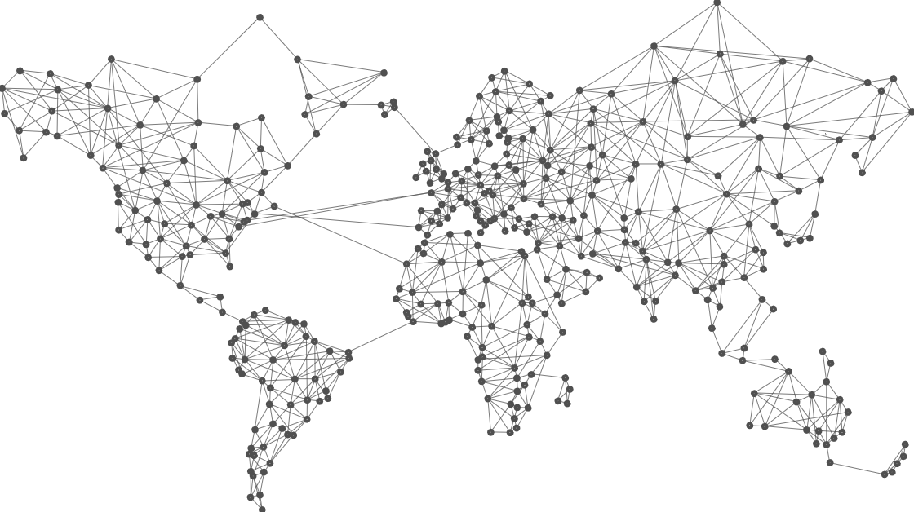
54
Azure regions
Notes:
Azure has 54 regions across the world. This is more than the rest of the major public cloud providers combined.
The Microsoft network that connects all these regions is the second-largest fiber optic network on the planet. (The only larger one is a government network.)

Slide 21
Additional Resources – Blogs, Whitepapers, Cloud Workshops
https://www.microsoft.com/trustcenter
https://www.microsoft.com/learn
https://azure.microsoft.com/blog/implementation-patterns-for-big-data-and-data-warehouse-on-azure
https://azure.microsoft.com/blog/near-real-time-analytics-in-azure-sql-data-warehouse
https://github.com/Microsoft/MCW-Big-data-and-visualization

