Slide 1
emotion detection from text

Slide 2
Emotion Detection from Text
Humans express a wide range of emotions through written language.
Identifying emotions from text helps in mental health monitoring,
social media analysis, and chatbot improvement.
Objective: Build a machine learning model to classify emotions
like joy, sadness, anger, fear, love, and surprise from raw text.

Slide 3
Project Approach
Dataset: Downloaded sentences with labelled emotions (text format)
and converted into CSV format.
Preprocessing:
Cleaned text using utils.py
Removed punctuation, semicolons
Vectorization: TF-IDF used to convert text into numerical format.
Model: Logistic Regression for multiclass classification

Slide 4
Tools & Technologies Used
Python Libraries:
Pandas, NumPy, Scikit-learn, Seaborn, NeatText, Joblib
Visualization: Seaborn for plotting emotion distribution
Model Saving: joblib for storing model and vectorizer
Live App: Built using Streamlit for real-time predictions
IDE & Tools: VS Code, Streamlit, CSV file editor

Slide 5
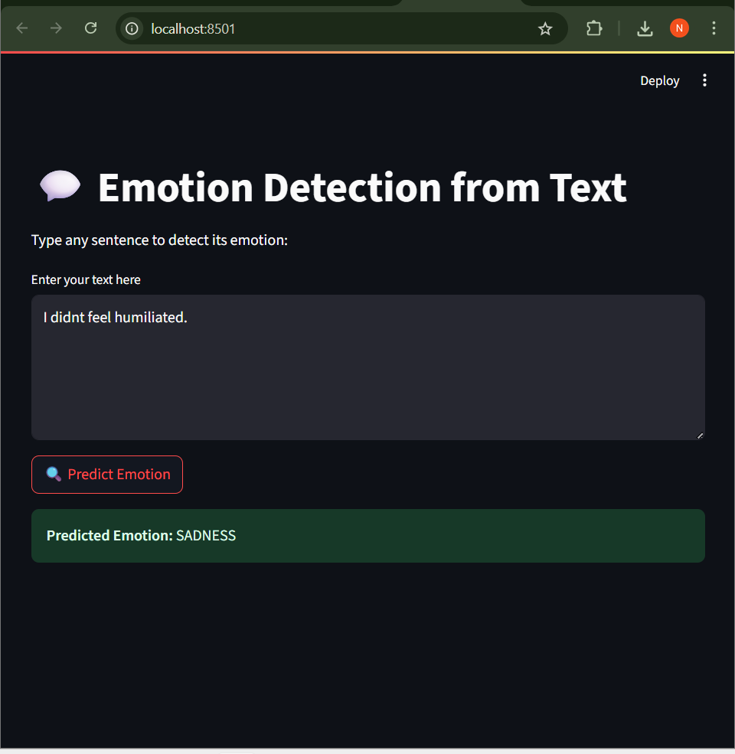
Results & Outcome
Successfully trained a multi-class classifier with good label distribution
Live prediction app built using streamlit.
Model predicts emotions from any user-entered text
Stored and re-used model with .pkl files
Future Scope: Add more data, fine-tune model, expand to multilingual texts

