Slide 1
Interactive Visual Graph Exploration by Finding Dense Subgraphs
Presented by:
Neha Sinha
Mon 13 April 2020

Slide 2
Outline
Introduction
Solution
Preliminaries
Algorithm
Implementation
Experiment
Time Efficiency
Density
Conclusion And Future work

Slide 3
Outline
Introduction
Solution
Preliminaries
Algorithm
Implementation
Experiment
Time Efficiency
Density
Conclusion And Future work

Slide 4
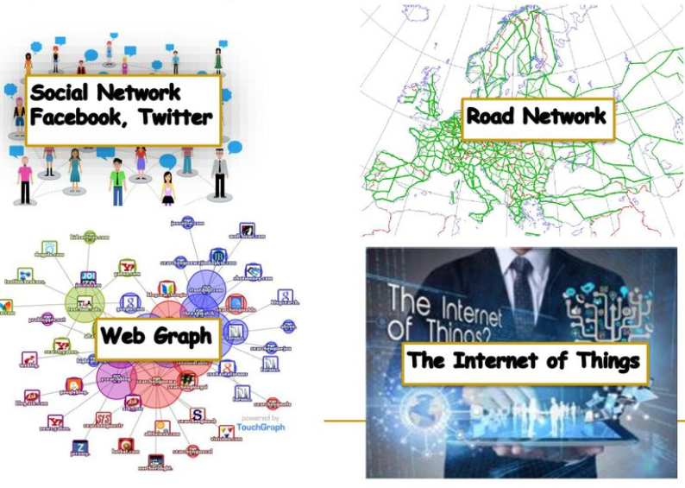
Introduction
Graphs are everywhere.

Slide 5
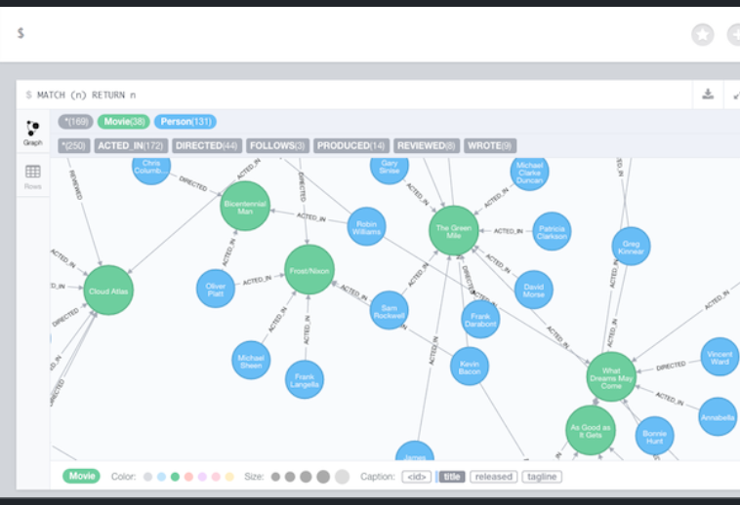
Introduction (contd..)
There are many existing graph visualization tool available online which loads graph and shows its data to user
If graph is large user can be overwhelmed.
Example: Neo4j[1], Gephi[2], Graphviz[3]

Slide 6
Project Goal
Build an interactive visualization tool for quickly analyzing graph data by exploring its dense subgraphs.

Slide 7
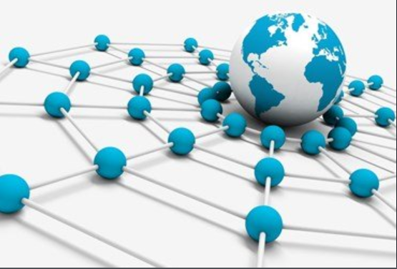


Why Dense Subgraph?
Application domains
Among the many concepts that have been proposed for discovering dense subgraphs, k-cores [4] and graph density[5] are particularly attractive.

Slide 8
Outline
Introduction
Solution
Preliminaries
Algorithm
Implementation
Experiment
Time Efficiency
Density
Conclusion And Future work

Slide 9
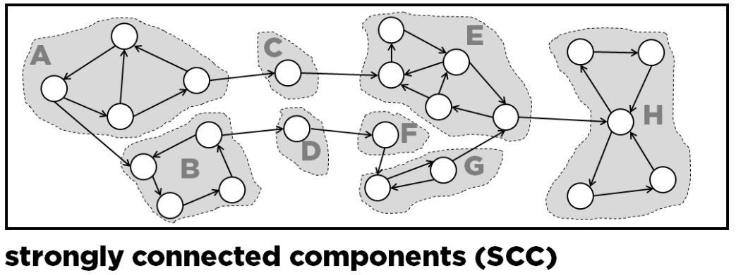

Preliminaries
We model a directed graph as $G\left(V,E\right)$, where $V$ and $E$denote the sets of nodes and edges in$G.$
A graph $G^{′}\left(V^{′},E^{′}\right)$ is a subgraph of $G$if $V^{′}⊆V$ and $E^{′}⊆E$.
Given a graph $G\left(V,E\right),$its edge-density is τ ($G$)= |$E$ |/|$V$²| which is total number of edges upon possible number of edges in the graph.
A directed graph is strongly connected if every vertex is reachable from every other vertex.

Slide 10
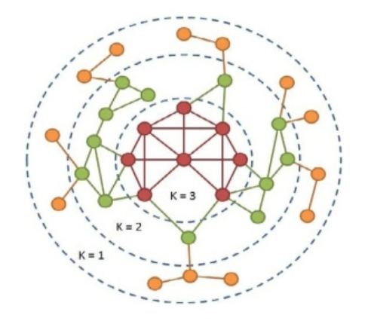
Preliminaries (Contd..)
A k-core of a graph G is a maximal connected subgraph of G in which all vertices have degree at least k. [4]
K-core decomposition :
  1-core – all nodes with degree at least 1.
  2-core – all nodes with degree at least 2 in
  the remaining graph.
  3-core – all nodes with degree at least 3 in
  the remaining graph.
  Etc.

Slide 11
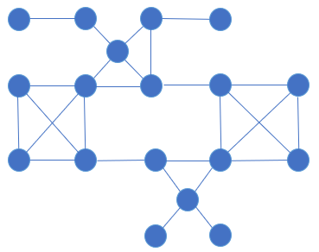

Naïve K-core Algorithm
Input graph $G$
Step-1 : Find 1-core - Remove all nodes with degree = 0
  $G$ is its own 1-core

Slide 12
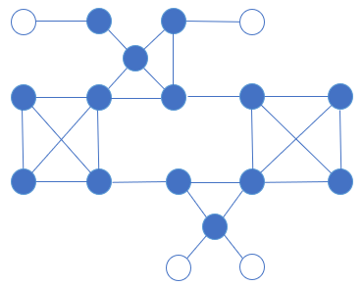
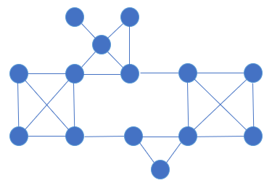
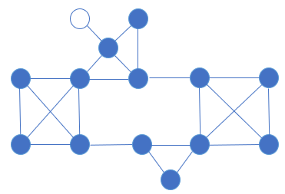
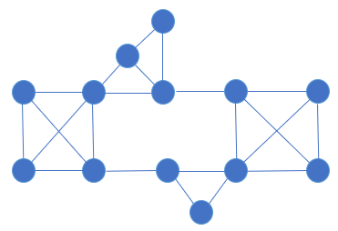
Naïve K-core Algorithm (contd..)
Step-2 : Find 2-core - Remove all nodes with degree =1
Check remaining graph and remove all nodes with degree =1. Repeat this until all vertices have degree ≥ 2.
Find 2-core
1-core
Find
2-core
Final

Slide 13
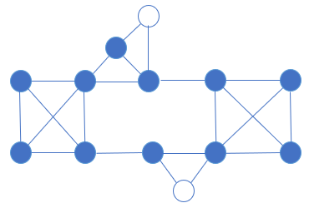
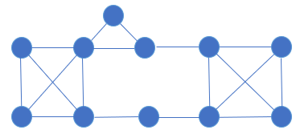
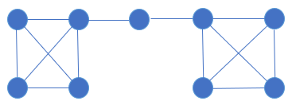
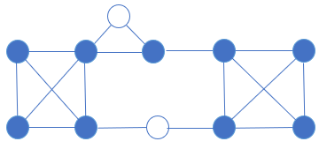
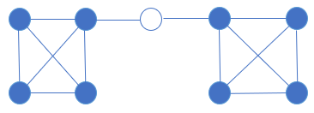
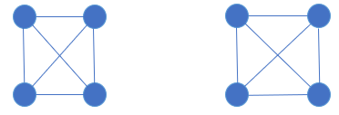
Naïve K-core Algorithm (contd..)
Step-3 : Find 3-core - Remove all nodes with degree = 2. Repeat this until all vertices have degree ≥ 3.
3-core
delete
2-core subgraph
Check
check
delete
Final 3-core

Slide 14
Modified K-core Algorithm
Drawback of naïve k-core method
  In every iteration, there is an step to check if remaining nodes have degree at least k.
Modified K-core method
  No need of repeated loop to check modified degree of vertices.
  Start with higher k value.
  Increment k with higher value.

Slide 15
Modified K-core Algorithm
Step-1 : Find 2-core – Remove all vertices with degree ≤ 1.
Output:
Find 2-core
Input Graph (1-core)

Slide 16
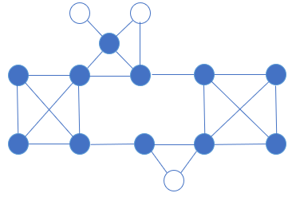
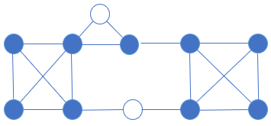
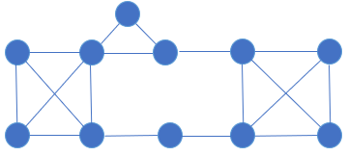
Modified K-core Algorithm (contd..)
Step-3: Find 3-core - Remove all vertices with degree ≤ 2
Output:
3-core

Slide 17
Modified K-core Algorithm (contd..)
Final Step : check remaining vertices and remove all vertices with degree < 3. Repeat this until all vertices have degree ≥ 3.
3-core
Delete
check
Final 3-core

Slide 18
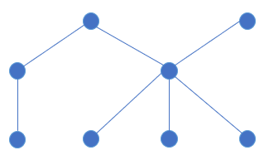
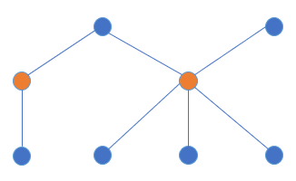
EdgeWeight Algorithm
EdgeWeight method
  This methods helps to remove more edges from the input graph before feeding it into K-core without loosing dense component.
Explanation
Step-1: Randomly select vertices based on some sampling ratio.
sampling ratio = 0.3
Input Graph

Slide 19
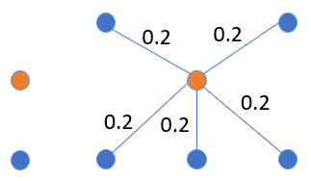
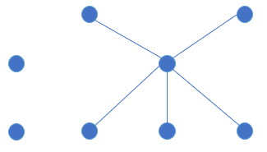
EdgeWeight Algorithm(contd..)
Step-2: Calculate edge weight- For any randomly selected vertex u, the weight of its edge e is defined as weight(e)= 1/degree(u)
Step-3: Delete all edges with weight more than some threshold = 0.3
0.5
0.2
0.2
Compute weight
0.5
0.2
0.2
0.2
Final output

Slide 20
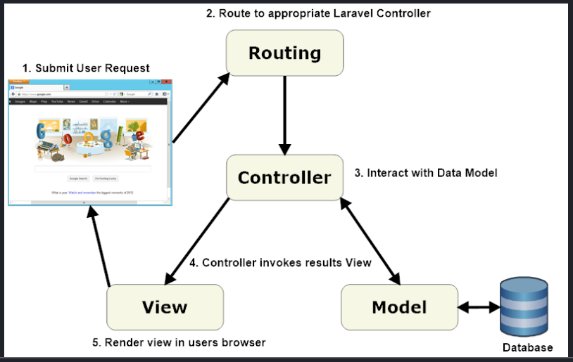
Implementation
Below frameworks have been used for development of the tool:
Spring MVC : A Spring MVC is a Java framework which is used to build web applications. It follows the Model-View-Controller design pattern.[6]
D3.js : JavaScript library for producing dynamic, interactive data visualizations in web browsers. [7]
GitHub: For distributed version control and source code management.

Slide 21
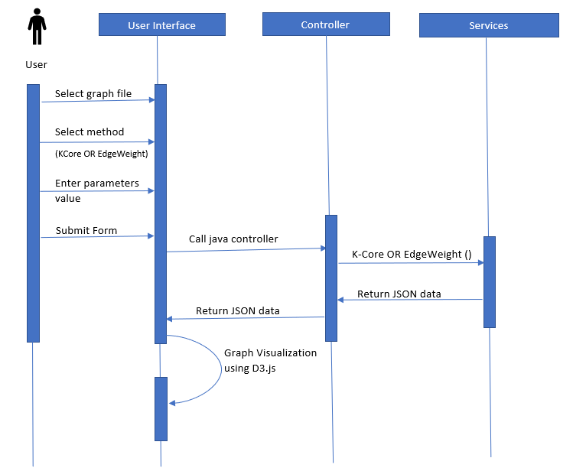
Implementation (Contd..)
Sequence Diagram:

Slide 22
User Interface
Demo

Slide 23
Outline
Introduction
Solution
Preliminaries
Algorithm
Implementation
Experiment
Time Efficiency
Density
Conclusion And Future work

Slide 24
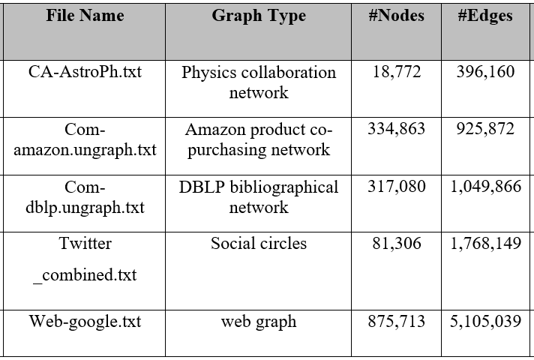
Experiment
Experiments are performed on below datasets taken from SNAP library [9].
These experiments are done in machine with 8GB memory and 3.9 GHz processor.

Slide 25
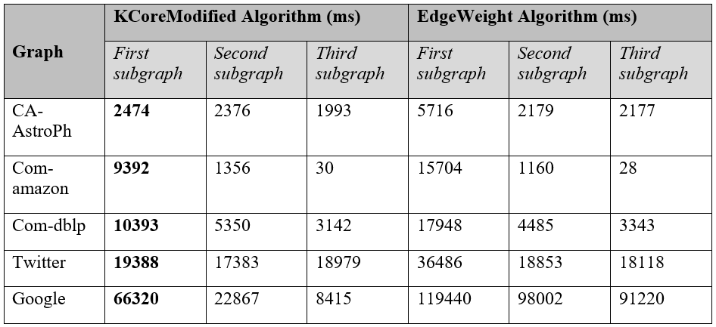
Time Efficiency : Comparison b/w algorithms
The parameters are: K_start = 5, K_increment = 2, MIN_SCC_SIZE = 50, DELETED_NODE_PERCENT = 50, VERTEX_PERCENTAGE = 0.4 and WEIGHT_THRESHOD = 0.2

Slide 26
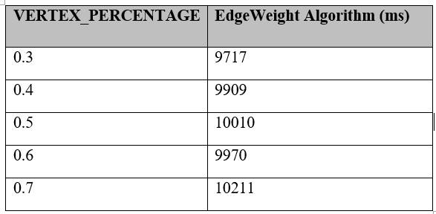
Time Efficiency : Based on Parameters
VERTEX_PERCENTAGE:
Other parameters used are - graph dataset = DBLP, K_start=5, K_increment =1, MIN_SCC_SIZE = 50, DELETED_NODE_PERCENT = 50, WEIGHT_THRESHOD = 0.2
This parameter is used in EdgeWeight algorithm.
More the percentage value means more part of the graph will be considered for finding the weight of the edge. So more the value more will be execution time.

Slide 27
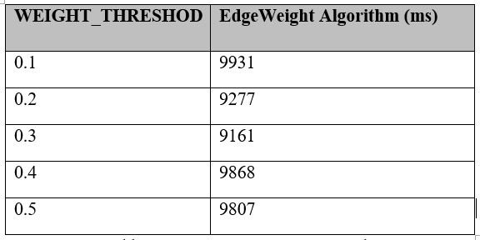
Time Efficiency : Based on Parameters
WEIGHT_THRESHOD:
Other parameters used are graph dataset = DBLP, K_start = 5, K_increment = 1, MIN_SCC_SIZE = 50, DELETED_NODE_PERCENT = 50, VERTEX_PERCENTAGE = 0.4
Smaller the value of this threshold the more edges get pruned. So, it takes more time to execute.

Slide 28
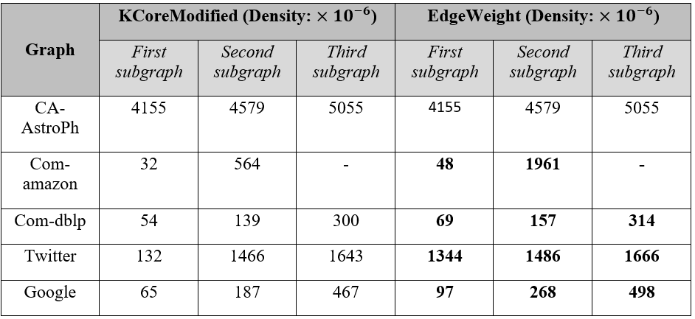
Density: Comparison b/w algorithms
Parameters used are: K_start =5, K_increment = 1, MIN_SCC_SIZE = 50, DELETED_NODE_PERCENT = 50, VERTEX_PERCENTAGE = 0.4 and WEIGHT_THRESHOD = 0.2

Slide 29
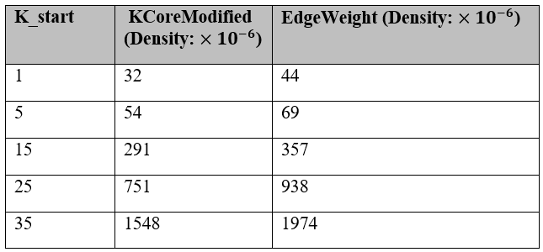
Density: Based on parameters
K_start:
Other parameters used are graph dataset = DBLP, K_increment=1, MIN_SCC_SIZE = 50, DELETED_NODE_PERCENT =50, VERTEX_PERCENTAGE=0.4, WEIGHT_THRESHOD = 0.2
For any given K_start value, EdgeWeight method will always outperform the K-core method.
Density increases with higher K value.

Slide 30
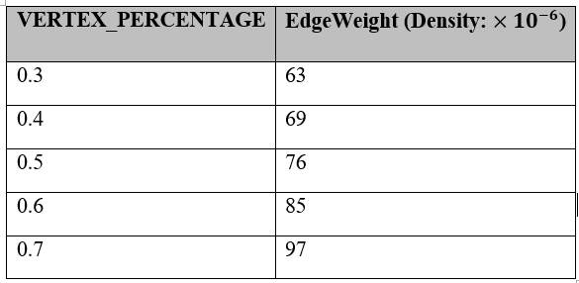
Density: Based on parameters
VERTEX_PERCENTAGE:
Other parameters used are graph dataset = DBLP, K_start=5, K_increment =1, MIN_SCC_SIZE = 50, DELETED_NODE_PERCENT = 50, WEIGHT_THRESHOD = 0.2
Higher the percentage value larger the portion of graph covered for execution.
So, with more vertices and edges, density bound to increase.

Slide 31
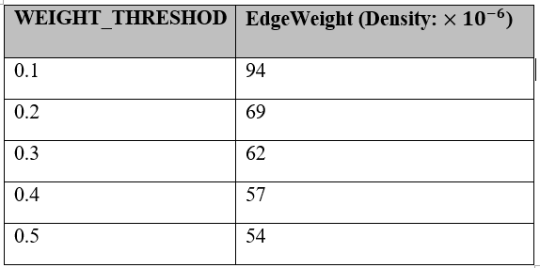
Density: Based on parameters
WEIGHT_THRESHOD:
Other parameters used are graph dataset = DBLP, K_start = 5, K_increment = 1, MIN_SCC_SIZE = 50, DELETED_NODE_PERCENT = 50, VERTEX_PERCENTAGE = 0.4
Smaller the value of this threshold the higher is the number of edges to get pruned.
So, the density will be high for less threshold as seen in the table.

Slide 32
Outline
Introduction
Solution
Preliminaries
Algorithm
Implementation
Experiment
Time Efficiency
Density
Conclusion And Future work

Slide 33
Conclusion
Built an interactive visualization tool for graph analysis and implemented two algorithms to find dense subgraph efficiently.
Done experiments to evaluate time efficiency and density of the outcome subgraphs.

Slide 34
Future work
Optimize code for better memory utilization and testing on bigger graphs.
Incorporating other profiling metrics, e.g., centrality distribution, to the visualization tool

Slide 35
References
[1] Ne04j- URL: https://neo4j.com/
[2] Gephi, The Open Graph Viz Platform – URL: https://gephi.org/
[3] Graphviz – URL: http://graphviz.org/
[4] S. Seidman. Network structure and minimum degree. Social Networks, 5(3):269–287, 1983.
[5] S. Khuller and B. Saha. On finding dense subgraphs. In ICALP, 2009.
[6] Spring MVC-URL: https://docs.spring.io/spring/docs/current/spring-framework-reference/web.html
[7] D3.js – URL: https://d3js.org/
[9] SNAP. Stanford network analysis package– URL: https://snap.stanford.edu/data/index.html

Slide 36
Thank You.

