Slide 1
Introduction MySQL
What is Data??
Data in simple words, is distinct pieces of information or collection of facts related to any entity.
Database :
Database is a container wherein all the data is stored. So basically it is a systematic collection of data. It supports the storage and manipulation of data.
A database is used to store the collection of records in an organized form. It allows us to hold the data into tables, rows, columns, and indexes to find the relevant information frequently. We can access and manage the records through the database very easily.
So to manage data and database we need something known as the database management systems.

Slide 2
Database Management System:
The software which is used to manage database is called Database Management System (DBMS).
A collection of programs which enables users to access database, manipulate data and represent data.
It a technology to store and retrieve data with most efficiency along with its appropriate security measures.
Type of DBMS:
Hierarchical database
Network database
Relational database
Object-Oriented database

Slide 3
Hierarchical DBMS
In a Hierarchical database, model data is organized in a tree-like structure. Data is Stored Hierarchically (top down or bottom up) format. Data is represented using a parent-child relationship.
Network Model
The network database model allows each child to have multiple parents. It helps you to address the need to model more complex relationships like as the orders/parts many-to-many relationship.
Relational Model
Relational DBMS is the most widely used DBMS model because it is one of the easiest. This model is based on normalizing data in the rows and columns of the tables. Relational model stored in fixed structures and manipulated using SQL.
Object-Oriented Model
In Object-oriented Model data stored in the form of objects. The structure which is called classes which display data within it.

Slide 4
Introduction MySQL
MySQL is a very popular open-source relational database management system (RDBMS).
MySQL is a widely used relational database management system (RDBMS).
MySQL is free and open-source.
MySQL is ideal for both small and large applications.
MySQL is very fast, reliable, scalable, and easy to use

Slide 5
What is MySQL Workbench-
MySQL Workbench is a graphics tool for working with MySQL servers and databases.
MySQL Workbench functionalities :
SQL Development: This functionality enables you to create and manage connections to the database Servers.
Data Modelling (Design): Enables reverse and forward engineering between a Schema and a live database, and edit all aspects of the database using the comprehensive Table editor. The Table editor gives the facilities for editing tables, columns, indexes, views, triggers, partitioning, etc.
Server Administration: This functionality enables you to administer MySQL Server instances by administering users, inspecting audit data, viewing database health, performing backup and recovery, and monitoring the performance of MySQL Server.
Data Migration: This functionality allows you to migrate from Microsoft SQL Server, SQLite, Microsoft Access, PostgreSQL, Sybase ASE, SQL Anywhere, and other RDBMS tables, objects, and data to MySQL. It also supports migrating from the previous versions of MySQL to the latest releases.
MySQL Enterprise Supports: This functionality gives the support for Enterprise products such as MySQL firewall, MySQL Enterprise Backup, and MySQL Audit.

Slide 6
Structured Query Language(SQL) is the database language by the use of which we can perform certain operations on the existing database and also we can use this language to create a database. SQL uses certain commands like Create, Drop, Insert, etc. to carry out the required tasks.
These SQL commands are mainly categorized into four categories as:
DDL – Data Definition Language
DML – Data Manipulation Language
DCL – Data Control Language
TCL-Transaction Control language

Slide 7
1. DDL(Data Definition Language) :
DDL or Data Definition Language actually consists of the SQL commands that can be used to define the database schema. It simply deals with descriptions of the database schema and is used to create and modify the structure of database objects in the database.
Examples of DDL commands:
CREATE – is used to create the database or its objects (like table, index, function, views, store procedure and triggers).
DROP – is used to delete objects from the database.
ALTER-is used to alter the structure of the database.
TRUNCATE–is used to remove all records from a table, including all spaces allocated for the records are removed.
COMMENT –is used to add comments to the data dictionary.
RENAME –is used to rename an object existing in the database.

Slide 8
2. DML(Data Manipulation Language):
The SQL commands that deals with the manipulation of data present in the database belong to DML or Data Manipulation Language and this includes most of the SQL statements.
Examples of DML:
SELECT – is used to retrieve data from the database.
INSERT – is used to insert data into a table.
UPDATE – is used to update existing data within a table.
DELETE – is used to delete records from a database table.
3.DCL(Data Control Language):
DCL includes commands such as GRANT and REVOKE which mainly deal with the rights, permissions and other controls of the database system.
Examples of DCL commands:
GRANT- gives users access privileges to the database.
REVOKE- withdraw user’s access privileges given by using the GRANT command.

Slide 9
4. TCL(transaction Control Language):
TCL commands deal with the transaction within the database.
Examples of TCL commands:
COMMIT– commits a Transaction.
ROLLBACK– rollbacks a transaction in case of any error occurs.
SAVEPOINT–sets a save point within a transaction.
SET TRANSACTION–specify characteristics for the transaction.

Slide 10
Database normalization :
Normalization is the process of organizing the data in the database.
Normalization is used to minimize the redundancy from a relation or set of relations. It is also used to eliminate the undesirable characteristics like Insertion, Update and Deletion Anomalies.
Normalization divides the larger table into the smaller table and links them using relationship.
The normal form is used to reduce redundancy from the database table.
The database normalization process is divided into following the normal form:
First Normal Form (1NF)
Second Normal Form (2NF)
Third Normal Form (3NF)
Boyce-Codd Normal Form (BCNF)
Fourth Normal Form (4NF)
Fifth Normal Form (5NF)

Slide 11
First Normal Form (1NF) :
Each column is unique in 1NF.
It states that an attribute of a table cannot hold multiple values. It must hold only single- valued attribute.
Sample Employee table, it displays employees are working with multiple departments.
Employee table following 1NF:
Employee | Age | Department
Melvin | 32 | Marketing, Sales
Edward | 45 | Quality Assurance
Alex | 36 | Human Resource
Employee | Age | Department
Melvin | 32 | Marketing
Melvin | 32 | Sales
Edward | 45 | Quality Assurance
Alex | 36 | Human Resource

Slide 12
Second Normal Form (2NF) :
The entity should be considered already in 1NF.
In the second normal form, all non-key attributes are fully functional dependent on the primary key
TEACHER_ID | SUBJECT | TEACHER_AGE
25 | Chemistry | 30
25 | Biology | 30
47 | English | 35
83 | Math | 38
83 | Computer | 38
TEACHER_ID | SUBJECT
25 | Chemistry
25 | Biology
47 | English
83 | Math
83 | Computer
TEACHER_ID | TEACHER_AGE
25 | 30
47 | 35
83 | 38

Slide 13
3rd Normal Form (2NF) :
Rule 1- Be in 2NF
Rule 2- Has no transitive functional dependencies
EMP_ID | EMP_NAME | EMP_ZIP | EMP_STATE | EMP_CITY
222 | Harry | 201010 | UP | Noida
333 | Stephan | 02228 | US | Boston
444 | Lan | 60007 | US | Chicago
555 | Katharine | 06389 | UK | Norwich
666 | John | 462007 | MP | Bhopal
EMP_ID | EMP_NAME | EMP_ZIP
222 | Harry | 201010
333 | Stephan | 02228
444 | Lan | 60007
555 | Katharine | 06389
666 | John | 462007
EMP_ZIP | EMP_STATE | EMP_CITY
201010 | UP | Noida
02228 | US | Boston
60007 | US | Chicago
06389 | UK | Norwich
462007 | MP | Bhopal

Slide 14
Boyce Codd normal form (BCNF)
BCNF is the advance version of 3NF. It is stricter than 3NF.
A table is in BCNF if every functional dependency X → Y, X is the super key of the table.
For BCNF, the table should be in 3NF, and for every FD, LHS is super key.
EMP_ID | EMP_COUNTRY | EMP_DEPT | DEPT_TYPE | EMP_DEPT_NO
264 | India | Designing | D394 | 283
264 | India | Testing | D394 | 300
364 | UK | Stores | D283 | 232
364 | UK | Developing | D283 | 549
EMP_DEPT | DEPT_TYPE | EMP_DEPT_NO
Designing | D394 | 283
Testing | D394 | 300
Stores | D283 | 232
Developing | D283 | 549
EMP_ID | EMP_DEPT
264 | 283
264 | 300
364 | 232
364 | 549
EMP_ID | EMP_COUNTRY
264 | India
364 | UK

Slide 15
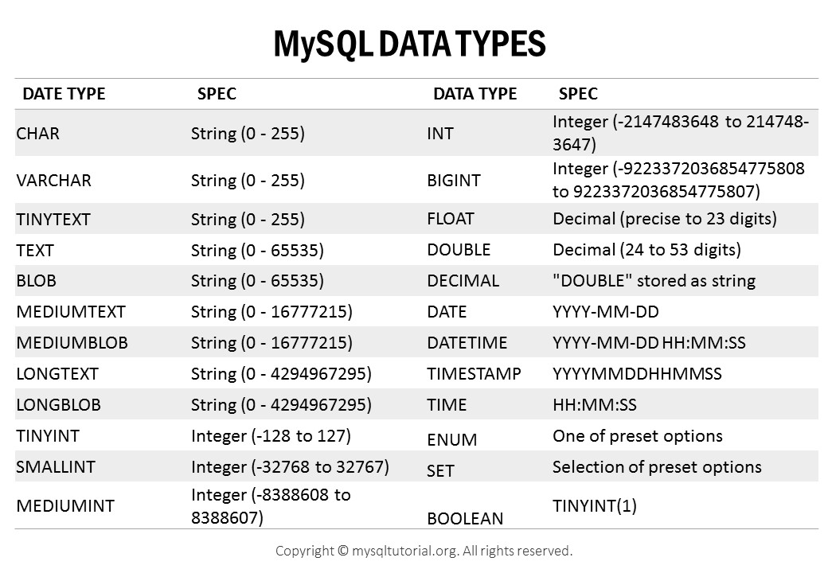
MySQL Data Types :
The data type of a column defines what value the column can hold: integer, character, money, date and time, binary, and so on.

Slide 16
MySQL CREATE DATABASE Statement :
Syntax :
CREATE DATABASE databasename;
MySQL DROP DATABASE Statement :
Syntax :
DROP DATABASE databasename;
To see the list of databases:
Syntax :
SHOW DATABASES

Slide 17
MySQL CREATE TABLE :
Syntax :
CREATE TABLE table_name ( column1 datatype, column2 datatype, column3 datatype, .... );
Create Table Using Another existing Table :
Syntax :
CREATE TABLE new_table_name AS SELECT column1, column2,... FROM existing_table_name WHERE ....;

Slide 18
The MySQL DROP TABLE :
The drop table statement is used to drop an existing table in a database.
DROP TABLE table_name;
MySQL TRUNCATE TABLE
The TRUNCATE TABLE statement is used to delete the data inside a table, but not the table itself.
TRUNCATE TABLE table_name;
MySQL ALTER TABLE :
ALTER TABLE - ADD Column
ALTER TABLE table_name ADD column_name datatype;
ALTER TABLE - DROP COLUMN
ALTER TABLE table_name DROP COLUMN column_name;
ALTER TABLE - MODIFY COLUMN
ALTER TABLE table_name MODIFY COLUMN column_name datatype;

Slide 19
MySQL Constraints :
SQL constraints are used to specify rules for data in a table.
Constraints can be specified when the table is created with the CREATE TABLE statement, or after the table is created with the ALTER TABLE statement.
CREATE TABLE table_name ( column1 datatype constraint, column2 datatype constraint, column3 datatype constraint, .... );
The following constraints are commonly used in SQL:
NOT NULL- Ensures that a column cannot have a NULL value
UNIQUE - Ensures that all values in a column are different
PRIMARY KEY-A combination of a NOT NULL and UNIQUE. Uniquely identifies each row in a table
FOREIGN KEY-
CHECK-Ensures that the values in a column satisfies a specific condition
DEFAULT-Sets a default value for a column if no value is specified

Slide 20
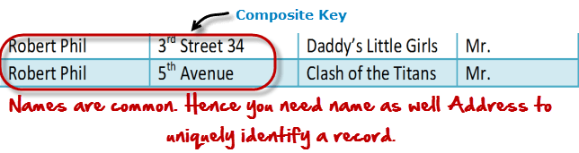
MySQL PRIMARY KEY Constraint :
The PRIMARY KEY constraint uniquely identifies each record in a table.
Primary keys must contain UNIQUE values, and cannot contain NULL values.
A table can have only ONE primary key; and in the table, this primary key can consist of single or multiple columns (fields).
MySQL FOREIGN KEY Constraint :
The FOREIGN KEY constraint is used to prevent actions that would destroy links between tables.
A FOREIGN KEY is a field (or collection of fields) in one table, that refers to the PRIMARY KEY in another table.
The table with the foreign key is called the child table, and the table with the primary key is called the referenced or parent table
MySQL Composite Key Constraint :
A composite key is a primary key composed of multiple columns used to identify a record uniquely

Slide 21
MySQL CREATE INDEX Statement
The CREATE INDEX statement is used to create indexes in tables.
Indexes are used to retrieve data from the database more quickly than otherwise. The users cannot see the indexes, they are just used to speed up searches/queries.
Syntax :
CREATE INDEX index_name ON table_name (column1, column2, ...);

Slide 22
AUTO INCREMENT :
MySQL uses the AUTO_INCREMENT keyword to perform an auto-increment feature.
By default, the starting value for AUTO_INCREMENT is 1, and it will increment by 1 for each new record.

Slide 23
The MySQL INSERT INTO Statement :
The INSERT INTO statement is used to insert new records in a table
It is possible to write the INSERT INTO statement in two ways:
Specify both the column names and the values to be inserted:
INSERT INTO table_name (column1, column2, column3, ...) VALUES (value1, value2, value3, ...);
If you are adding values for all the columns of the table, you do not need to specify the column names in the SQL query. However, make sure the order of the values is in the same order as the columns in the table.
INSERT INTO table_name VALUES (value1, value2, value3, ...);

Slide 24
Introduction to MySQL LIKE operator :
The LIKE operator is a logical operator that tests whether a string contains a specified pattern or not.
MySQL provides two wildcard characters for constructing patterns: percentage % and underscore _.
The percentage % wildcard matches any string of zero or more characters.
The underscore _ wildcard matches any single character.

Slide 25
MySQL Temporary Table:
MySQL uses the CREATE TEMPORARY TABLE statement to create a temporary table.
This statement can only be used when the MySQL server has the CREATE TEMPORARY TABLES privilege.
It can be visible and accessible to the client who creates it, which means two different clients can use the temporary tables with the same name without conflicting with each other. It is because this table can only be seen by that client who creates it. Thus, the user cannot create two temporary tables with the same name in the same session.
A temporary table in MySQL will be dropped automatically when the user closes the session or terminates the connection manually.
A temporary table can be created by the user with the same name as a normal table in a database. For example, if the user creates a temporary table with the name student, then the existing student table cannot be accessible. So, the user performs any query against the student table, is now going to refer to the temporary student table. When the user removes a temporary table, the permanent student table becomes accessible again.

Slide 26
MySQL Joins
MySQL Joining Tables
A JOIN clause is used to combine rows from two or more tables, based on a related column between them.
Supported Types of Joins in MySQL :
INNER JOIN:
Returns records that have matching values in both tables
LEFT JOIN:
Returns all records from the left table, and the matched records from the right table
RIGHT JOIN:
Returns all records from the right table, and the matched records from the left table
CROSS JOIN:
Returns all records from both tables
SELF JOIN :

Slide 27
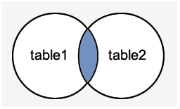
MySQL INNER JOIN :
The INNER JOIN keyword selects records that have matching values in both tables
Syntax :
SELECT column_name(s) FROM table1 INNER JOIN table2 ON table1.column_name = table2.column_name;

Slide 28
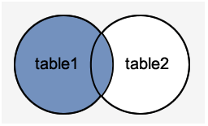
MySQL LEFT JOIN :
the Left Join clause returns all the rows from the left table and matched records from the right table or returns Null if no matching record found.
SELECT column_name(s) FROM table1 LEFT JOIN table2 ON table1.column_name = table2.column_name;

Slide 29
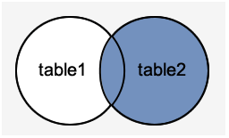
MySQL RIGHT JOIN :
The Right Join is used to joins two or more tables and returns all rows from the right-hand table, and only those results from the other table that fulfilled the join condition. If it finds unmatched records from the left side table, it returns Null value.
SELECT column_name(s) FROM table1 RIGHT JOIN table2 ON table1.column_name = table2.column_name;

Slide 30
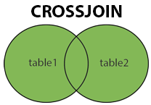
MySQL CROSS JOIN :
The CROSS JOIN keyword returns all records from both tables (table1 and table2).
SELECT column_name(s) FROM table1 CROSS JOIN table2;

Slide 31
MySQL SELF JOIN :
A SELF JOIN is a join that is used to join a table with itself.
SELECT column_name(s) FROM table1 T1, table1 T2 WHERE condition;

Slide 32
MySQL GROUP BY Statement :
The MYSQL GROUP BY Clause is used to collect data from multiple records and group the result by one or more column. It is generally used in a SELECT statement.
You can also use some aggregate functions like COUNT, SUM, MIN, MAX, AVG etc. on the grouped column.
Syntax:
SELECT expression1, expression2, ... expression_n,
aggregate_function (expression)
FROM tables
[WHERE conditions]
GROUP BY expression1, expression2, ... expression_n;

Slide 33
MySQL View :
In SQL, a view is a virtual table based on the result-set of an SQL statement.
A view contains rows and columns, just like a real table. The fields in a view are fields from one or more real tables in the database.
You can add SQL statements and functions to a view and present the data as if the data were coming from one single table.
Syntax
CREATE VIEW view_name AS SELECT column1, column2, ... FROM table_name WHERE condition;

Slide 34
Advantages of view :
Simplify complex query
It allows the user to simplify complex queries. If we are using the complex query, we can create a view based on it to use a simple SELECT statement instead of typing the complex query again.
Increases the Re-usability
We know that View simplifies the complex queries and converts them into a single line of code to use VIEWS. Such type of code makes it easier to integrate with our application. This will eliminate the chances of repeatedly writing the same formula in every query, making the code reusable and more readable.
Help in Data Security
It also allows us to show only authorized information to the users and hide essential data like personal and banking information. We can limit which information users can access by authoring only the necessary data to them.
Enable Backward Compatibility
A view can also enable the backward compatibility in legacy systems. Suppose we want to split a large table into many smaller ones without affecting the current applications that reference the table. In this case, we will create a view with the same name as the real table so that the current applications can reference the view as if it were a table.

