Slide 1
Bank Campaign Response Modelling
Submitted by Neha Balani for Lloyds Banking Interview process
Date: 21st Feb 2022

Slide 2
Agenda
1
Data Exploration
2
Model Base
3
Data Challenges and resolutions
4
Modelling steps
5
Choice of Modelling Technique
6
Model Evaluation

Slide 3
Data exploration
Spread of Purchasers by Category
15% of Married Couples purchase insurance as compared to 1% for couples not in marriage
Buddhists, Hindus are more prone to buying insurance
People from some regions like Cambodia, Canada and Greece are more prone to Insurance \
People interested in insurance have a slightly higher probability of buying than those who said no
A whopping 33% of people from Swindon buy insurance
Similarly 48% of people who are doctorates and 23% of those who are Masters buy insurance
56% of people with positive Capital gain go for Insurance and 40% of people with Capital loss do
Purchasers are more educated, work in higher occupations and have spent significantly more time in their current employments

Slide 4
Modelling Base
Base Data
The base campaign data consists of not only campaign customers and their outcomes but also other relevant fields for mortgage customers.
Base Campaign Data
Previous campaign was sent to 3,027 Customers
This data when merged and deduped with other Mortgage data reduces to 2,463 after deduplication
This excludes Mortgage duplicates and Mortgage missing in the model
Model Response Rate
The target category (customers who finally created insurance account) is around 8% with 182 responses
The customers who did not respond are 92% with count of 2,281

Slide 5
Data Challenges and resolutions
Merge Keys data quality issues between Campaign and Mortgage data
Merged on First Name, last name and area code
Data issues with name key. Derivation of Names using name parser to merge
Address match key was not comparable. Derived area codes from town and post codes and used as merge key using web scraping, postcode parsing packages
First merged with available keys and then sorted and deduped data to prioritize near matches
Got age difference in both data sets and ordered the one with least difference on top
Prioritized title match post that
Salary information field required data cleaning and sorting for use in model. Exact local currency conversions were not done at this point

Slide 6

Modelling steps
Iterative process until optimized solution is reached
Campaign Data
Data Cleaning and Aggregation
Feature Engineering
Treatments for outliers & dummy creation
Algorithm tuning
Model evaluation
Final Model selection
Mortgage Data
Modelling and Prediction data set Summary
Data Type | Usage | Original Records | Campaign responders | Unique records post merging and dedupliacation with mortgage
Campaign Data | Used for modelling & feature engineering | 32,060 | 3,027 | 2,909
Mortgage Data | Used for prediction on remaining campaign customers + feature engineering | 32,561 | NA | 31,096

Slide 7
Choice of Modelling Technique
Why choose Xgboost over Random forest?
Better recall
Tunable parameters to accommodate class imbalance considering smote was not performed
Less prone to overfitting due to regularizations involved
Why not other models?
Logistic: Need of transformations, WOE binning's etc for better modeling
Linear: Problem was binary so a generalization would work but not a direct linear model
Gradient boosting: Better Regularization in XGBoost

Slide 8
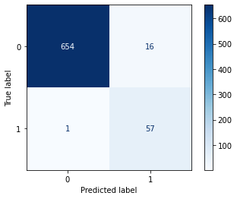
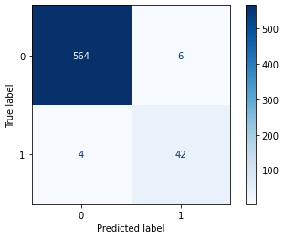
Model Evaluation Xgboost and Random Forest were tested for performance
XG Boost
Random Forest
AUC: 0.96 Precision: 0.79 Recall: 0.98
AUC: 0.95 Precision: 0.88 Recall: 0.91

Slide 9
Model Evaluation XG boost has a slightly better recall at 0.99
Selected Recall is a valid choice of evaluation metric since we wanted to capture as many purchasers as possible.
High recall: Of every 100 actual insurance purchases, the model could identify 98 purchases
Good Precision: for every 100 model identified purchases, 78 actually purchased

Slide 10
Model Evaluation - Accuracy improvement strategies Started with 70% recall and reached to 98% recall
Deduplicated data with match ambiguity
Use of Stratified k fold sampling with additional test dataset
User of a grid search to select best model amongst possible hyper parameters
Use of Base search to converge quickly
Re-categorized a few variables to avoid overfitting
Leveraged Xgboost’s regularization parameters to avoid overfitting
Use of scale_pos_weight parameter in Xgboost to optimize imbalanced class errors
Used Xgboost to take care of missing values using the sparsity aware matrices

Slide 11
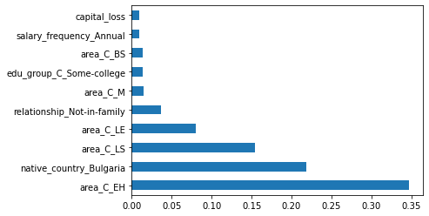
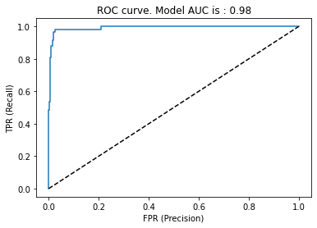
Model Evaluation - Variable Importance and ROC curve- XGBoost
Area codes for a few regions like Swindon are strong predictors
Capital Gain/ loss determines a customer’s appetite for Insurance product
Amongst other variables, Demographics like Native, education, occupation are important too
Salary related information have interacted well despite lack of common converter used

Slide 12
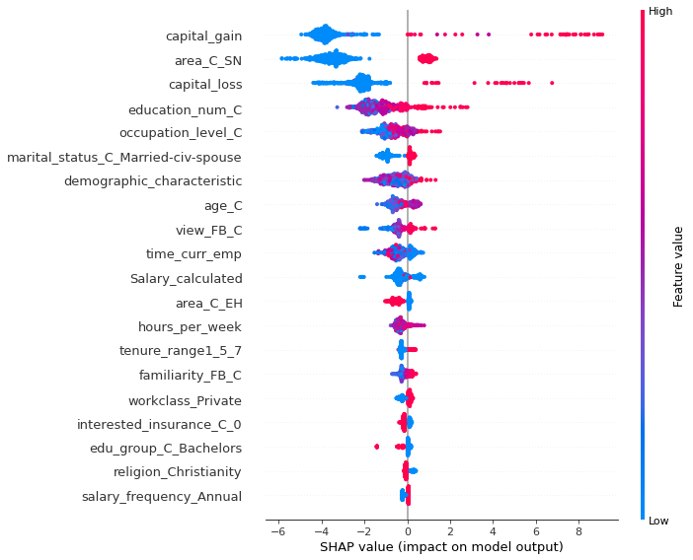
Variable Importance Shap Values - XGBoost
Variables like capital gain, area and education look like major contributors for most of the customers predicted
Shap value is able to successfully capture the impact of other variables like demographic characteristic, working hours, view of Future bank that the Gini importance from Xgboost is not able to bring out

Slide 13
Appendix

Slide 14
Thank You

