Slide 1
INFINISPAN
Neha Bansal

Slide 2
Agenda
What is Infinispan?
Features

Slide 3
What is Infinispan?
Extremely scalable, highly available key/value data store and data grid platform.
Often used as a distributed cache, but also as a NoSQL key/value store or object database.

Slide 4
Features
In-memory local and clustered cache
Clustering
Transactions
Persistence
Configuration / Development
Integrations

Slide 6
Clustering

Slide 7
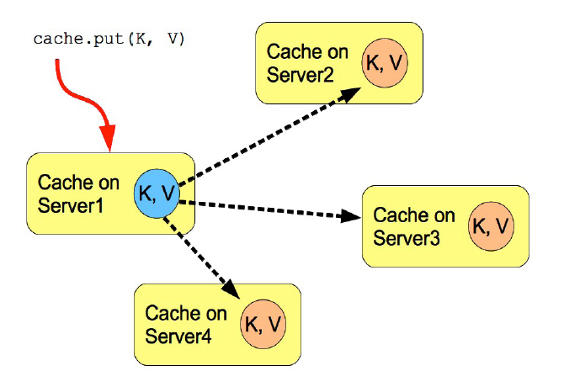
Replicated Mode
automatically discover neighboring instances on other JVMs on the same local network, and form a cluster
Entries added to any of these cache instances will be replicated to all other cache instances in the cluster
Replication can be synchronous or asynchronous.
synchronous replication requires acknowledgments from all nodes in a cluster
Asynchronous replication works in a fire-and-forget mode.
replication practically only performs well in small clusters (under 10 nodes)

Slide 8
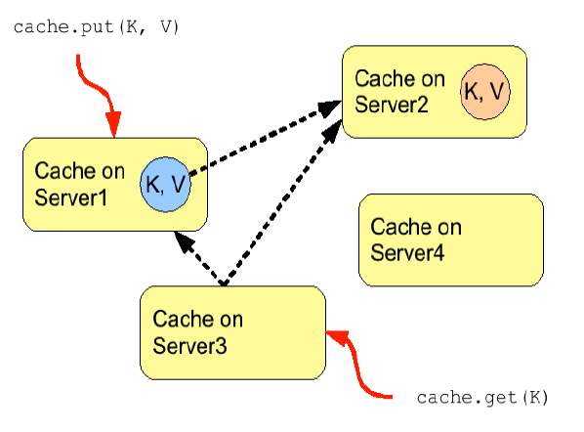
Distribution Mode

