Slide 1
INFINISPAN
Neha Bansal

Slide 2
Agenda
What is Infinispan?
Interacting with Infinispan
Modes
Transcations
Persistency

Slide 3
What is Infinispan?
Data Grid Platform
Distributed Cache
NoSQL key/value store
Extremely scalable
In-memory cache
Open Source
Highly available

Slide 4
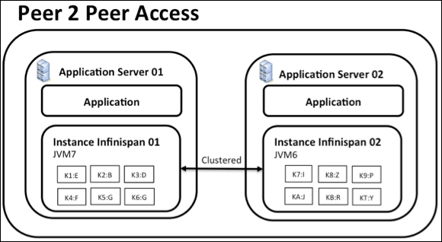
Interacting with Infinispan
Embedded (P2P)
Into your application code
exist in same JVM as application code.
Data grid easily scalable.
Used when, application or a framework needs to be cluster-aware
Used when, application needs an in-memory distributed cache to front a database or some other expensive data source
Starting and stopping these instances can be a slow process due to state transfer

Slide 5
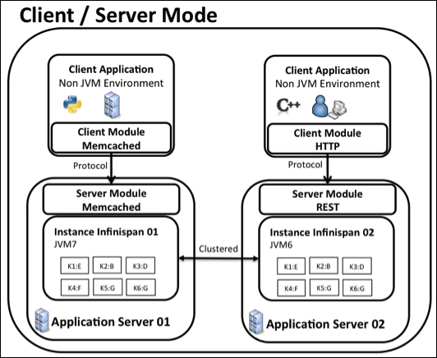
Interacting with Infinispan
As a Remote server
Accessed by a client
Supported protocols are: REST, Memcached, Hot Rod
Built on top of JBoss AS 7.2
Provide external access to data grid.
Provide access from a non-JVM environment
Acts as a shared storage tier when multiple applications need access to data storage.

Slide 6
Modes
LOCAL MODE
acts as a simple, in-memory data cache
entries are stored on the local node only
More features than a map:
Eviction
Write-through and Write-behind

Slide 7
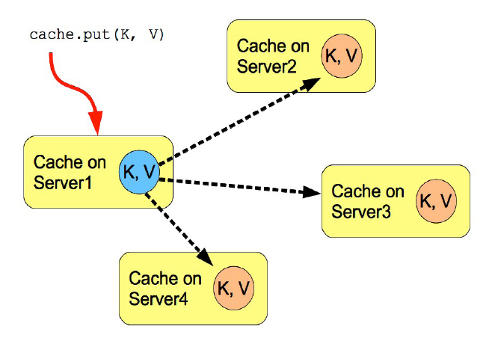
Modes
Replication Mode
Entries replicated to all cache instances
Does not offer increased heap space
Synchronous replication requires acknowledgments from all
Asynchronous replication works in a fire-and-forget mode.
Practically performs well in small clusters (under 10 nodes)

Slide 8
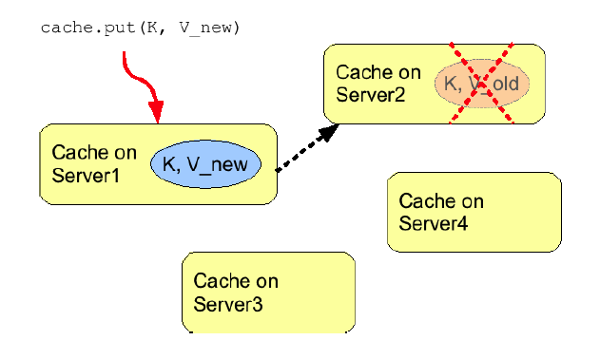
Modes
Invalidation Mode
Does not share data
Removes data that may be stale from remote cache
Used for optimization with other permanent store
Minimized network traffic
Modified data is looked up in lazy manner.

Slide 9
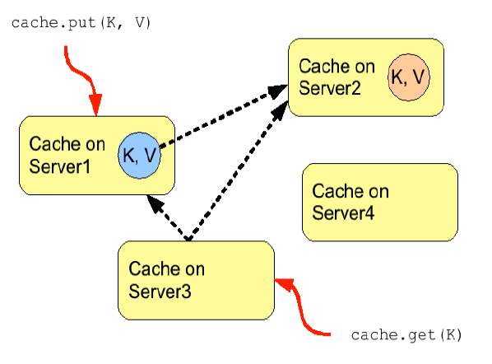
Modes
Distribution Mode

Slide 10
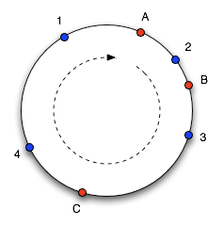
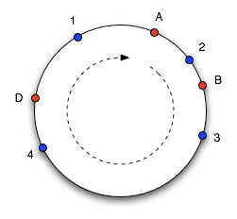
Distribution Mode
Consistent Hashing

Slide 11
Features
In-memory local and clustered cache
Clustering
Transactions
Persistence
Configuration / Development
Integrations

Slide 12
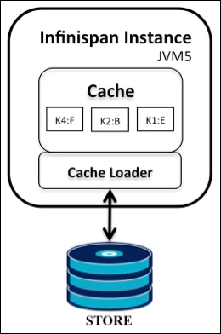
Persistence
Use a CacheLoader interface to save the in-memory cache data to a persistent cache store
An external persistent storage might be useful for:
Increased Durability
Write-through
Overflow Data

Slide 13
Clustering

