Slide 1
INFINISPAN
Neha Bansal

Slide 2
Agenda
What is Infinispan?
Interacting with Infinispan
Modes
Features

Slide 3
What is Infinispan?
Data Grid Platform
Distributed Cache
NoSQL key/value store
Extremely scalable
In-memory cache
Open Source
Highly available

Slide 4
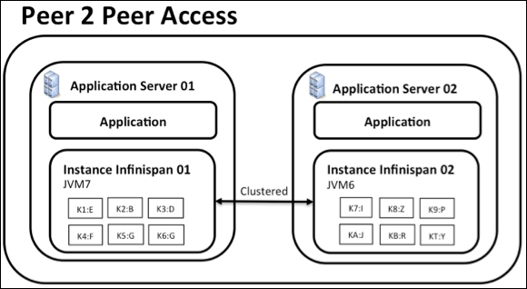
Interacting with Infinispan
Embedded (P2P)
into your application code
Libraries exist in same JVM as application code.
Data grid is easily scalable.
Peer to Peer deployments are simpler than client-server.
Used when:
application or a framework that needs to be cluster-aware
need an in-memory distributed cache to front a database or some other expensive data source

Slide 5
Interacting with Infinispan
As a Remote server : supported protocols
accessed by a client
supported protocols are:
REST
Memcached
Hot Rod
Infinispan provides client components to access data grid using these protocols.
Used when :
need to provide external access to data grid.
accessing Infinispan from a non-JVM environment
multiple applications need access to data storage, deploy Infinispan in client-server mode keeping a pool of Infinispan data grid nodes acting as a shared storage tier for your applications.

Slide 6
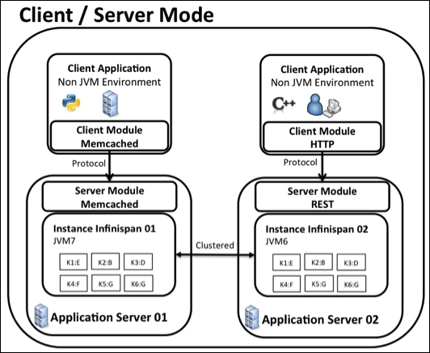

Slide 7
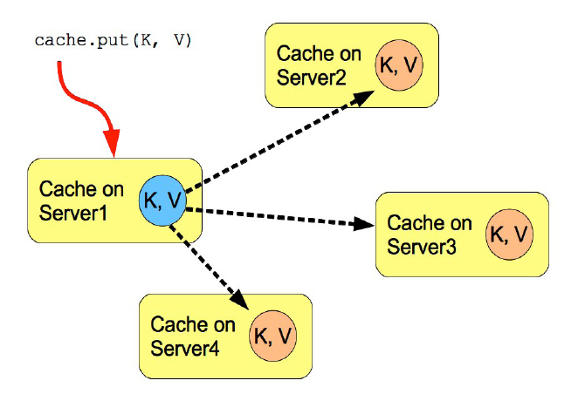
Replicated Mode
automatically discover neighboring instances on other JVMs on the same local network, and form a cluster
Entries added to any of these cache instances will be replicated to all other cache instances in the cluster
Replication can be synchronous or asynchronous.
synchronous replication requires acknowledgments from all nodes in a cluster
Asynchronous replication works in a fire-and-forget mode.
replication practically only performs well in small clusters (under 10 nodes)

Slide 8
Modes
Local
entries are stored on the local node only
Infinispan is typically operating as a local cache
Invalidation
Replication
Distribution

Slide 9
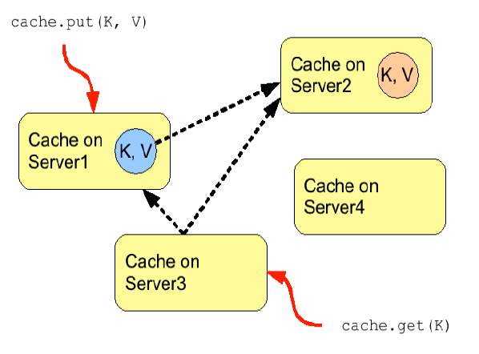
Distribution Mode

Slide 10
Features
In-memory local and clustered cache
Clustering
Transactions
Persistence
Configuration / Development
Integrations

Slide 11
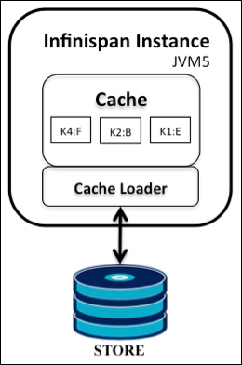
Persistence
Use a CacheLoader interface to save the in-memory cache data to a persistent cache store
An external persistent storage might be useful for:
Increased Durability
Write-through
Overflow Data

Slide 12
Clustering

