Slide 1
INFINISPAN
Neha Bansal

Slide 2
Agenda
What is Infinispan?
Interacting with Infinispan
Cache API
Caching Modes
Persistence
References

Slide 3
What is Infinispan?
Data Grid Platform
Distributed
In-memory
Key/value store
Extremely scalable
Highly available
Open Source

Slide 4
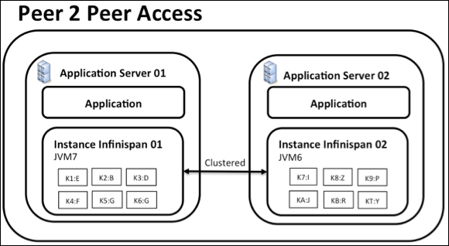
Interacting with Infinispan
Embedded (P2P)
Exist in same JVM as application code
Data grid easily scalable
P2P communication through RPC calls between nodes
Used when, application needs an in-memory distributed cache to front a database or some other expensive data source
Starting and stopping these instances can be a slow process due to state transfer

Slide 5
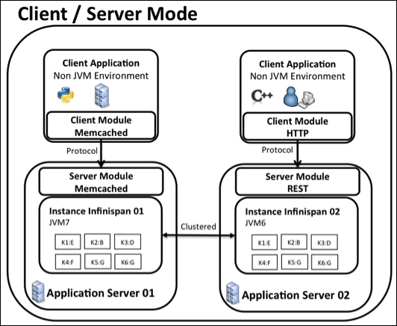
Interacting with Infinispan
As a Remote server
Provide external access to data grid
Provide access from a non-JVM environment
Describe relationship between Infinispan data grid and clients
Acts as a shared storage tier when multiple applications need access to data storage
Supported protocols are: REST, Memcached, Hot Rod
Built on top of JBoss AS 7.2

Slide 6
Cache API
Cache
JSR-107 compliant interface
Provides methods for adding, removing and retrieving entries
Provides Eviction/Expiration, Event Notifications, Persistence and Transactions
Cache cache = new DafaultCacheManager().getCache();
AdvancedCache
Provides ability to inject custom interceptors and to apply certain flags
AdvancedCache advancedCache = cache.getAdvancedCache();
Asynchronous API
Non-blocking API
Provides all guarantees of synchronous communication, in non-blocking fashion
Have ability to handle communication failures and exceptions
Future future = cache.putAsync(key1, value1); // does not block
future.get(); // check that the puts completed successfully

Slide 7
Cache API
Tree Module API
Store information in a hierarchical way
Hierarchy is defined using paths/nodes represented as FQN
Data is stored under nodes using key/value API
Configuration config = new Configuration().setInvocationBatchingEnabled(true);
Cache cache = new DefaultCacheManager(config).getCache();
TreeCache treeCache = TreeCacheFactory.createTreeCache(cache);
Listener API
Application can get notification about some events that occur inside the grid
API is annotation driven (@Listener)
Cluster Listener (@Listener(clustered=yes))
Cache Level Events
CacheEntryAddedEvent/Modified/Removed/Invalidated/Evicted
CacheEntryActivatedEvent/Passivated etc.
Cache Manager Level Events
CacheStartedEvent/Stopped/ViewChanged/Merged

Slide 8
Cache API
Eviction/Expiration
Used to avoid OutOfMemory exceptions, to keep really necessary entries in cache
Eviction | Expiration
Remove entries from cache when cache is exceeded from max no of entries. | Remove entries from cache but after specified period of time.
Uses eviction policy (LRU, LIRS) and maxEntries to evict entries. | Uses lifespan and maxIdle attribues to expire entries.
Can be used with passivation to store the evicted entries to the persistent store. | Expired entries cannot be stored to the persistent store.
<eviction strategy="LRU" max-entries="2000” /> | <expiration lifespan="1000" max-idle="500” />

Slide 9
Caching Modes
Local Mode
Acts as a simple, in-memory data cache
Entries are stored on the local node only
Limited by the maximum size of JVM heap
More features than a map:
Eviction
Write-through and Write-behind
<local-cache name="DefaultLocalCache" />

Slide 10
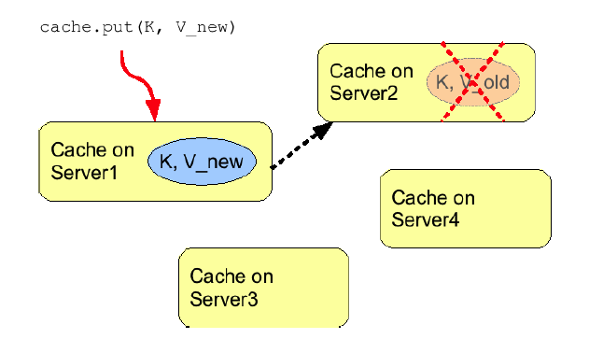
Caching Modes
Invalidation Mode
Does not share data
Removes data that may be stale from remote cache
Used for optimization with other permanent store
Minimized network traffic
Modified data looked up in lazily manner
<invalidation-cache name="invalidatedCache" mode="SYNC">
<persistence>
<cluster-loader remote-timeout="20000" preload="false" />
</persistence>
</invalidation-cache>

Slide 11
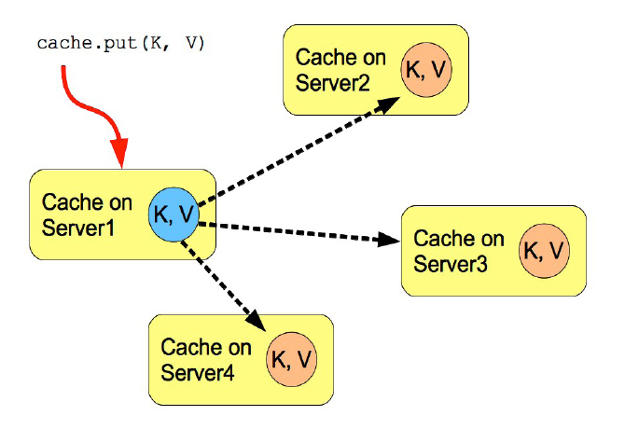
Caching Modes
Replication Mode
Entries replicated to all cache instances,
high availability
Does not offer increased heap space
Can be Synchronous or Asynchronous
Uses Replication Queue, to increase performance
Practically performs well in small clusters, due to no of replication messages
<replicated-cache name="replicationCache" mode="SYNC" remote-timeout="20000"> <state-transfer enabled="false" timeout="240000" chunk-size="0" />
</replicated-cache>

Slide 12
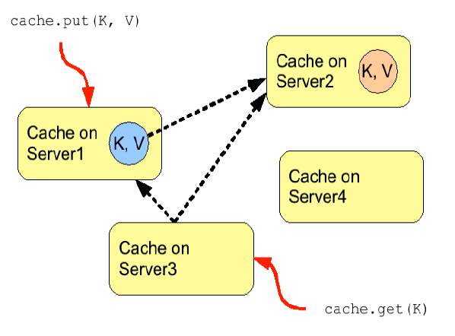
Caching Modes
Distribution Mode
Entries distributed to a subset of nodes, high scalability
Working as in-memory data grid and provide increased heap space
No of copies represent trade-off between performance and durability
Handles the Split Brain scenario
Uses Consistent Hash algorithm to determine nodes to store entries
Issue remote calls to fetch data from other cache
<distributed-cache name="distributedCache" mode="SYNC" owners="2" segments="80" />

Slide 13
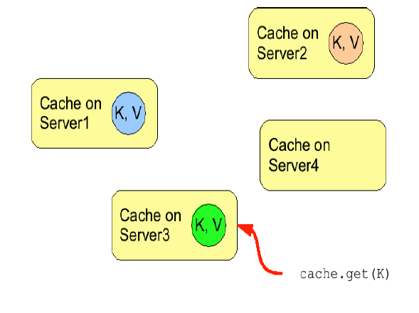
Distribution Mode
L1 Caching
Hold remote cache entries for short times
Prevent additional remote fetch operations and improve performance for reads
Update to a L1 cache entry invalidates all other L1 caches
Whenever key is update, invalidation messages need to be multicast
Increases the Java heap memory consumption
<distributed-cache name=“distributedCacheWithL1Cache" mode=“SYNC" owners="2" l1-lifespan="600000” />

Slide 14
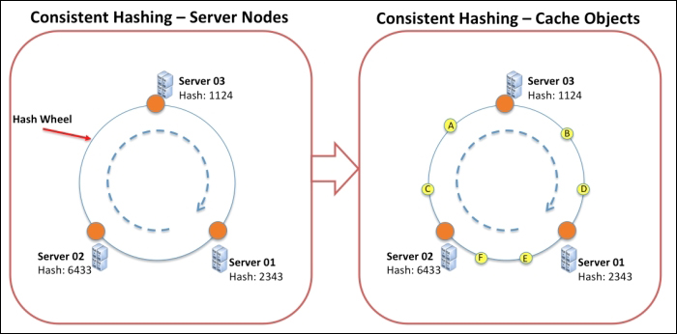
Distribution Mode
Consistent Hashing

Slide 15
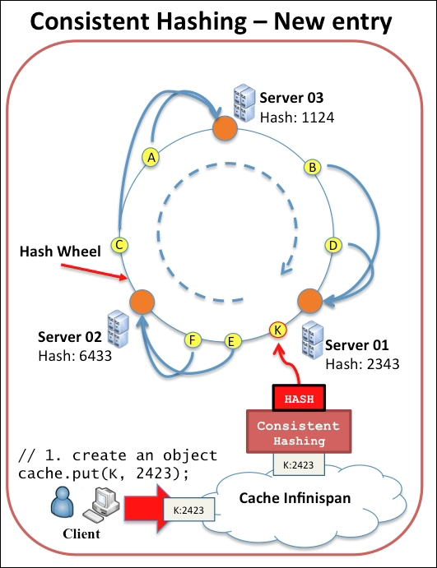
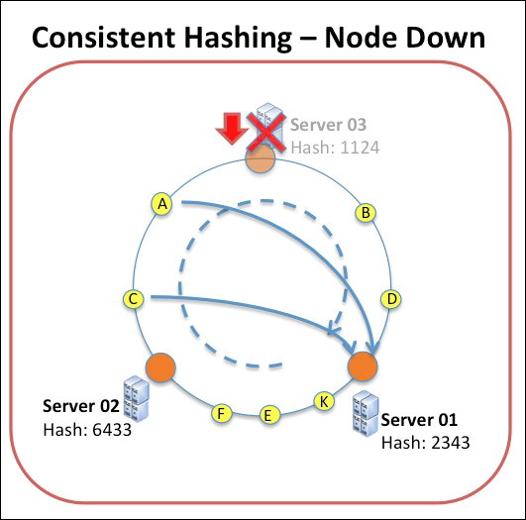
Distribution Mode
Consistent Hashing

Slide 16
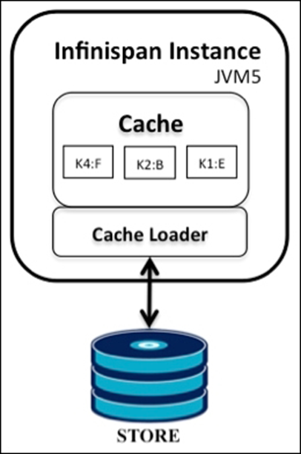
Persistence
Allows configuring persistent storage
External persistent storage is useful for : Increased Durability, Write-through and Overflow Data
Uses CacheLoader/CacheWriter to save/load data to/from persistent cache store in cache
Available cache loaders/stores:
Filesystem-based Cache Loaders
SingleFileStore
JDBC-based Cache Loaders
JdbcBinaryCacheStore
JdbcStringBasedCacheStore
JdbcMixedCacheStore
Others

Slide 17
References
http://infinispan.org/docs/7.2.x/user_guide/user_guide.html
http://infinispan.org/docs/7.2.x/getting_started/getting_started.html
Infinispan Data Grid Platform Definitive Guide

Slide 18

Questions

