Slide 1
RELEASE PROCESS
Neha Gani

Slide 2
Requirements’ Gathering
Planning
Design
Development
Requirements’ Gathering
Planning
Design
Development
Release
Requirements’ Gathering
Track, Monitor
Raising of User stories in Confluence
Acceptance Criteria, using JBehave for automation
Pre planning (if required), re-writing/defining scope
Planning (Planning Poker, points based or capacity based)
Planning
Development – SpringBoot, Angular 4
Commit - GITLab
Unit/Integration Test Cases – Karma, Mockito
Build – Maven (Triggered by commits)
Track, Monitor
Design
AGILE DEVELOPMENT
PAAS – PCF Release/Track/Monitor
CICD - Deployment till Pre PROD - Jenkins
Unit/Integration Test Cases
Sonar Test coverage and Code vulnerabilities, Bugs check
Fortify Security and Code Vulnerabilities check
Clean Up and Deploy (Blue Green deployments with 0 downtime) - PCF
Automation test cases (Sign Off required or not)
Performance/Load testing - jMeter
Release
Development

Slide 3

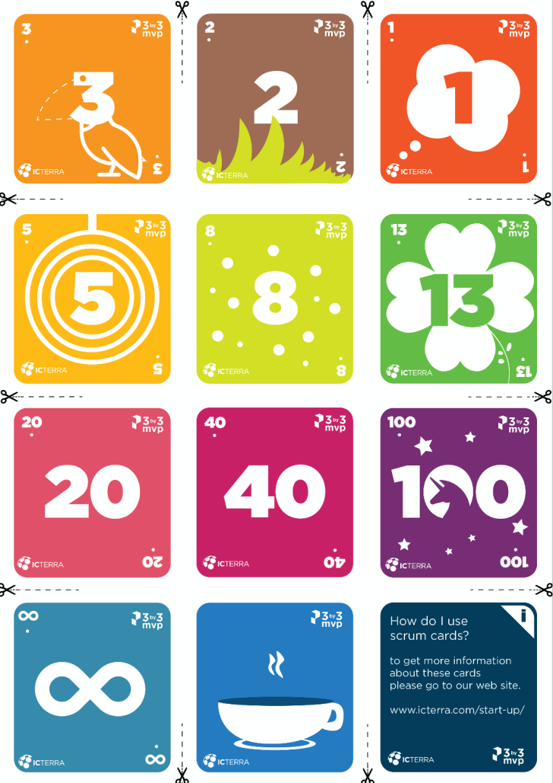


Requirements’ Gathering
Planning
Raising of User stories in Confluence
Acceptance Criteria, using JBehave for automation
Pre planning (if required), re-writing/defining scope
Planning (Planning Poker, points based or capacity based)

Slide 4
Requirements’ Gathering
Planning
Design
Development
Raising of User stories in confluence
Acceptance Criteria, using Jbehave for automation
Pre planning (if required), re-writing/defining scope
Planning (Planning Poker, points based or capacity based)
Development – Spring Boot, Angular 4
Commit - GITLab
Unit/Integration Test Cases
Build – Maven (Triggered by commits)
PAAS – PCF Release/Track/Monitor
CICD - Deployment till Pre PROD - Jenkins
Unit/Integration Test Cases
Sonar Test coverage and Code vulnerabilities, Bugs check
Fortify Security and Code Vulnerabilities check
Clean Up and Deploy (Blue Green deployments with 0 downtime) - PCF
Automation test cases (Sign Off required or not)
Performance/Load testing - jMeter

Slide 5




Design
Development
Development – SpringBoot, Angular 4
Commit - GITLab
Unit/Integration Test Cases – Karma, Mockito
Build – Maven (Triggered by commits)

Slide 6
Requirements’ Gathering
Planning
Design
Development
Raising of User stories in confluence
Acceptance Criteria, using Jbehave for automation
Pre planning (if required), re-writing/defining scope
Planning (Planning Poker, points based or capacity based)
Development – SpringBoot, Angular 4
Commit - GITLab
Unit/Integration Test Cases – Karma, Mockito
Build – Maven (Triggered by commits)
PAAS – PCF Release/Track/Monitor
CICD - Deployment till Pre PROD - Jenkins
Unit/Integration Test Cases
Sonar Test coverage and Code vulnerabilities, Bugs check
Fortify Security and Code Vulnerabilities check
Clean Up and Deploy (Blue Green deployments with 0 downtime) - PCF
Automation test cases (Sign Off required or not)
Performance/Load testing - jMeter

Slide 7
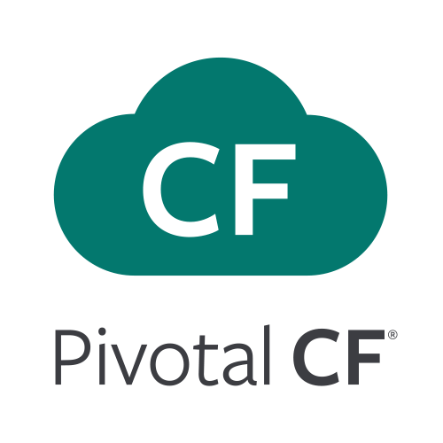




PAAS – PCF Release/Track/Monitor
CICD - Deployment till Pre PROD - Jenkins
Unit/Integration Test Cases
Sonar Test coverage and Code vulnerabilities, Bugs check
Fortify Security and Code Vulnerabilities check
Clean Up and Deploy (Blue Green deployments with 0 downtime) - PCF
Automation test cases (Sign Off required or not)
Performance/Load testing - jMeter

Slide 8
ONSITE
OFFSHORE
Business Analysts
Developers
Product Owners
Production Support
QA
DBAs
Scrum Master
Deployment Engineers

Slide 9

RoadMap
Automation Testing, complete CDCI implementation
Google Apigee
MariaDB MaxScale
Authentication of DB

Slide 10
DEMO

