Slide 1
RELEASE PROCESS
Neha Gani

Slide 2
Requirements’ Gathering
Planning
Design
Development
Requirements’ Gathering
Planning
Design
Development
Release
Requirements’ Gathering
Track, Monitor
Raising of User stories in Confluence/ Jira tasks
Acceptance Criteria, using JBehave for automation
Pre planning (if required), re-writing/defining scope
Planning (Planning Poker, points based or capacity based)
Planning
Development – SpringBoot, Angular 4
Commit - GITLab
Unit/Integration Test Cases – Karma, Mockito
Automation test cases - Selenium
Build – Maven (Triggered by commits)
Track, Monitor
Design
AGILE DEVELOPMENT
PAAS – PCF Release/Track/Monitor
CICD - Deployment till Pre PROD - Jenkins
Unit/Integration Test Cases
Sonar Test coverage and Code vulnerabilities, Bugs check
Fortify Security and Code Vulnerabilities check
Clean Up and Deploy (Blue Green deployments with 0 downtime) - PCF
Automation test cases (Sign Off required or not)
Performance/Load testing - jMeter
Release
Development

Slide 3

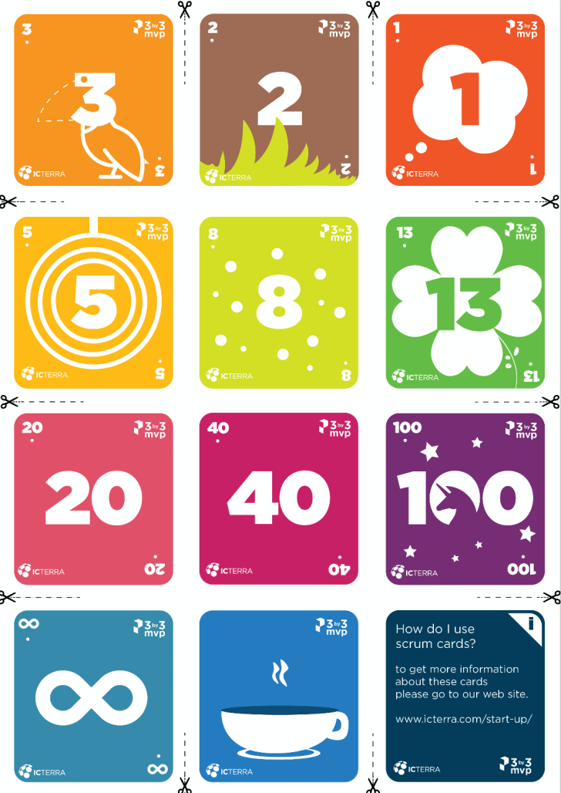


Requirements’ Gathering
Planning
Raising of User stories in Confluence/ Jira tasks
Acceptance Criteria, using JBehave for automation
Pre planning (if required), re-writing/defining scope
Planning (Planning Poker, points based or capacity based)

Slide 4
Requirements’ Gathering
Planning
Design
Development
Raising of User stories in Confluence/ Jira tasks
Acceptance Criteria, using JBehave for automation
Pre planning (if required), re-writing/defining scope
Planning (Planning Poker, points based or capacity based)
Development – SpringBoot, Angular 4
Commit - GITLab
Unit/Integration Test Cases – Karma, Mockito
Automation test cases - Selenium
Build – Maven (Triggered by commits)
PAAS – PCF Release/Track/Monitor
CICD - Deployment till Pre PROD - Jenkins
Unit/Integration Test Cases
Sonar Test coverage and Code vulnerabilities, Bugs check
Fortify Security and Code Vulnerabilities check
Clean Up and Deploy (Blue Green deployments with 0 downtime) - PCF
Automation test cases (Sign Off required or not)
Performance/Load testing - jMeter

Slide 5


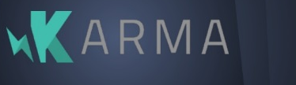




Design
Development
Development – SpringBoot, Angular 4
Commit - GITLab
Unit/Integration Test Cases – Karma, Mockito
Automation test cases - Selenium
Build – Maven (Triggered by commits)

Slide 6
Requirements’ Gathering
Planning
Design
Development
Raising of User stories in Confluence/ Jira tasks
Acceptance Criteria, using JBehave for automation
Pre planning (if required), re-writing/defining scope
Planning (Planning Poker, points based or capacity based)
Development – SpringBoot, Angular 4
Commit - GITLab
Unit/Integration Test Cases – Karma, Mockito
Automation test cases - Selenium
Build – Maven (Triggered by commits)
PAAS – PCF Release/Track/Monitor
CICD - Deployment till Pre PROD - Jenkins
Unit/Integration Test Cases
Sonar Test coverage and Code vulnerabilities, Bugs check
Fortify Security and Code Vulnerabilities check
Clean Up and Deploy (Blue Green deployments with 0 downtime) - PCF
Automation test cases (Sign Off required or not)
Performance/Load testing - jMeter

Slide 7





PAAS – PCF Release/Track/Monitor
CICD - Deployment till Pre PROD - Jenkins
Unit/Integration Test Cases
Sonar Test coverage and Code vulnerabilities, Bugs check
Fortify Security and Code Vulnerabilities check
Clean Up and Deploy (Blue Green deployments with 0 downtime) - PCF
Automation test cases (Sign Off required or not)
Performance/Load testing - jMeter

Slide 8
ONSITE
OFFSHORE
Business Analysts
Developers
Product Owners
Production Support
QA
DBAs
Scrum Master
Deployment Engineers

Slide 9

RoadMap
Automation Testing, complete CICD implementation
Google Apigee
MariaDB MaxScale
Authentication of DB

Slide 10
DEMO

