Slide 1
PROCESS FLOW FOR FILING OF ONLINE E-NOMINATION FORM BY MEMBER ON EPF PORTAL

Slide 2
Following are the pre-requisite of E-Nomination
UAN should be activated.
Verified Aadhar should be linked with UAN.
Mobile number should be linked with Aadhar.
Photo of member should be available in profile.(View>Profile of Member Interface of Unified Portal).
Use desktop version of Mozilla Firefox 58.0+ browser for using this facility.

Slide 3
Following is step by step procedure for filing E-Nomination
Member will login to the Member Interface of Unified Portal through below mentioned URL
https://unifiedportal-mem.epfindia.gov.in/memberinterface/
Login through UAN, Password & Captcha

Slide 4
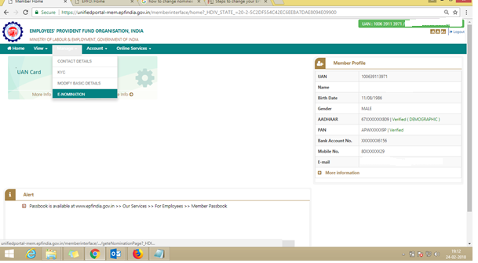
After entering UAN portal select “Manage” option → select “E- Nomination” option.

Slide 5
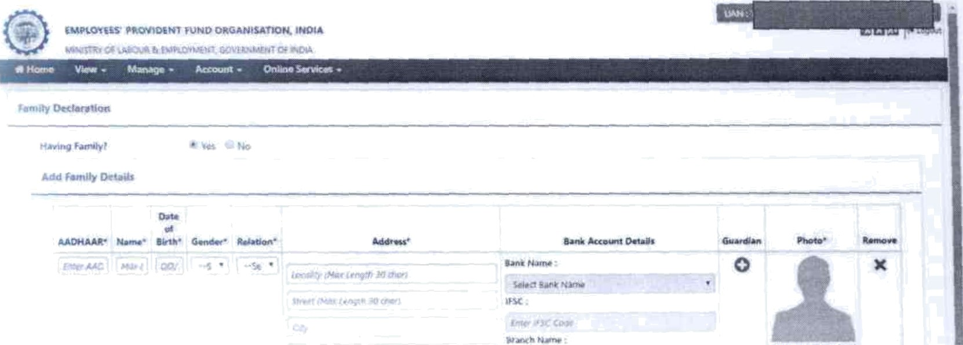
Type current & permanent address & save.
Then select the Having Family option (Yes/No), if input is given as Yes system will ask to enter family details. Member can add family details by clicking on “Add New” button. Aadhar and photo of family members are mandatory. After mentioning all family details click on “Save Family Details”

Slide 6
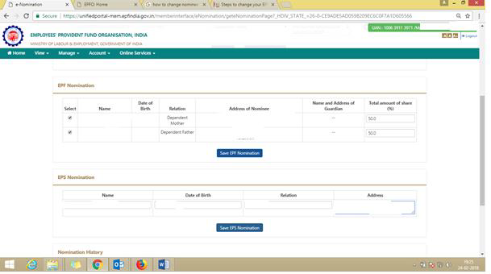
Select the combo box for EPF nomination percentage & save EPF nomination. After that mention the EPS nomination & save the EPS nomination option.

Slide 7
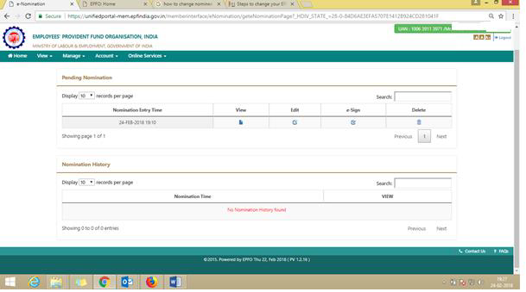
Then select the E-Sign option. For E-sign virtual ID is mandatory. Virtual ID can be generated by visiting UIDAI official website (https://resident.uidai.gov.in/)

Slide 8
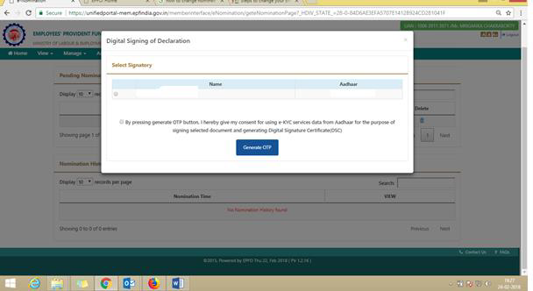
Select the 2 no. combo box & generate OTP option

Slide 9
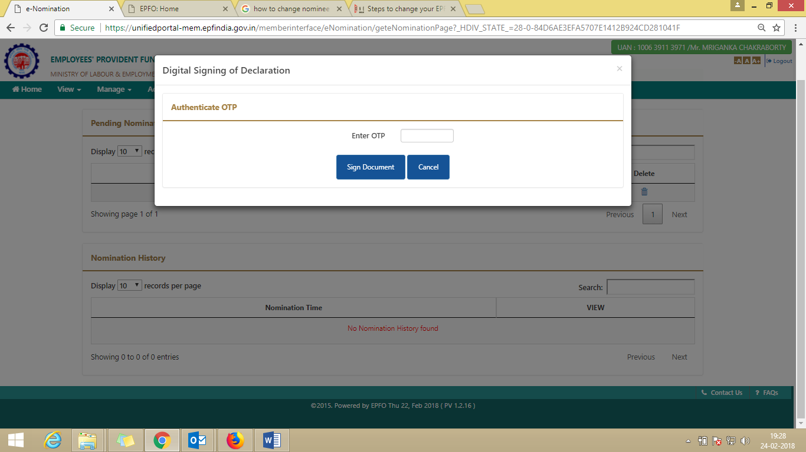
Type the OTP which is come to your registered Mobile no.

Slide 10
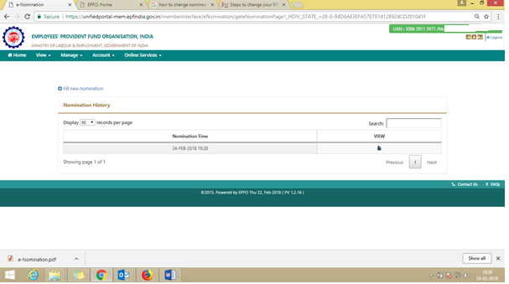
Select the view option for Digital Form 2 download.

Slide 12
THANK Y U

