Slide 1

Hostel Management System
Submitted by:
Neha Kumari Shah
Rujen Khadka
Semester : 6th Sem (BCA)

Slide 2
Introduction
A hostel management system is a software application designed to streamline the day-to-day operations of a hostel or a similar accommodation facility. .
These systems will allow the warden to manage various activities related to hostel operations, such as student registration, fee collection, etc.

Slide 3
Problem Statement
Manual hostel management is time-consuming
Managing different aspects of hostel operations manually leads to in-efficiency and increased costs.

Slide 4
Objectives
Create a user-friendly interface for hostel wardens to manage student records and streamline daily activities.
Automate daily hostel operations to improve efficiency and accuracy.
Ensure easy navigation for hostel students within the system.

Slide 5
Scope And Limitations
Scope
Single platform for multiple hostels
Flexible room booking
Limitations
No offline mode
No Mobile Application

Slide 6
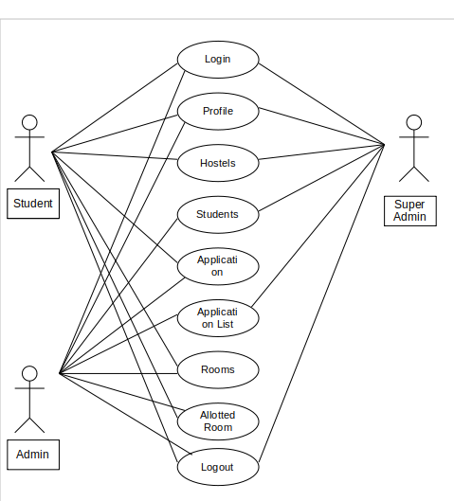
Functional Requirements

Slide 7
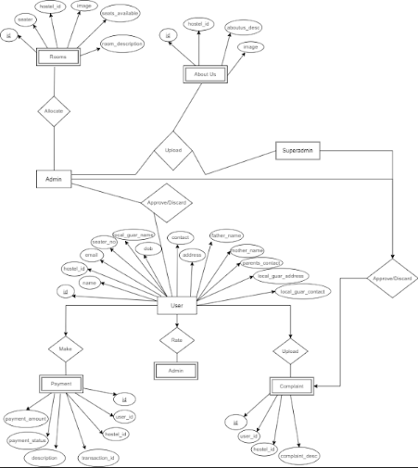
Data Modeling

Slide 8
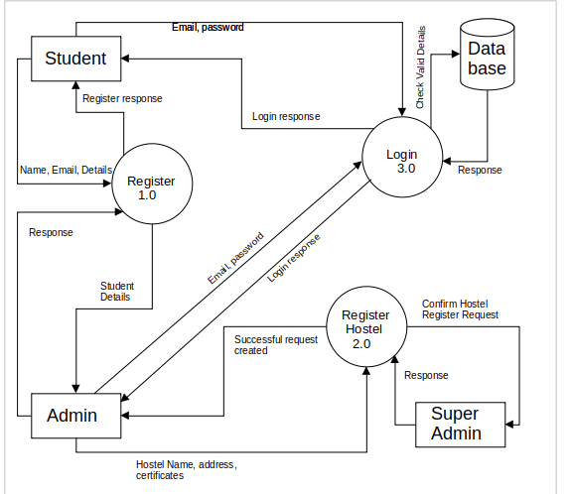
Process Modeling

Slide 9
Technology used
Frontend
Html
CSS
JavaScript
Backend
Laravel
MYSQL

Slide 10
AES Algorithm
AES Encrypt
Uses openssl_encrypt fucntion
Uses a key and a initializtion vector
Loops through the text and XORs with previous cypher text
AES Decrypt
Checks the key and the initializtion vector set during sign up
Used during the login phase

Slide 11
Conclusion
A hostel management system is a valuable tool for improving the management and efficiency of hostel facilities.
The expected outcome of a hostel management system includes increased efficiency, improved communication between staff and students, and overall improved management of hostel facilities.

Slide 12
Thank You !!

