Slide 1
Brazilian E-commerce analysis
Industry : E-commerce Retail
Country : Brazil
By-Neha Toppo

Slide 2


Methodology
PostgreSQL
Create Tables & Data import
Extract selected columns transform into one table using join
Python
Load data from SQL
EDA
Feature Engineering
Data Analysis
Visualization
Action recommendations
Insights

Slide 3
objective
Analyze sales trends
Delivery delay impact
Region performance compare
Identify top products

Slide 4
Business questions
What is the customer retention rate?
Does delivery delay impact customer retention?
Identify top 10 states by customer count?
Which region generates the highest revenue?
Which product category contribute the most revenue?

Slide 5
Dataset overview
Dataset source: Kaggle
No.of Tables : 8
Time period: Sep 2016-Sep 2018
Important columns:
Order id
Price
Order date
Delivery date
Product category
Customer state

Slide 6
feature engineering
Created new columns:
delivery_days
Repeat_customer
is_delayed
region

Slide 7
KPI’s
TOTAL ORDERS
11.02K
TOTAL SALE
13.22M
TOTAL CUSTOMER
96K
AOV
119.98

Slide 8
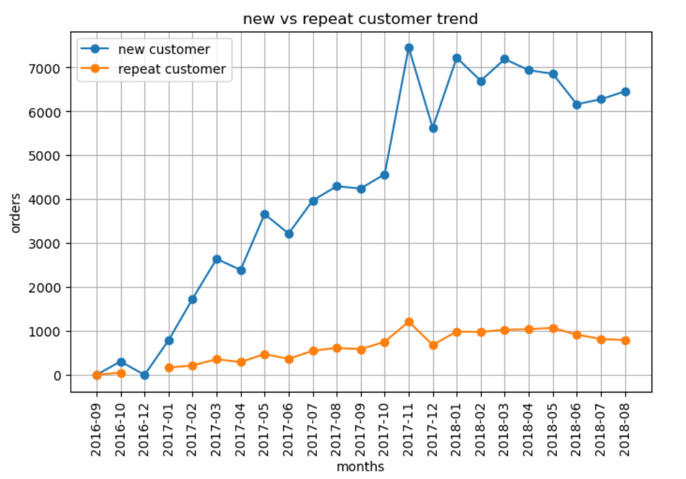
What is the customer retention rate?
New vs Repeat Customer Segmentation
Insights:
New customer has increases over the months while repeat customer line is inflated.

Slide 9
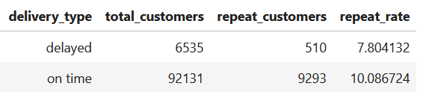
2.Does delivery delay impact customer retention?
Insights:
Delayed deliveries reduced repeat customer rate, indicating the risk of increase on customer churn.

Slide 10
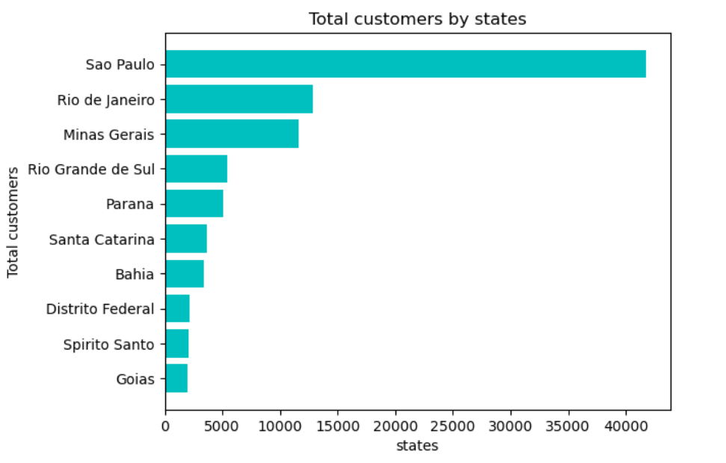
3.Identify top 10 states by customer count?
Highest customer by state
Insights:
Sao Paulo has highest customer, followed by Rio de Janeiro and Minas Gerais

Slide 11
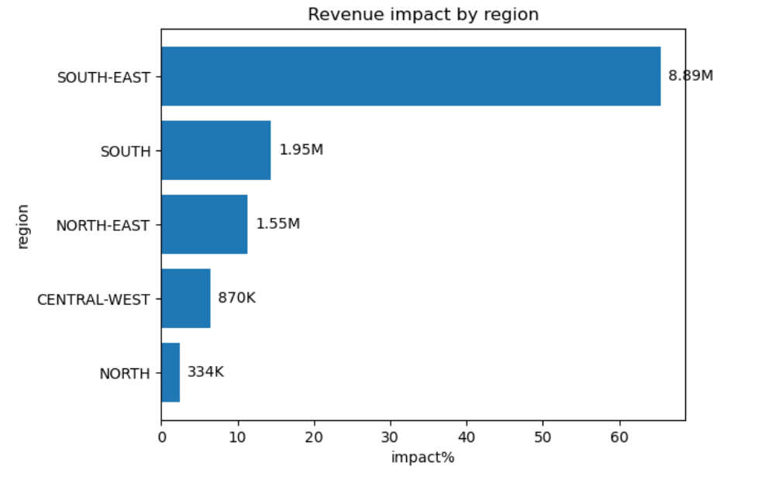
4. Which region generates the highest revenue?
Revenue Distribution
Insights:
Region South-East dominates with 65.38% impact of total revenue, North and Central-West combined has less than 10% impact on total revenue.

Slide 12
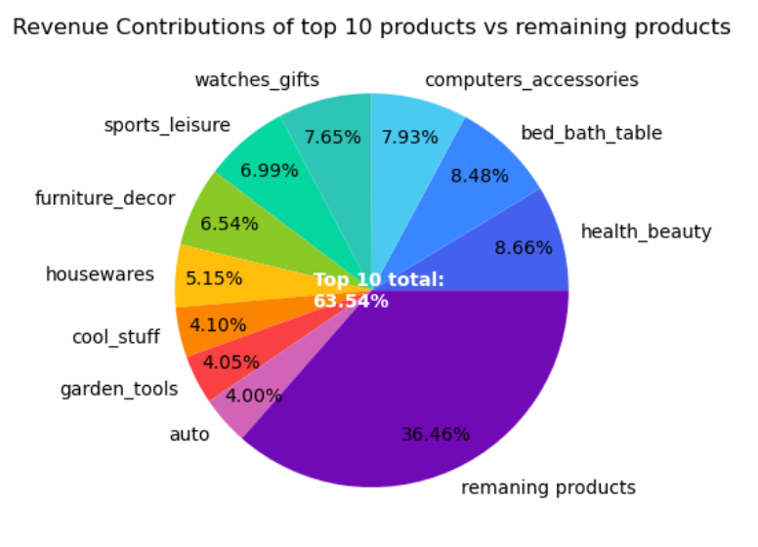
5. Which product category contribute the most revenue?
Insights:
Top 10 products contribute on revenue is 63.54 %
The remaining products contribute 36.46%, meaning they are not utilized effectively or may not be as competitive.

Slide 13
recommendation
Increase budget for top 10 products on marketing, inventory and lower budget for remaining product.
Evaluate pricing and run offers for less purchased products.
Increase marketing with customer loyalty campaigns to improve repeat purchase rate .
North and Central-West combined has less impact on total revenue, investigate issue (logistics, competition) and create target campaigns to reduce the issue.

Slide 14
Business impact
By implementing these recommendations, the company can achieve customer retention, mitigate risks, and enhance overall revenue.

Slide 15
Thank you

