Slide 1
SUPERMARKET BILLING SYSTEM
Submitted To:
Dr. M. Syamala Devi
Submitted By:
Dikshita(12) & Neha(27) MCA 1 - Morning 2021-24

Slide 2
ABSTRACT
Supermarkets tend to use a software for their stock and to store bills. This is an abstract model of the billing system they use. In this application, we allow store keepers to enter the details of the products available in their store, to view them, to delete them, and prepare bills.

Slide 3
INTRODUCTION
The purpose of creating a Supermarket Billing system is to keep track of the inventory of the store so that every time a customer tries to buy something the stock of that particular reduces by the quantity purchased by the user and is later decremented in the stock as well. Hence, it helps in not only maintaining an inventory or to create bills, it helps in keeping a close eye on the stock. The owner can any time display the inventory to check for the availability of products.

Slide 4
If the owner doesn’t use this software for billing and maintaining inventories then s/he will have to make the bills by hand and memorize the stock availability. It’s difficult to keep of the inventory if you have large number of items available in the store and a huge sale. Using the software, you can easily check the products available and help the customers with it. This not only saves time but also increases the efficiency with which the store operates.

Slide 5
The Features of this Software include:
• The Supermarket owner can perform various operations like:
Maintaining an inventory.
Adding products to the inventory.
Deleting products from the inventory .
Display the products in the inventory.
• The Customer can perform operations like:
Add items to the bill.
Calculate the Total amount payable.
Display the bill of the corresponding customer.

Slide 6
MODULES
ADMIN MODULES:
Before entering admin view, the user has to enter a password to have access to the database. The admin view is used to create an inventory of the stock and store information of the products available in the Supermarket.
The following modules are there in the Admin view:
Add Product
Delete Product
Display Product
CUSTOMER MODULES:
The following modules are there in the Customer view:
Make Bill
Display Bill

Slide 7
PROJECT DESIGN
BILLING SOFTWARE
ADMIN VIEW
Add Product
Delete Product
CUSTOMER VIEW
Create Bill
Display Product
Display Bill

Slide 8
DETAILS OF FILES ASSOCIATED
Main file: BILLING SOFTWARE.C
Executable file: BILLING SOFTWARE.exe
Text File: Quantity.txt
Inventory: Records.csv

Slide 9
TESTING AND VALIDATION

Slide 10

FRONT PAGE

Slide 11
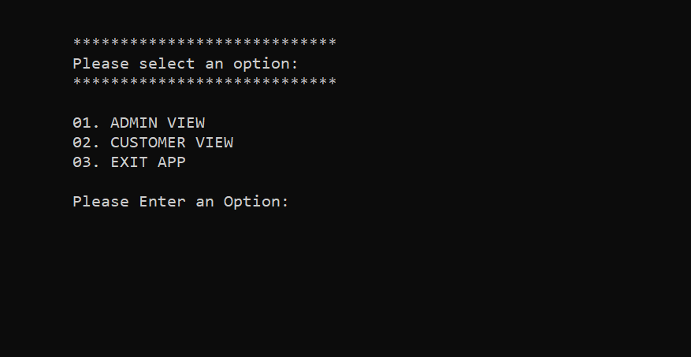
After 30 seconds:

Slide 12
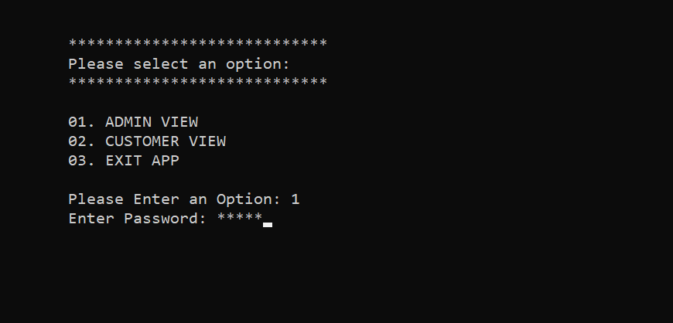
ADMIN VIEW
Enter Password:

Slide 13
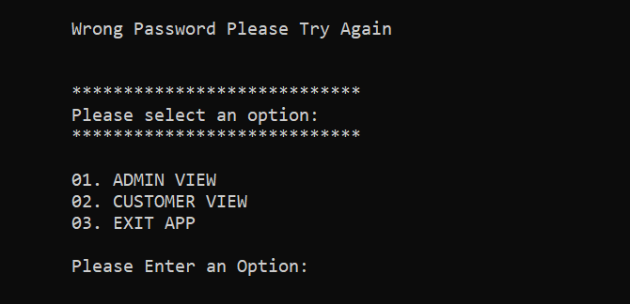
Incorrect Password:

Slide 14
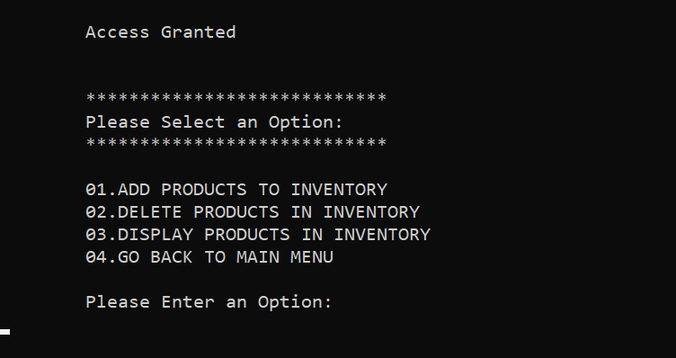
If valid password is entered, Admin Menu is opened:

Slide 15
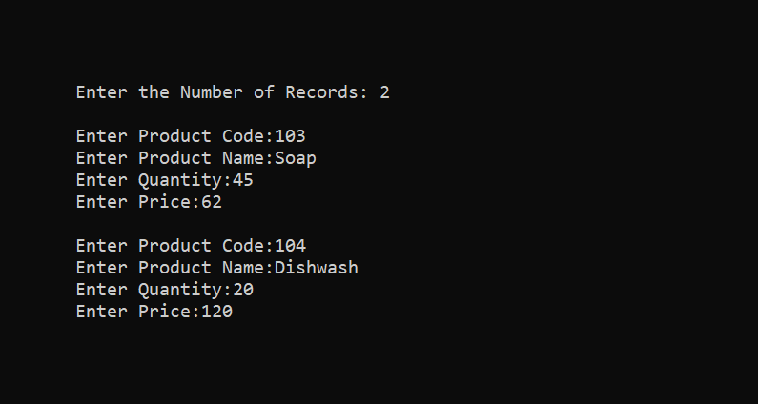
Add products in Inventory:

Slide 16
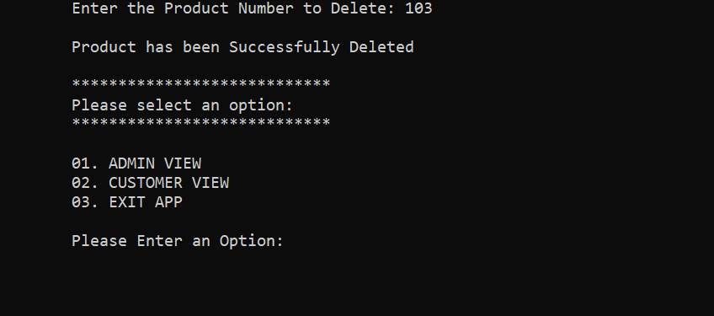
Delete products from Inventory:

Slide 17
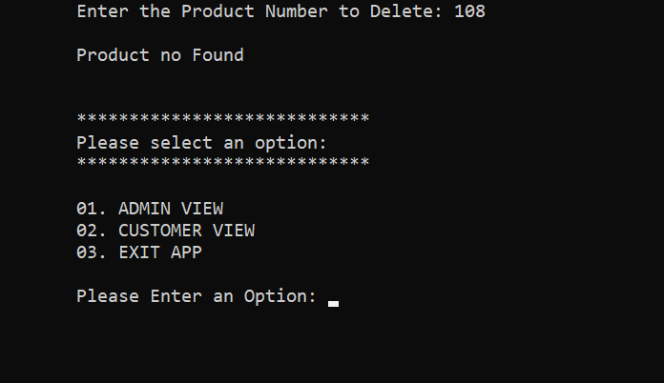
If wrong product id entered:

Slide 18
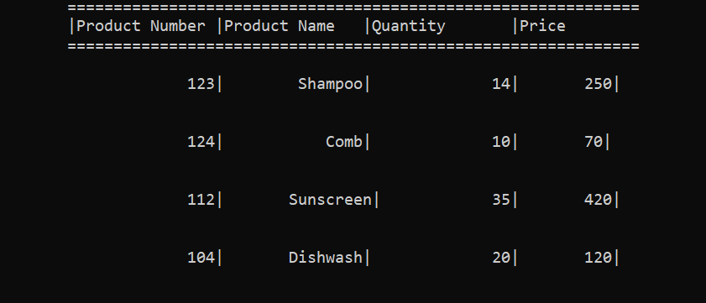
Show products in Inventory:

Slide 19
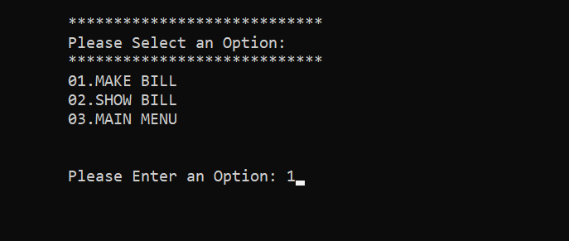
CUSTOMER VIEW
Customer Menu:

Slide 20
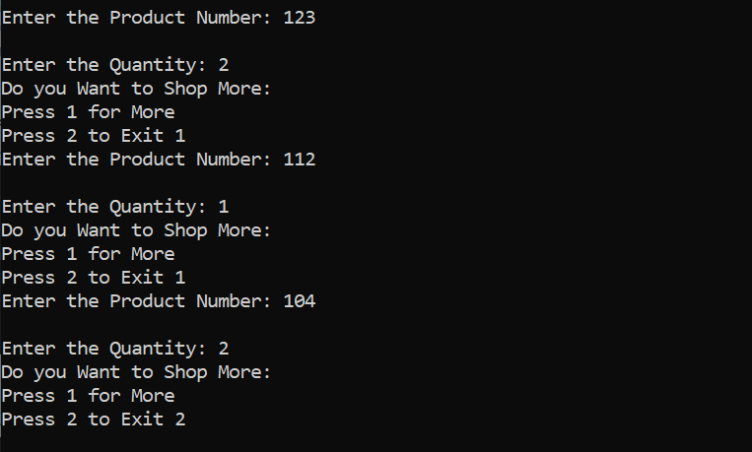
Make Bill:

Slide 21
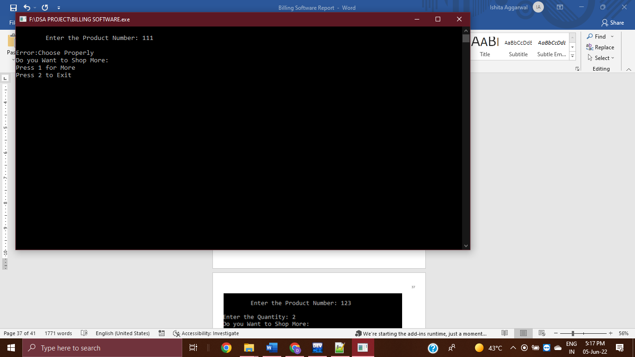
Incorrect product id in Make Bill:

Slide 22
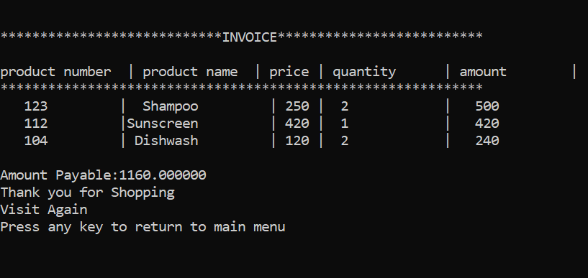
Show Bill:

Slide 23
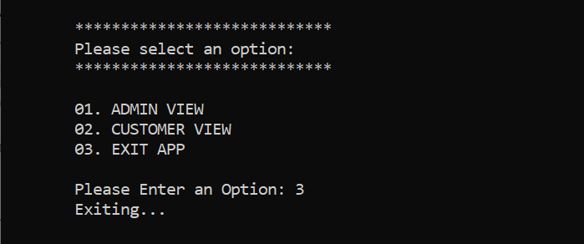
EXITING

Slide 24
FUTURE SCOPE
This billing system focus on the development of an information system that will automate manual transaction.
This project will help the store keeper in fast billing.
This project helps in keeping a close eye on the stock present in the Inventory.
This project will help the store keeper to check the availability of products and help the customers with it.

Slide 25
Advantages of using Arrays:
Code Optimization
Functionality
Index-Based data structure
Multi-dimensional
Memory Allocation
Multiple Uses

Slide 26
Disadvantages of Arrays:
Size is fixed
The problem in expansion
Memory wastage
Limitation of type of data
Operational limitation
Memory space

Slide 27
Thank You !

