Slide 1

Group Number : 5
Samriddhi Sahu - 202401100300213
Sanskriti Agrawal - 202401100300216
Ridhima Goyal - 202401100300198
Neha Yadav- 202401100300159
Mridula - 202401100300157
Project Topic : Stock Price Prediction

Slide 2

Project
Stock Price Prediction

Slide 3

Predicting stock prices is a significant challenge in the field of financial analytics due to the volatile and non-linear nature of the stock market. This project aims to develop a regression-based model to predict the next-day closing price of a stock using historical price data.
The model will be trained on historical stock data, which includes features like prev close, open, last traded price etc.
By the end of this project, we aim to not only predict next-day prices with reasonable accuracy but also provide meaningful insights into how regression techniques can be used in financial forecasting.
introduction
introduction

Slide 4
problem statement
problem statement
Stock Price Prediction
Project Question: Create a regression-based model to predict next-day stock prices from historical
data. Visualize trends and evaluate the model’s accuracy.

Slide 5
We developed a stock price prediction system using machine learning to forecast next-day closing prices.
Utilized Random Forest Regression for accurate predictions.
Designed a pipeline that handles data preprocessing, training, and evaluation.
Focused on key performance indicators: RMSE, MAE, R² Score, Directional Accuracy, and ±2% Tolerance Accuracy.
Delivered clear visual insights through performance plots and metric comparisons.
Enables data-driven decision making and helps assess stock movement trends effectively.
PITCH DECK PRESENTATION
our solutions
our solutions

Slide 6
Methodology
Methodology
Data Extraction: Unzipped and selected 7 stock CSV files.
Preprocessing: Parsed dates, selected key features, and created next-day Close as target.
Modeling: Trained Random Forest Regressor (80% train / 20% test split).
Evaluation Metrics:
RMSE, MAE, R² Score
Directional Accuracy (Up/Down)
±2% Tolerance Accuracy
Visualization:
Line plots (Actual vs Predicted)
Bar charts for metric comparison

Slide 7
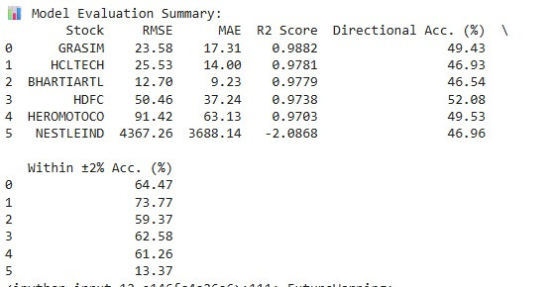
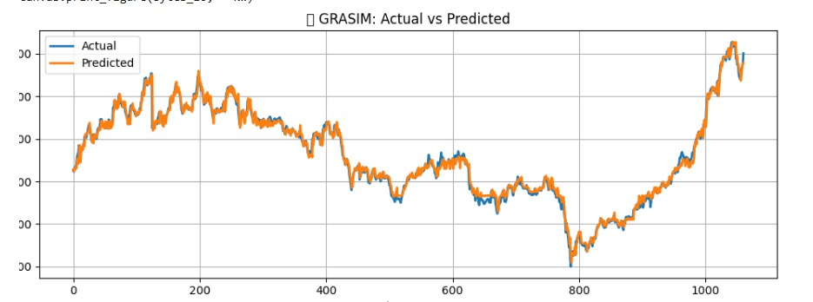
Results

Slide 8
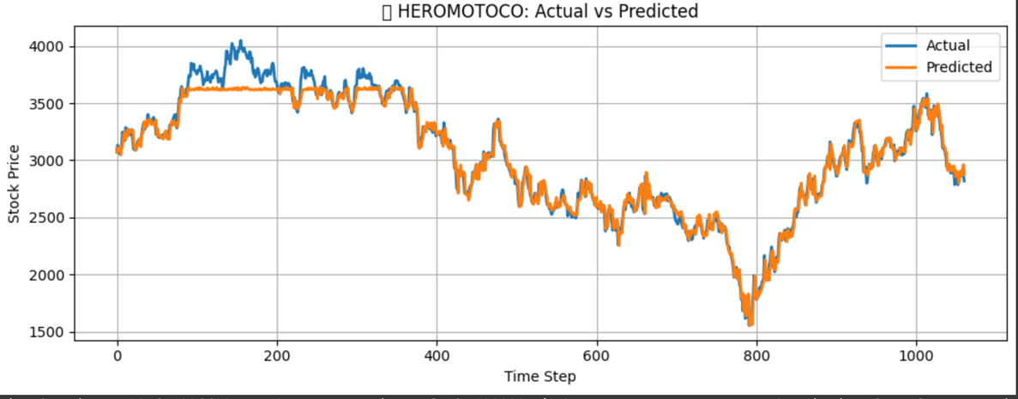
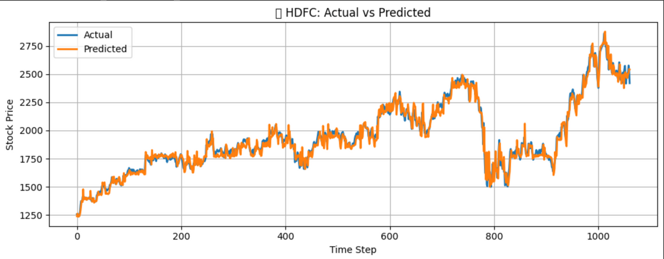
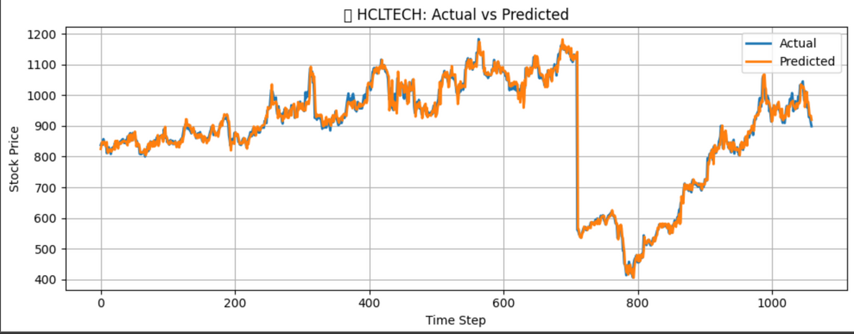
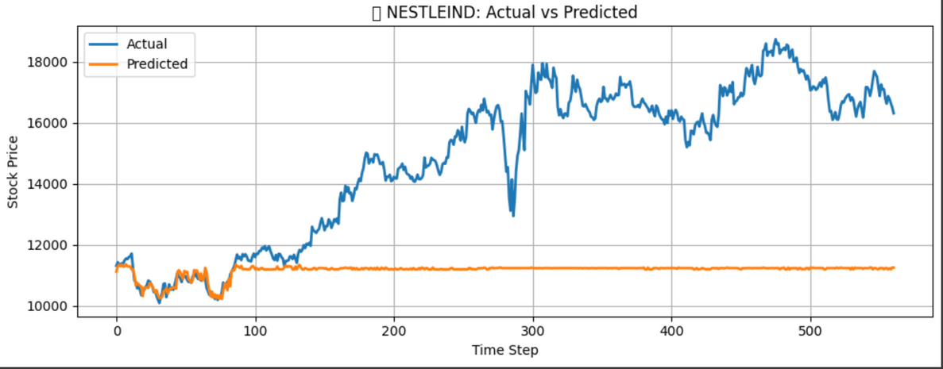
Results

Slide 9
References
www.kaggle.com
Developer
Refrences

Slide 10
Thank You
Thank
You

