Slide 1



salesreport
View in Power BI
Last data refresh:
12/27/2024 12:09:00 PM UTC
Downloaded at:
12/27/2024 12:22:44 PM UTC

Slide 2
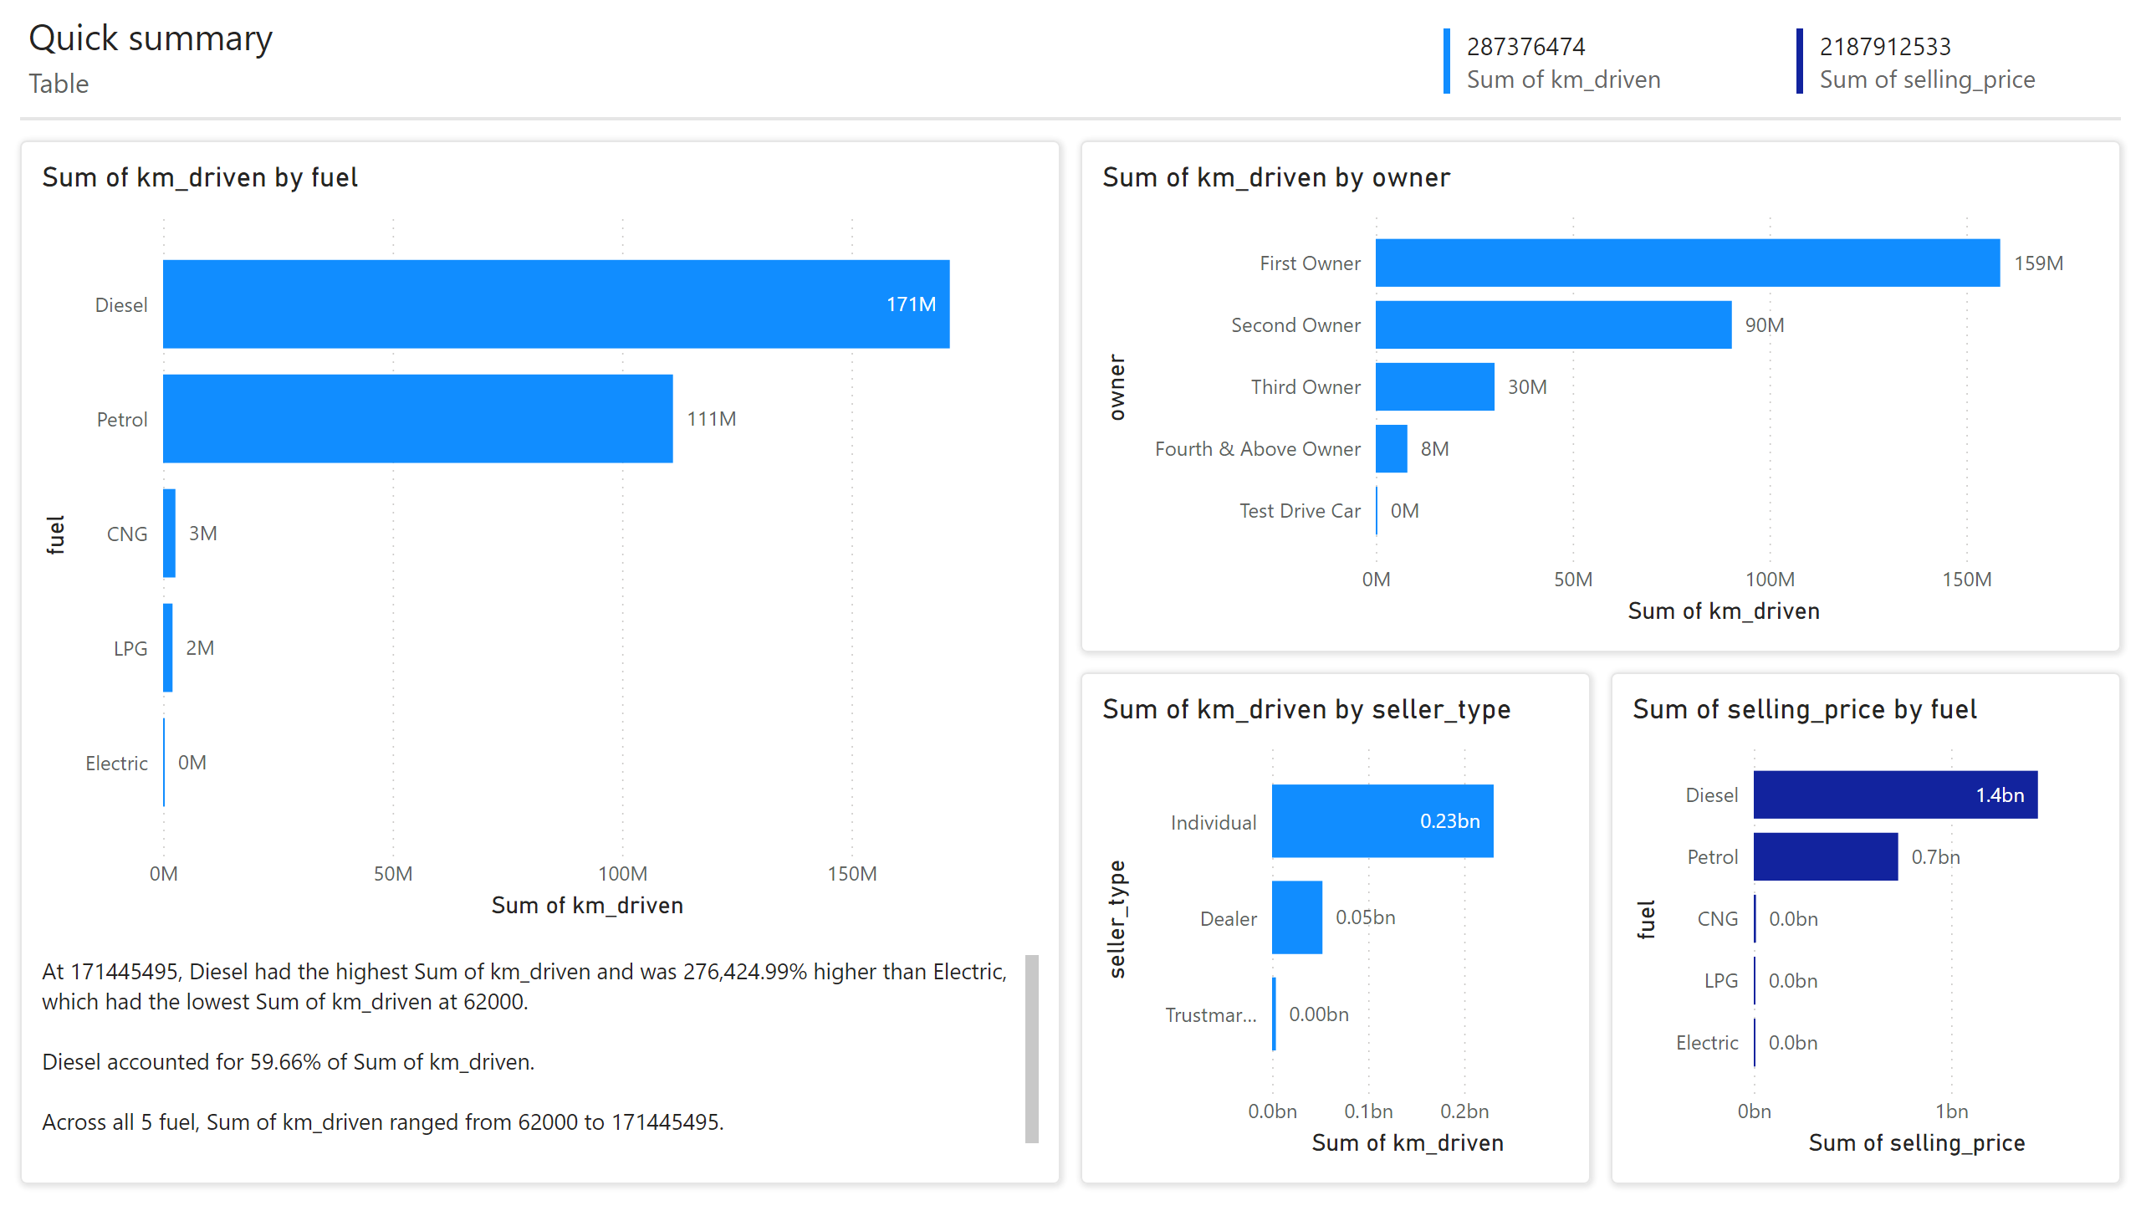
Page 1
Notes:
clusteredBarChart
No alt text provided
clusteredBarChart
No alt text provided
clusteredBarChart
No alt text provided
clusteredBarChart
No alt text provided
shape
No alt text provided
textbox
No alt text provided
shape
No alt text provided
shape
No alt text provided
shape
No alt text provided
textbox
No alt text provided
textbox
No alt text provided
multiRowCard
No alt text provided
multiRowCard
No alt text provided
shape
No alt text provided

