Slide 1
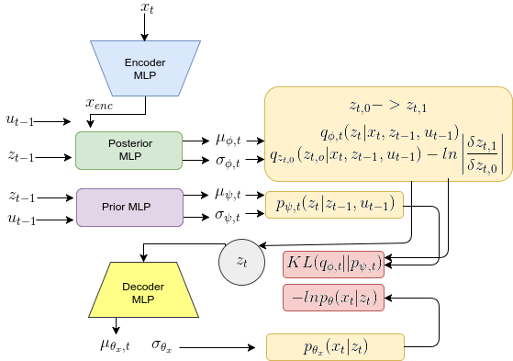
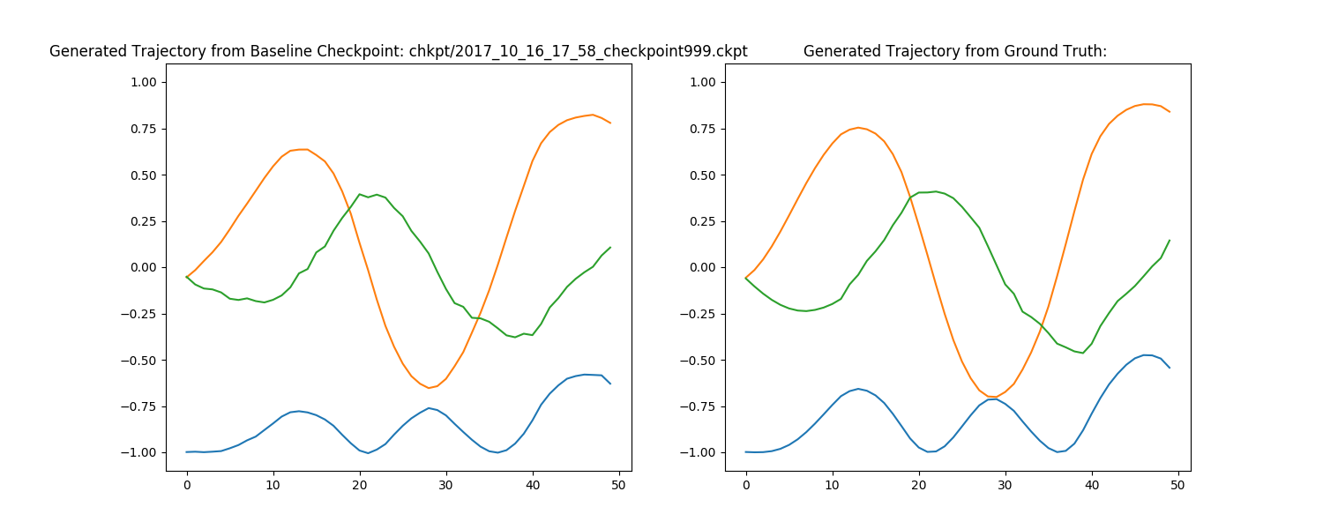
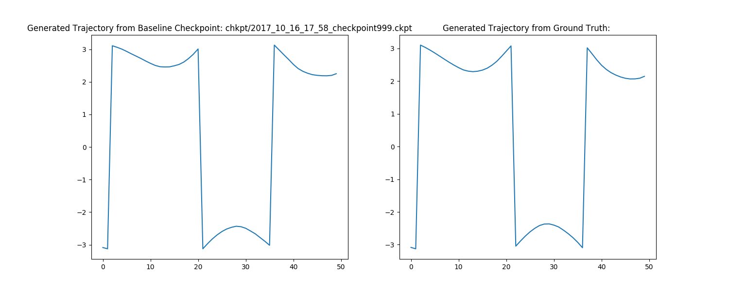
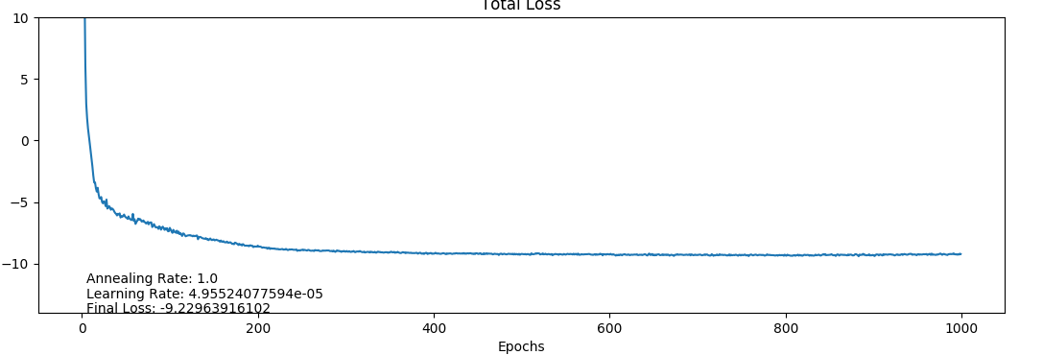
Architecture for Inserted IAF
Generated Trajectory from Inserted IAF
Generated Trajectory from Ground-Truth
Generated Trajectory from Inserted IAF
Generated Trajectory from Ground-Truth
Total Loss

