Slide 1

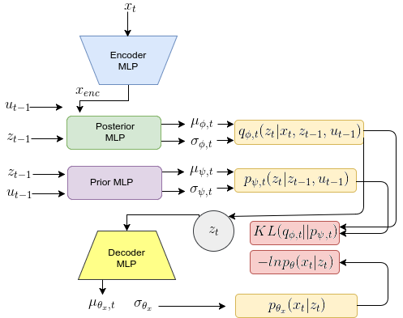
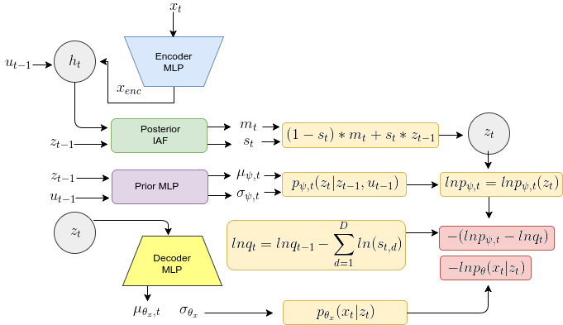




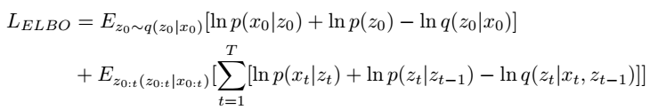
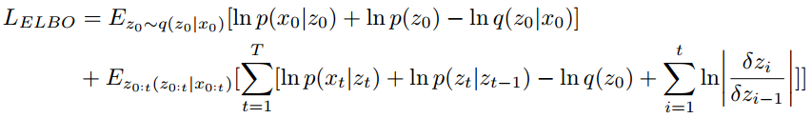


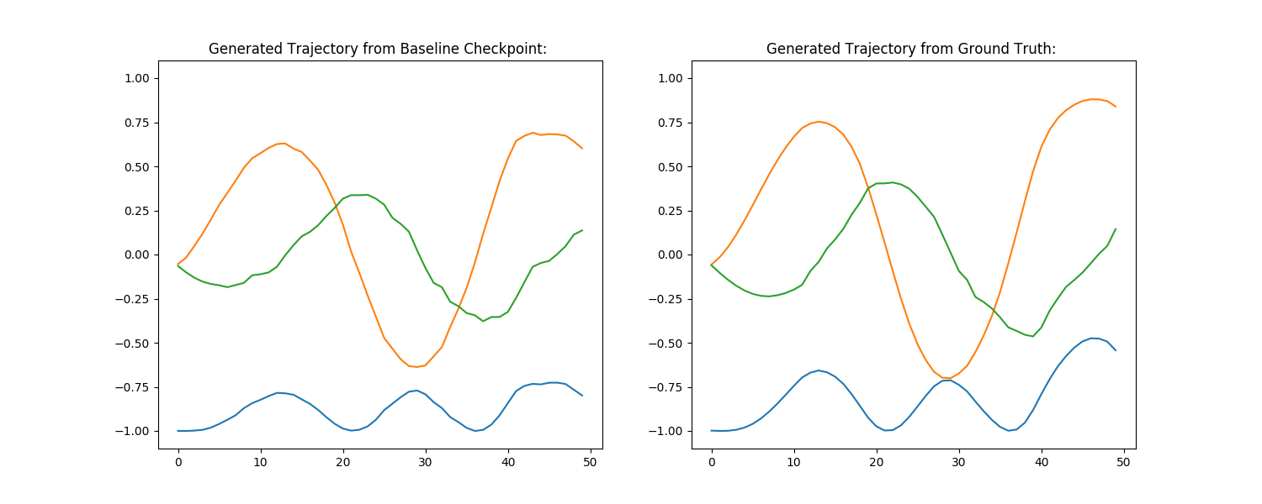
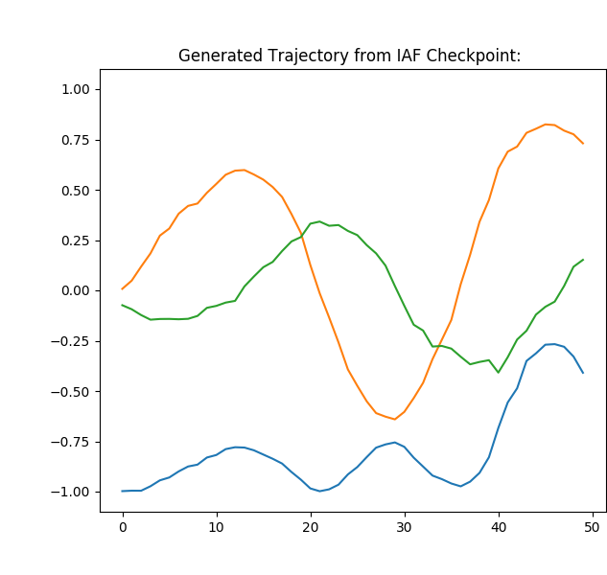



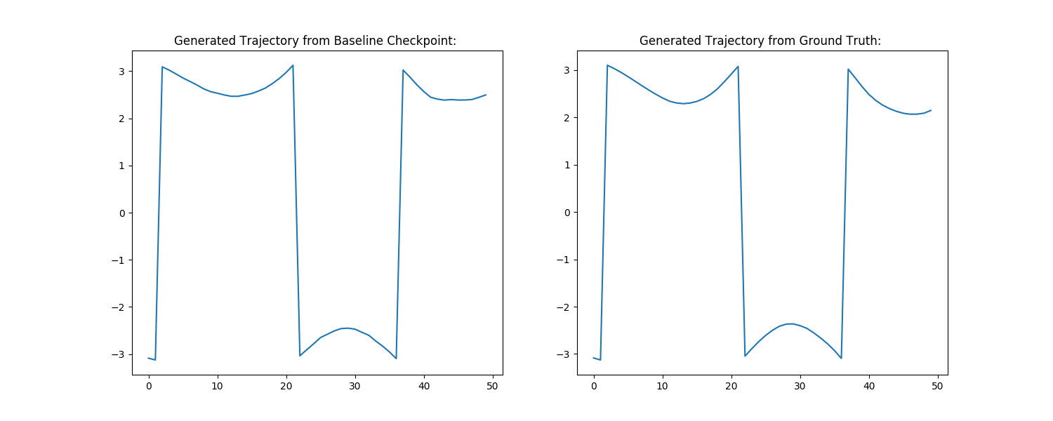
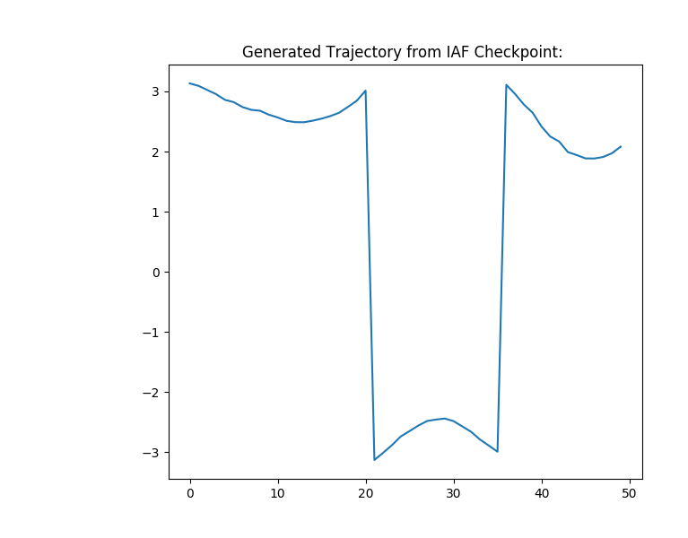






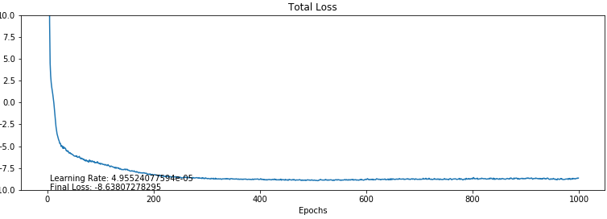
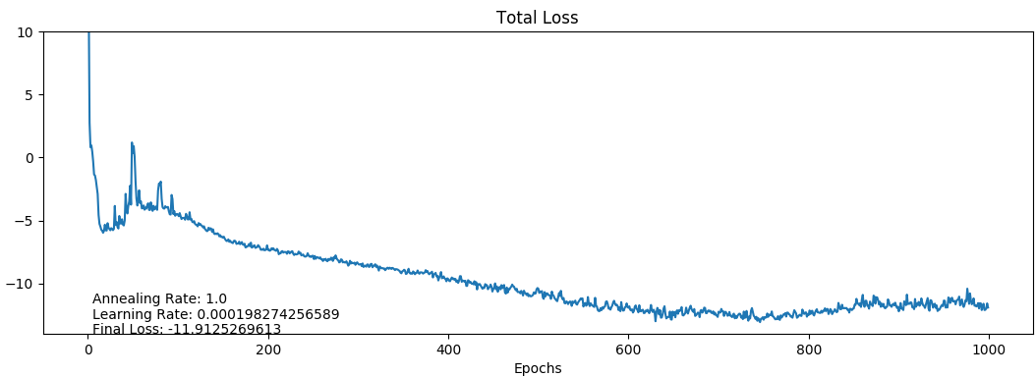

IAF AS A DISTRIBUTION OVER TRAJECTORIES
Presented by - Jakob Breuninger, Neha Das, Sumit Dugar
GOAL: MODELLING A DYNAMICAL SYSTEM MODEL
ARCHITECTURE
DATA AND TRAINING
We seek a probabilistic, latent dynamical system model, which given a sequence of controls and an initial latent state can generate a sequence of latent states and corresponding observations .
Such a model should maximize the probability of observing given under the assumption of an underlying latent dynamical system. This probability can be formalized with:
Baseline DVBF
IAF DVBF
We train and test our network on data generated from one of the classic conrol environments of OpenAIGym - “Pendulum-v0”.
  Training Set: 500 instances of 50 step trajectories
  Validation Set: 128 instances of 50 step trajectories
  Test Set: 128 instances of 50 step trajectories
Both the networks were trained for 1000 epochs with batch size 16. The initial learning rate for baseline was kept at 0.0005 and for IAF DBVF as 0.001
BASELINE DVBF
INSIGHTS
Our baseline network is a recurrent neural network inspired by the deep variational bayes filter.
In the interest of achieving the goal stated above, we require good long term predictions. This can be achieved, by enforcing a State Space Model (SSM) formulation in latent space. Thus we have:
and
Now, by applying the Variational Auto Encoder paradigm and replacing the bottleneck in the temporal autoencoder with stochastic units, we can train our model by attempting to maximize the variational lower bound (disregarding for simplicity):
The architecture of this model is shown in the adjoining section.
Difference in assumptions from baseline – In order to incorporate IAF model as we do, we had to assume that the distribution q is factorized in a manner different from the baseline.
  In Baseline:
  In our model:
However, this doesn’t conflict with our enforcement of a state space model in the latent space.
Annealing – In order to stabilize our training and ensure that the loss continues to decrease to negative values, we annealed the KL Loss over 600 epochs.
*
*
* disregarding for simplicity
* disregarding for simplicity
INVERSE AUTOREGRESSIVE FLOW
EXPERIMENTAL RESULTS
SETBACKS AND LIMITATIONS
With Normalizing Flows we can transform a computationally cheap posterior
q0(z0jx) k-times to be arbitrarily flexible (see Figure below), through invertible mappings zi = f (zi−1; x) [4]:
Generated Trajectory of Observations - Baseline
Trajectory of Observations – Ground Truth
Generated Trajectory of Observations – IAF DVBF
Close but not improved results – As you can see, while the generated trajectory is very close to the baseline, they are still slightly worse and do not improve upon them.
Negative KL Loss – Towards the middle of the training, the KL loss keeps on decreasing and turns negative, which is something that shouldn’t happen. This may indicate that there’s a flaw in our method.
The log-likelihood of the transformed posterior can be calculated through the change of variables theorem by summing up the determinant of the Jacobian of each transformation:
CONCLUSION
Inverse Autoregressive Flow (IAF) is a flexible type of normalizing flow that scales well to high dimensional latent spaces while remaining computational efficiency [2]. At each IAF step the latent variable is transformed with:
Generated Trajectory : Arctan - Baseline
Trajectory : Arctan – Ground Truth
Generated Trajectory : Arctan – IAF DVBF
Our method produces comparable (but slightly worse) results and needs only one sampling step per trajectory as opposed to one sampling step per time step, thus reducing the computational cost marginally. However, further investigation is needed for examining what goes wrong with the KL Loss.
Where are the output of an autoregressive neural network with the input
Due to the autoregressive property and are lower triangular & thus the Jacobian is a trivial sum:
REFERENCES
Maximilian Karl, Maximilian Soelch, Justin Bayer, Patrick van der Smagt, “Deep Variational Bayes Filters: Unsupervised Learning of State Space Models from Raw Data”, Proceedings of the International Conference on Learning Representations (ICLR), 2017
M. Germain, K. Gregor, I. Murray, and H. Larochelle, “MADE: masked autoencoder for distribution estimation”, CoRR, abs/1502.03509, 2015.
D. P. Kingma, T. Salimans, and M. Welling, “Improving variational inference with inverse autoregressive flow”, CoRR, abs/1606.04934, 2016.
D. P. Kingma and M. Welling, “Auto-encoding variational bayes”, CoRR, abs/1312.6114, 2013.
D. Rezende and S. Mohamed “Variational inference with normalizing flows”, In D. Blei and F. Bach, editors, Proceedings of the 32nd International Conference on Machine Learning (ICML-15), pages 1530–1538. JMLR Workshop and Conference Proceedings,
Mean absolute difference of the generated trajectory from ground truth : 0.1536
Mean absolute difference of the generated trajectory from ground truth : 0.1915
PROPOSAL
Total Loss - Baseline
Total Loss – IAF DBVF
We propose that Inverse Autoregressive Flow be incorporated in the transition of the latent state z through time. This modelling could be used for the posterior . Sampling a trajectory from an IAF transformed posterior would only require only one sample from an auxiliary
random variable instead of one per time step.

