Slide 1
Chapter - 11
Software Maintenance

Slide 2
Introduction
Software maintenance is an important activity, which keeps a system remain useful during its lifetime.
Maintenance is performed after the system is deployed at the customer site.
As the customer starts working on the system, the system and its parts may introduce defects.
Some new feature may be added/deleted to the system if the customer needs change.
Organizational operating environment and policies change from time to time, which causes a system to be transported or adapted to a new environment.

Slide 3
Introduction
Software maintenance is valuable to avoid software aging and to maintain the quality of software product.
Without software maintenance and evolution, system becomes complex and unreliable.
The cost of software change varies from project to project and with the types of changes.
A survey indicates that the software maintenance or change consumes 60–80% of the total life cycle cost.
Major software cost is incurred due to enhancement (75–80%) rather than correction.

Slide 4
Software Change
Lehman’s laws of software evolution state that a successful software product undergoes changes over time.
The main propose of change is to satisfy the changing needs of the user.
The change can be related to correcting faults, adapting to some new environment, or to completely changing the software system with a new platform.
Software change is inevitable in the organization.

Slide 5
Software change trends
Initial development
Evolution
Maintenance
Reengineering
Close down
Innovations
Servicing
Migration
Figure 11.1: Software change trend

Slide 6
Software Evolution
Evolution is inevitable for software systems.
Due to various reasons, software systems need to change. The Lehman believed that software is a tool to mechanise the real world.
He claimed that since the real world is dynamic, so the software should get changed and updated to be able to reflect the changes in the real world.
Software evolution is important to keep the software remain productive within a changing environment.
Evolvability is defined as the capability of software products to be evolved to continue to serve their customers in a cost-effective way.

Slide 7
Lehman's laws
Lehman's laws essentially describe software evolution as a force that is responsible for both driving new and/or revising the existing developments in a system.
Lehman offered eight laws after the survey of large systems.
All the laws relate to E-type systems.
E-type systems are the software systems that solve a problem or implement a computer application in the real world
Software concentrates more on quality issues, such as interoperability, portability, usability, reliability, and robustness; and it is sometimes referred to as industrial quality software

Slide 8
Lehman's laws for software evolution
Number | Name | Description
I | Continuing change | An E-type program that is used must be continually adapted else it becomes progressively less satisfactory.
II | Increasing complexity | As a program is evolved, its complexity increases unless work is done to maintain or reduce it.
III | Self-regulation | The program evolution process is self-regulating with closeness to normal distribution of measures of product and process attributes.
IV | Conservation of organizational stability (invariant work rate) | The average effective global activity rate on an evolving system is invariant over the product lifetime.
V | Conservation of familiarity | During the active life of an evolving program, the content of successive releases is statistically invariant.
VI | Continuing growth | Functional content of a program must be continually increased to maintain user satisfaction over its lifetime.
VII | Declining quality | Software programs will be perceived of declining quality unless rigorously maintained and adapted to a changing operational environment.
VIII | Feedback system | E-type programming processes constitute multi-loop, multi-level feedback systems and they must be treated as such to be successfully modified or improved.

Slide 9
Software Maintenance
IEEE defines, “software maintenance is the process of modifying a software system or component after delivery to correct faults, improve performances, or other attributes; or adapt to a changed environment.”
The main purpose of maintenance is to keep the system up and running after delivery.
Pigoski states, “Software maintenance is the totality of activities required to provide cost-effective support to a software system. Activities are performed during the pre-delivery stage as well as the post-delivery stage. Pre-delivery activities include planning for post-delivery operations, supportability, and logistics determination. Post-delivery activities include software modification, training, and operating a helpdesk

Slide 10
Categories of Maintenance
Corrective maintenance
fixing defects or failures
Adaptive maintenance
changes due to operating environment changes
Perfective maintenance
improve performance or maintainability
Preventive maintenance
update the software in anticipation of any future problems
Emergency maintenance
repair or replacement of facility components or equipment requiring immediate attention

Slide 11
Maintenance Process Models
The process models organize maintenance into a sequence of related activities, or phases, and define the order in which these phases are to be executed.
Some models are:
Quick-Fix Model
Osborne’s Model
Iterative-Enhancement Model
Full-Reuse Model
IEEE 1219 model
ISO-12207 model

Slide 12
Quick-Fix Model
The quick-fix model is an ad hoc approach to the maintenance
Its approach is to work on the code first and then make necessary changes to the accompanying documentation
The idea is to identify the problem and fix it as early as possible.
After the code has been changed, it may affect requirement, design, testing; and any other form of available documents impacted by the modification should be updated.
Due to time constraint, this model does not pay attention to the long-term effects.
Changes are often made without proper planning, design, impact analysis, and regression testing.
Also, repeated changes may demolish the original design, thus making future modifications progressively more expensive to carry out.

Slide 13
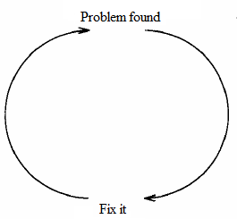
Quick-Fix Model

Slide 14
Osborne’s Model
The Osborne’s model is concerned with the reality of the maintenance environment.
This model assumes that the technical problems that arise during maintenance are due to poor communication between and control of the management.
According to the Osborne strategies, maintenance requirements need to be included in the change specification; a quality assurance program is required to establish quality assurance requirements, and a metrics needs to be developed in order to verify that the maintenance goals have been met.

Slide 15
Iterative-Enhancement Model
This model considers that making changes in a system throughout its lifetime is an iterative process.
The iterative-enhancement model assumes that the requirements of a system cannot be gathered and fully understood initially.
The system is to be developed in builds. Each build completes, corrects, and refines the requirements of the previous builds based on the feedback of users.
The construction of a build in the iteration (i.e., maintenance) begins with the analysis of the existing system’s requirements, design, code, and test; and continues with the modification of the highest-level document affected by changes..

Slide 16
Iterative-Enhancement Model
A key advantage of the iterative-enhancement model is that documentation is kept updated as the code changes.
The iterative-enhancement model keeps the system maintainable as compared to the quick-fix model.
Also, the maintenance changes are faster in iterative-enhancement .
This model is observed to be ineffective if there is unavailability of complete documentation.
The iterative-enhancement model is well suited for systems that have a long life and evolve over time.

Slide 17
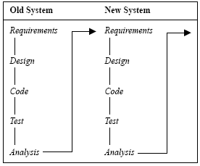
Iterative-Enhancement Model

Slide 18
Full-Reuse Model
Here, maintenance is considered as reuse-oriented software development, where reusable components are used for maintenance and replacements for faulty components.
It begins with requirements analysis and design of a new system and reuses the appropriate requirements, design, code, and tests from the earlier versions of the existing system.
The reuse repository plays an important role in the full-reuse model.
It also promotes the development of more reusable components.

Slide 19
Full-Reuse Model
Old system
New system
Reuse repository
Requirement analysis
Requirement analysis
Design
Design
Source code
Source code
Test data
Test data
The full-reuse model

Slide 20
Full-Reuse Model
The full-reuse model is more suited for the development of lines of related products.
This model takes some initial cost to institutionalize the reuse environment.
The full-reuse model is especially important for the maintenance of component-based systems or reengineering-type projects that are to be migrated onto a component-based platform.

Slide 21
IEEE 1219 Model
The IEEE standard organizes the maintenance process in seven phases.
The phases are classification and identification, analysis, design, implementation, system test, acceptance test, and delivery.
Initially, modification requests are generated by the user, customer, programmer, or the manager of the maintenance team.

Slide 22
IEEE 1219 Model
Analysis
Impleme-ntation
Acceptan-ce test
Delivery
Classific-ation and identification
Design
System test
Modification request

Slide 23
ISO-12207 Model
The ISO-12207 standard organizes the maintenance process in six phases.
The phases are process implementation, problem and modification analysis, modification implementation, maintenance review/acceptance, migration, and software retirement.
Initially, modification requests are generated by the user, customer, programmer, or the manager of the maintenance team.

Slide 24
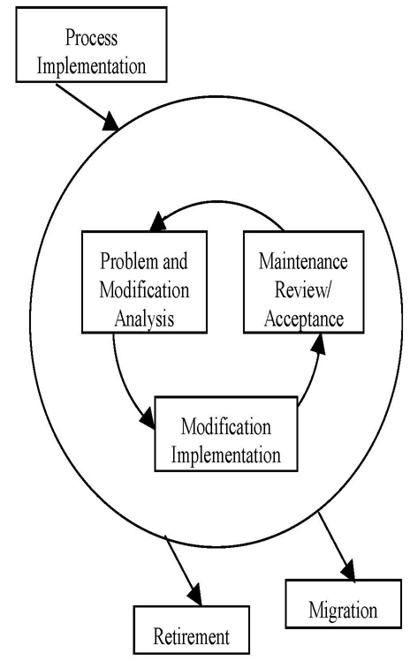
ISO-12207 Model

Slide 25
Maintenance cost
The maintenance cost can be reduced if the defects are taken care of in earlier phases of development.
The maintenance cost varies from application to application.
Initially, modification requests are generated by the user, customer, programmer, or the manager of the maintenance team.
Berry Boehm has proposed a formula, ACT, for estimating the maintenance cost as part of the COCOMO estimation model.
ACT is defined as “the fraction of a software product’s source instructions which undergoes change during a year through addition, deletion, or modification.”

Slide 26
Maintenance cost
ACT is related to the number of change requests as follows:
KLOC_{added} + KLOC_{deleted}
ACT = KLOC_{total}
Where KLOC_{added} is the total lines of code added during maintenance. KLOC_{deleted} is the total lines of code deleted during maintenance.
The maintenance effort in person-months can be calculated as follows:
Maintenance effort = ACT x Development effort
Software projects have different characteristics. The maintenance effort varies from project to project.
Therefore, effort adjustment factors (EAF) are considered for accurate estimation of the maintenance effort. Considering EAFs, the maintenance effort is calculated as follows:
Maintenance effort = ACT x Development x EAF

Slide 27
Why is Reengineering?
In legacy systems, the following symptoms are observed:
Poor documentation or its nonexistence
Complexity of the code and program structure
Inability to satisfy customer requirements
Low business value
Obsolete technology
High maintenance cost
High frequency of occurrences of failures
Constant need to update and renovate the system
Feel obsolete to operate due to aging

Slide 28
What is Reengineering?
Continuous maintenance of these systems becomes tedious and the cost approaches to the business cost.
These systems are too difficult to maintain and enhance continuously and are too important to be discarded because old systems have a high business value.
One possible solution for legacy systems is to transform them onto a modern platform to meet the defined quality goals. Hence, reengineering becomes more and more important.
“Reengineering is the process of analyzing and representing a subject system at a higher level of abstraction to reconstitute it into a form and the subsequent implementation of the new form.”

Slide 29
What is Reengineering?
The reengineering process involves the following activities for managing reengineering projects:
Reengineering team formation
Inventory analysis
Project feasibility, preliminary investigation, and verification of the existing artifacts
Program comprehension
Reengineering requirements analysis
Planning for reengineering
Acquiring, instantiating, modifying, and integrating reusable assets
Reverse engineering and forward engineering
Preparing test plan, test cases, and test data
Testing of reengineered system
Redocumentation

Slide 30
What is Reengineering?
Reengineering = Reverse engineering + ∆ + Forward engineering
Where ∆ represents the changes made in the candidate system. The reengineering process represents the candidate system at a very high level of representation through reverse

Slide 31
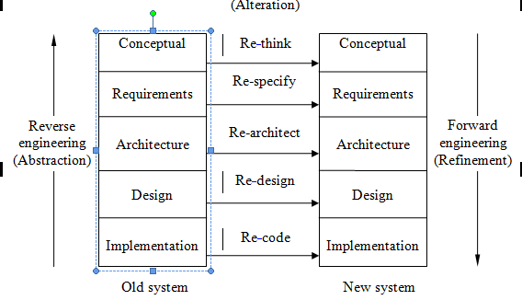
Reengineering Process

Slide 32
Reengineering Activities
Reverse engineering
Forward engineering
Program comprehension
Restructuring
Design recovery
Re-documentation

Slide 33
Reverse Engineering
Reverse engineering is the process of recovering the design specifications of an existing business system from its implementation and representing it at a much higher level of abstraction .
Reverse engineering techniques can be performed to extract data, architecture, design information, and content of a procedural system.
Reverse engineering techniques provide the means for recovering the lost information and developing alternative representations of a system, such as generation of structure charts, dataflow diagrams, entity-relationship diagrams, etc.

Slide 34
Reverse Engineering
Software artifacts
Parsing and analysis
Restructuring
Extract abstractions
Refine and simplify
Requirement specifications

Slide 35
Forward Engineering
Once reverse engineering has been performed and all important artifacts have been recovered, forward engineering is performed.
Forward reengineering is the traditional process of moving from high-level abstraction using logical design to physical implementation.
Forward engineering moves from a higher-level abstract representations and design details to implementation level of the system.
Design details such as object models, use case diagrams, pseudo codes, etc., can be converted to object-oriented programming languages.

Slide 36
Program Comprehension
Program comprehension is an essential part of software evolution and software maintenance.
Software that is not comprehended cannot be changed.
Frequently in program comprehension the programmer understands domain concepts, but not the code. The knowledge of domain concepts is based on program use and therefore it is easier to acquire than knowledge of the code.
Program comprehension is the root of the reverse engineering process. It is the process of acquiring or extracting knowledge about the software artifacts such as code, design, document, etc.

Slide 37
Restructuring
Restructuring transforms the system from one representation form to another at the same level of abstraction.
Restructuring modifies the code and data that are adaptable to future changes. It preserves semantics and functionality between the new and old representations.
Mainly, it has two major aspects, namely, code restructuring and data restructuring.
Code restructuring produces designs with higher quality than the existing one.
Data restructuring is performed to extract the data items and objects to understand data flow and the existing data structure.

Slide 38
Design Recovery
Design recovery recreates design abstractions from a combination of code, existing design documentation, personal experience, and general knowledge about problem and application domains.
The recovered design abstractions must include conventional software engineering representations such as formal specifications, module breakdowns, data abstractions, data flows, and program description language.
Design recovery is performed across a spectrum of activities from software development to maintenance.
A key objective of design recovery is to develop structures that will help the software engineer to understand a software system.

Slide 39
Re-documentation
Re-documentation is the process of creating a semantically equivalent representation at the corresponding levels of abstraction.
In this aspect, system documents are updated/rewritten/replaced to document the target system.
Various documents that may be affected in legacy software include requirement specifications, design and implementation, design decision report, configuration, data dictionary, user and reference manuals, and the change document.
The process of re-documentation is similar to reverse engineering activities.

Slide 40
Summary
Software change is performed to correct faults, adapt to some new environment, or to completely change the software system by implementing it onto a new platform.
Software maintenance is the process of modifying a software system or component after delivery to correct faults, improve performance or other attributes, or adapt to a changed environment.
The main categories of software maintenance are corrective, adaptive, perfective, preventive, and emergency maintenance.
The most widely used maintenance models are the quick-fix model, iterative-enhancement model, full-reuse model, Osborne’s model, IEEE 1219, and ISO-12207 model.
Reengineering makes the system more understandable, makes the maintenance task easier, and enhances the reusability and quality of the software product.
It involves various activities such as reverse engineering, forward engineering, program comprehension, restructuring, design recovery, and re-documentation.

