Slide 1

CHAPTER 7:
ADVANCED SQL
Modern Database Management
11th Edition
Jeffrey A. Hoffer, V. Ramesh,
Heikki Topi
© 2013 Pearson Education, Inc. Publishing as Prentice Hall

Slide 2
OBJECTIVES
Define terms
Write single and multiple table SQL queries
Define and use three types of joins
Write noncorrelated and correlated subqueries
Understand and use SQL in procedural languages (e.g. PHP, PL/SQL)
Understand triggers and stored procedures
Discuss SQL:2008 standard and its enhancements and extensions

Slide 3
PROCESSING MULTIPLE TABLES
Join–a relational operation that causes two or more tables with a common domain to be combined into a single table or view
Equi-join–a join in which the joining condition is based on equality between values in the common columns; common columns appear redundantly in the result table
Natural join–an equi-join in which one of the duplicate columns is eliminated in the result table
The common columns in joined tables are usually the primary key of the dominant table and the foreign key of the dependent table in 1:M relationships.

Slide 4
PROCESSING MULTIPLE TABLES
Outer join–a join in which rows that do not have matching values in common columns are nonetheless included in the result table (as opposed to inner join, in which rows must have matching values in order to appear in the result table)
Union join–includes all columns from each table in the join, and an instance for each row of each table

Slide 5
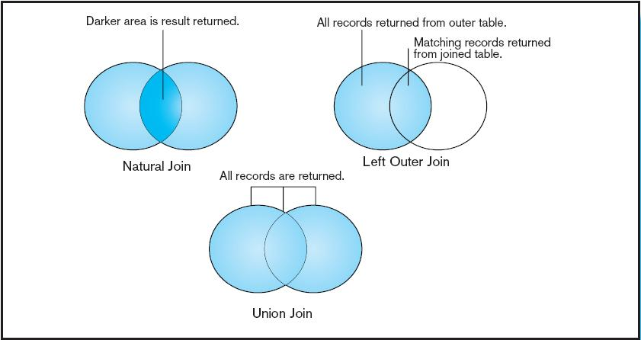
Figure 7-2
Visualization of different join types with results returned in shaded area

Slide 6
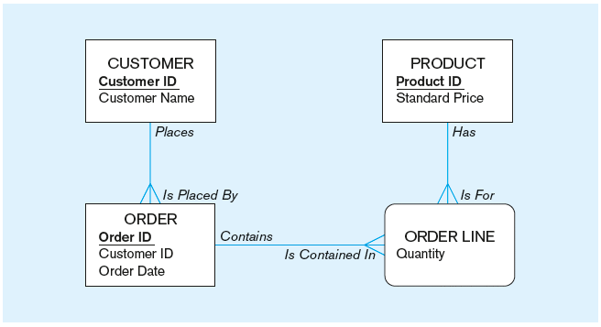
THE FOLLOWING SLIDES CREATE TABLES FOR THIS ENTERPRISE DATA MODEL
(from Chapter 1, Figure 1-3)

Slide 7
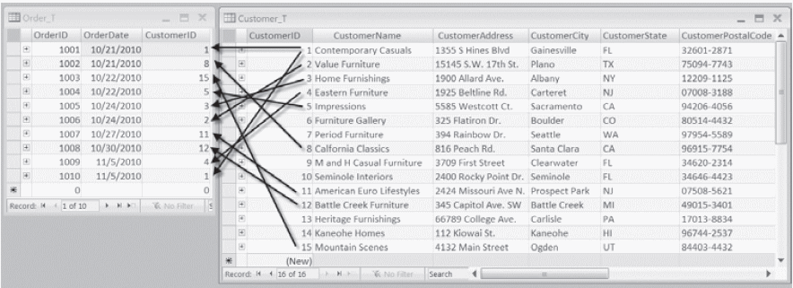
Figure 7-1 Pine Valley Furniture Company Customer_T and Order_T tables with pointers from customers to their orders
These tables are used in queries that follow
Chapter 7
© 2013 Pearson Education, Inc. Publishing as Prentice Hall

Slide 8
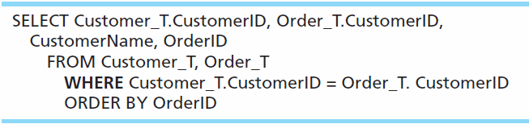
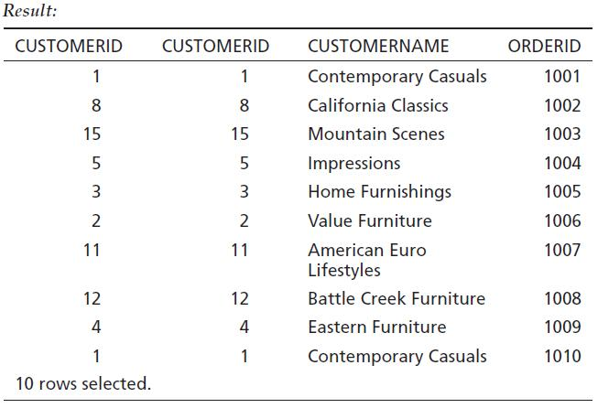
EQUI-JOIN EXAMPLE
For each customer who placed an order, what is the customer’s name and order number?
Customer ID appears twice in the result

Slide 9
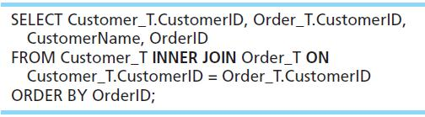
EQUI-JOIN EXAMPLE – ALTERNATIVE SYNTAX
INNER JOIN clause is an alternative to WHERE clause, and is used to match primary and foreign keys.
An INNER join will only return rows from each table that have matching rows in the other.
This query produces same results as previous equi-join example.

Slide 10
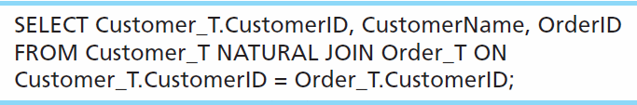
NATURAL JOIN EXAMPLE
For each customer who placed an order, what is the customer’s name and order number?
Join involves multiple tables in FROM clause
ON clause performs the equality check for common columns of the two tables
Note: From Fig. 7-1, you see that only 10 Customers have links with orders.
➔ Only 10 rows will be returned from this INNER join

Slide 11
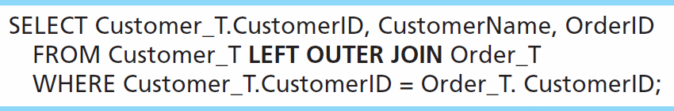
OUTER JOIN EXAMPLE
List the customer name, ID number, and order number for all customers. Include customer information even for customers that do have an order.
LEFT OUTER JOIN clause causes customer data to appear even if there is no corresponding order data
Unlike INNER join, this will include customer rows with no matching order rows

Slide 12
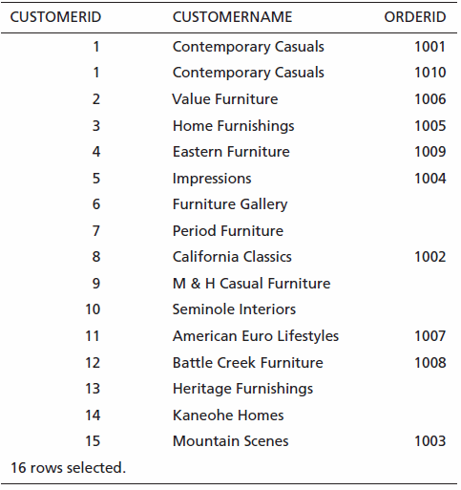
Outer Join Results
Unlike INNER join, this will include customer rows with no matching order rows
Chapter 7
© 2013 Pearson Education, Inc. Publishing as Prentice Hall

Slide 13
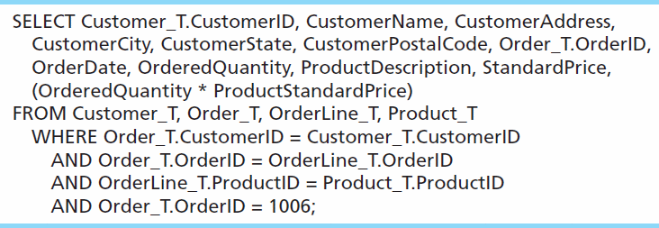
MULTIPLE TABLE JOIN EXAMPLE
Assemble all information necessary to create an invoice for order number 1006
Four tables involved in this join
Each pair of tables requires an equality-check condition in the WHERE clause, matching primary keys against foreign keys.

Slide 14
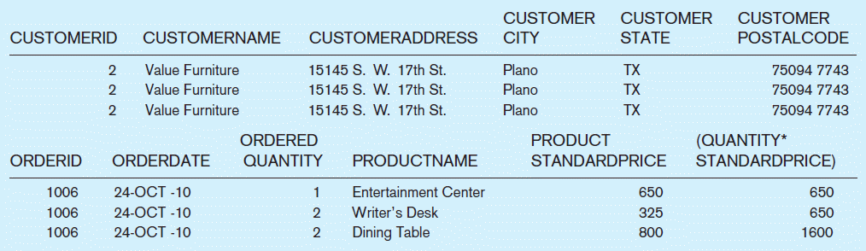
Figure 7-4 Results from a four-table join (edited for readability)
From CUSTOMER_T table
From ORDER_T table
From PRODUCT_T table

Slide 15
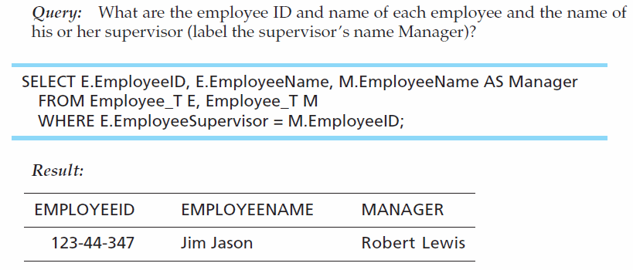
SELF-JOIN EXAMPLE
The same table is used on both sides of the join; distinguished using table aliases
Self-joins are usually used on tables with unary relationships.

Slide 16
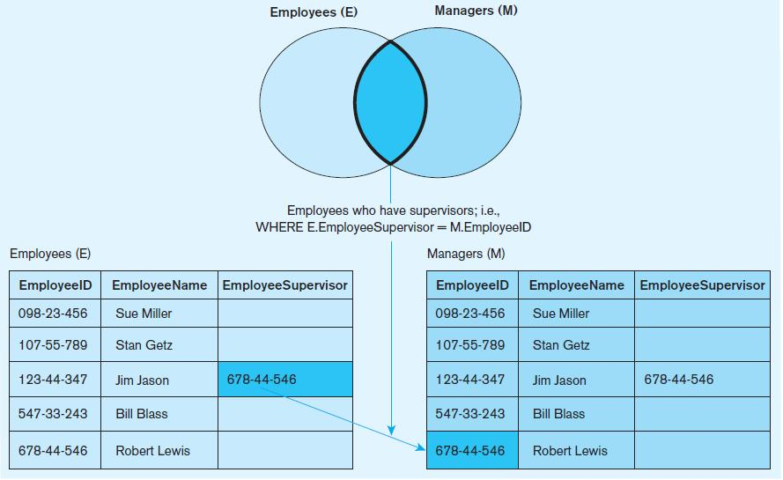
Figure 7-5 Example of a self-join

Slide 17
PROCESSING MULTIPLE TABLES
USING SUBQUERIES
Subquery–placing an inner query (SELECT statement) inside an outer query
Options:
  In a condition of the WHERE clause
  As a “table” of the FROM clause
  Within the HAVING clause
Subqueries can be:
  Noncorrelated–executed once for the entire outer query
  Correlated–executed once for each row returned by the outer query

Slide 18
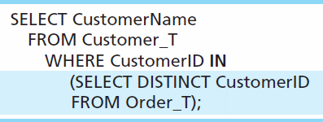
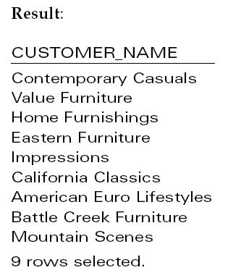
SUBQUERY EXAMPLE
Show all customers who have placed an order
The IN operator will test to see if the CUSTOMER_ID value of a row is included in the list returned from the subquery
Subquery is embedded in parentheses. In this case it returns a list that will be used in the WHERE clause of the outer query

Slide 19
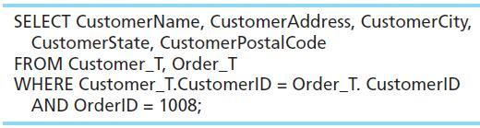
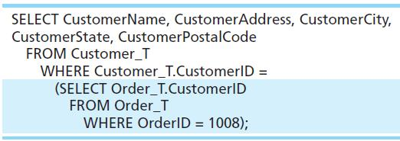
JOIN VS. SUBQUERY
Some queries could be accomplished by either a join or a subquery
Join version
Subquery version

Slide 20
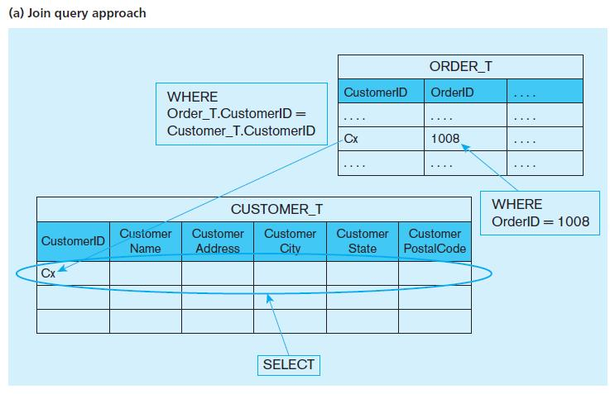
Figure 7-6 Graphical depiction of two ways to answer a query with different types of joins

Slide 21
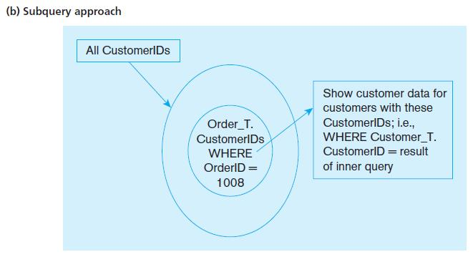
Figure 7-6 Graphical depiction of two ways to answer a query with different types of joins

Slide 22
CORRELATED VS. NONCORRELATED SUBQUERIES
Noncorrelated subqueries:
  Do not depend on data from the outer query
  Execute once for the entire outer query
Correlated subqueries:
  Make use of data from the outer query
  Execute once for each row of the outer query
  Can use the EXISTS operator

Slide 23
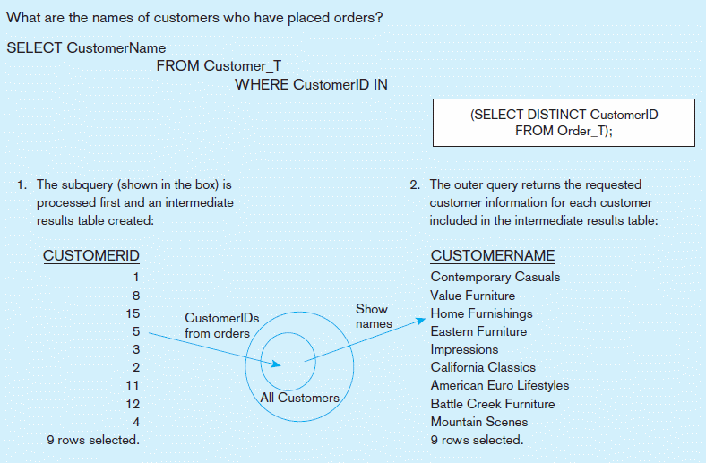
Figure 7-8a Processing a noncorrelated subquery
A noncorrelated subquery processes completely before the outer query begins.
Chapter 7
© 2013 Pearson Education, Inc. Publishing as Prentice Hall

Slide 24
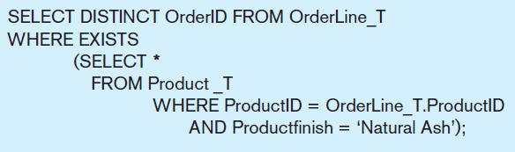
CORRELATED SUBQUERY EXAMPLE
Show all orders that include furniture finished in natural ash.
The EXISTS operator will return a TRUE value if the subquery resulted in a non-empty set, otherwise it returns a FALSE
➔ A correlated subquery always refers to an attribute from a table referenced in the outer query
The subquery is testing for a value that comes from the outer query

Slide 25
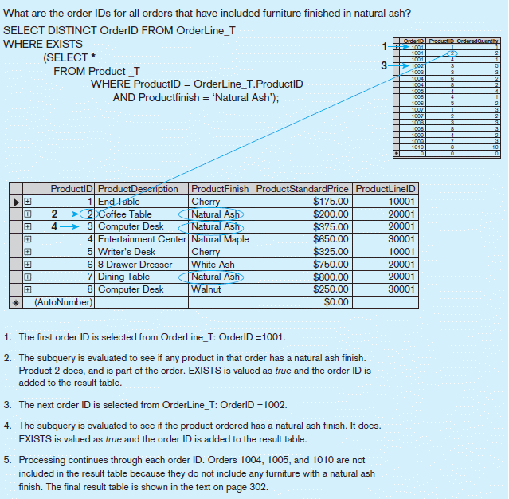
Figure 7-8b Processing a correlated subquery
Subquery refers to outer-query data, so executes once for each row of outer query
Note: Only the orders that involve products with Natural Ash will be included in the final results.
Chapter 7
© 2013 Pearson Education, Inc. Publishing as Prentice Hall

Slide 26
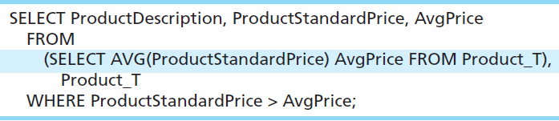
ANOTHER SUBQUERY EXAMPLE
Show all products whose standard price is higher than the average price
One column of the subquery is an aggregate function that has an alias name. That alias can then be referred to in the outer query.
Subquery forms the derived table used in the FROM clause of the outer query
The WHERE clause normally cannot include aggregate functions, but because the aggregate is performed in the subquery its result can be used in the outer query’s WHERE clause.

Slide 27
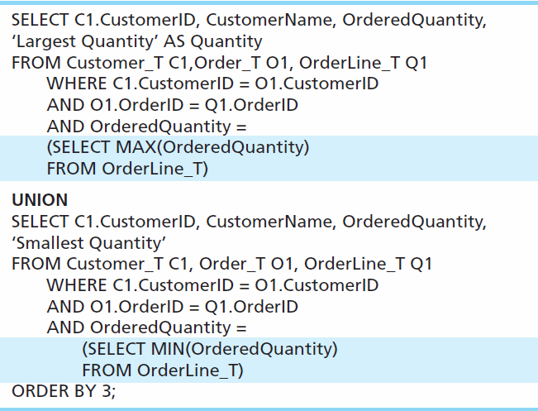
UNION QUERIES
Combine the output (union of multiple queries) together into a single result table
First query
Combine
Second query

Slide 28
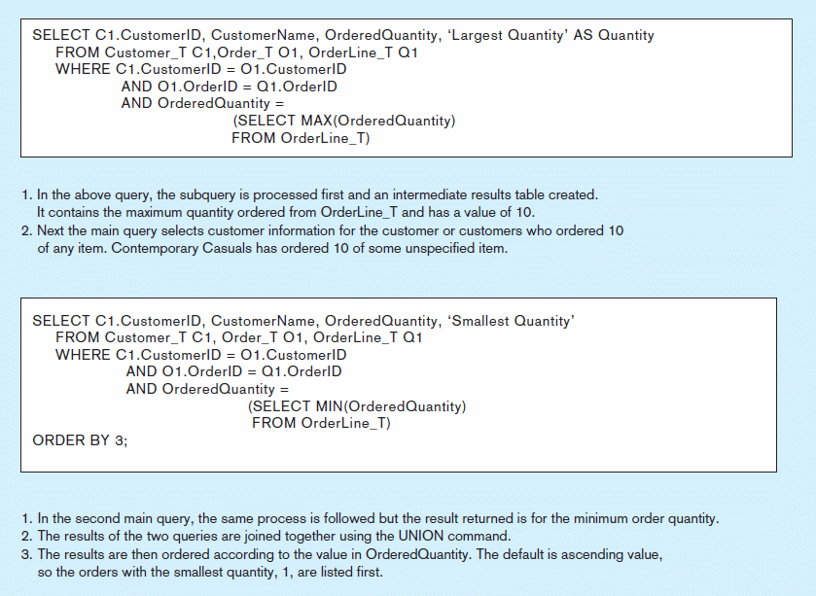
Figure 7-9 Combining queries using UNION
Note: With UNION queries, the quantity and data types of the attributes in the SELECT clauses of both queries must be identical.
Chapter 7
© 2013 Pearson Education, Inc. Publishing as Prentice Hall

Slide 29
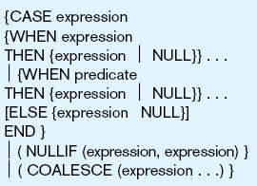
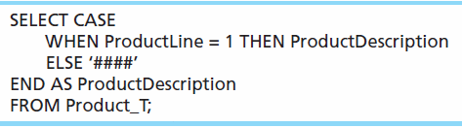
CONDITIONAL EXPRESSIONS USING CASE SYNTAX
This is available with newer versions of SQL, previously not part of the standard
Figure 7-10

Slide 30
TIPS FOR DEVELOPING QUERIES
Be familiar with the data model (entities and relationships)
Understand the desired results
Know the attributes desired in results
Identify the entities that contain desired attributes
Review ERD
Construct a WHERE equality for each link
Fine tune with GROUP BY and HAVING clauses if needed
Consider the effect on unusual data

Slide 31
QUERY EFFICIENCY CONSIDERATIONS
Instead of SELECT *, identify the specific attributes in the SELECT clause; this helps reduce network traffic of result set
Limit the number of subqueries; try to make everything done in a single query if possible
If data is to be used many times, make a separate query and store it as a view

Slide 32
GUIDELINES FOR BETTER QUERY DESIGN
Understand how indexes are used in query processing
Keep optimizer statistics up-to-date
Use compatible data types for fields and literals
Write simple queries
Break complex queries into multiple simple parts
Don’t nest one query inside another query
Don’t combine a query with itself (if possible avoid self-joins)

Slide 33
GUIDELINES FOR BETTER QUERY DESIGN (CONT.)
Create temporary tables for groups of queries
Combine update operations
Retrieve only the data you need
Don’t have the DBMS sort without an index
Learn!
Consider the total query processing time for ad hoc queries

Slide 34
ENSURING TRANSACTION INTEGRITY
Transaction = A discrete unit of work that must be completely processed or not processed at all
  May involve multiple updates
  If any update fails, then all other updates must be cancelled
SQL commands for transactions
  BEGIN TRANSACTION/END TRANSACTION
    Marks boundaries of a transaction
  COMMIT
    Makes all updates permanent
  ROLLBACK
    Cancels updates since the last COMMIT

Slide 35
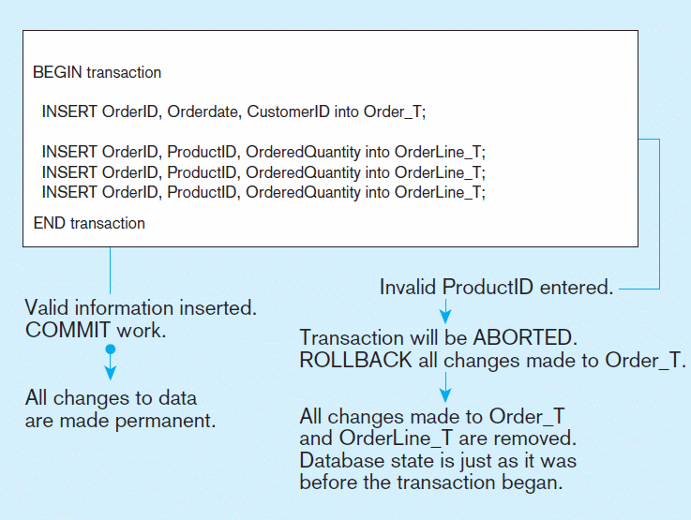
Figure 7-12 An SQL Transaction sequence (in pseudocode)
Chapter 7
© 2013 Pearson Education, Inc. Publishing as Prentice Hall

Slide 36
DATA DICTIONARY FACILITIES
System tables that store metadata
Users usually can view some of these tables
Users are restricted from updating them
Some examples in Oracle 11g
  DBA_TABLES – descriptions of tables
  DBA_CONSTRAINTS – description of constraints
  DBA_USERS – information about the users of the system
Examples in Microsoft SQL Server 2008
  sys.columns – table and column definitions
  sys.indexes – table index information
  sys.foreign_key_columns – details about columns in foreign key constraints

Slide 37
SQL:2008 ENHANCEMENTS/EXTENSIONS
User-defined data types (UDT)
  Subclasses of standard types or an object type
Analytical functions (for OLAP)
  CEILING, FLOOR, SQRT, RANK, DENSE_RANK, ROLLUP, CUBE, SAMPLE,
  WINDOW–improved numerical analysis capabilities
New Data Types
  BIGINT, MULTISET (collection), XML
CREATE TABLE LIKE–create a new table similar to an existing one
MERGE

Slide 38
SQL:2008 ENHANCEMENTS (CONT)
Programming extensions
Persistent Stored Modules (SQL/PSM)
  Capability to create and drop code modules
  New statements:
    CASE, IF, LOOP, FOR, WHILE, etc.
    Makes SQL into a procedural language
Oracle has propriety version called PL/SQL, and Microsoft SQL Server has Transact/SQL

Slide 39
ROUTINES AND TRIGGERS
Routines
  Program modules that execute on demand
Functions–routines that return values and take input parameters
Procedures–routines that do not return values and can take input or output parameters
Triggers–routines that execute in response to a database event (INSERT, UPDATE, or DELETE)

Slide 40
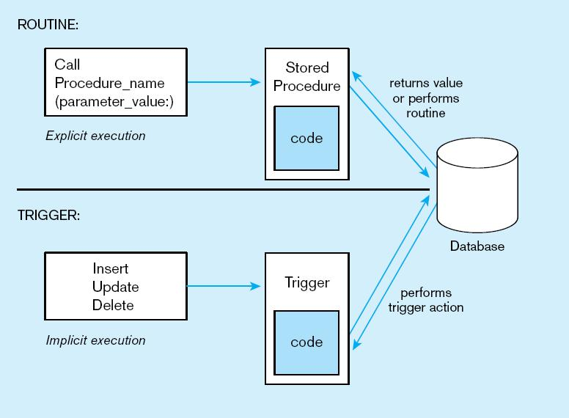
Figure7-13 Triggers contrasted with stored procedures (based on Mullins 1995)
Procedures are called explicitly
Triggers are event-driven
Source: adapted from Mullins, 1995.
Chapter 7
© 2013 Pearson Education, Inc. Publishing as Prentice Hall

Slide 41
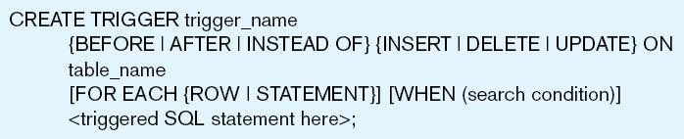
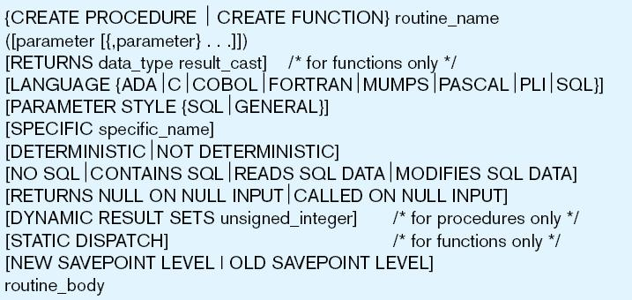
Figure 7-14 Simplified trigger syntax, SQL:2008
Figure 7-15 Syntax for creating a routine, SQL:2008
Chapter 7
© 2013 Pearson Education, Inc. Publishing as Prentice Hall

Slide 42
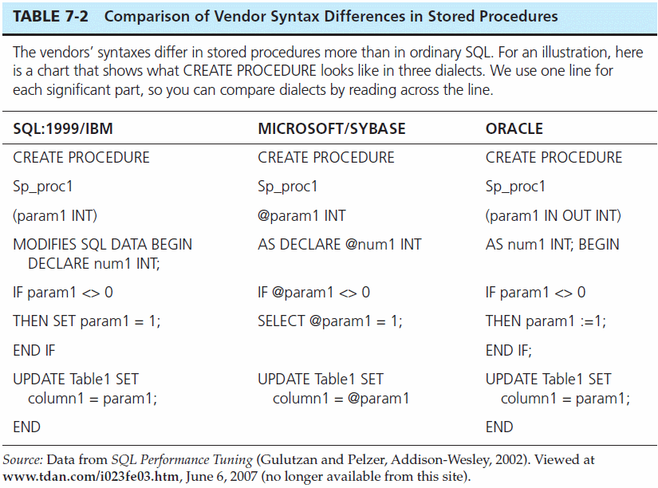
Chapter 7
© 2013 Pearson Education, Inc. Publishing as Prentice Hall

Slide 43
EMBEDDED AND DYNAMIC SQL
Embedded SQL
  Including hard-coded SQL statements in a program written in another language such as C or Java
Dynamic SQL
  Ability for an application program to generate SQL code on the fly, as the application is running

Slide 44
REASONS TO EMBED SQL IN 3GL
Can create a more flexible, accessible interface for the user
Possible performance improvement
Database security improvement; grant access only to the application instead of users

Slide 45

Copyright © 2013 Pearson Education, Inc. Publishing as Prentice Hall

