Slide 1
EV
EduVerse AI
Your course. Your notes. Your AI mentor.
A personalised learning assistant that answers from your own notes and shows its sources
[Sahib , Neha] | 25MCI10083 25MCI10056
MCA (AI/ML), University Institute of Computing, Chandigarh University | Project Expo 2026
Notes:
Introduce yourself and the one-line idea: EduVerse is a study assistant that knows YOUR course and YOUR notes, and tells you where each answer came from. About 20 seconds.

Slide 2

Students have AI, but not the right AI
Generic answers
Confident mistakes
Scattered study
Chatbots do not know your syllabus or your teacher’s notes, so explanations are one-size-fits-all.
Models can state wrong facts fluently, and there is no source to check them against.
Notes, quizzes, plans and progress live in different apps, so test results never shape what you study next.
Notes:
Three pains: generic answers, hallucination with no source, and fragmented tools. Ask the audience: who has pasted a question into a chatbot and doubted the answer?

Slide 3






One place to learn, test and plan
My Notes
AI Mentor
Quizzes
Upload PDF, text or Markdown notes.
Streamed answers at your level, with [1] [2] citations.
Made from any topic or your notes.
Study material
Study planner
XP and badges
Notes, summaries, flashcards and revision sheets.
Day-by-day plan from your progress and goal.
Levels, 8 badges and a class leaderboard keep you going.
Notes:
Walk through the six features quickly. Mention course-aware sign-up: BCA, MCA, B.Tech etc. set up subjects automatically.

Slide 4
How it answers from your notes
1
2
3
4
5
Upload
Search
Fuse
Gate
Answer
›
›
›
›
Notes are split into ~900-character passages at headings
BM25 keywords plus meaning-based embeddings
Reciprocal Rank Fusion merges both rankings
Only passages that truly match are kept; else it says so
Gemini writes the reply and cites [1], [2]
Why it matters: if your notes do not cover a question, EduVerse says so and answers from general knowledge instead of forcing an unrelated passage.
Notes:
This is the core idea. Hybrid search = keyword + meaning. The gate is the key safety feature: off-topic questions return nothing. Retrieval is from the student's own notes only, filtered by student id.

Slide 5
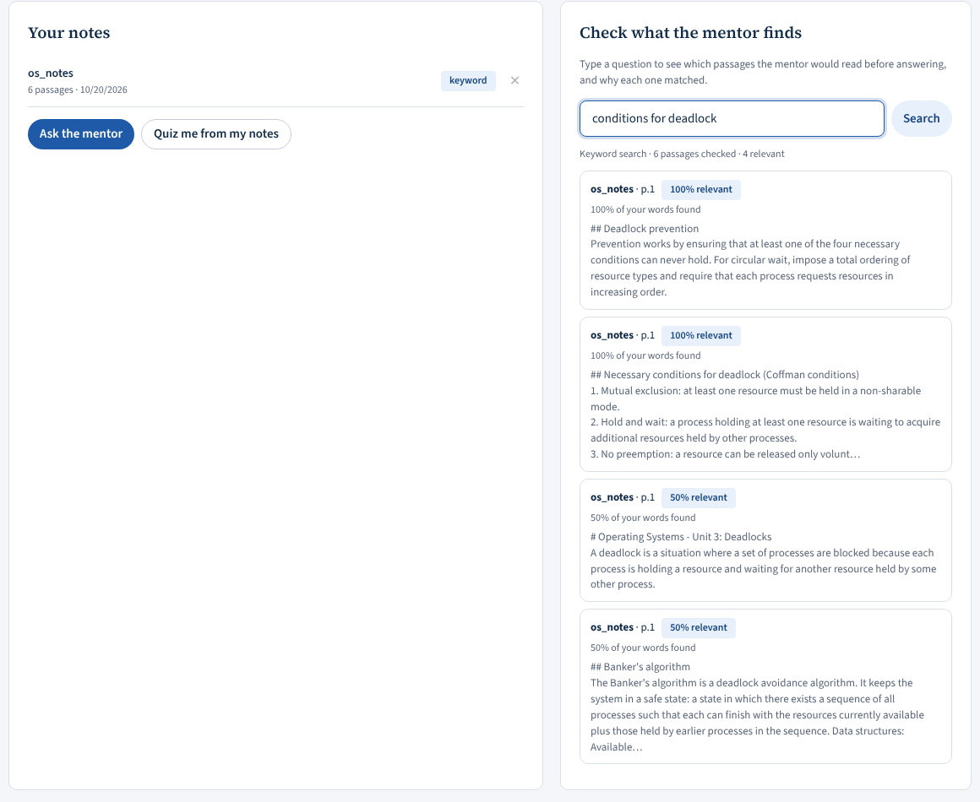
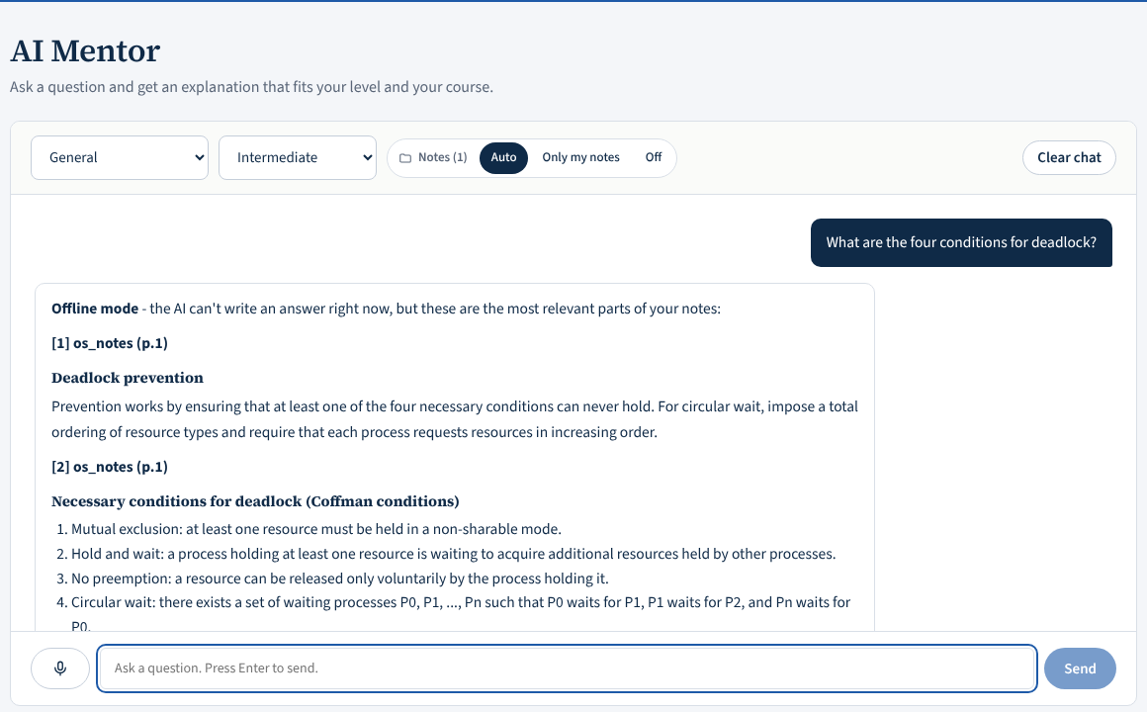
See what the mentor finds, and why
Every result shows how many of your words matched. Answers list the passages they used.
Notes:
LIVE DEMO: upload the sample OS notes, search 'conditions for deadlock', then ask the mentor. Then ask 'how do I cook pasta' to show it does not use the notes. Screenshots here are from offline mode (no API key); with the key the mentor writes a full answer.

Slide 6
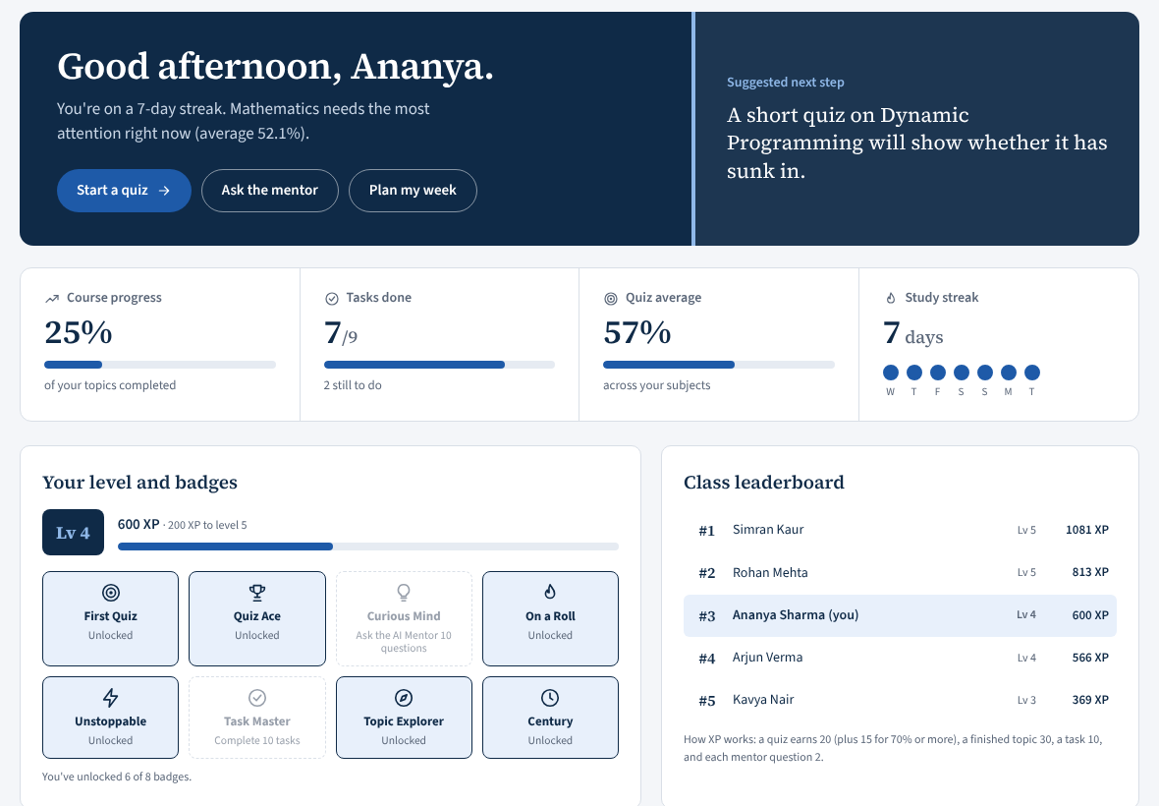
Progress you can see, motivation that sticks
XP and levels
Quiz 20 (+15 if 70%+), task 10, topic 30, mentor question 2
8 badges
First Quiz, Quiz Ace, Curious Mind, On a Roll and more
Class leaderboard
Top five students by XP
Notes:
Gamification is grounded in research on engagement but depends on context. Dashboard data in the screenshot is seeded demo data.

Slide 7
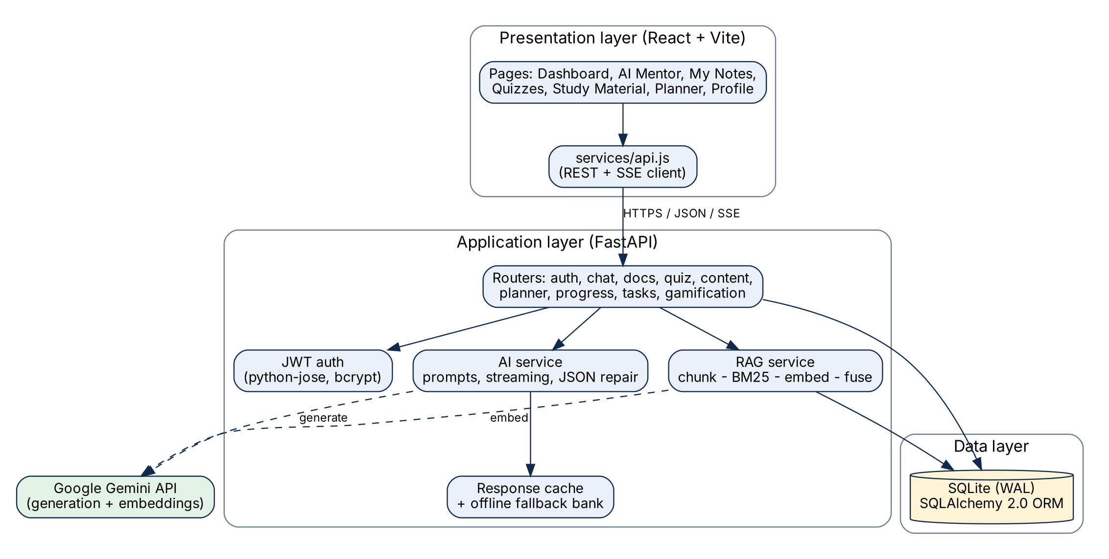
Architecture
React + Vite
Single-page app, streaming client
FastAPI
34 REST endpoints, JWT auth
SQLite + SQLAlchemy
9 tables, notes stored per student
Google Gemini
Generation and embeddings
About 6,300 lines of front-end code and 19 back-end modules.
Notes:
Layered: React front end, FastAPI application layer with RAG and AI services, SQLite data layer, Gemini as the external model. Modular monolith on purpose: simple to deploy on a laptop.

Slide 8



Built for when things go wrong
Auto-continue
JSON repair
Offline mode
If the model hits its token limit, EduVerse asks it to continue. Notes no longer stop mid-sentence.
Truncated quiz or plan JSON is retried with a bigger budget; complete questions are salvaged.
If the AI is unreachable, labelled offline content and your matching notes are shown instead of an error.
Notes:
These came from real failures seen in testing: a study note that stopped mid-sentence and a quiz that failed with 'Unterminated string'. Each was fixed and tested with a simulated truncating model.

Slide 9
Results from testing
20/20
8/10
5/5
~7 ms
functional test cases passed
in-scope questions answered from the right passage
off-topic questions correctly returned nothing
average notes search time (no network)
Small author-written test set on sample Operating Systems notes, keyword search only. Live answer quality and student learning gains are not yet measured.
Notes:
Be honest about scope: the 8/10 is on a small set I wrote; the 2 misses were topics the sample notes do not contain, and the system correctly returned nothing. Semantic search was not evaluated in these tests. Latency excludes the Gemini call.

Slide 10
Limits and what comes next
Today
Next
No study yet with real students
Cannot read scanned (image) PDFs
SQLite and one process: small groups, not thousands
Offline quiz bank covers two subjects
Evaluation with students and live answers
Teacher portal and class analytics
OCR for scanned notes
Spaced repetition and adaptive quizzes
PostgreSQL, hosting, Hindi and Punjabi support
Notes:
Likely questions: Why RAG not fine-tuning? (can cite sources, update by uploading a file, no training cost). Is my data private? (notes filtered by student id; only relevant passages are sent to the model). What if the internet fails? (offline mode). Which model? (Gemini).

Slide 11
Thank you
Questions and live demo

