Slide 1
INTERNSHIP PROJECT | INSURANCE ANALYSIS
Branch Performance
& Sales Dashboard
A unified analytics solution to monitor branch KPIs,
track sales targets, and drive data-informed decisions.
MySQL
Power BI
Tableau
Excel
Insurance Analysis Project · Branch Performance & Sales Dashboard

Slide 2
Problem Statement
CONTEXT
KEY CHALLENGES
The organization lacks a unified view to track and compare branch-level performance in real-time across New, Cross-Sell, and Renewal business lines.
Key decision-makers face challenges due to fragmented data spread across Excel sheets and CRM systems, with no clear alignment between individual targets and actual achievements.
No real-time tracking of branch-level KPIs
Inability to monitor meetings, opportunities & win ratios
Limited visibility into invoice count & conversion ratios
Difficult to identify top performers vs lagging branches
Delayed reporting & misaligned goals

Slide 3
Project Objective & Use Case
Objective
Build an interactive dashboard using Power BI, Tableau, and Excel to centralize data, automate performance tracking, and provide real-time decision support across branches.
01
02
03
Branch Monitoring
Sales Funnel Tracking
Strategic Decisions
Track revenue targets vs. achievement per branch and account executive across business streams
Monitor opportunity pipelines, stages, and win ratios at individual and branch level
Empower corporate teams with drill-down insights to identify high-performers and coaching areas

Slide 4
Data Sources & Tools Used
DATA SOURCES
TOOLS & TECHNOLOGIES
1
Target Sheets
MySQL
Database querying & data extraction
2
Brokerage & Fees Records
Power BI
Interactive dashboards & KPI tracking
3
Invoice Reports
Tableau
Visual analytics & trend analysis
4
Meetings Data
MS Excel
Data cleaning, pivot analysis & modeling
5
CRM Opportunities

Slide 5
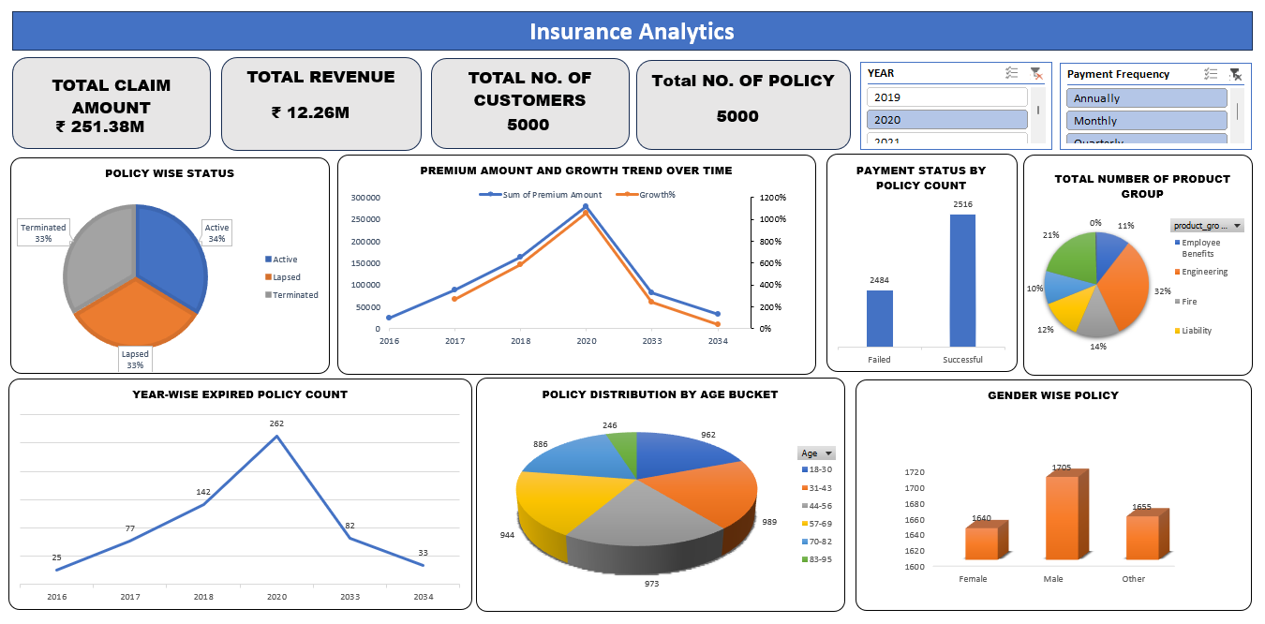
Dashboard Highlights — Excel

Slide 6
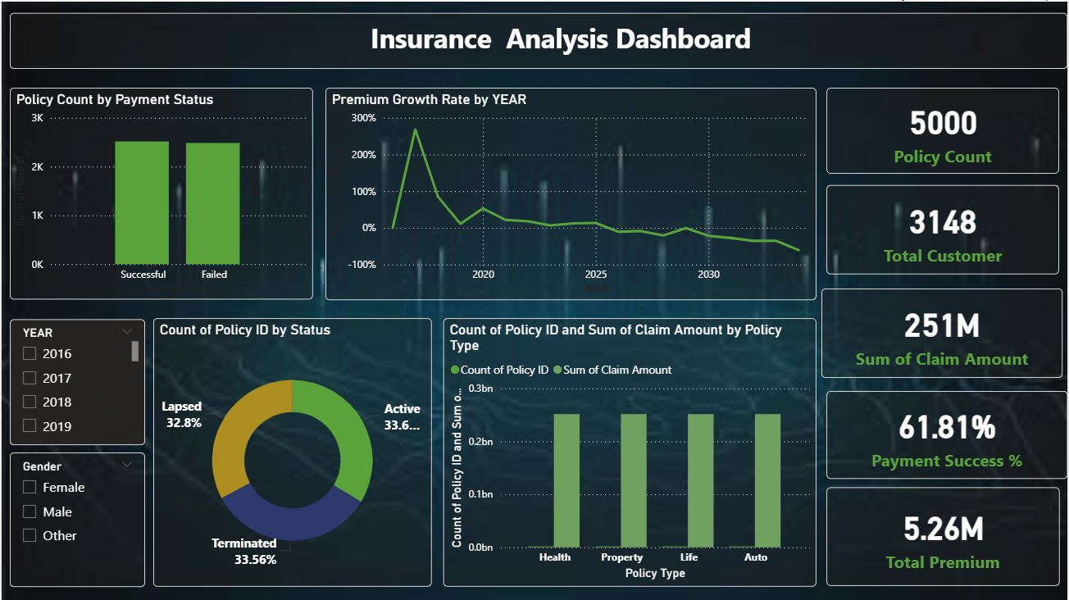
Dashboard Highlights — Power BI
Payment Success %

Slide 7
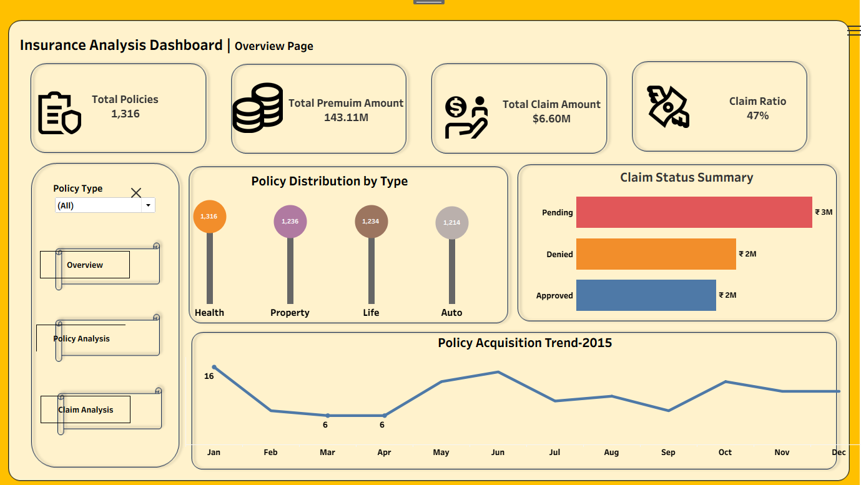
Dashboard Highlights — Tableau

Slide 8
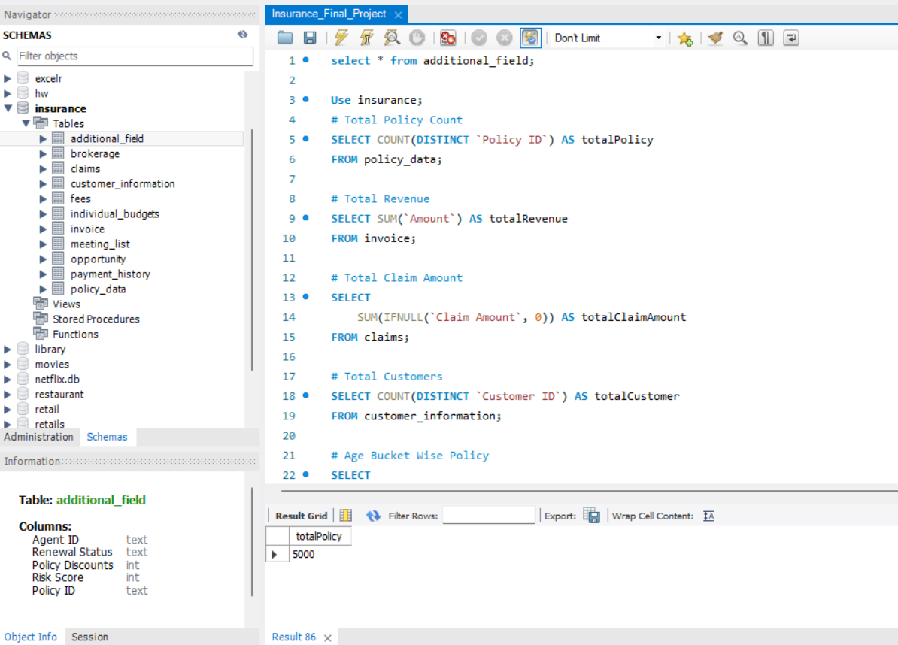
SQL Queries
Total Claim Amount

Slide 9
Key Findings & Recommendations
KEY FINDINGS
RECOMMENDATIONS
Active, Lapsed & Terminated policies are nearly equally split (~33% each) — retention focus needed
Implement automated alerts for lapsing policies to improve retention
Health insurance leads policy count (1,316); all types are closely matched
Strengthen payment collection workflows to reduce 38% failure rate
61.8% payment success rate — 38.2% failed payments signal collection process gaps
Use Power BI drill-down to identify underperforming branches weekly
Claim amount (₹251M) vs. premium (₹12.26M) reveals high claim exposure requiring risk review
Set individual KPI targets aligned to branch-level goals via CRM integration
This dashboard bridges the gap between fragmented data and strategic clarity — enabling accountability, transparency, and growth across all branches.

Slide 10
Thank You

