Slide 1

CROWDFUNDING KICKSTARTER

Slide 2
Table of Contents
I INTRODUCTION 3
II DATA OVERVIEW 4
III KEY INSIGHTS 5
IV DASHBOARD 8
V RECOMMENDATION AND INSIGHT CONCLUSION 9

Slide 3

1.WHAT IS CROWDFUNDING? ○ Crowdfunding is the practice of funding a project or venture by raising small amounts of money from a large number of people, typically via the Internet. ○ Crowdfunding is a form of crowdsourcing and alternative finance. In 2015, over US$34 billion was raised worldwide by crowdfunding 2.WHAT IS KICKSTARTER ? ○ Thousands of creative projects are funding on Kickstarter at any given moment. Each project is independently created and crafted by the person behind it. ○ The filmmakers, musicians, artists, and designers you see on Kickstarter have complete control and responsibility over their projects. ○ They spend weeks building their project pages, shooting their videos, and brainstorming what rewards to offer backers. When they're ready, creators launch their project and share it with their community. ○ If the project succeeds in reaching its funding goal, all backers' credit cards are charged when time expires. If the project falls short, no one is charged. Funding on Kickstarter is all-or-nothing.
INTRODUCTION

Slide 4

DATA OVERVIEW
Crowdfunding project dataset
→ This dataset contains information about projects launched on a crowdfunding platform.
Each row represents one project
→ Every record in the dataset corresponds to a single crowdfunding project.
Project details included
→ The data includes project goals, amount raised, number of backers, and project outcome.
Outcome information available
→ Projects are marked as successful or failed based on funding results.
Date information included
→ The dataset contains project creation dates used for time-based analysis.
Data cleaned before analysis
→ Missing values and errors were removed to ensure accurate analysis.

Slide 5


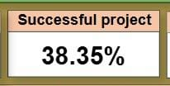

KEY INSIGHTS
Overall Performance
A large number of projects are created on the crowdfunding platform every year
Only a portion of total projects achieve successful funding.
This shows that crowdfunding is competitive and success is not guaranteed
Proper planning and realistic expectations are important for success.

Slide 6
KEY INSIGHTS
Funding and Backer Behavior Successful projects raise significantly higher amounts compared to failed projects.
Projects with higher number of backers have better chances of success.
A small number of top projects contribute a large share of total funding.
Backer engagement plays a key role in project performance.

Slide 7
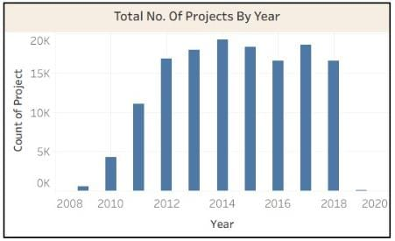
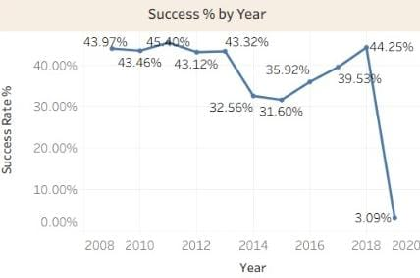
KEY INSIGHTS
Goal Range and Time Trends
Projects with lower goal amounts have higher success rates.
Very high goal projects show lower chances of success.
Project creation trends change over time across different years.
Choosing the right goal amount is a critical success factor.

Slide 8
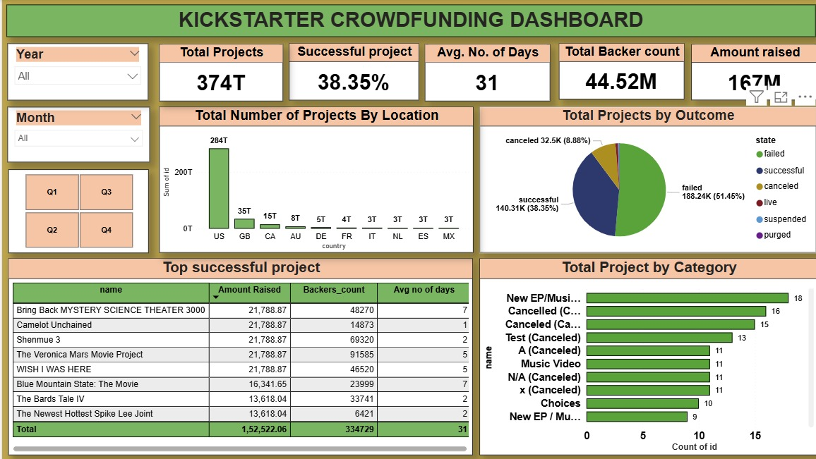

Slide 9

RECOMMEDATIONS
Creators should set realistic and achievable funding goals.
Projects with lower goal amounts have a higher success rate.
Strong project description, visuals, and updates help attract more backers.
Popular categories help, but clear planning matters more than category.
Launch timing and consistent engagement with backers improve success chances.

Slide 10

CONCLUSION
Crowdfunding platforms have a large number of projects, but not all succeed.
Success depends on goal amount, planning, and creator effort.
Data analysis using Excel, Power BI, and Tableau helped identify key trends.
Dashboards make it easy to track performance and take better decisions.
This analysis can help future creators improve their chances of success.

Slide 11
THANK YOU

