Slide 1
Bloom’s Taxonomy ML Classifier
Neha Vijay Patil

Slide 2
Defining the problem

Slide 3
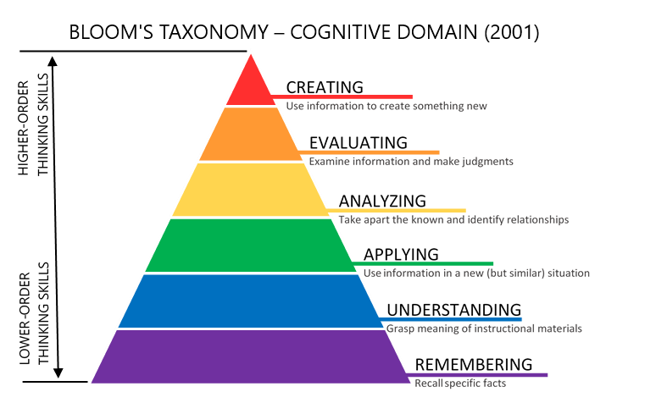
Problem Definition
Facilitating the creation of balanced question papers to evaluate students on different levels based on Bloom’s Taxonomy.
Notes:
Bloom's Taxonomy is a hierarchical framework used for classifying educational learning objectives.
helps educators categorize educational goals and objectives into different levels of complexity and cognitive skills.

Slide 4
Problem Definition
Existing method of implementation: Simple mapping of verbs -> levels
Limitations:
action verbs are not always the indicator of level. (what is…)
some verbs are associated with multiple levels. (describe)
Proposed solution:
ML Classifier will solve the above issues and automates the categorisation process
Notes:
the action verbs are indicators of the complexity (level) of the question. BUT NOT ALWAYS, may include nouns etc..
some of the verbs in the above table are associated with multiple Bloom’s Taxonomy levels. These verbs are actions that could apply to different activities. CONFUSION for categorisation
Eg: describe could be remembering or understanding.
Recall,state, : remembering
Create, deisgn, develop: creating

Slide 5
Literature Survey

Slide 6
Papers | [11] | [12] | [13] | [9] | [15] | [16] | Our Algorithm
Feature extraction | NA | Chi-Square+Laplace Smoothing | Chi-Square,Mutual Information, and Odd Ratio | TFPOS-IDF and word2vec | NA | Pos Tagging and Word Vector | TFPOS-IDF
Classifiers | SVM, K-NN. | Naive Bayes | Naïve Bayes(NB), (KNN). | KNN, Logistic Regression, SVM | SVM-Light | Rule based grammar, , Ensemble Technique on KNN, SVC and NB, Wordnet. | Ensemble Technique on KNN, SVC and NB.
Accuracy | SVM: 69% K-NN: 65% | 60.63%. | KNN: 87%. NB: 83%. | KNN: 71.1%, LR: 82.3% SVM: 83.7% | 87.4%. Poor recall and F-measure values | Ensemble: 82.5% Rule Based: 60% | 93.5% Precision: 94% Recall: 93%
Notes:
verbs are the most important words to determine the level of the question according to Bloom’s taxonomy last is pronoun pronoun -[9]
{'v':5,'n':3,'a':3,'g':1,'r':1,None:1}
Most used knn, naïve bayes, svm

Slide 7
Data & Model Design

Slide 8
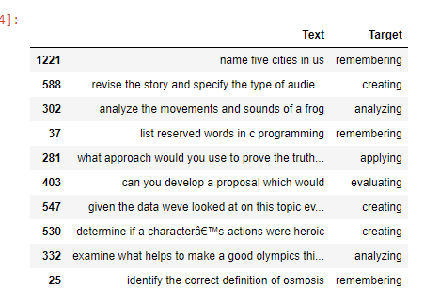
Snippet of the dataset
Notes:
Source of data: Research paper Question classification based on Bloom’s taxonomy cognitive domain using modified TF-IDF and word2vec[9]
2000 questions

Slide 9
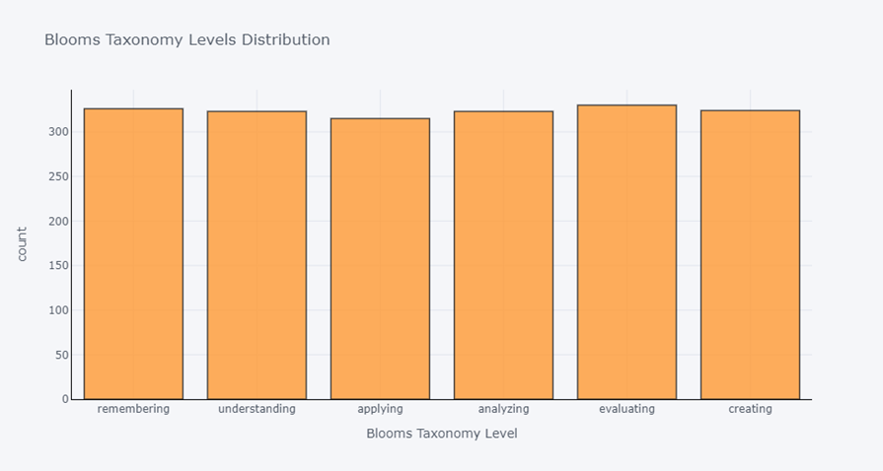
Distribution of levels in dataset
Notes:
Evenly distributed.good for model training.

Slide 10
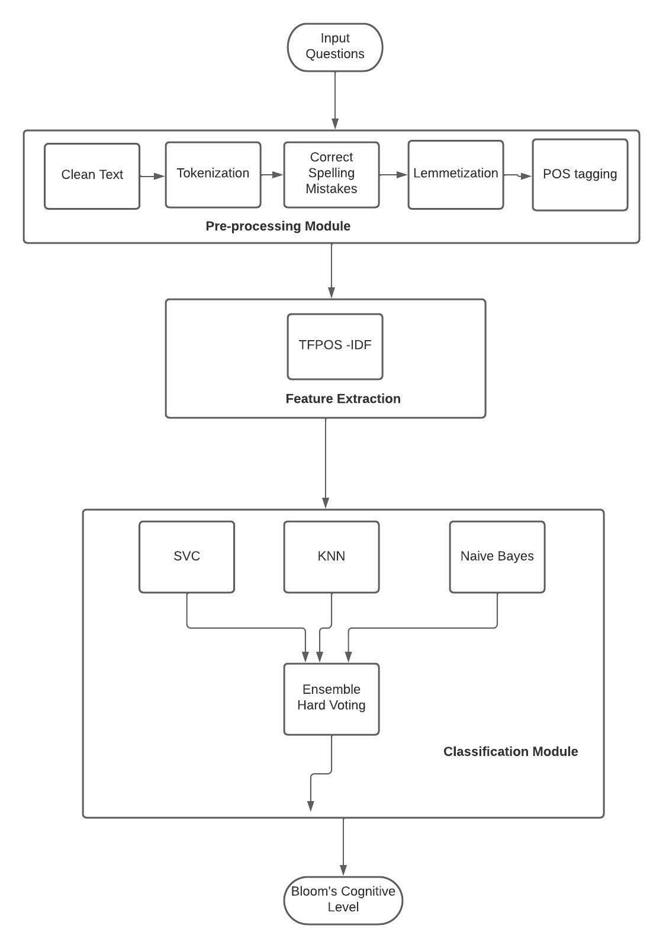
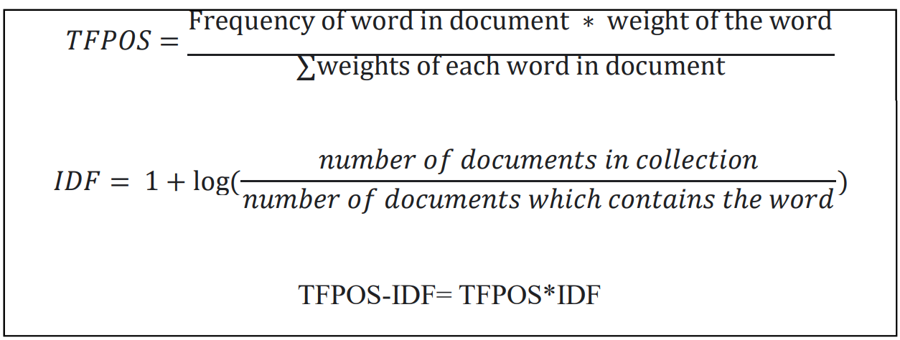
Model Design
- Customised feature extraction algorithm to give high weightage based on positioning.
- Ensemble ML classifier combining results of 3 models: KNN, SVC and Naïve Bayes using hard voting.
Notes:
Lemmatization is a natural language processing (NLP) technique used to reduce words to their base or canonical form, known as the lemma. Unlike stemming, which chops off prefixes or suffixes of words to derive the root form (stem), lemmatization considers the context and morphological analysis of words to produce the lemma.
Why not forest, neural: require a lot of data and resources, over complex, over kill for this task.
K ko manage karna padtay , how we found k? simple grid search

Slide 11
Implementation
https://github.com/neha7799/BloomsTaxonomyClassifier/blob/main/model%20presentation.ipynb
Notes:
https://github.com/neha7799/BloomsTaxonomyClassifier/blob/main/model%20presentation.ipynb

Slide 12
Results

Slide 13
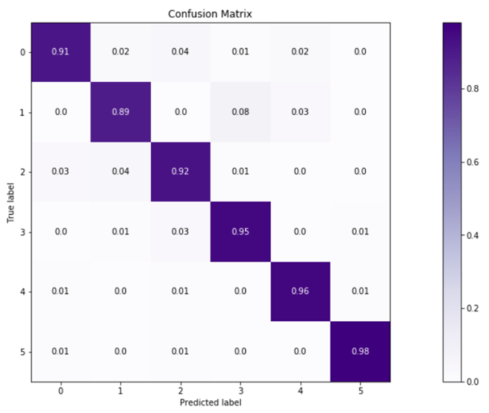
Confusion Matrix
Notes:
Read y axis vs x axis: x==y (true positives) diagonal values: i.e correctly predicted : super high

Slide 14
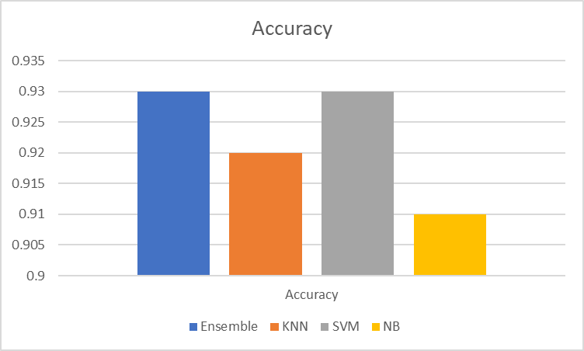
Notes:
Accuracy = Number of correct predictions/Total number of predictions

Slide 15
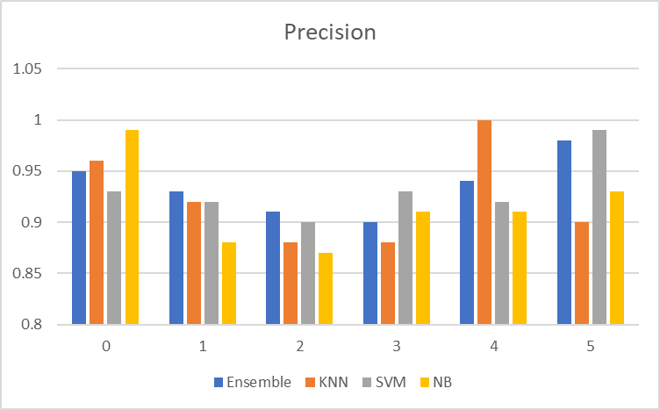
Notes:
Correctly predicted x / all predicted x
Out of all the predictions made as x, which ones were actually x?
Ensemble may not be having highest precision in all classes, but it is consistent and always above 90%.

Slide 16
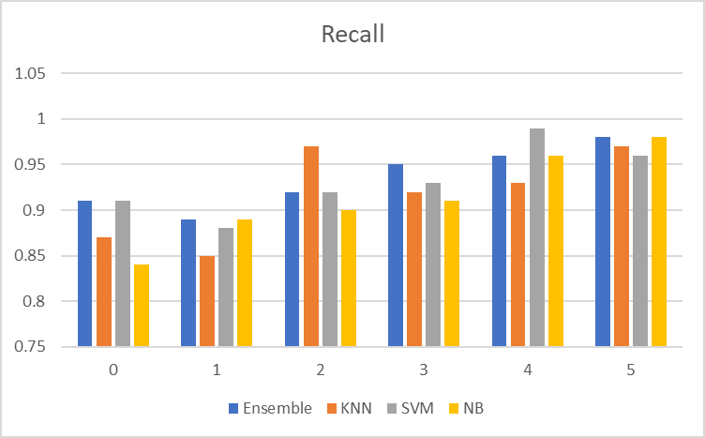
Notes:
Predicted x/ all actual x
Out of all the actual x, how many were predicted as x?
Ensemble may not be having highest recall in all classes, but it is consistent and overall better than other classifiers.

Slide 17
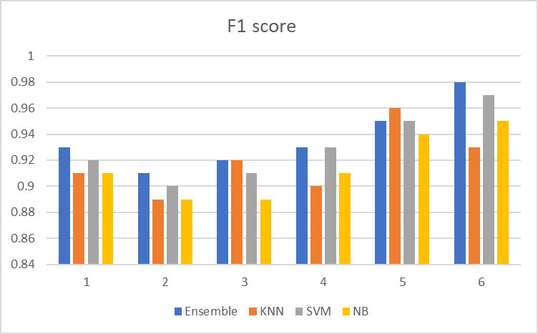
Notes:
The Precision-Recall Trade-Off represents the fact that in many cases, you can tweak a model to increase precision at a cost of a lower recall, or on the other hand increase recall at the cost of lower precision.F1 score is to combine the precision and recall metrics into a single metric.
high F1 score == both Precision and Recall are high
Ensemble is consistently highest in all categories except 5( where its second highest score) , thus we can conclude from f1 score n accuracy that the model is performing well.

Slide 18
Future Work
More data collection.
Apply cross validation techniques.
Check for overfitting.
Notes:
Cross validation: kfold use kar

Slide 19
Thank you!
Open to questions

