Slide 1
Bloom’s Taxonomy ML Classifier
Neha Vijay Patil

Slide 2
Defining the problem

Slide 3
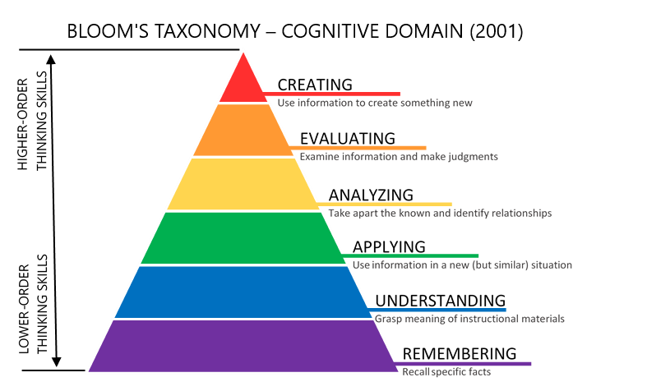
Problem Definition
Facilitating the creation of balanced question papers to evaluate students on different levels based on Bloom’s Taxonomy.
Notes:
As mentioned in the last semester, the problem statement we chose was based on Blooms Taxonomy for classification of questions. We focused on facilitating the creation of balanced question papers to evaluate students based on Blooms taxonomy and hence have built an Automatic question classifier

Slide 4
Problem Definition
Existing method of implementation: Simple mapping of verbs -> levels
Limitations:
action verbs are not always the indicator of level. (what is…)
some verbs are associated with multiple levels. (describe)
Proposed solution:
ML Classifier will solve the above issues and automates the categorisation process
Notes:
examination reforms:
Quite often, the action verbs are indicators of the complexity (level) of the question. BUT NOT ALWAYS
some of the verbs in the above table are associated with multiple Bloom’s Taxonomy levels. These verbs are actions that could apply to different activities. CONFUSION for categorisation
Eg: describe could be remembering or understanding.

Slide 5
Literature Survey

Slide 6
Papers | [11] | [12] | [13] | [9] | [15] | [16] | Our Algorithm
Feature extraction | NA | Chi-Square+Laplace Smoothing | Chi-Square,Mutual Information, and Odd Ratio | TFPOS-IDF and word2vec | NA | Pos Tagging and Word Vector | TFPOS-IDF
Classifiers | SVM, K-NN. | Naive Bayes | Naïve Bayes(NB), (KNN). | KNN, Logistic Regression, SVM | SVM-Light | Rule based grammar, , Ensemble Technique on KNN, SVC and NB, Wordnet. | Ensemble Technique on KNN, SVC and NB.
Accuracy | SVM: 69% K-NN: 65% | 60.63%. | KNN: 87%. NB: 83%. | KNN: 71.1%, LR: 82.3% SVM: 83.7% | 87.4%. Poor recall and F-measure values | Ensemble: 82.5% Rule Based: 60% | 93.5% Precision: 94% Recall: 93%
Notes:
verbs are the most important words to determine the level of the question according to Bloom’s taxonomy last is pronoun pronoun -[9]

Slide 7
Data & Model Design

Slide 8
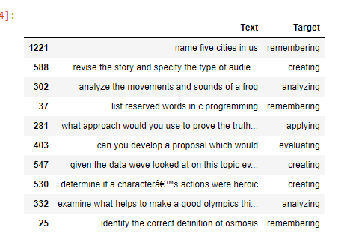
Snippet of the dataset
Notes:
Source of data: Research paper Question classification based on Bloom’s taxonomy cognitive domain using modified TF-IDF and word2vec[9]
2000 questions

Slide 9
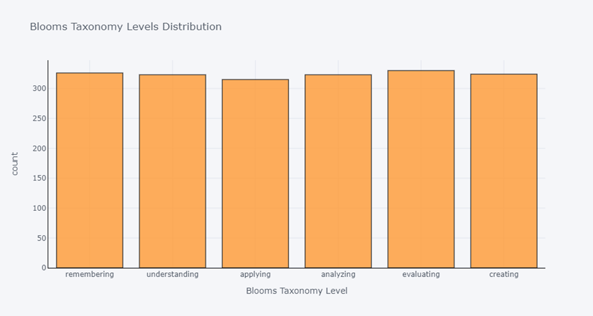
Distribution of levels in dataset
Notes:
Evenly distributed.good for model training.

Slide 10
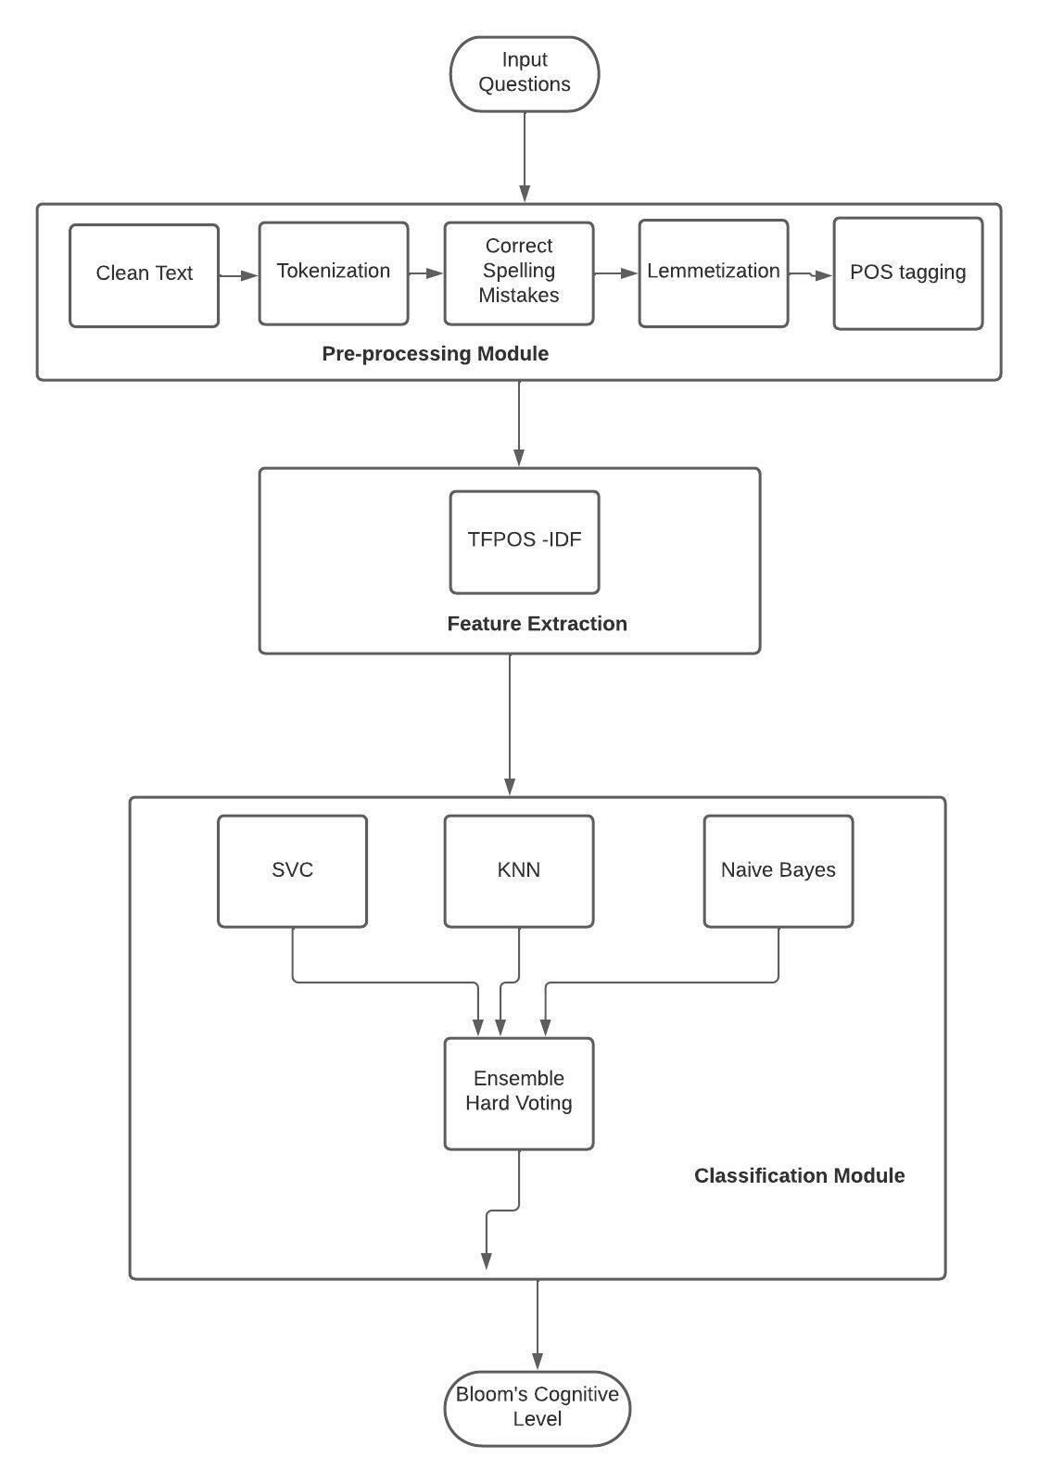
Model Design
- Pre-processing
- Customised feature extraction algorithm to give high weightage based on positioning. (wer is paper??)
- Ensemble ML classifier combining results of 3 models: KNN, SVC and Naïve Bayes using hard voting.
Notes:
The purpose of this model is to take a question paper as input and categorize each question into a Bloom’s Cognitive Level accurately. The structure of the model will be as follows:
NLP Preprocessing - Tokenization, Stop Words Removal, Lemmatization, POS Tagging
Feature Extraction - combination of TF-IDF.
Machine Learning Classification - SVM, KNN, Naive Bayes
Ensemble - applying majority voting algorithm on the output of the above classifiers.
Final output - combination of above output and WordNet similarity values which gives out the Bloom’s Cognitive Level for that question.

Slide 11
Implementation
https://github.com/neha7799/BloomsTaxonomyClassifier/blob/main/Project%20-%2027march-%20model%20presentation.ipynb

Slide 12
Results

Slide 13
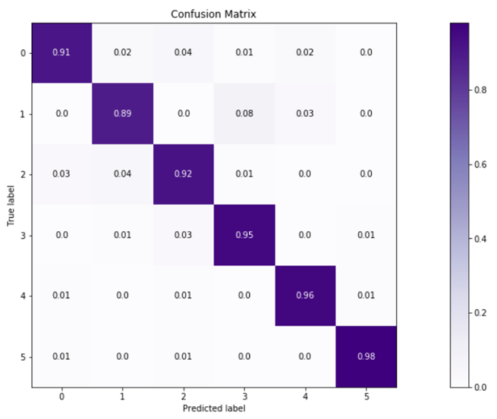
Confusion Matrix
Notes:
Read y axis vs x axis: x==y (true positives) diagonal values: i.e correctly predicted : super high

Slide 14
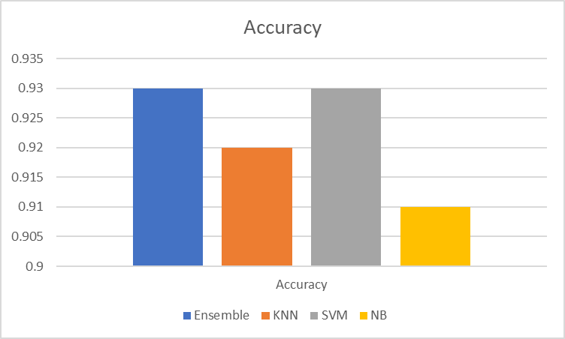
Notes:
Accuracy = Number of correct predictions/Total number of predictions

Slide 15
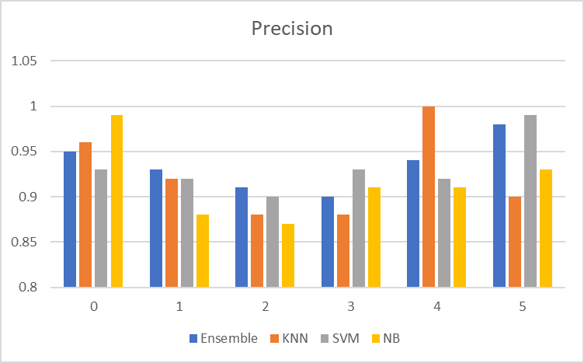
Notes:
Correctly predicted x / all predicted x
Out of all the predictions made as x, which ones were actually x?
Ensemble may not be having highest precision in all classes, but it is consistent and always above 90%.

Slide 16
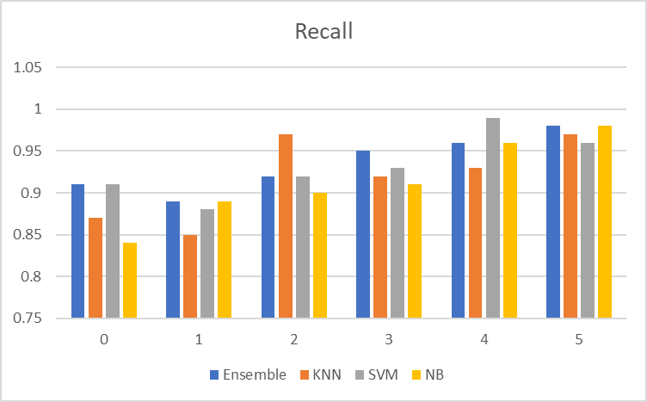
Notes:
Predicted x/ all actual x
Out of all the actual x, how many were predicted as x?
Ensemble may not be having highest recall in all classes, but it is consistent and overall better than other classifiers.

Slide 17
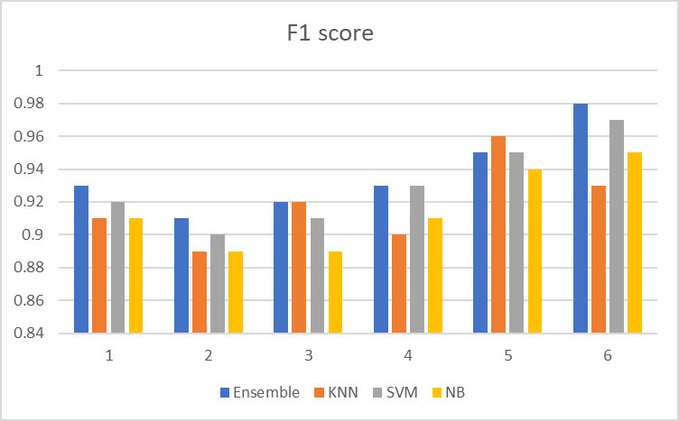
Notes:
The Precision-Recall Trade-Off represents the fact that in many cases, you can tweak a model to increase precision at a cost of a lower recall, or on the other hand increase recall at the cost of lower precision.F1 score is to combine the precision and recall metrics into a single metric.
high F1 score == both Precision and Recall are high
Ensemble is consistently highest in all categories except 5( where its second highest score) , thus we can conclude from f1 score n accuracy that the model is performing well.

Slide 18
Future Work
More data collection.
Apply cross validation techniques.
Check for overfitting.

Slide 19
More about me
Cloud Infrastructure Intern (IAM Team) : Azure, PowerShell scripting
Research Assistant : Software Engineering & Human Computer Interaction
Full Stack Development course and projects: Angular
Data Analytics Intern : Python, REST API, MySQL, XML
CyberSecurity Research Intern: Reverse Engineering, Linux, Vulnerability, Malware analysis

Slide 20
Thank you!
Open to questions

