Slide 1

Stock Learning
and
Forecast
Presented by –
Abhishek Kumar (191500027)
Ritika Brewal (191500663)
Neha (191500489)
Submitted to:-
Mr.Kunal Goyal
Technical Trainer
GLA University

Slide 2

OUTLINE
About the project
Objective
Requirements
Snapshots of Website

Slide 3
ABOUT THE PROJECT
This website is based on the stock prediction and for this we have used Machine Learning using python libraries i.e. TensorFlow, Pandas, Matplot and the python framework Dash to deploy our ML model.
The front-end is done by using HTML, CSS and
Javascript.

Slide 4
OBJECTIVE
This project is a novel method for the prediction of stock market closing prices.
The website is convenient for users as it will tell
the high and lows in a particular stock which
will ultimately becomes useful for further
investment.

Slide 5
REQUIREMENTS
1. Software Specifications:
-Technology implemented: Machine learning, web development
- Languages: HTML, CSS, JavaScript, Python
- IDE used: Visual Studio Code, Jupyter Notebook
- Web browser: Google chrome

Slide 6
2. Hardware Used:
-Processor Used : Intel 5
-Operating System : Windows 11
-Hardware Devices : Computer System
-Hard Disk : 256 GB

Slide 7
SNAPSHOTS OF
OUR PROJECT

Slide 8
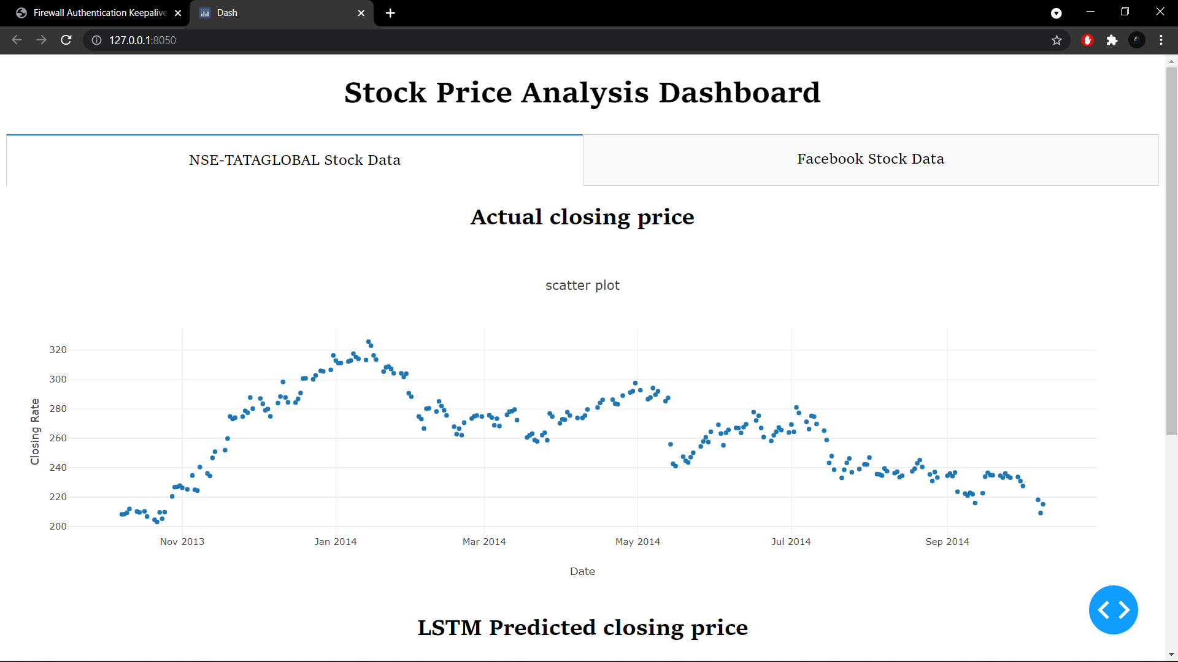

Slide 9
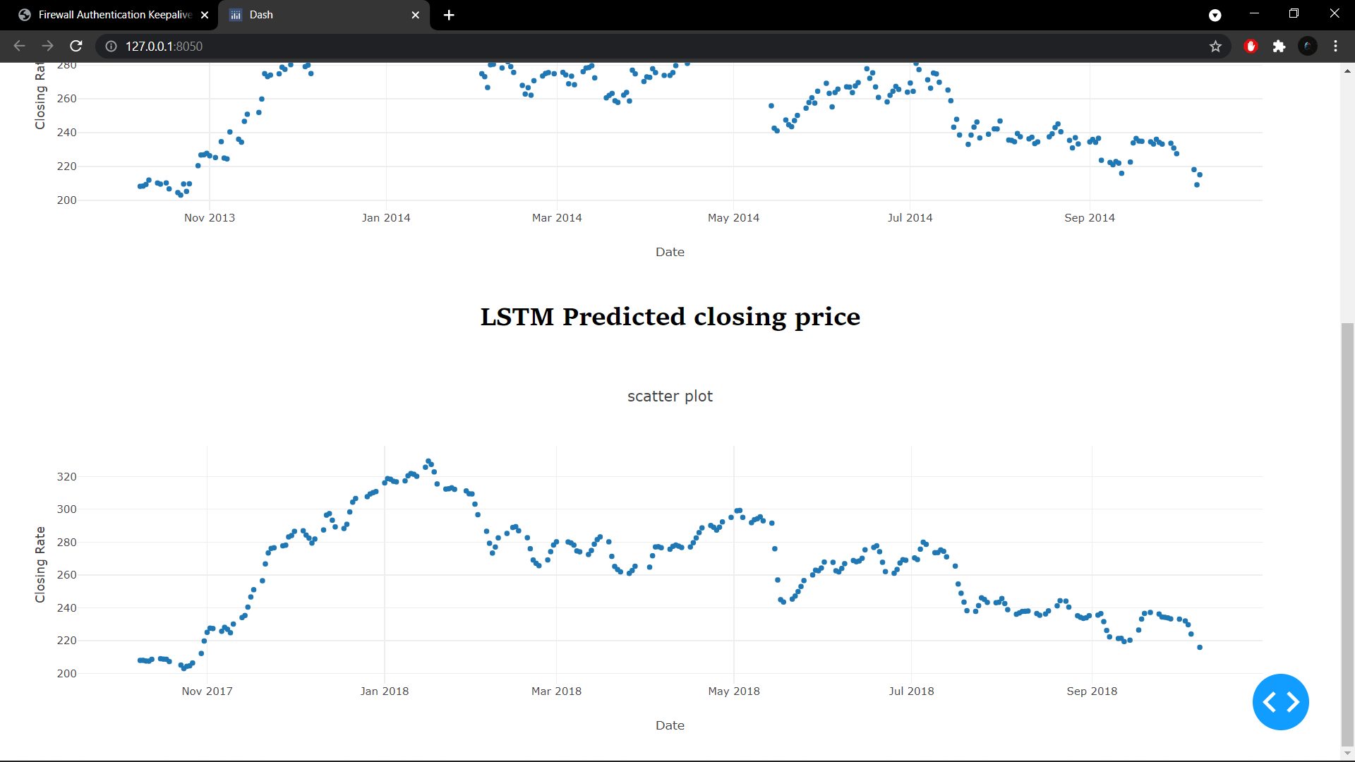

Slide 10
