Slide 1
Professor Profiler
Neha Anand
Data Science Immersive Cohort 12
Galvanize Seattle

Slide 2
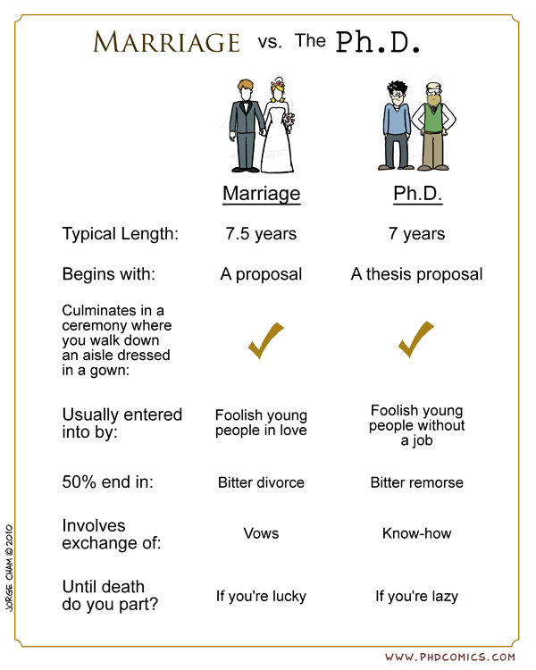


Problem Statement
Build a holistic profile of a university professor
Contact Information
University Information
Research area tags based on publications
Impact of Research
Ratings/reviews given by past students for classes taught by him/her
Target Users:
For Prospective graduate students: Choose between grad schools and research advisors.
For research collaboration: Collaborate with a research expert in a particular field.

Slide 3
current scope

Slide 4
data acquisition

Slide 5
modeling process

Slide 6
model comparison and evaluation

Slide 7
results

Slide 8
conclusion and Future work

