Slide 1
Pumpkinmeter: Personalized Movie Recommendations Using Spark
Neha Omprakash
BUAN 5315 02 – Big Data Analysis
06/11/2025

Slide 2
Business Problem
Ripe Pumpkins aims to launch Pumpkinmeter, a movie recommendation engine.
Inspired by the success of platforms like Netflix.
Goal: Increase user engagement and retention using personalized recommendations.

Slide 3
Use Case & Technology
Use Case: Collaborative Filtering for movie recommendations.
Technology: Apache Spark with MLlib ALS.
Advantage: Scalable for millions of ratings; distributed processing.
Spark enables fast computation for large datasets.

Slide 4
Dataset Overview
Source: GroupLens MovieLens (https://grouplens.org/datasets/movielens/)
Data: Full Dataset (~33 million ratings)
ratings.csv: userId, movieId, rating, timestamp
movies.csv: movieId, title, genres

Slide 5
Model Development
Used Spark’s ALS (Alternating Least Squares).
Steps:
- Sampled 50% data for parameter tuning
- Trained final model on full dataset
- Best rank found: 12
- Two test users with 10 rated movies each

Slide 6
Recommendation Scenarios
Scenario 1: Filter movies with ≥25 ratings (higher personalization)
Scenario 2: Filter movies with ≥100 ratings (higher reliability)
Top 15 recommended movies generated for each scenario and user

Slide 7
Results – User 1
Scenario 1: Includes niche films with few but high ratings
Scenario 2: Popular classics like The Godfather Part II
Shows how filter threshold impacts personalization vs. reliability

Slide 8
Results – User 2
Scenario 1: Unique titles like Mushishi and Cosmos
Scenario 2: Popular titles like Lord of the Rings and Fight Club
Personal preferences vs. broad consensus clearly visible

Slide 9
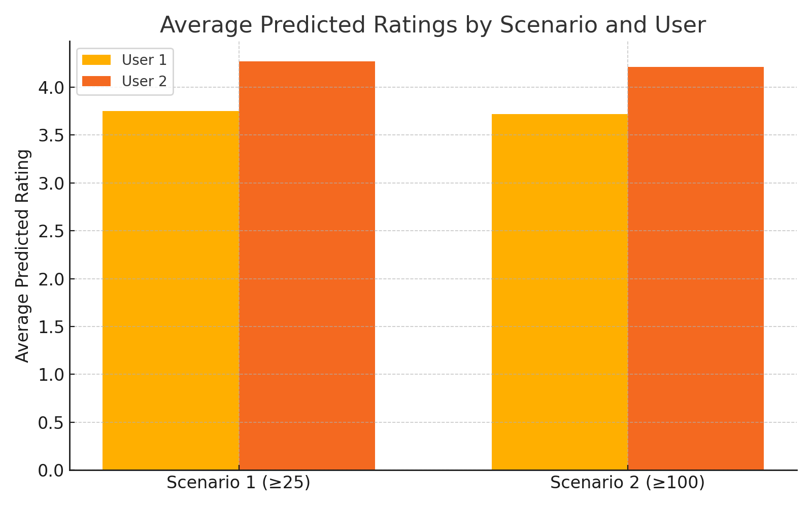

Slide 10
Insights & Foresights
Scenario 1: More diversity and personalization, lower reliability
Scenario 2: Strong reliability, but less personalized
Recommendation: Combine both for balanced suggestions
Helps retain users with meaningful content exposure

Slide 11
Challenges & Achievements
Memory issues mitigated using sampled training sets
Fixed bugs in Spark transformation
Created reusable function for scenario-based recommendations
Successfully scaled model to 33+ million entries

Slide 12
Conclusion
Pumpkinmeter validates scalable collaborative filtering in Spark.
Business benefits include user retention and content personalization.
Next Steps:
- Integrate UI for app/web
- Enable dynamic retraining
- A/B test hybrid filtering systems

Slide 13
References
1. Jadianes, D. Codementor Project
2. GroupLens MovieLens Dataset
3. BUAN 5315 Lecture Materials
4. Apache Spark MLlib Documentation

