Slide 1


REGRESSION CAPSTONE PROJECT - II
YES BANK STOCK CLOSING PRICE PREDICTION

Slide 2

Contents
Agenda
Problem Statement
Data Summary
Data
Checking observations & cleaning
EDA Multicollinearity
Data Modelling
Challenges
Conclusion

Slide 3

Team mates
.
NEHA
JADHAV
AKANKSHA JADHAV

Slide 4
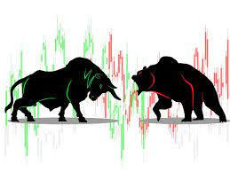

AGENDA
We are having a dataset with the monthly stock price details for Yes Bank. The objective of this project has been to apply different models to check whether the prices/movement of the stock can be predicted using features and past performance by using Linear Regression.
Looking at the various features of the dataset, we can understand the relationships between them and accordingly pass the required parameters in the model to train it and ultimately predict the closing price.

Slide 5

PROBLEM STATEMENT
Yes Bank Limited is an Indian private sector bank headquartered in Mumbai, India, and was founded by Rana Kapoor and Ashok Kapoor in 2004.
It offers a wide range of differentiated products for corporate and retail customers through retail banking and asset management services.
On 5 March 2020, in an attempt to avoid the collapse of the bank, which had an excessive amount of bad loans, the Reserve Bank of India (RBI) took control of it.
Since 2018, it has been in the news because of the fraud case involving Rana Kapoor.
Owing to this fact, it was interesting to see how that impacted the stock prices of the company and whether linear regression models or any other predictive models can do justice to such situations.

Slide 6
DATE
In our data it is monthly observation of a stock since it was listed.
OPEN
It is the price at which a security first trades upon the opening of an exchange on a trading day.
CLOSE
The closing price is a stock's trading price at the end of a trading day.
DATASET VALUES
HIGH
The high is the highest price at which a stock traded during a period.
LOW
The low is the highest price at which a stock traded during a period.
.

Slide 7
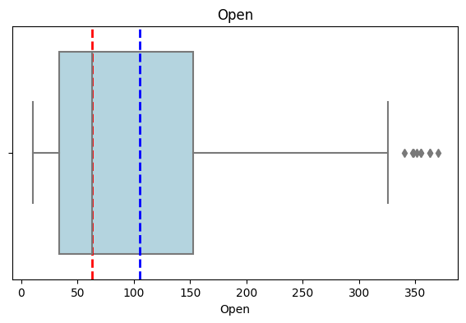
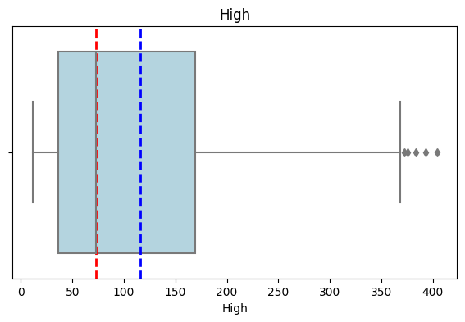
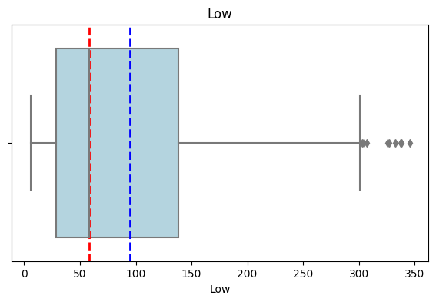
DATA OBSERVATIONS AND CLEANING
The shape of our dataset is 185 rows and 5 columns.
Datatype of Date is given as object which we need to change that to Date Time.
Yes bank stock listed on the month of July 2005. We have data available from July 2005 to November 2020.
From the statistical information we can see that it is not a normal distribution as mean and 50% values are having a lot of difference.
There are no duplicates present.
There are no null values present.

Slide 8
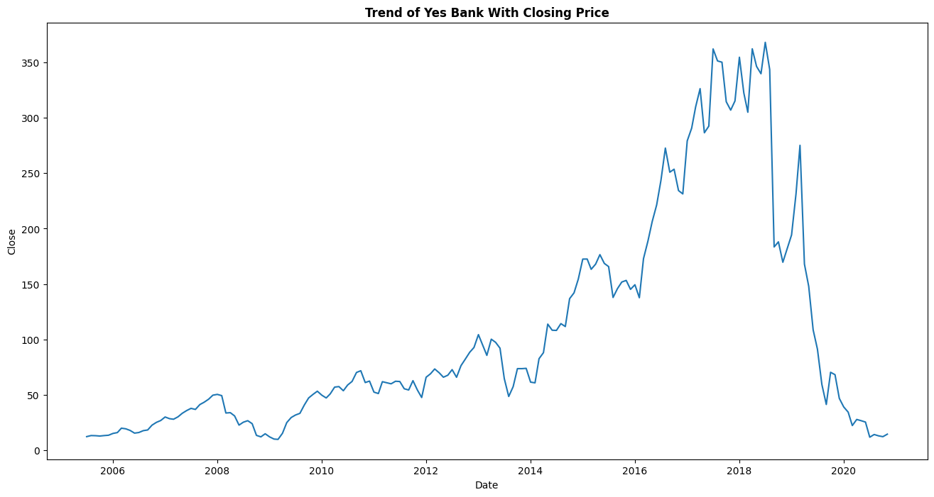
TREND OF YES BANK WITH CLOSING PRICE
HERE WE CAN SEE THAT THE PRICES WERE HIGH BETWEEN 2017 AND 2018, BUT THE PRICES DROPPED AFTER THE FRAUD CASE INCLUDING RANA KAPOOR.

Slide 9
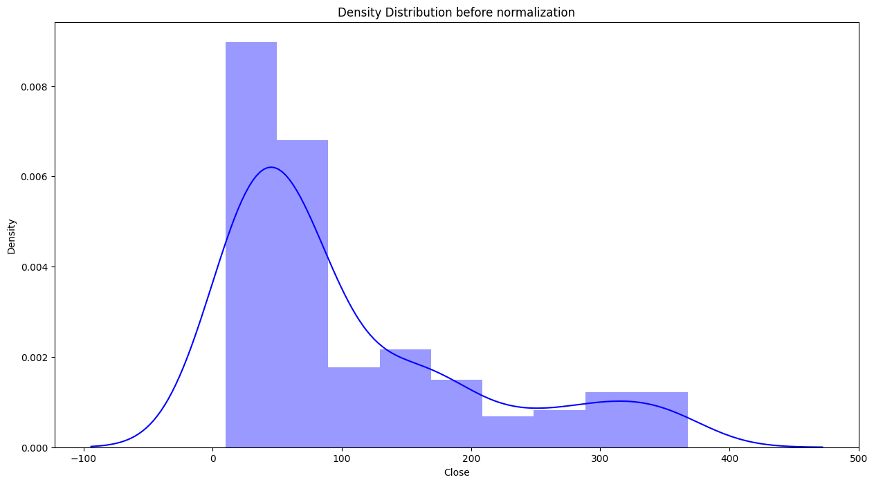
DENSITY Distribution of dependent variable (Close Price of stock).
It is a rightly skewed distribution.
We need to do log transformation to make it normal distribution.

Slide 10
TRANSFORMATIONS
We know that in the regression analysis the response variable should be normally distributed to get better prediction results.
Below are some types of ways to deal above type of problem.
square-root for moderate skew: sqrt(x) for positively skewed data, sqrt(max(x+1) - x) for negatively skewed data.
log for greater skew: log10(x) for positively skewed data, log10(max(x+1) - x) for negatively skewed data
inverse for severe skew: 1/x for positively skewed data 1/(max(x+1) - x) for negatively skewed data
Linearity and heteroscedasticity: First try log transformation in a situation where the dependent variable starts to increase more rapidly with increasing independent variable values If your data does the opposite – dependent variable values decrease more rapidly with increasing independent variable values – you can first consider a square transformation.
Most of the data scientists claim they are getting more accurate results when they transform the independent variables too.
It means skew correction for the independent variables.
Lower the skewness better the result.

Slide 11
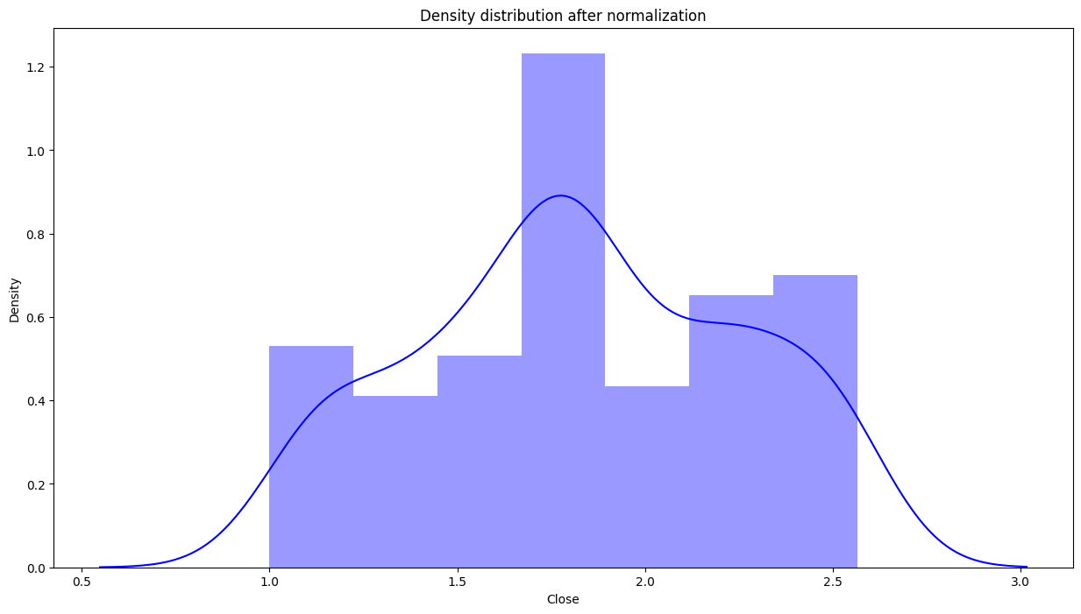
DENSITY Distribution of dependent variable (Close Price of stock After Transformation).
As we can see after using log transformation the density distribution looks normal.

Slide 12
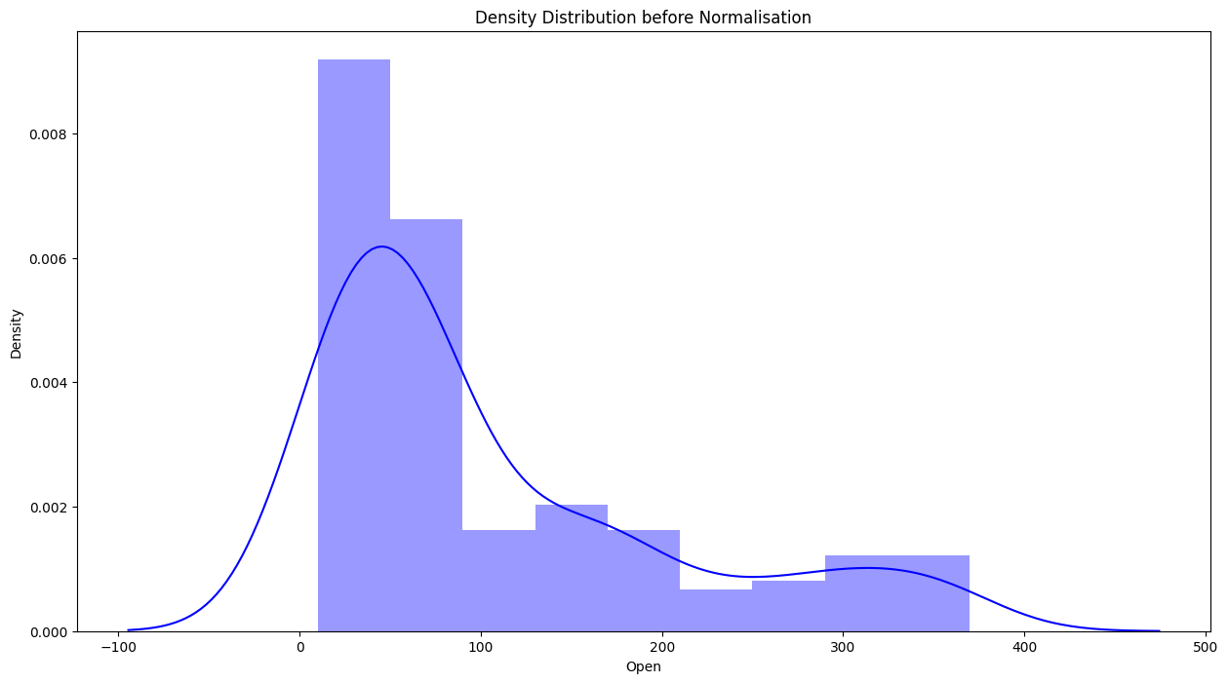
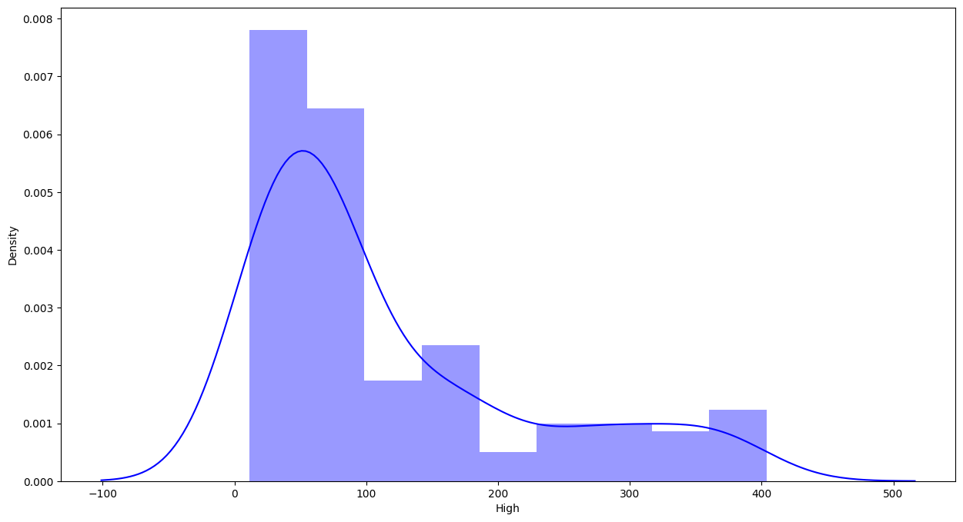
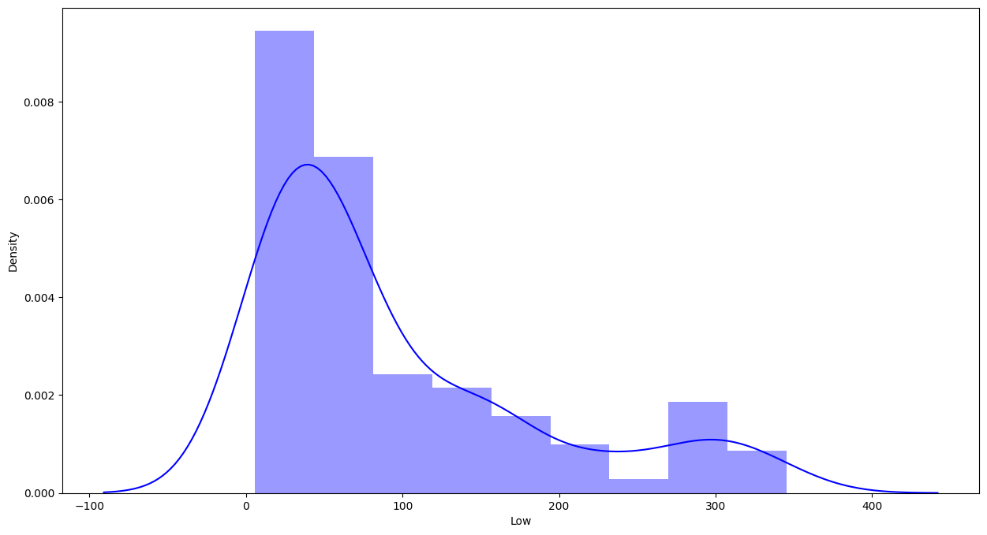
DENSITY DISTRIBUTION OF INDEPENDENT VARIABLES (HIGH,LOW,OPEN)
(OPEN)
(HIGH)
(LOW)
It looks like all independent variables are right skewed and we have to apply log transformation to make distribution normal.

Slide 13
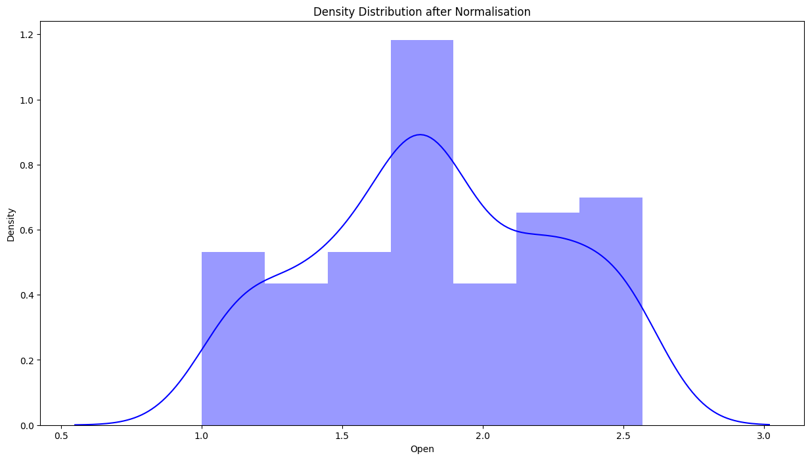
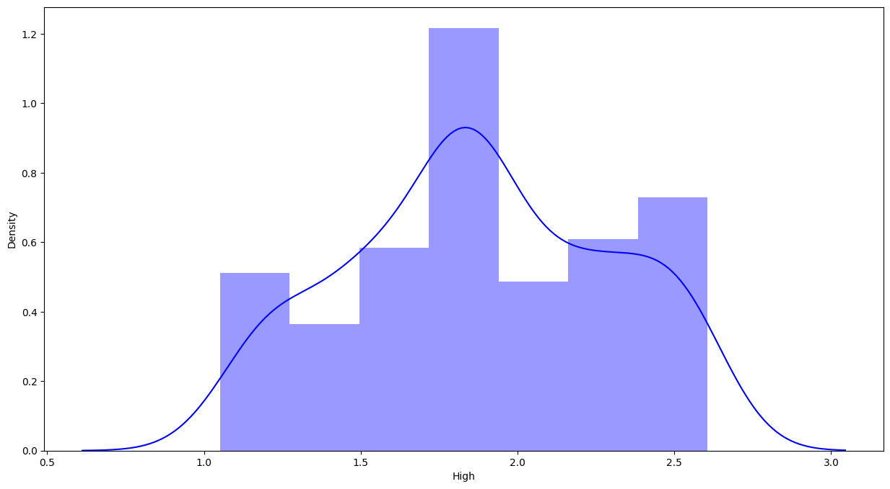
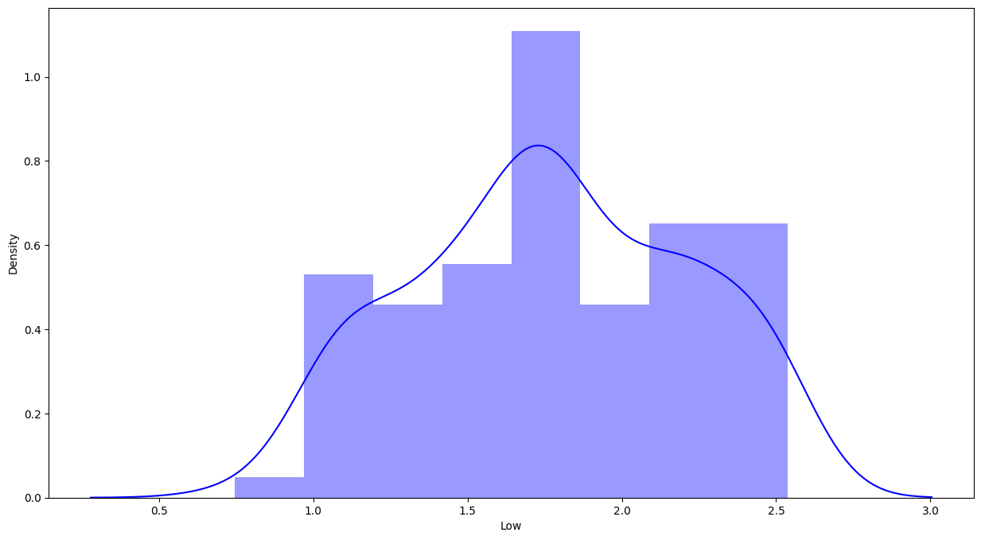
DENSITY DISTRIBUTION OF INDEPENDENT VARIABLES (HIGH,LOW,OPEN AFTER TRANSFORMATION)
(OPEN)
(HIGH)
(LOW)
As we can see after using log transformation the density distribution looks normal.

Slide 14
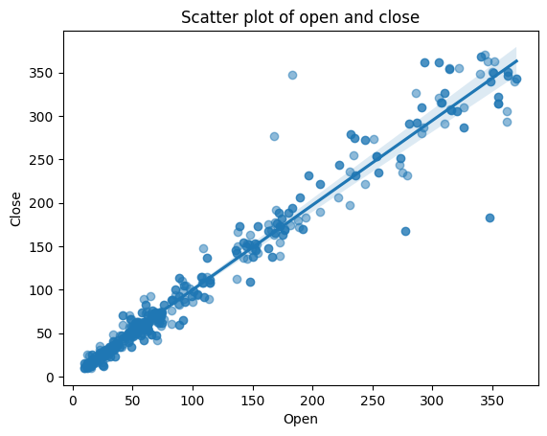
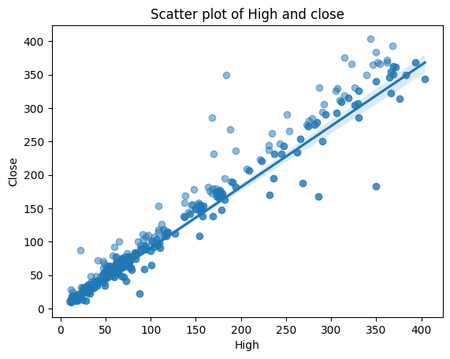
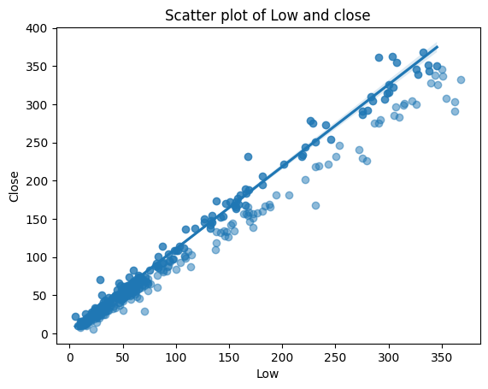
Scatter plot with best fit line
Plotting a scatter plot with data points can help you to determine whether there’s a potential relationship between them.

Slide 15
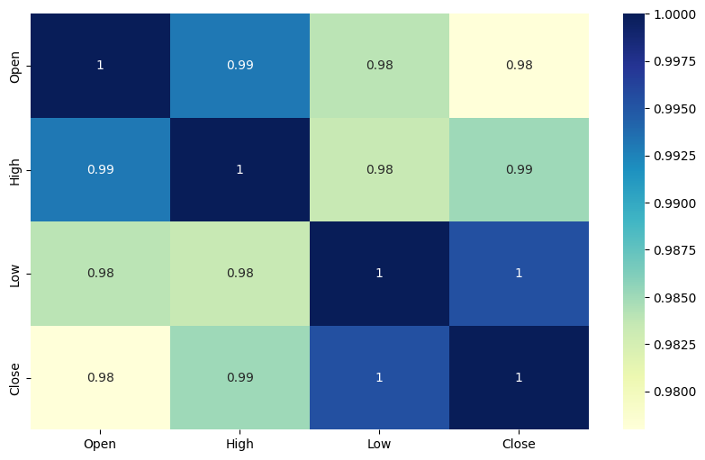
HEATMAP TO SEE THE CORRELATION
There are very high correlations between independent variables which lead us to multicollinearity.
High multicollinearity is not good for fitting models and prediction because a slight change in any independent variable will give very unpredictable results.

Slide 16
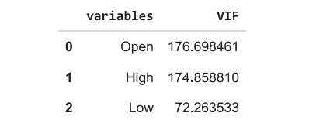
VIF (VARIANCE INFLATION FACTOR)
Variance inflation factor (VIF) is a measure of the amount of multicollinearity in a set of multiple regression variables.
In general case, Any variable having VIF above 5 is considered to be highly multicollinear.
The thumb rule is to drop the highest VIF variable. However, you may choose to select the variable to be dropped based on business logic.

Slide 17
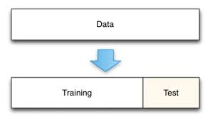
DATA MODELLING
Splitting data
X = Independent variable(High, Low ,Open )
Y = Dependent variable(Close)
Splitting train-test data with 80-20 Data must be normally distributed before applying normalization. Normalization is one of the feature scaling techniques. We particularly apply normalization when the data is skewed on either axis i.e. when the data does not follow the Gaussian distribution. In normalization, we convert the data features of different scales to a common scale which further makes it easy for the data to be processed for modeling. Thus, all the data features(variables) tend to have a similar impact on the modeling portion. We have used z score and log transformation.
80% data
20% data

Slide 18
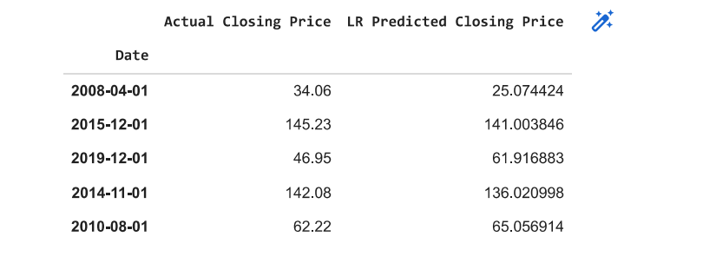
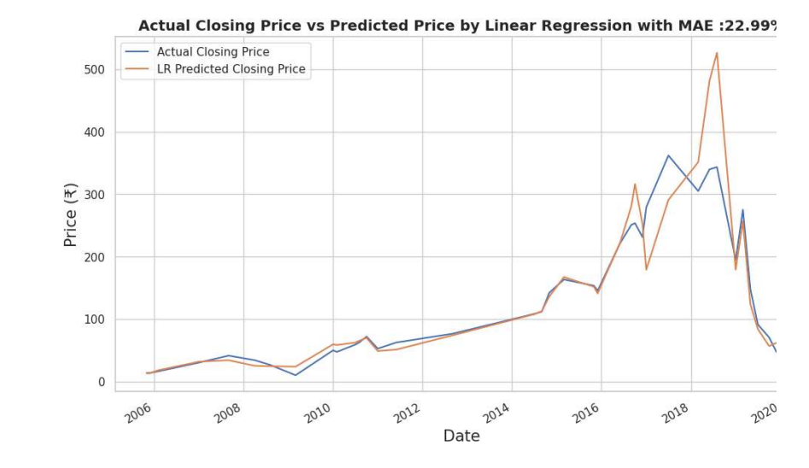
Linear regression
Linear regression is one of the easy and popular Machine Learning algorithms.
It is a statistical method that is used for predictive analysis.
Linear regression makes predictions for continuous or numeric variables such as sales, salary, age, product price, etc.
The linear regression algorithm shows a linear relationship between a dependent (y) and one or more independent (y) variables, hence called linear regression.
Since linear regression shows the linear relationship, which means it finds how the value of the dependent variable is changing according to the value of the independent variable.
We got a score of 94.29 for R squared value.

Slide 19
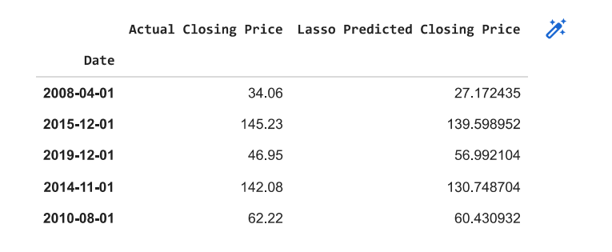
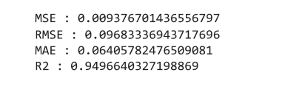
LASSO REGRESSION
Lasso regression is linear regression, but it uses a technique called "shrinkage" where the coefficients of determination shrink towards zero.
Linear regression gives you regression coefficients as observed in the dataset.
The lasso regression allows to shrink or regularize coefficients to avoid overfitting and make them work better on different datasets.
This type of regression is used when the dataset shows high multicollinearity or when you want to automate variable elimination and feature selection.
We got score of 94.96 for R squared value.

Slide 20
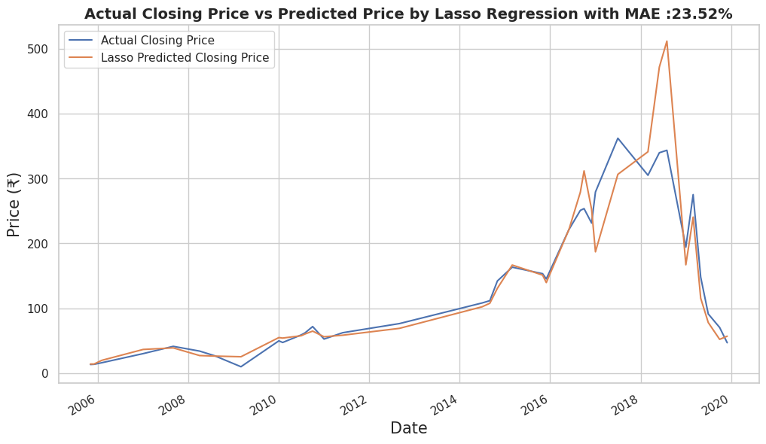
Cross ValIDation of Lasso Regression

Slide 21
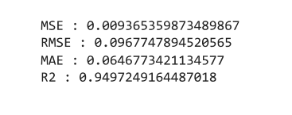
Ridge Regression
Ridge regression is a regularized version of linear least squares regression.
It works by shrinking the coefficients or weights of the regression model toward zero.
This is achieved by imposing a squared penalty on their size.
This is one of the methods of regularization techniques in which the data suffer from multicollinearity.
In this multicollinearity, the least squares are unbiased and the variance is large and which deviates the predicted value from the actual value. Equations have an error term.
We got a score of 94.97 as R squared value.

Slide 22
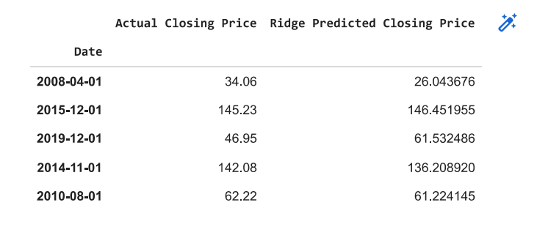
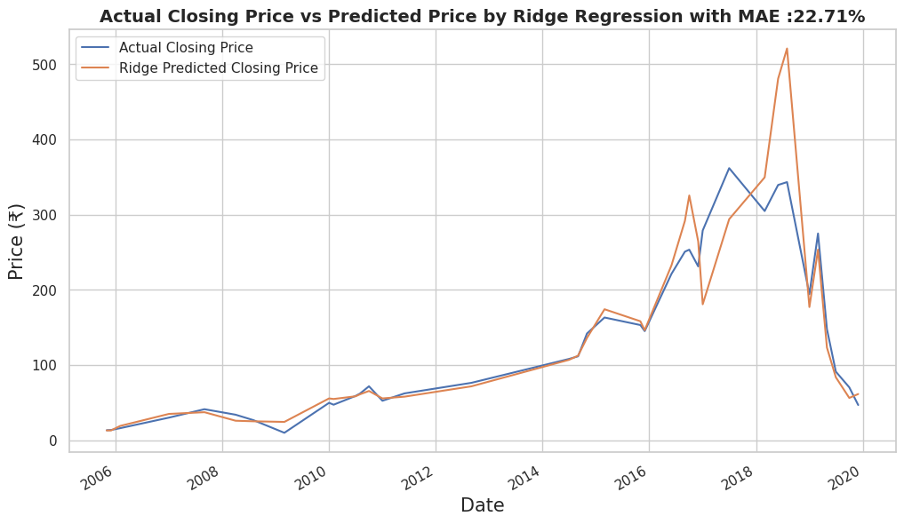
Cross Validation of Ridge Regression

Slide 23
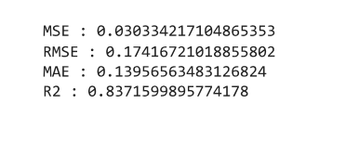
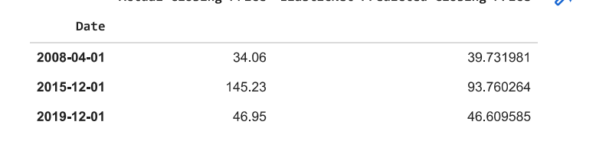
Elastic Net Regression
Elastic Net Regression is the third type of Regularization technique.
It came into existence due to the limitation of the Lasso regression.
Lasso regression cannot take correct alpha and lambda values as per the requirement of the data.
The solution for the problem is to combine the penalties of both ridge regression and lasso regression.
We got a score of 83.75 as R squared value.

Slide 24
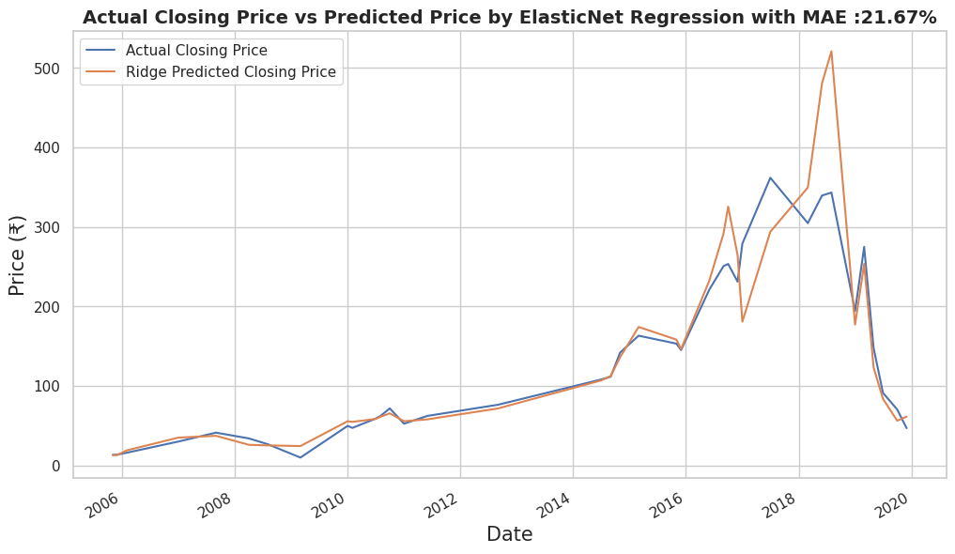
Cross Validation of Elastic Net

Slide 25
CHALLENGES
While deciding on the independent variables we faced difficulty as there were very limited parameters and they were having very high collinearity with the dependent variable.
The disadvantage of Linear regression while predicting stock prices is that it is highly limited in its scope.
Many predictors cannot be used, which is required to solve the stock price prediction problem.
According to our observation we concluded that such problems can be better handled by using time series forecasting using FbProphet.

Slide 26
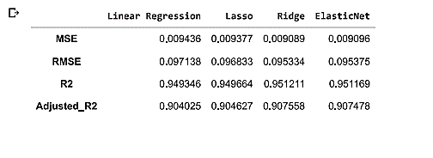
CONCLUSION
There is increase in trend of Yes Bank's stock Close, Open.
High, Low price till 2018 and then sudden decrease.
3. We observed that open vs close price graph concluded that after 2018 yes bank's stock hitted drastically.
4. We saw Linear relation between the dependent and independent value.
5. There was a lot of multicollinearity present in data.
6. The target variable is highly dependent on input variables.
Ridge and ElasticNet Regression has given the best results with the lowest MSE, RMSE scores evaluation metrics.
Lasso regression did feature selection and ended up giving up worse results than ridge which again reflects the fact that each feature is important (as previously discussed).
There is increase in trend of Yes Bank's stock .

Slide 27
References
Stack overflow
II. GeeksforGeeks
III. Analytics Vidhya
IV. Almabetter
V. github
VI. Towards data science

Slide 28
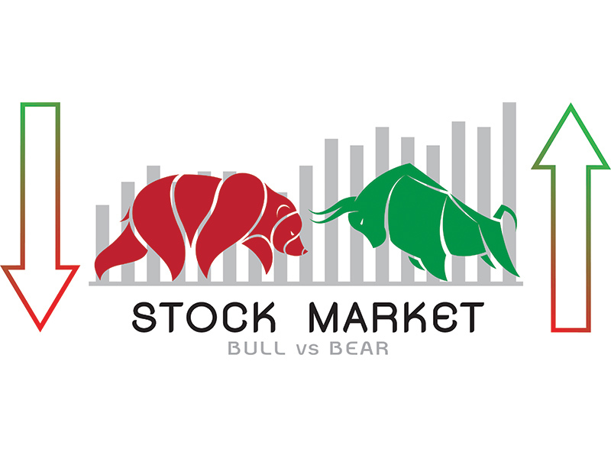
THANKYOU

