Slide 1
Restaurant Growth PPT
SkyCity Auckland Restaurants & Bars
Growth potential • profitability • channel strategy • strategic classification
Project 2 • Restaurant Growth Analysis • 1/10

Slide 2
1. Business Objective
Turn restaurant-level operating data into practical growth decisions.
Identify where growth potential is strongest across restaurants, segments and subregions.
Compare profitability across in-store, third-party delivery and self-delivery channels.
Build a transparent Growth Potential Score to classify restaurants into Low, Medium and High potential.
Translate the analysis into actions for revenue growth, channel optimization and margin improvement.
Project 2 • Restaurant Growth Analysis • 2/10

Slide 3
2. Dataset & Data Audit
1,696 restaurant records • 30 source fields • no missing values
Restaurants
1,696
unique restaurant records
Source fields
30
operational + financial
Monthly orders
2.02M
across all restaurants
Revenue
$77.74M
aggregated channel revenue
Dimensions: cuisine, segment and Auckland subregion.
Operating measures: AOV, orders, delivery radius and delivery cost.
Financial measures: revenue, COGS, OPEX, commission and channel-level net profit.
Quality check: channel orders reconcile exactly to MonthlyOrders for every record.
Project 2 • Restaurant Growth Analysis • 3/10

Slide 4
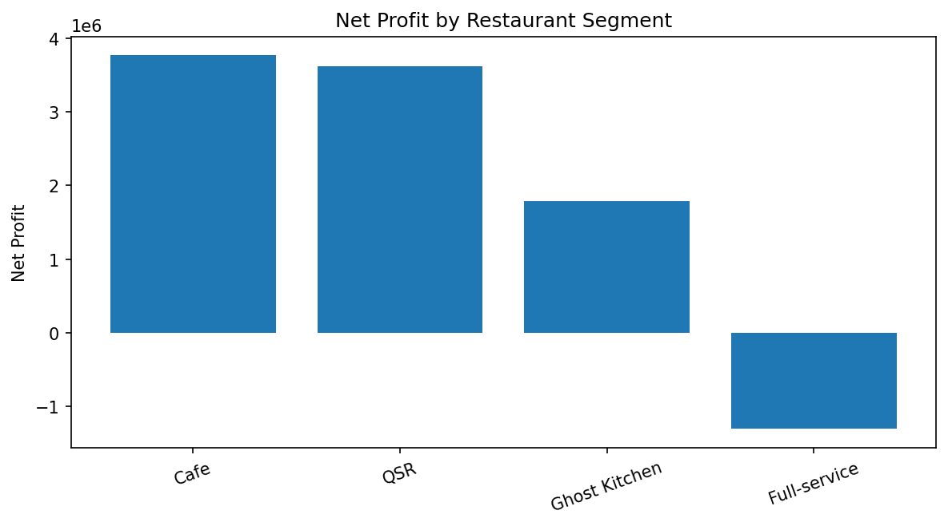
3. Overall Business Snapshot
The dataset shows strong revenue scale, but profitability varies sharply by channel and format.
Total revenue
$77.74M
all channels
Net profit
$7.87M
all channels
Profit margin
10.1%
portfolio-level
Monthly orders
2.02M
combined channels
Full-service restaurants generate $1.30M in net losses in the dataset.
In-store and self-delivery are substantially more profitable than third-party delivery channels.
High growth potential is concentrated in South Auckland and West Auckland, while CBD records carry a lower growth factor.
Project 2 • Restaurant Growth Analysis • 4/10

Slide 5
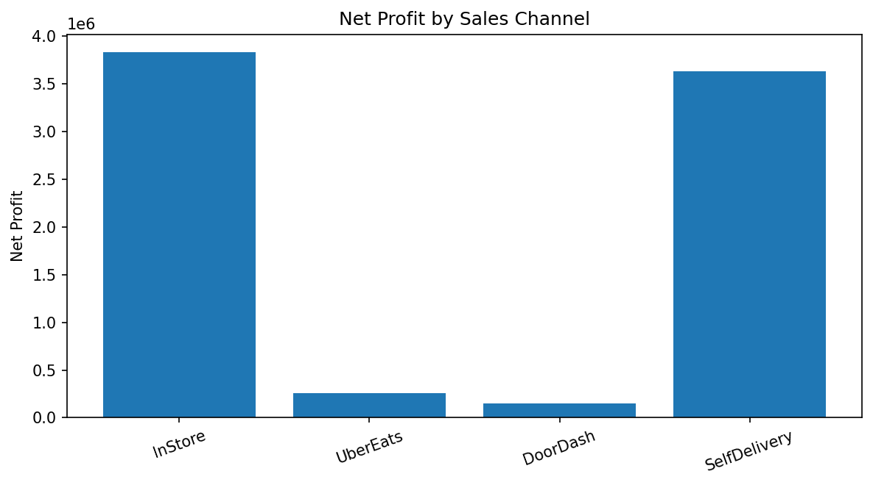
4. Channel Profitability
Revenue scale does not automatically translate into profit.
In-store margin: 26.8%
Self-delivery margin: 22.9%
Uber Eats margin: 0.8%
DoorDash margin: 0.9%
Third-party channels carry high commission exposure; 31.7% of restaurants are loss-making on each of Uber Eats and DoorDash in this dataset.
Project 2 • Restaurant Growth Analysis • 5/10

Slide 6
5. Segment Performance
Format economics reveal where operational models are working best.
Cafe: 3.77M profit • 16.2% margin
QSR: 3.61M profit • 15.1% margin
Ghost Kitchen: 1.78M profit • 22.2% margin
Full-service: -1.30M profit • -5.8% margin
Project 2 • Restaurant Growth Analysis • 6/10

Slide 7
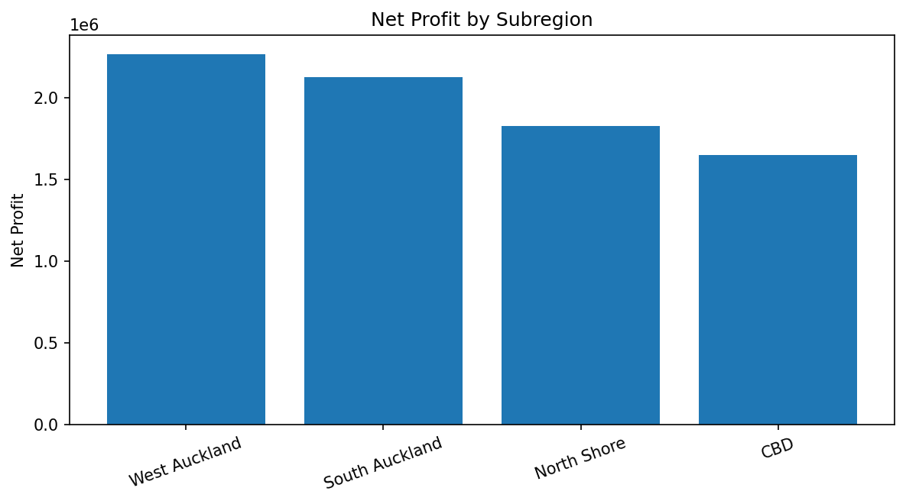
6. Where Growth Is Concentrated
Subregion growth factors provide a clear geographic signal.
South Auckland: growth factor 1.05; 441 restaurants.
West Auckland: growth factor 1.04; 462 restaurants.
North Shore: growth factor 1.03; 383 restaurants.
CBD: growth factor 0.99; 410 restaurants.
Top cuisine by net profit: Burgers ($2.33M).
Project 2 • Restaurant Growth Analysis • 7/10

Slide 8
7. Growth Potential Model
A transparent composite score converts multiple business signals into one decision metric.
Growth factor
30%
model weight
Profit margin
35%
model weight
Monthly orders
20%
model weight
AOV
15%
model weight
Each feature is min-max normalized to a 0–100 scale.
The weighted score ranges from 0 to 100.
Classification uses portfolio score bands: Low < 45.8; Medium 45.8–63.5; High > 63.5.
The model is designed as a prioritization tool, not a guarantee of future performance.
Project 2 • Restaurant Growth Analysis • 8/10

Slide 9
8. Strategic Classification
High-potential restaurants combine stronger economics with stronger growth signals.
High potential
509
restaurants
High-potential profit
$4.93M
aggregate
High-potential margin
17.6%
aggregate
HIGH: prioritize expansion, menu optimization, local demand capture and self-delivery capacity.
MEDIUM: improve conversion, AOV and channel mix before major expansion.
LOW: focus on cost control, third-party commission reduction and format-specific turnaround actions.
The high class contains 197 Cafe, 186 QSR and 110 Ghost Kitchen restaurants, but only 16 Full-service restaurants.
Project 2 • Restaurant Growth Analysis • 9/10

Slide 10
9. Strategic Action Plan & Next Step
Use the scorecard to move from analysis to targeted intervention.
1 • Protect profitable channels: strengthen in-store and self-delivery where unit economics are favorable.
2 • Reprice or redesign weak delivery offers: review commissions, menu pricing, bundles and minimum order values.
3 • Prioritize South & West Auckland growth pockets using the restaurant-level score.
4 • Review full-service economics: the segment is loss-making in aggregate despite meaningful revenue volume.
5 • Build a Streamlit dashboard with filters for subregion, segment, cuisine, channel and growth class.
Next: publish the dashboard + documentation, then capture the project feedback video for submission.
Project 2 • Restaurant Growth Analysis • 10/10

