Slide 1
Healthy humans
Your fitness friend – A website by Neha Abrol

Slide 2
Index – Divided into 2 sections
1.Demo of the application with screenshots
2.Overview of the Technology used

Slide 3
1.Demo of the application

Slide 4
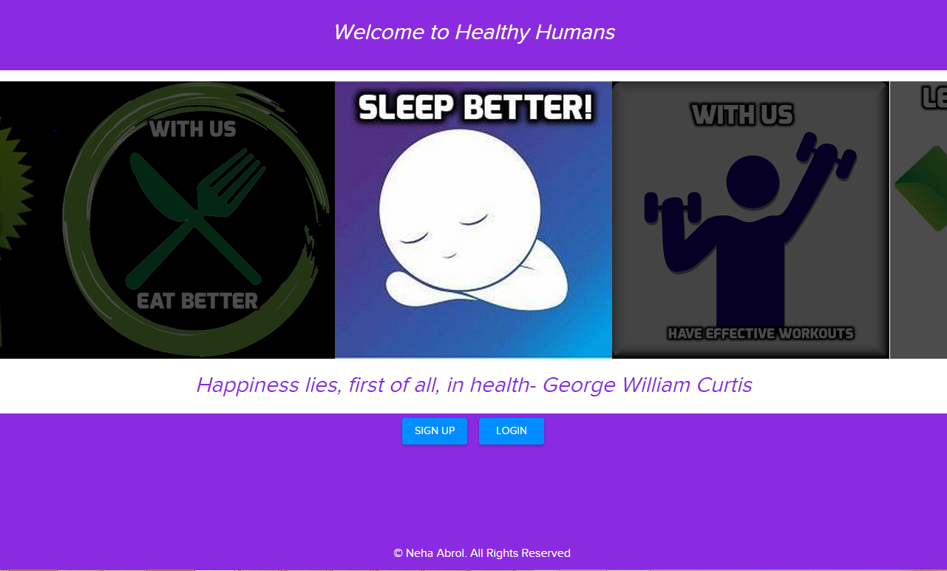
About Us
Healthy Humans allows you to plan and track healthy meals and physical activities.
Users can use their unique logins to access their profiles.

Slide 5
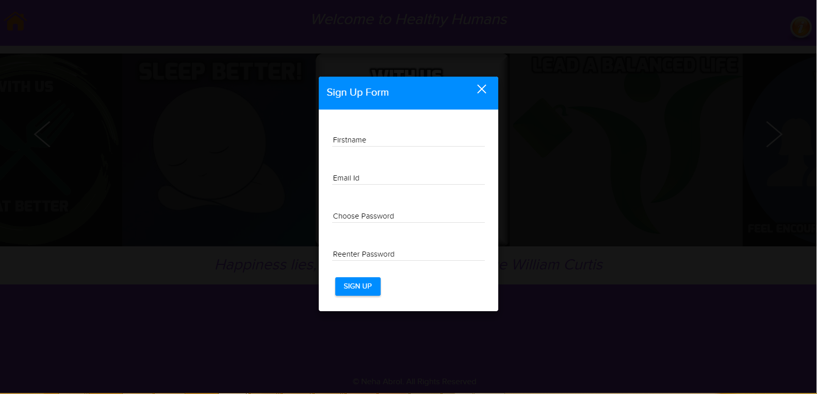
New User – Sign Up Form
Validations
All form fields are mandatory.
Errors are thrown if email id is invalid or any of the mandatory field is missed.

Slide 6
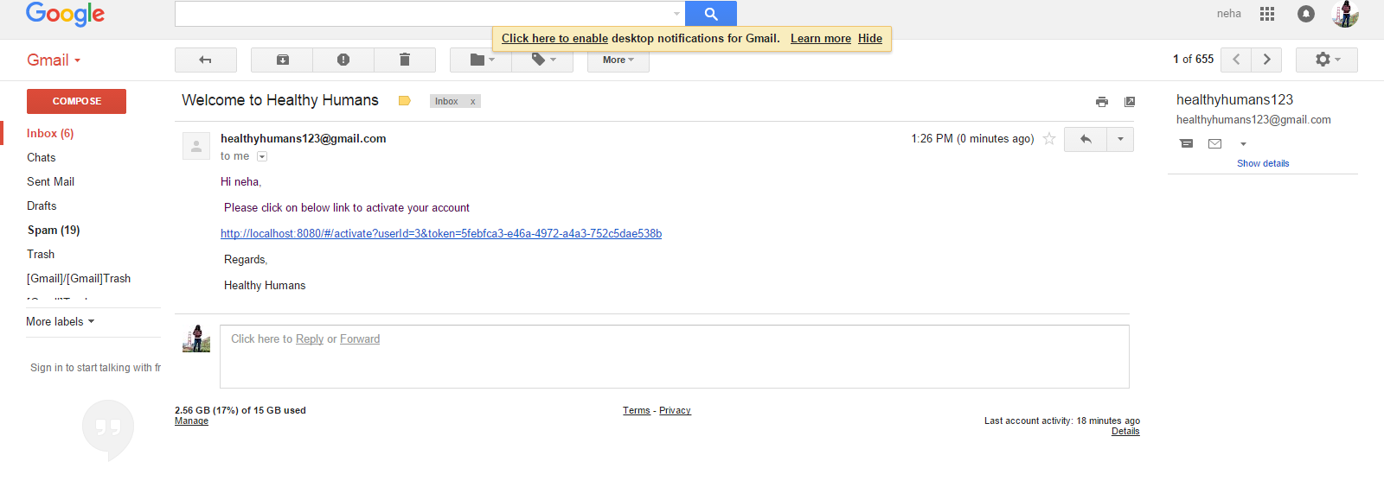
Email is sent to user-He needs to click the verification link to access his profile. Note a unique token is generated and sent so that user can be validated.

Slide 7

User clicks on verification link
If the link is valid (user is validated against) then activation is successful
Following page is displayed
Link :
http://localhost:8080/#/activate?userId=3&token=5febfca3-e46a-4972-a4a3-752c5dae538b

Slide 8
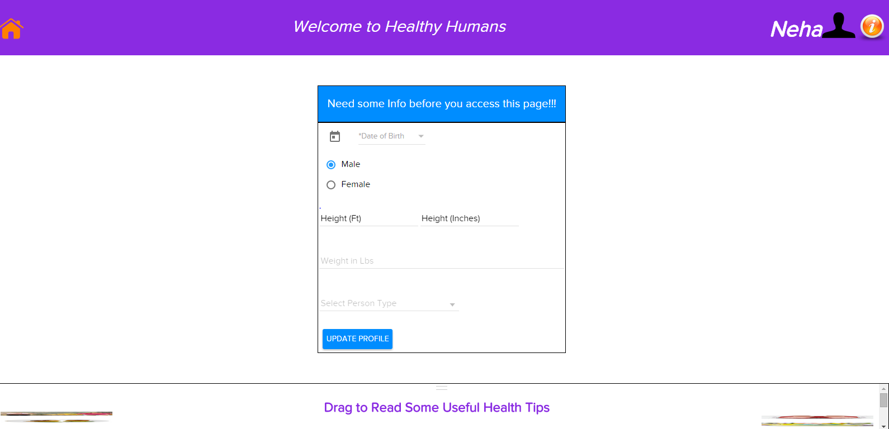
User logs in from Home Page
Default profile page has a form to get more information from user.
Again Form has validations and once user submits form he is redirected to the actual profile page

Slide 9
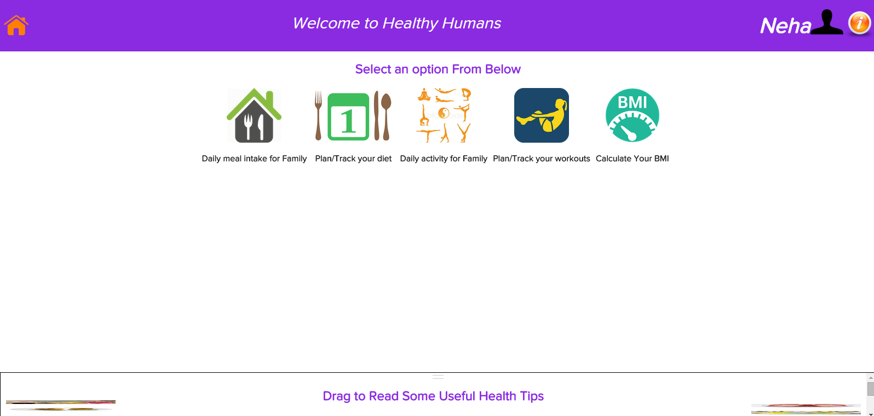
Navigating options on Profile page
It has multiple options. User can select any

Slide 10
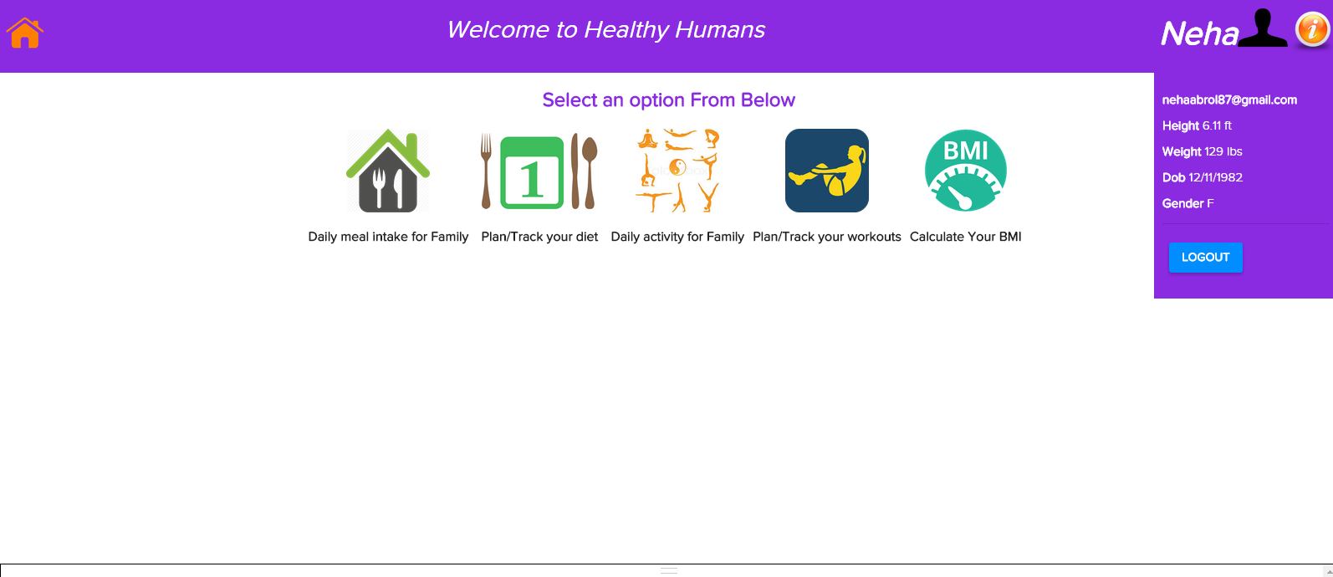
User info Panel displays all user info at a glance

Slide 11
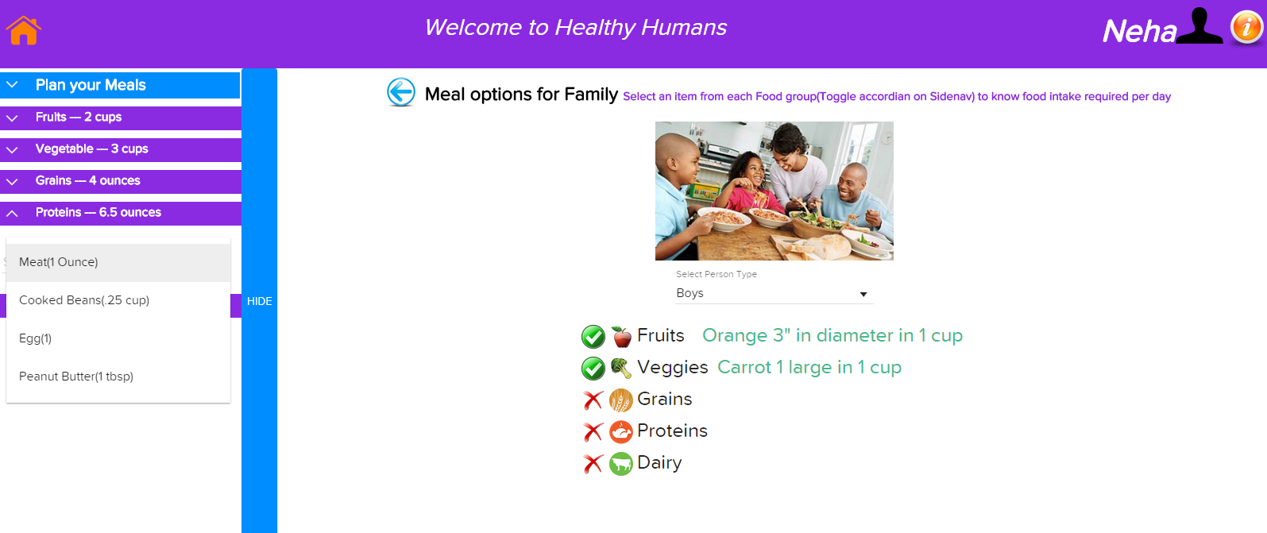
Daily meal intake for family
User can select person type and food type and amount needed daily is displayed next to it

Slide 12
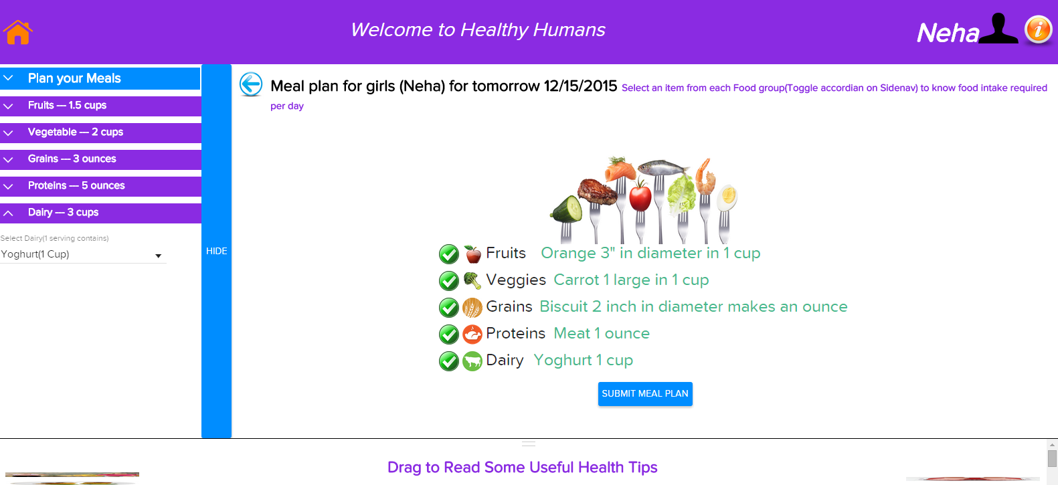
Plan/Track your diet- Clicks back button and goes to default option
Before being able to track his progress user must submit diet plan for tomorrow

Slide 13
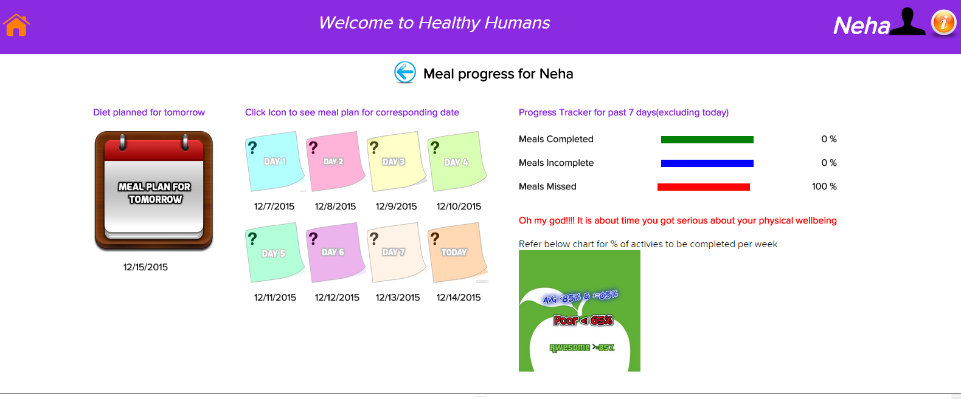
User is redirected to following view once he submits meal plan
Since this is a new user there are no meal plans for past 7 days
(indicated by question mark on each day)

Slide 14
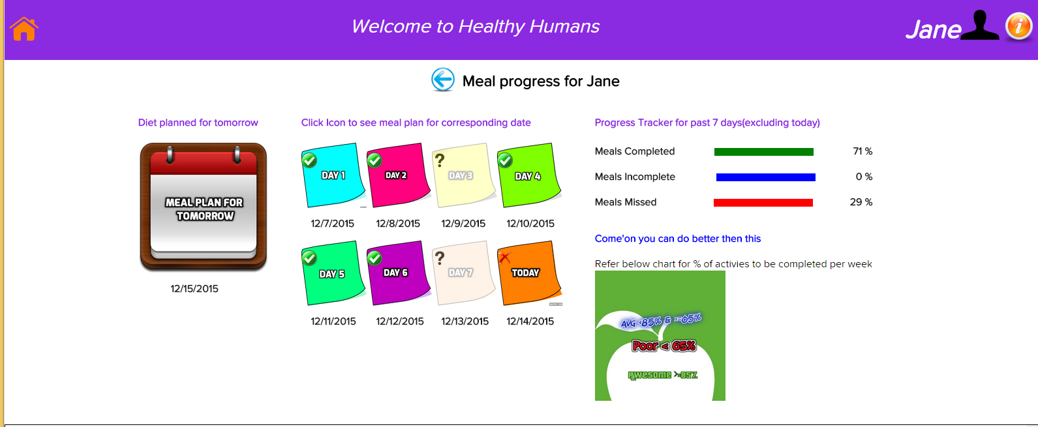
Another user with some activity since last 7 days

Slide 15
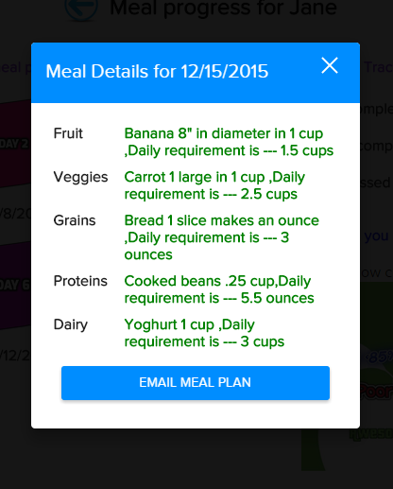
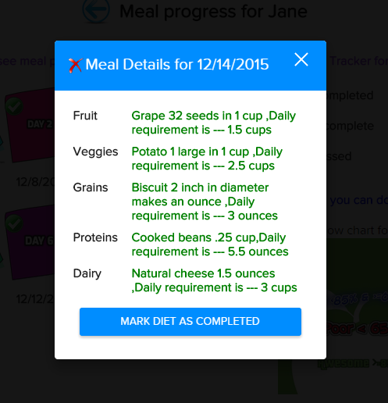
User can click on icon and get meal plan for that day
Meal plan for other dates
User has option to mark his diet as completed for a date
Meal plan for tomorrow
He can email himself the plan

Slide 16
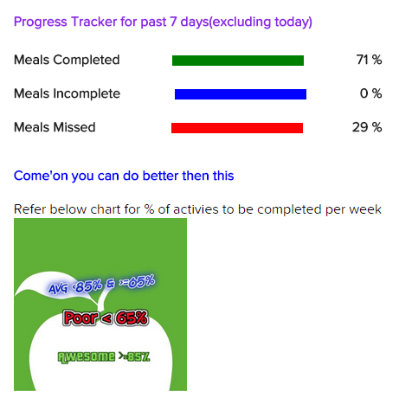
Progress is displayed to user

Slide 17
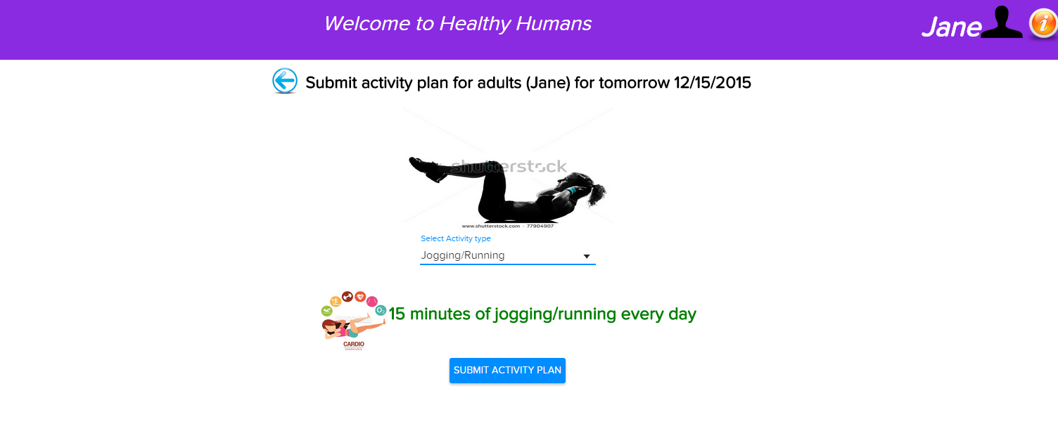
Activity options are same as meal
User can submit activity plan and track progress

Slide 18
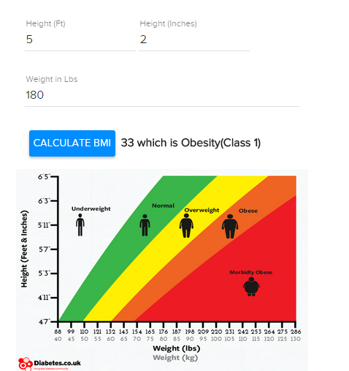
Calculate BMI

Slide 19
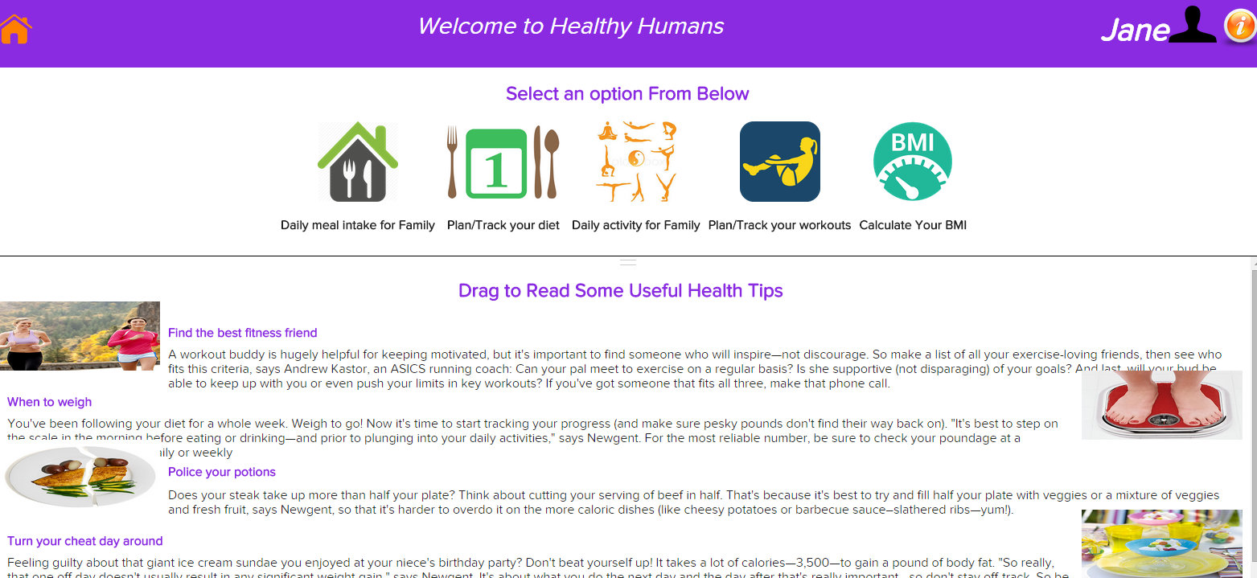
Health Tips
There is a drag gable drawer which can be used to drag up and down to read health tips(space reusability☺

Slide 20
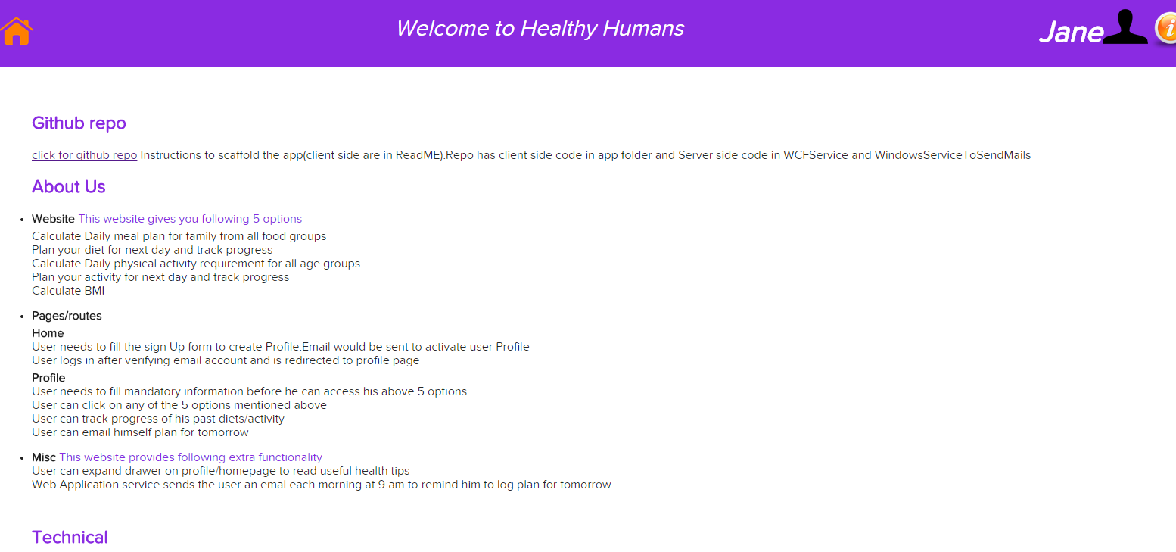
Info Page – Click on the (i) in header
It gives app specific information

Slide 21
User is sent Email everyday at 9 am
I have written a Web Application service to send email to users at 9am to remind them to log their meals/activity for the day. This way user can be reminded to log meals/activity in case they forget.
I am having some domain issues so am unable to demonstrate it.
References http://www.aspsnippets.com/Articles/Simple-Windows-Service-that-runs-periodically-and-once-a-day-at-specific-time-using-C-and-VBNet aspx

Slide 22
2.Technology overview

Slide 23
Client Side
Angular 1.4.0-rc.1
Angular Materials Design
Type Script 1.5.0-alpha (Superset of Javacript)
Angular2 Router / UI-Router
Gulp
Jspm for package management (Node modules are only used for gulp plugins)
Express.js - Used as a development server with proxy

Slide 24
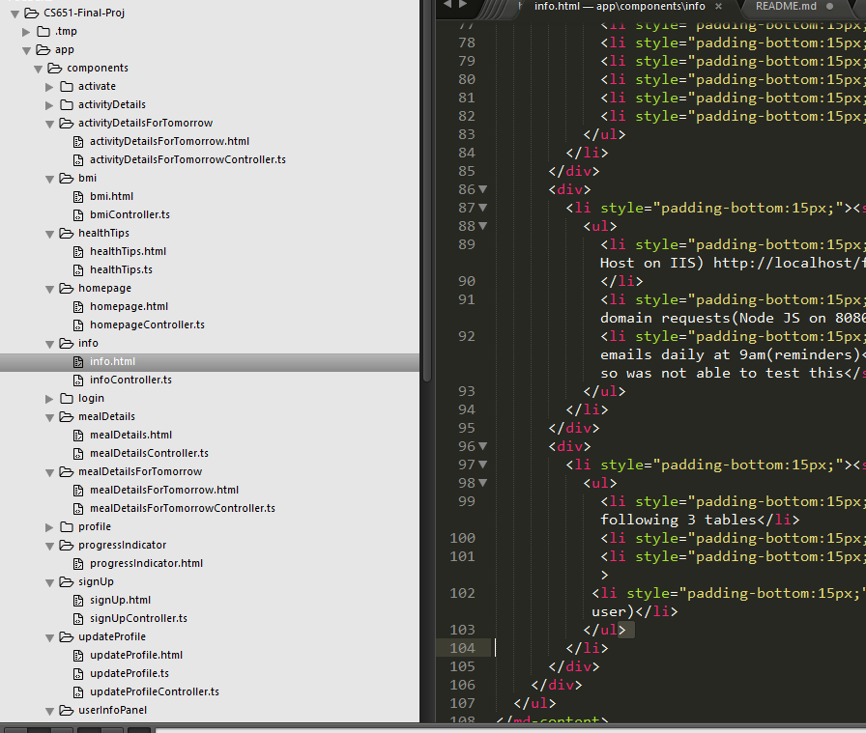
Controllers /Routes and Services
I have used MVC model where my app is divided into view ,model and controllers.
Services have been used to fire http requests.
Main.ts (has directives,controller,services)
Application-config-Routing info

Slide 25
Server Side
WCF service for server side code(Hosedt on IIS) http://localhost/finalservice/Service.svc/
It act like a restful API catering to AJAX requests
Global.asax file to allow cross domain requests(Node JS on 8080)
Web application service for sending emails daily at 9am(reminders) I was running into installation issues so was not able to test this

Slide 26
Global.asax file
It had been created since I was getting CORS errors(Cross domain requests).
This allows all PUT,POST,GET requests from localhost:8080 on which my app is running (Node JS)

Slide 27
WCF Service
It is where all the server side functionality takes place.
It received requests (POST,GET) from the application and sends JSON response.
Each action has a separate service method eg (signup,login,verify user,submit meal plan etc)

Slide 28
Database – Healthy Humans
Users Table – Primary key is user id (It has all user related information)
Meals table – Primary key is combination of email and date
Activity table – Primary key is combination of email and date

Slide 29
Thank you!

