Slide 1
EXACTSPACE TASK-2
Architecture Diagram
BY NEHA KV(1RN22CS099)

Slide 2
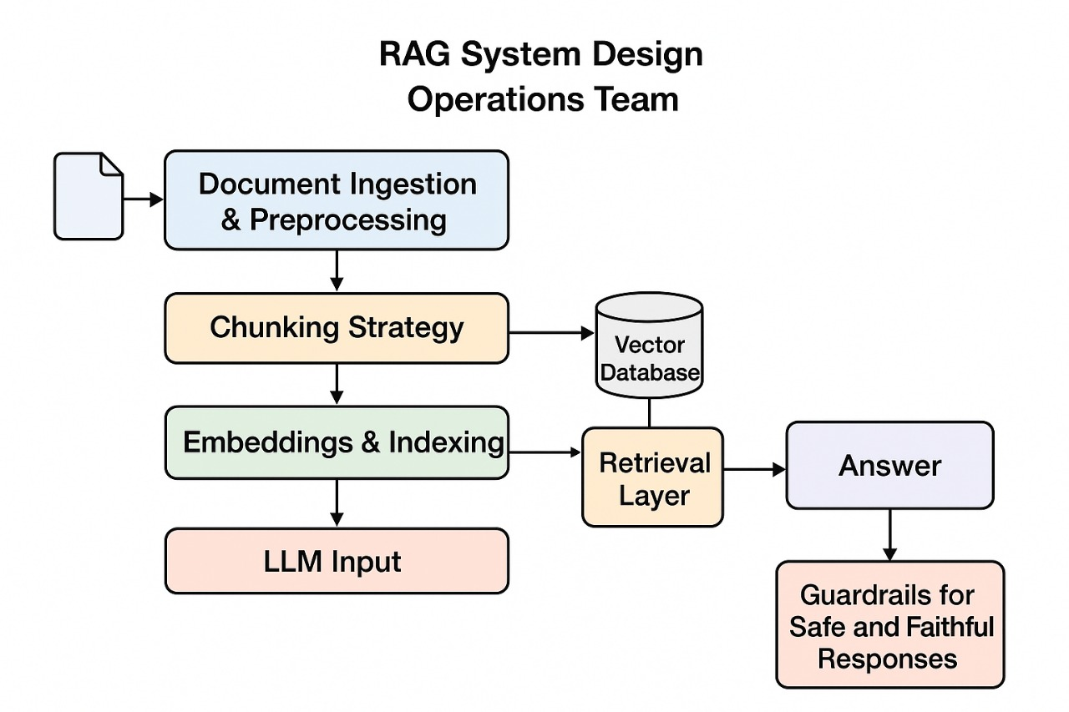
RAG System Architecture

Slide 3
RAG System Architecture
1. Document Ingestion & Preprocessing
Collect and clean technical manuals or domain documents.
Convert PDFs and text files into machine-readable format.
2. Chunking Strategy
Split long documents into smaller, meaningful text chunks.
Maintain contextual continuity for accurate retrieval.
3. Embeddings & Indexing (Vector Database)
Generate vector representations using embedding models.
Store embeddings in a FAISS (or similar) vector database for fast similarity search.

Slide 4
RAG System Architecture
4. Retrieval Layer
Retrieve the most relevant document chunks for a user query.
Acts as a bridge between stored knowledge and the language model.
5. LLM Layer (Answer Generation)
Use a Large Language Model (LLM) to generate context-aware answers.
Combines retrieved content with user query to form responses.
6. Guardrails for Safe & Faithful Responses
Enforce factual, source-grounded, and safe answers.
Include prompts and validation to avoid hallucinations.

