Slide 1
Problem characteristic

Slide 2
Characteristics of Problem
1. Is the program decomposable into a set of independent smaller or easier sub-problems?
2. Can the solution steps be ignored or undone if they prove fruitless?
3. Is the problem’s universe predictable?
4. Is the good solution absolute or relative?
5. Is the desired solution a state of the problem’s world or a path to a state?
6. What is the role of knowledge about the problem’s domain?
7. Will the computer return the solution having fed the problem automatically or will the solution be obtained only after the interaction between the computer and the problem solver?

Slide 3
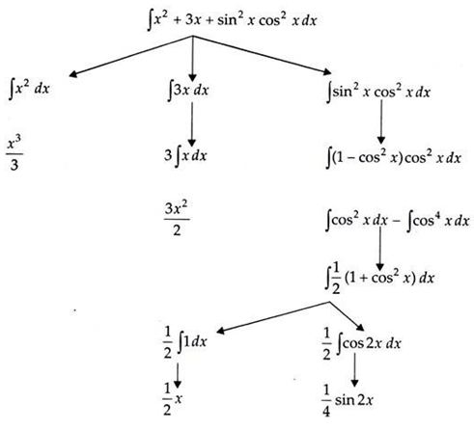
Is the program decomposable into a set of independent smaller or easier sub-problems?

Slide 4
This problem can be solved by breaking it down into three smaller problems, each of which can then be solved by using specific rules.
The problem tree is shown above.
At every step it is checked if the problem, can be solved directly, if so its value is given otherwise it is broken into smaller sub-problems.
Then by recursion method sub-problems are solved. The final solution is the sum of all the sub-problems.

Slide 5
2. Can the solution steps be ignored or undone if they prove fruitless?
This characteristic can be tackled from three different views: steps to the solution:
i. Can be ignored
ii. Have to be kept on record
iii. Are irrevocable (back tracked)
So consider three types of problems:
1. Mathematical,
2. 8-puzzle and
3. Playing chess.

Slide 6
1. Mathematical Problem:
If a particular trial, does not help getting the solution, nothing is lost, the problem still stands, what has been lost is the effort spent in exploring the blind alley, solution can be ignored, and a new one can be tried or in other words, the steps can be ignored.
2. 8-Puzzle Problem:
The 8-puzzle is a square tray in which are placed eight square tiles. The remaining ninth square is uncovered. Each tile has a number on it. A tile which is adjacent to the blank space can be sliced in to that space. The game consists of starting position and a specified goal position. The goal is to transform the starting position into the goal position by sliding the tiles around,

Slide 7
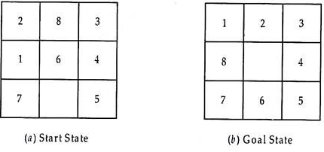
An additional step must be performed to undo each incorrect step, whereas no action was required in the mathematical theorem. In addition the control mechanism for an 8-puzzle solver must keep track of the order in which operations are performed so that operations can be undone one at a time, if necessary. The solution steps are recoverable indeed.

Slide 8
3. Playing Chess:
Suppose a chess-playing programme makes a stupid move and realised it a couple of moves later. Now, it cannot back track. Since the adversary has already moved and the state space has changed. All it can do is to try to make the best of the current situation and go from there. This is an irrecoverable game.

Slide 9
3. Is the Universe Predictable?
Considering 8-Puzzle Game:
In the single player game when a move is made it is known in advance what is going to happen. In 8-puzzle game; it is possible to plan an entire sequence of moves and become confident of the resulting state. Planning can be used to avoid undoing the moves, though sometimes backtracking may still be needed.
In board games such a planning process may not be possible at all. Suppose we want to play Bridge. Planning may not be possible at all which card has to be thrown first can be planned at the most. It is not possible to plan completely because we do not know where all other ‘cards’ are or what the other players would do in their turn.
At best we can investigate some moves plans and use probabilities of the various outcomes to choose a plan or a combination of plans to know the path which has the highest expected probability of leading towards a solution.
Thus, planning can be used to generate a sequence of actions which is guaranteed to lead to a solution. For uncertain-outcome problems planning can at best generate a sequence of operators which has a good probability of leading to a solution.
In such cases planning is continuously monitored after getting the necessary feedback.

Slide 10
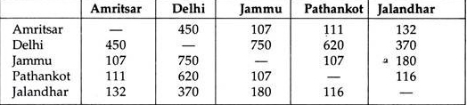
4. Is the Good Solution Absolute or Relative?
Consider now travelling salesman problem. Our goal is to find the shortest path so that the sales man visits each city exactly once. Suppose the cities we need to visit and the distances between them are known,

Slide 11
Let the salesman start from Jammu. He could follow the one path covering the total distance of 1252 Km. But is this the solution? We are not sure unless other alternate paths are covered. A second or third path can also be known, a second one is shown on the right hand side of the earlier traversal tree giving certainly first path as the answer, which is of course relative

Slide 12
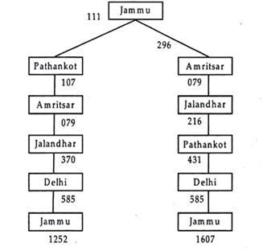

Slide 13
5. Is the Solution a State or a Path?
In some problems we are only interested in the state representing the solution, whereas in other cases we also want to know how we got to the solution, that is which is the optimum path.
Consider the problem of finding a consistent interpretation for a sentence: which is so common in natural language understanding.
The sentence can be:
The bank president ate a dish of fruity ice cream with the fork.
There are several components of this sentence, each of which in isolation, may have more than one interpretation, but the components must form a coherent ‘whole’ and so they constrain each other’s interpretation.
Some of the sources of ambiguity in this sentence are the following:
1. The word ‘bank’ may refer to either a financial institution or to a side of a river. But only one of these may have a president (of a financial institute).
2. The word ‘dish’ is the object of the word ‘eat’. Is it possible that a dish (of metal or paper) was eaten? So it is more likely that fruity ice cream in it was eaten.

Slide 14
Examples of State: Crossword puzzle, eight-queens problem, magic squares, natural language problem or mathematical theorem proving. The main interest is that the crossword is completed, how it is completed no one worries.
Examples of Path:
Travelling Salesman Problem:
He wants the route to be as short as possible
A Magic Square is a square of numbers where each row, column and diagonal adds upto the same number.
The 8-queen Problem is a classic placing problem. The goal is to place eight queens on a chess board such that no queen attacks any other (A queen attacks any piece in the same row, column or diagonal).
Towers of Hanoi Problem:

Slide 15
Role of Knowledge in Computing:
In chess playing suppose we have an efficient computer (a work station or even a super-computer) all the rules for determining legal moves are known and an efficient control strategy is also available, then the problem can be solved after the application of tactical moves.

Slide 16
Problem Solving
Problem Solving in games such as “Sudoku” can be an example. It can be done by building an artificially intelligent system to solve that particular problem. To do this, one needs to define the problem statements first and then generating the solution by keeping the conditions in mind.
Some of the most popularly used problem solving with the help of artificial intelligence are:
Chess.
Travelling Salesman Problem.
Tower of Hanoi Problem.
Water-Jug Problem.
N-Queen Problem.

Slide 17
Problem Searching
In general, searching refers to as finding information one needs.
Searching is the most commonly used technique of problem solving in artificial intelligence.
The searching algorithm helps us to search for solution of particular problem.
Problem
Problems are the issues which comes across any system. A solution is needed to solve that particular problem.

Slide 18
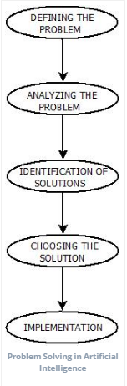
Solve Problem Using Artificial Intelligence
The process of solving a problem consists of five steps. These are:

Slide 19
Defining The Problem: The definition of the problem must be included precisely. It should contain the possible initial as well as final situations which should result in acceptable solution.
Analyzing The Problem: Analyzing the problem and its requirement must be done as few features can have immense impact on the resulting solution.
Identification Of Solutions: This phase generates reasonable amount of solutions to the given problem in a particular range.
Choosing a Solution: From all the identified solutions, the best solution is chosen basis on the results produced by respective solutions.
Implementation: After choosing the best solution, its implementation is done.

