Slide 1
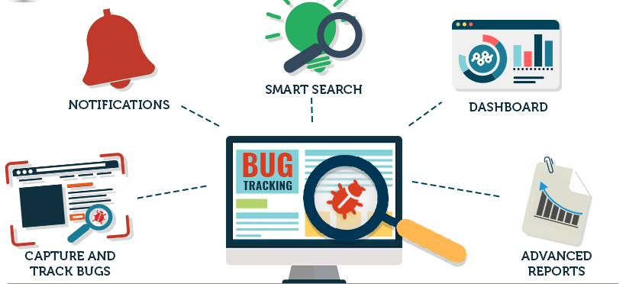
The BUG TRACKING SYSTEM
Team: BUG MAFIA

Slide 2



Team Members / Responsibilities
Neha Goud Baddam: Full Stack Developer
Reshmi Chowdary Divi: Back-end Developer
Prem Kumar Maddula: Back-end Developer
Rahul Mandaloju: Frontend Developer
Vamsi Sai Konidena: Frontend Developer
Harika Uppalapati: UI Developer
Purandhara Maharshi Chidurala: UI Developer
Shiva Surya Vardhan Reddy: Testing and Documentation

Slide 3

CONTENTS:
Project description
Modules
Technical Requirement
Project Timeline and Milestones
Gantt Chart
PERT Chart
Risk Analysis
Risk Management
Next Steps

Slide 4

Project Description:
The Bug tracking System is an application that helps in tracking tickets raised to resolve bugs in a system/project.

Slide 5
Modules
A bug is reported in the project/system by the customer through the website by an agent.
Manager Module: Once the ticket is created, manager looks for new tickets created and assigns it to the staff. Manager has authorities to move the ticket from one staff member to another.
Staff Module: Once the ticket is assigned to the staff, they can change the status of the ticket until the bug is resolved.
Customer Module:
Manager Module:
Staff Module:

Slide 6
Technical Requirements
Core Programming Languages: python
Database Languages: SQL, Oracle DB
UI Coding Languages: HTML, CSS, Java Script
Tools: Zoom (For Meetings)

Slide 7
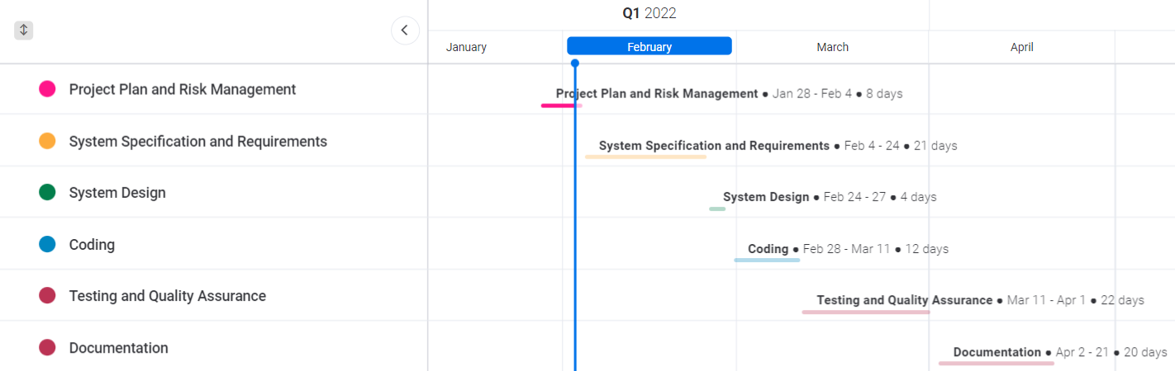
PROJECT TIMELINE AND MILESTONES

Slide 8
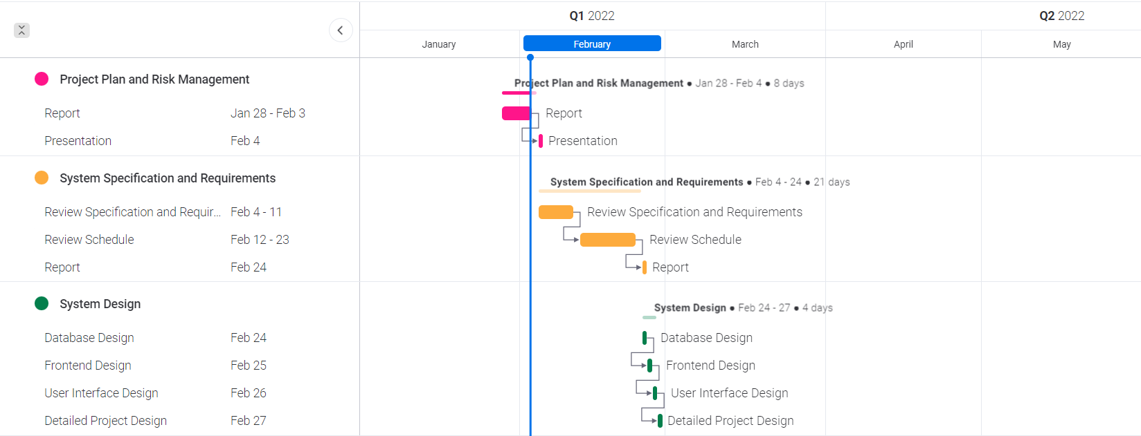
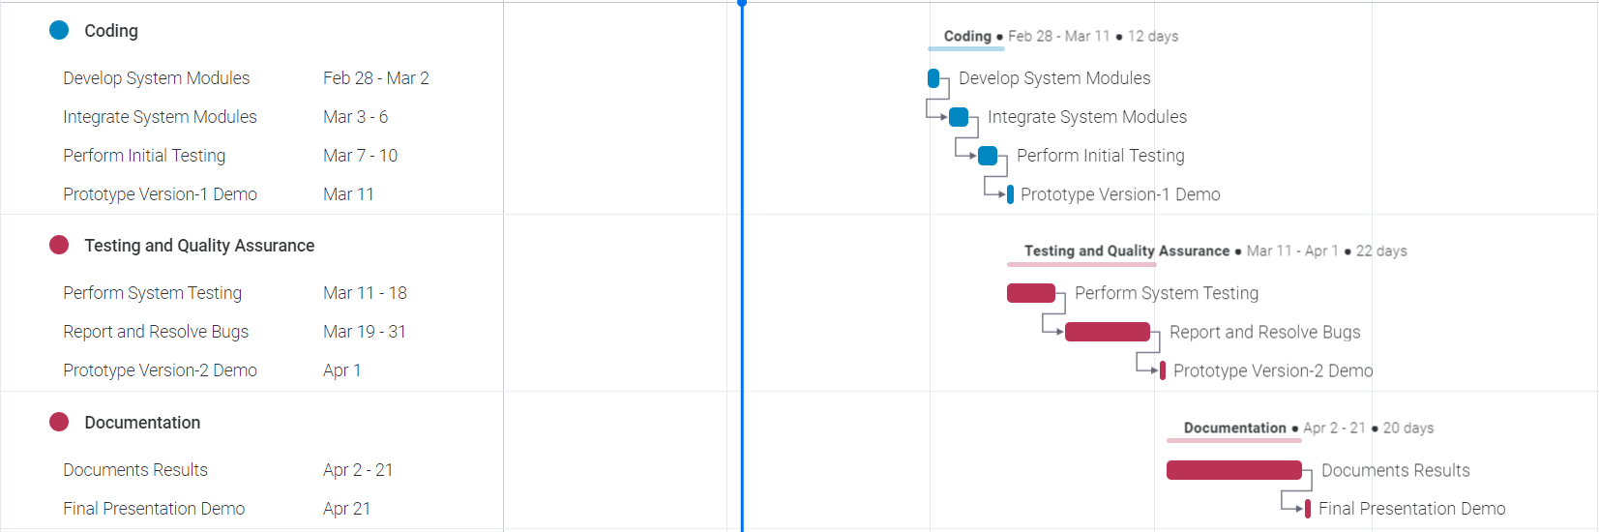
GANTT Chart

Slide 9
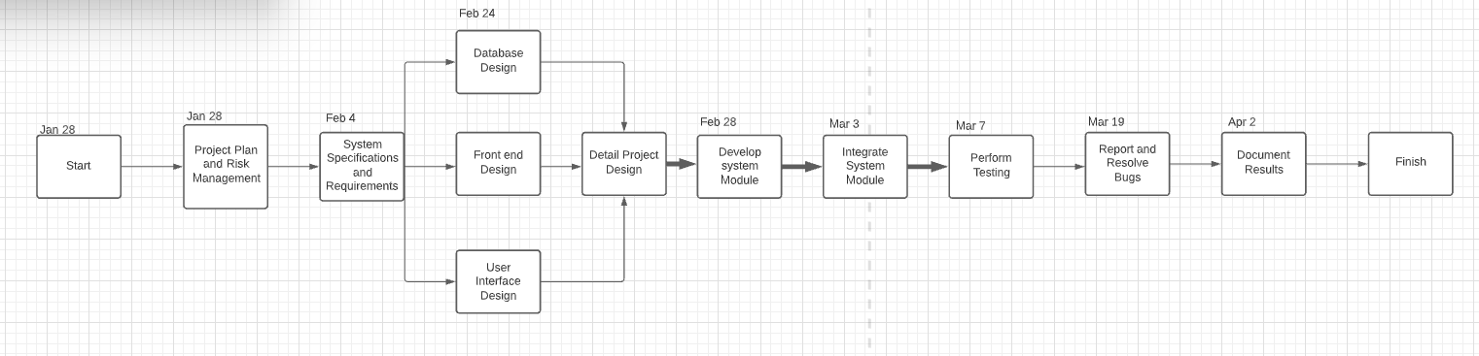
PERT Chart

Slide 10
RISK Analysis
Only the admin/Manager can assign the tickets to the team members, this could sometimes delay the process of resolving the bug.
It is difficult to handle multiple user profiles to give authorities to each functional area.
The sole communication between the team members is done through this application, arising the possibility of misunderstanding the issue.
To deliver the first version of prototype within March 11th 2022 is going to be a huge task and requires great planning and effective understanding of requirements and system design.

Slide 11

RISK Management
A way to authorize few team members to assign tickets in absence of the team manager.
Careful planning to authorize multiple user profiles.
Adding additional reports and GUI to make the application user friendly.
Conducting frequent meetings and effective use of GitHub and Trello Kanban Board to track milestones can help in successful delivery of the product.

Slide 12


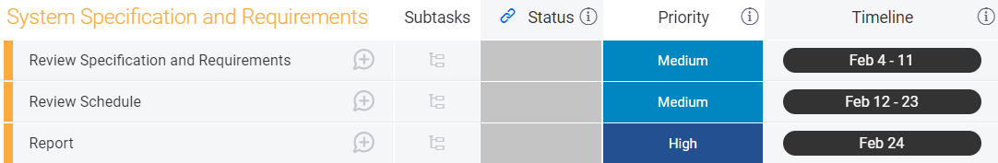
NEXT StEPS

Slide 13

Thank You !

