Slide 1
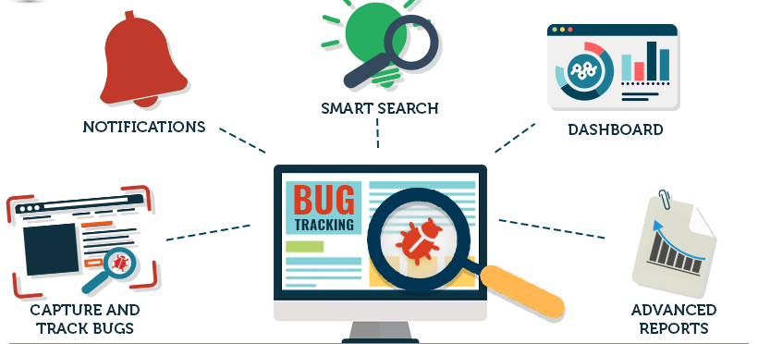
The BUG TRACKING SYSTEM
Team: BUG MAFIA

Slide 2



Team Members / Responsibilities
Neha Goud Baddam: Full Stack Developer
Reshmi Chowdary Divi: Back-end Developer
Prem Kumar Maddula: Back-end Developer
Rahul Mandaloju: Frontend Developer
Vamsi Sai Konidena: Frontend Developer
Harika Uppalapati: UI Developer
Purandhara Maharshi Chidurala: UI Developer
Shiva Surya Vardhan Reddy: Testing and Documentation

Slide 3

CONTENTS:
Project description
Modules
Technical Requirement
Team members responsibilities
Implementation details
Feedback from peer reviews
Code inspection results
Limitations during development
Web address link

Slide 4

Project Description:
The Bug tracking System is an application that helps in tracking tickets raised to resolve bugs in a system/project.

Slide 5
Modules
A bug is reported in the project/system by the customer through the website by an agent.
Manager Module: Once the ticket is created, manager looks for new tickets created and assigns it to the staff. Manager has authorities to move the ticket from one staff member to another.
Staff Module: Once the ticket is assigned to the staff, they can change the status of the ticket until the bug is resolved.
Customer Module:
Manager Module:
Staff Module:

Slide 6
Technical Requirements
Core Programming Languages: PHP
Database Languages: SQL
UI Coding Languages: HTML, CSS, Java Script
Tools: Zoom (For Meetings)

Slide 7
Team members responsibilities
Admin Module – Divi Reshmi
Shiva surya
Vamsi sai
Employee Module – Neha
Harika
Customers Module – Maharshi
Rahul
Prem

Slide 8
Implementation Details
Language – PHP
Testing Platform – PHP My admin
Deployment Platform – NGROK
Unit testing – PHP unit
Other Packages - HTML, CSS, JQuery

Slide 9
Feedback from peer reviews
1.Adding the priority level for the bug, based on the priority given by the customer to the bug, manager can assign the bug to his employees.
2.Adding project related files by the customer during bug creation, it will help to the manager to assign project related employees easily.
3.Triggering the emails to the customer, manager and employees during the bug creation process and status updating process.

Slide 10
Code inspection results
Decreasing the complexity of the code.
Adding proper indentations for source code so that every one can easily understand.
Adding comments for the variables and functions which describes their functionality.

Slide 11
Limitations during development
1.Getting the errors while integrating the project files, done by each and every member in the team.
2.While developing the complex scenarios test cases for integrating testing so that we can know each and every functionality is working properly.
3.XAMPP did not work as expected while deploying the project in real time, we had to take help of other tunneling software to successfully deploy the project.
4.We shall be implementing the download button for the project report at the manager end, as we could not implement that in the current version.
5.Email triggers have been added whenever the assignee is changed, but they are not working as expected. We might include this part in future developments.

Slide 12

Web address link
https://724d-76-187-207-192.ngrok.io/Code/BTS/

Slide 13

Thank You !

