Slide 1
Assignment - 2
Contents:
Creating a database
Separation of Duties
local-system-admin
data-entry
data-view
data-backup
Unsuccessful Logon Attempts
APPLY ACCESS CONTROLS TO THE DATABASE

Slide 2
Creating a Database
Creating a Database:
Download GTD
Create MySQL Schema
Upload DB to MySQL

Slide 3
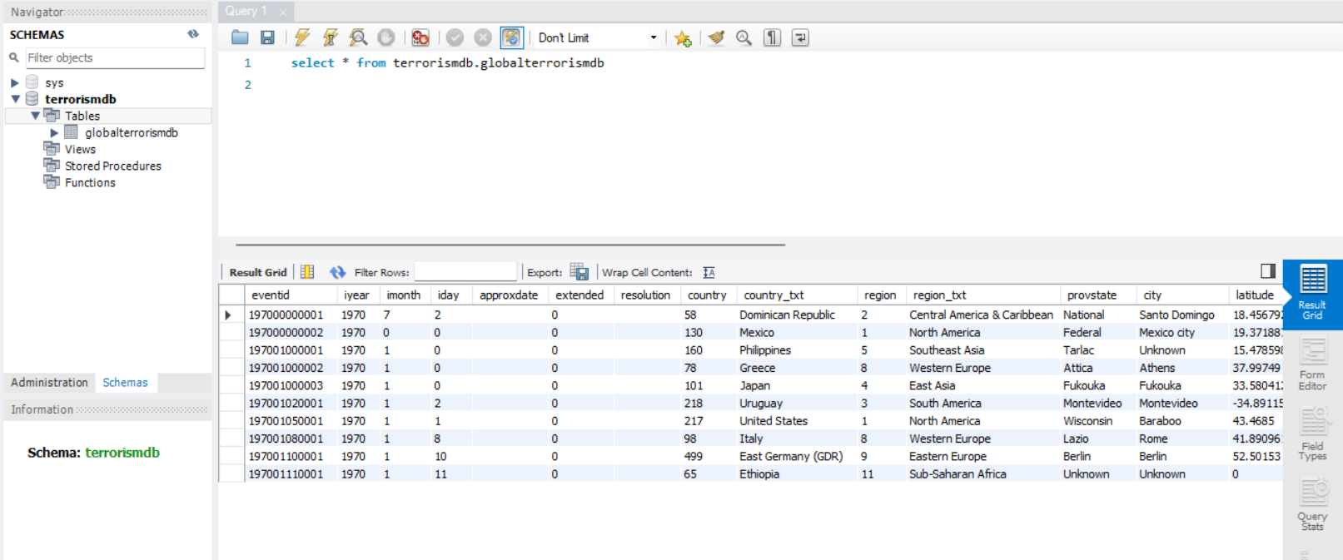
Setting Up database
I have downloaded the database "globalterrorismdb.xlsx" from Global Terrorism Database Site.
Created a MySQL schema "terrorismdb" in MySQL Workbench 8.0 CE
I have imported the "globalterrorismdb.csv" into a table in "terrorismdb" schema.

Slide 4
Separation of Duties
Creating User Roles:
local-system-admin
data-entry
data-view
data-backup

Slide 5
local-system-admin
Login shall be allowed from IP address: 127.0.0.1 or localhost (default).
In MySQL Workbench, open the "Users and Privileges" panel by clicking on the "Server" in the toolbar of the home screen.
Select the user account for which you want to allow login from the specific IP address.
In the "Login" tab, set the "Limit to Hosts Matching" field to 127.0.0.1 or localhost.

Slide 6
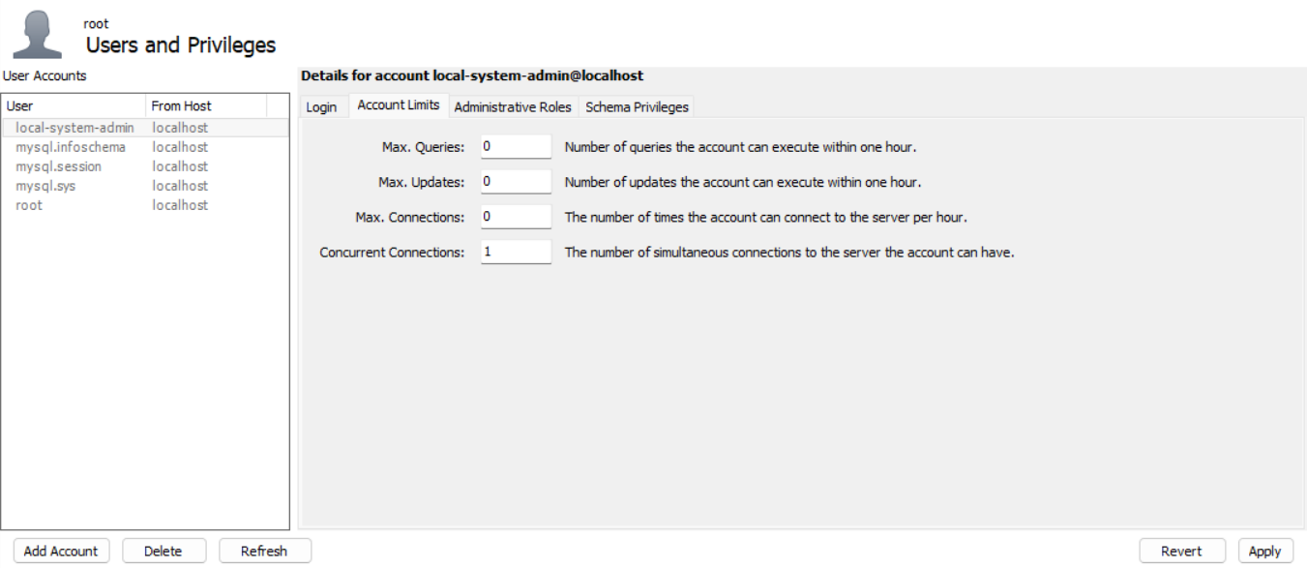
local-system-admin
2. Only one session shall ever be allowed to connect to this account.
In the "Account Limits" tab, set the "Concurrent connections" field to 1.

Slide 7
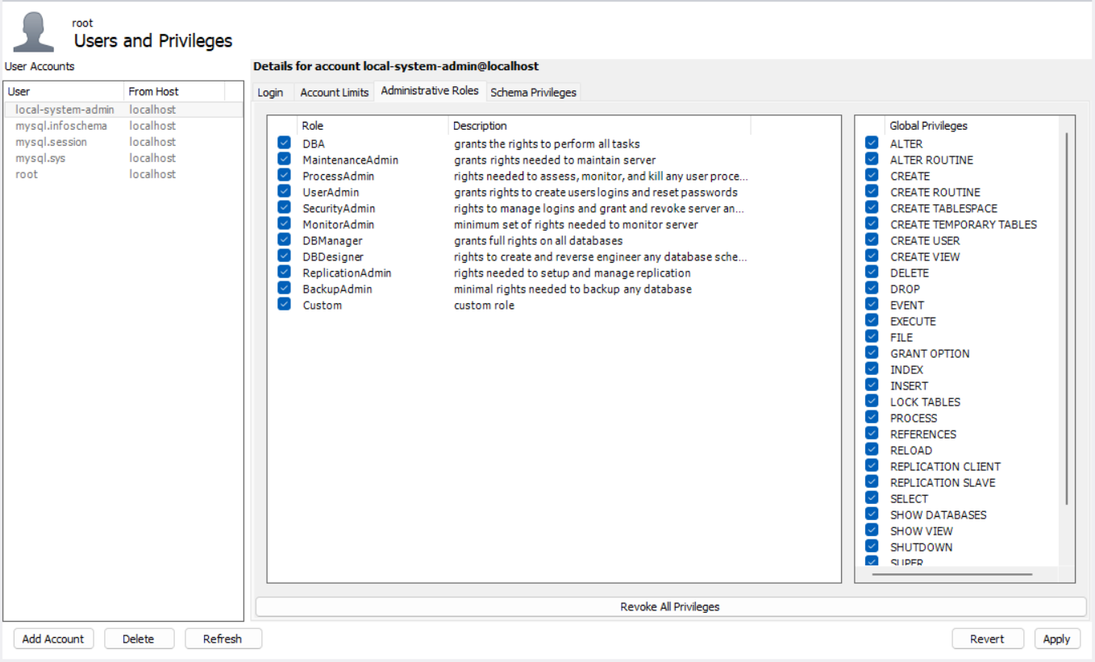
local-system-admin
3. All global privileges.
In the "Administrative Roles" tab , check the "DBA" checkbox to grant all global privileges.

Slide 8
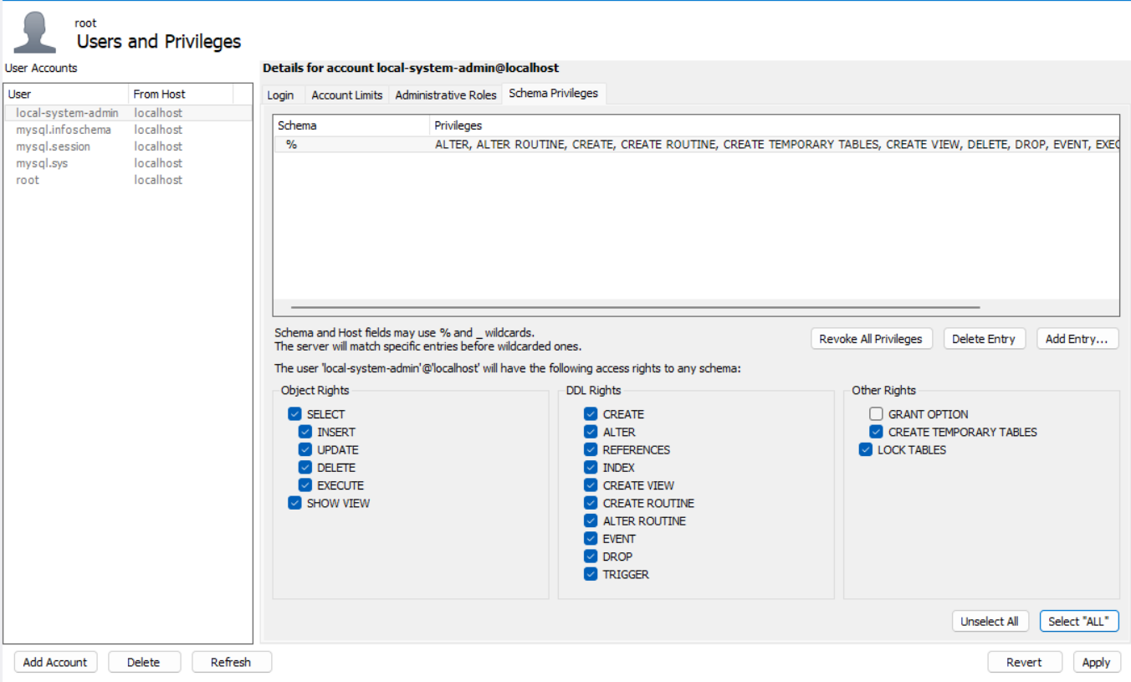
local-system-admin
4. All privileges on all tables.
In the "Schema Privileges" tab, click on the "Add Entry" button.
Select the schema that contains the tables you want to grant privileges for.
Select all privileges checkboxes under the "Privileges" section, such as "SELECT", "INSERT", "UPDATE", "DELETE", etc. In this case, we can use the "Select *ALL*" button.
Click on the "Apply" button to save the changes.

Slide 9
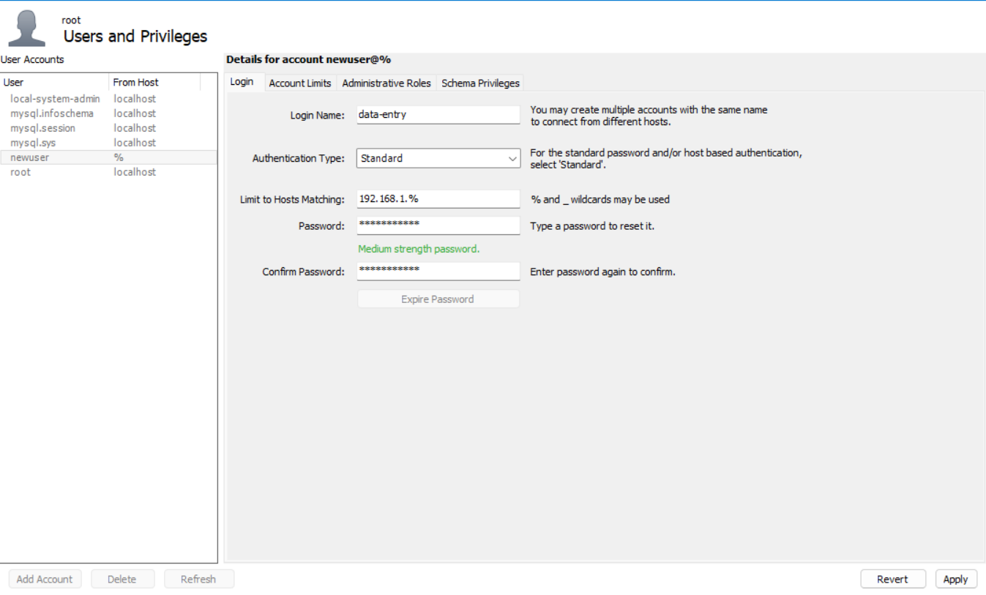
DATA-ENTRY
Login shall be allowed ONLY from the local network, hosts matching 192.168.1.*.
In MySQL Workbench, open the "Users and Privileges" panel by clicking on the "Server" in the toolbar of the home screen.
Select the user for which you want to restrict login to the local network.
In the "Login" tab, set the "Limit to Hosts Matching" field to 192.168.1.% to allow connections only from hosts matching 192.168.1.*.

Slide 10
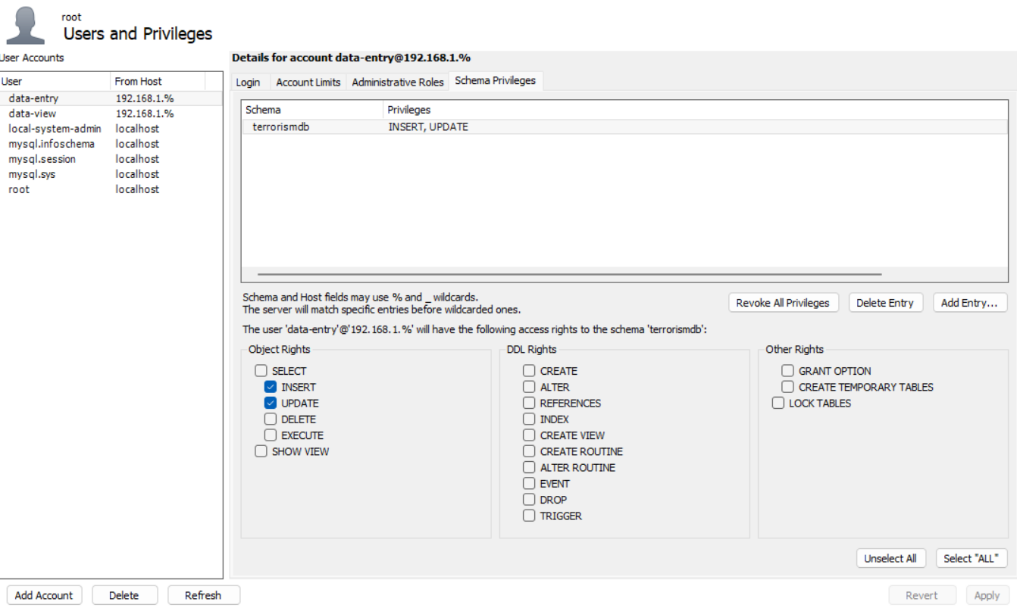
DATA-ENTRY
2. User shall be allowed ONLY to `INSERT, UPDATE` to database "terrorismdb".
In the "Schema Privileges" tab, click on the "Add Entry" button.
Select the "terrorismdb" database.
Select only the "INSERT" and "UPDATE" checkboxes under the "Object Rights" section.
In the "Administrative Roles" tab, do not select any administrative roles.
Click on the "Apply" button to save the changes.

Slide 11
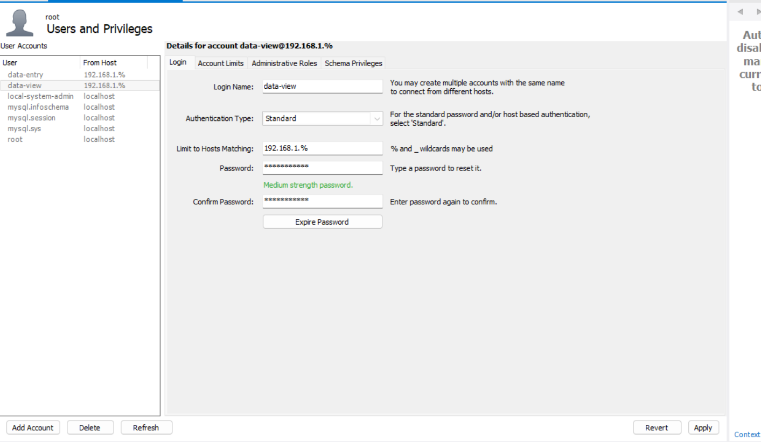
data-view
1. Login shall be allowed ONLY from the local network, hosts matching 192.168.1.*.
In MySQL Workbench, open the "Users and Privileges" panel by clicking on the "Server" in the toolbar of the home screen.
Select the user for which you want to restrict login to the local network.
In the "Login" tab, set the "Limit to Hosts Matching" field to 192.168.1.% to allow connections only from hosts matching 192.168.1.*.

Slide 12
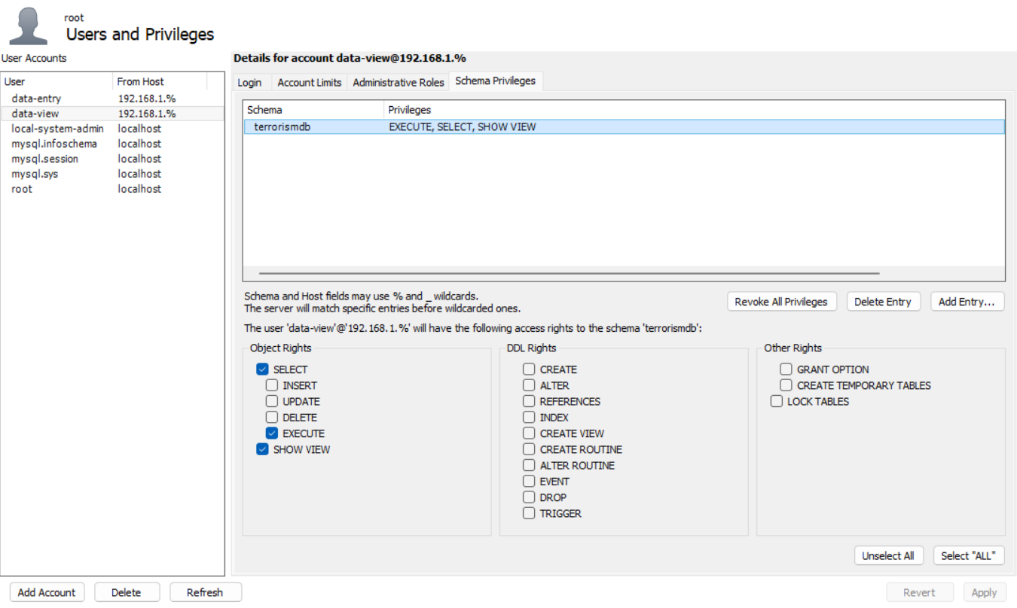
data-view
2. User shall be allowed ONLY to "EXECUTE, SELECT, SHOW VIEW" from "terrorismdb".
In the "Schema Privileges" tab, click on the "Add Entry" button.
Select the "terrorismdb" database.
Select only the "EXECUTE", "SELECT", and "SHOW VIEW" checkboxes under the "Object Rights" section.
In the "Administrative Roles" tab, do not select any administrative roles.
Click on the "Apply" button to save the changes.

Slide 13
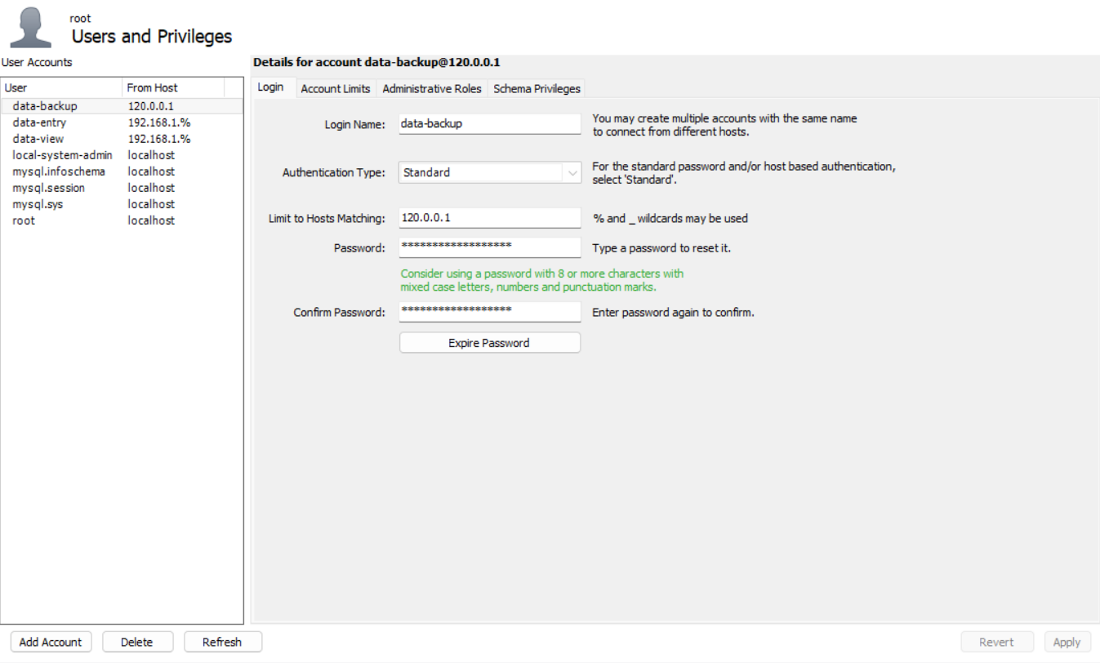
data-backup
1. Login shall be allowed from 127.0.0.1 only.
In MySQL Workbench, open the "Users and Privileges" panel by clicking on the "Server" in the toolbar of the home screen.
Select the user account for which you want to allow login from the specific IP address.
In the "Login" tab, set the "Limit to Hosts Matching" field to 127.0.0.1 or localhost.

Slide 14
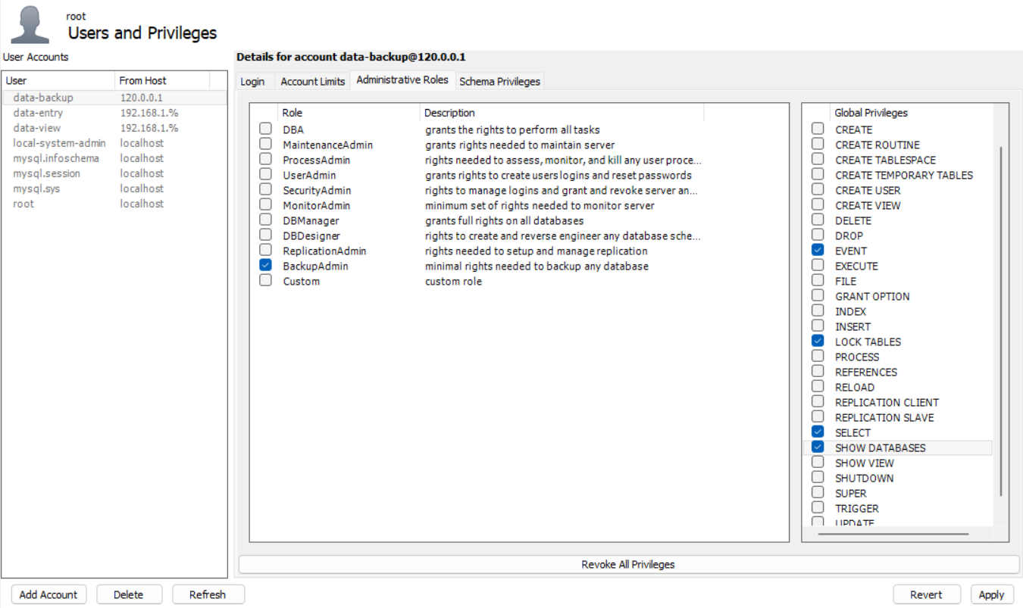
data-backup
2. They have the following global privileges: EVENT, LOCK TABLES, SELECT, SHOW DATABASES
In the "Administrative Roles" tab, select the "Event Scheduler", "Lock Tables", "Select", and "Show Databases" checkboxes. Or you can select the Role "BackupAdmin".

Slide 15
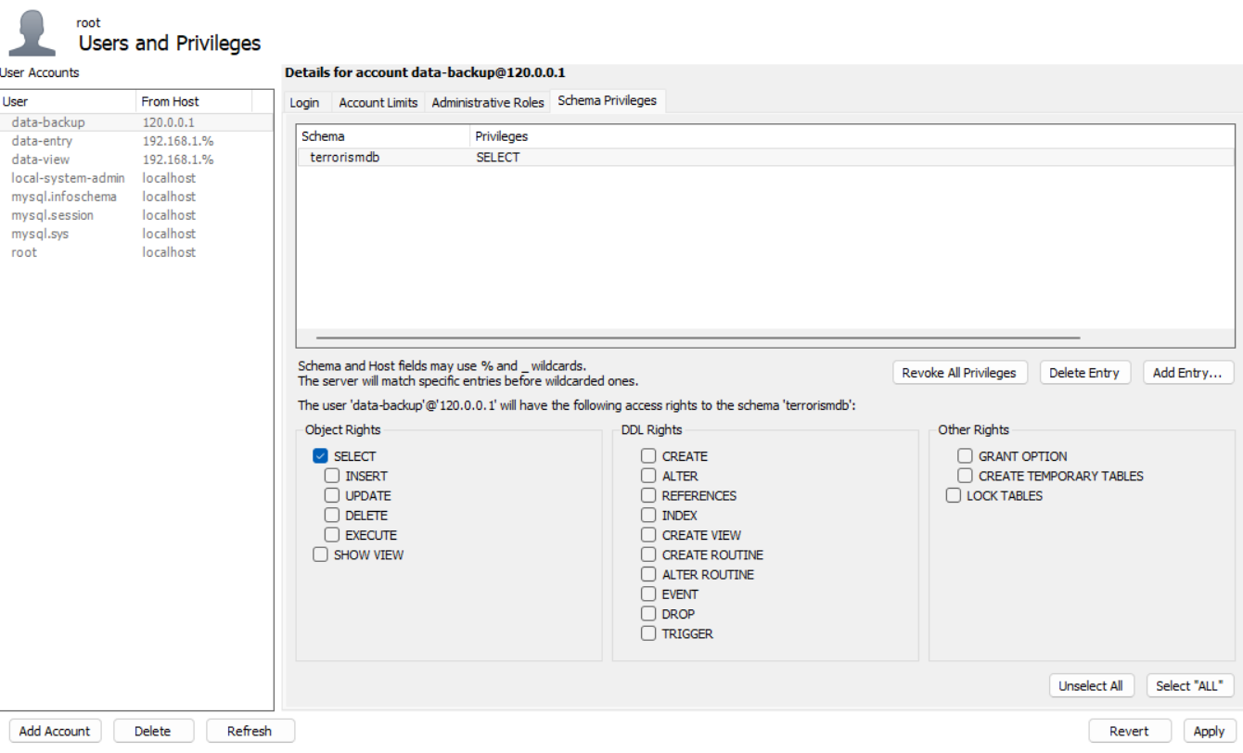
data-backup
3. User shall be allowed ONLY to "SELECT" from "terrorismdb".
In the "Schema Privileges" tab, click on the "Add Entry" button.
Select the "terrorismdb" database.
Select only the "SELECT" checkboxes under the "Object Rights" section.
Click on the "Apply" button to save the changes.

Slide 16
data-backup
4. Backup tasks shall be automated.
Click on the "Server" menu and select "Data Export".
In the "Data Export" wizard, select the "Export to Self-Contained File" option and click on the "Start Export" button.
In the "Select Objects" screen, select the database or databases that you want to include in the backup. You can also choose to include or exclude specific tables, views, or stored procedures.
In the "Options" screen, select the backup options that you want to use. You can choose to include or exclude data, select the format of the backup file, and specify compression options.
In the "Export Progress" screen, monitor the progress of the backup process. Depending on the size of your database, this process may take some time to complete.
Once the backup process is complete, you can find the backup file in the location that you specified in the "Options" screen.
To restore the backup file, click on the "Server" menu and select "Data Import". In the "Data Import" wizard, select the backup file that you want to restore and follow the prompts to restore the database.

Slide 17
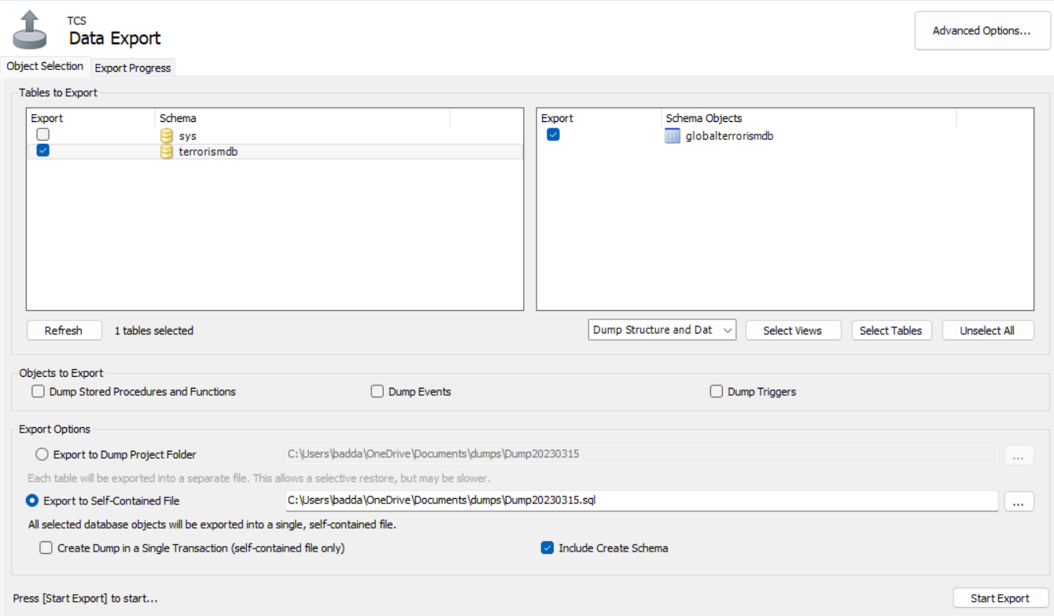
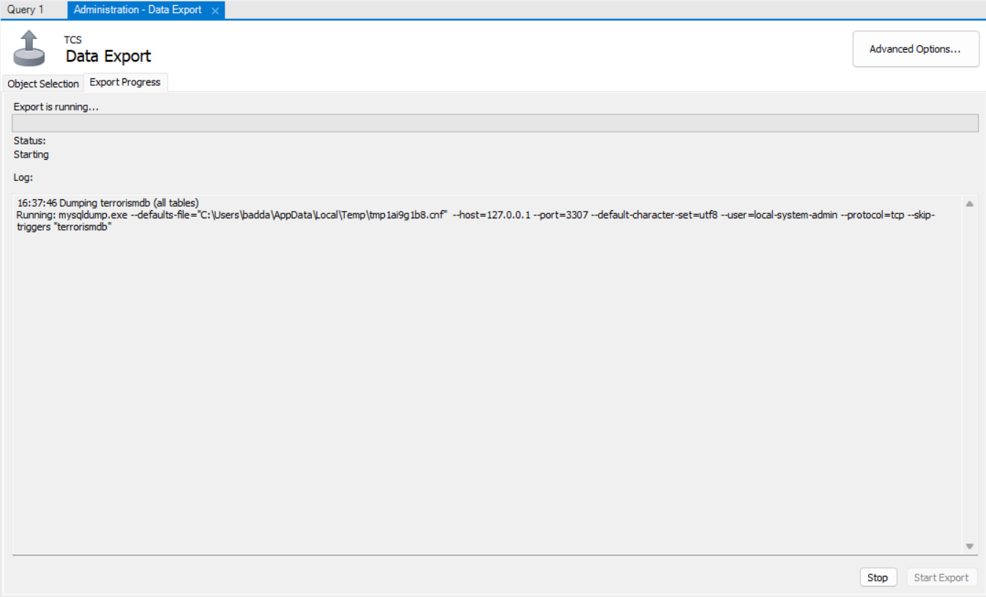
data-backup

Slide 18
data-backup
5. Human login shall be limited to emergencies.
We can set up a separate emergency user account with limited privileges and use it only in emergencies. For, example local-system-admin can be used for emergencies.
6. Backups shall be performed to a hardware-controlled cold storage array that maintains a time period worth of backups before they overwrite the other media.
We can perform backups to a hardware-controlled cold storage array using the built-in MySQL Workbench Backup feature.
7. Password shall be a random string of sufficient length, stored offline on paper or a USB key.
I have stored the password on paper.

Slide 19
Unsuccessful Logon Attempts
a. Enforcing a limit on local-system-admin user
b. Rationale for Automatic account or node locking

Slide 20
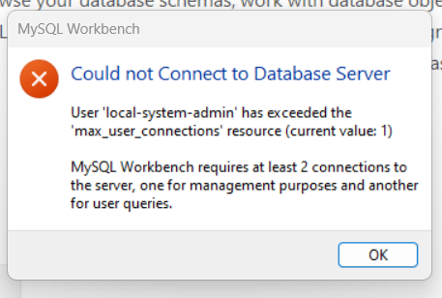
Enforcing a limit on local-system-admin user
Enforce a limit consecutive invalid logon attempts by a user
I have tried to login using the local-system-admin, consecutive connection limit is 1.
Error is popped if more than 1 logon sessions are attempted.

Slide 21
Rational for Automatic account or node locking
Automatic account or node locking when the maximum number of unsuccessful login attempts is exceeded is a crucial security measure for organizations.
Firstly, it prevents brute-force attacks, where an attacker tries multiple username and password combinations repeatedly to gain unauthorized access to the system. By automatically locking the account or node after a certain number of unsuccessful attempts, further attempts are prevented.
Secondly, it enhances the security of the user's account by preventing unauthorized access to sensitive data. If the user's credentials have been compromised, automatic account locking prevents further unauthorized access and reduces the damage caused.
Thirdly, it helps organizations to comply with regulatory requirements and industry standards, which require the implementation of access controls and account lockout policies to protect sensitive data.
Lastly, automatic account locking encourages users to choose strong and unique passwords, which in turn reduces the likelihood of successful brute-force attacks. This promotes best practices in password management.
In summary, automatic account or node locking after the maximum number of unsuccessful login attempts is a critical security measure that prevents brute-force attacks, reduces damage from compromised credentials, promotes compliance with regulatory requirements and standards, and encourages strong password management practices.

Slide 22

Thankyou

