Slide 1
US Census Income Analysis
Neha Bais
MET CS-544
Summer’20

Slide 2
Introduction
Data of US survey to see individual’s income lies in which range.
Conducted in 1994.
Link for dataset:
https://www.kaggle.com/uciml/adult-census-income/data

Slide 3
About Dataset
32561 observations each representing an individual.
15 rows representing socio-economic factors (age, work class, occupation, education etc.) of the respondents to the survey.
2399 rows having missing values

Slide 4
About Dataset
Categorical
Numerical
  Work class
  Education
  Marital status
  Occupation
  Relationship
  Race
  Sex
  Native Country
  Income
  Age
  Fnlwgt
  Education num
  Capital Gain
  Capital Loss
  Hours per week

Slide 5
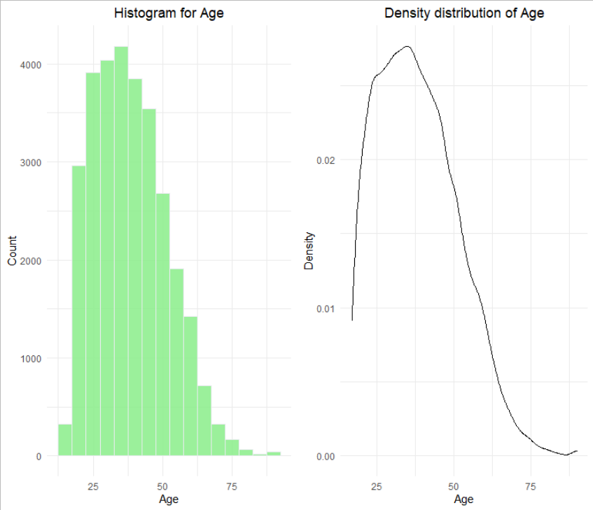
Age

Slide 6

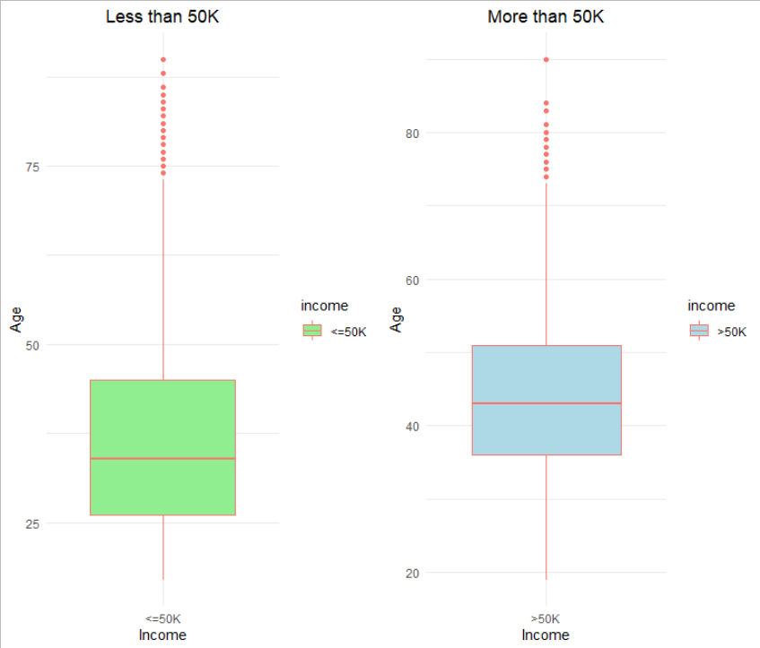
Age vs Income
Median age of people earning more is greater than those earning less.

Slide 7
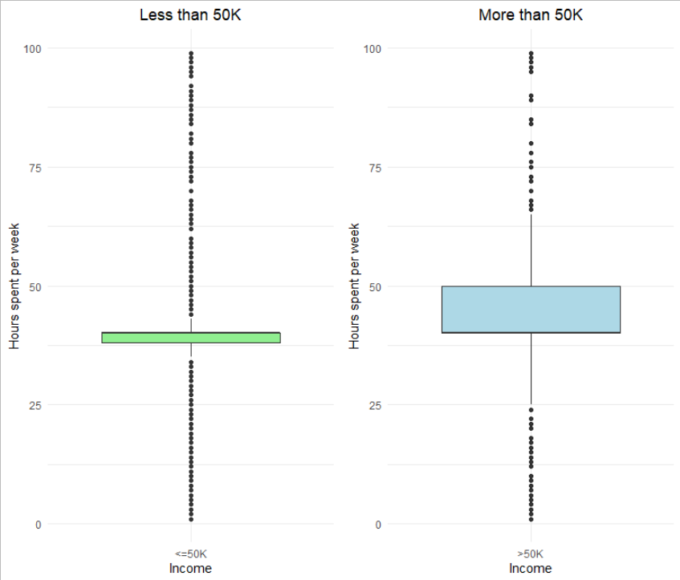
Hours per week vs Income
Average hours spent by individuals earning more is likely to greater than those earning less.
Outliers represent some jobs expecting more hours but pay less and vice versa.

Slide 8
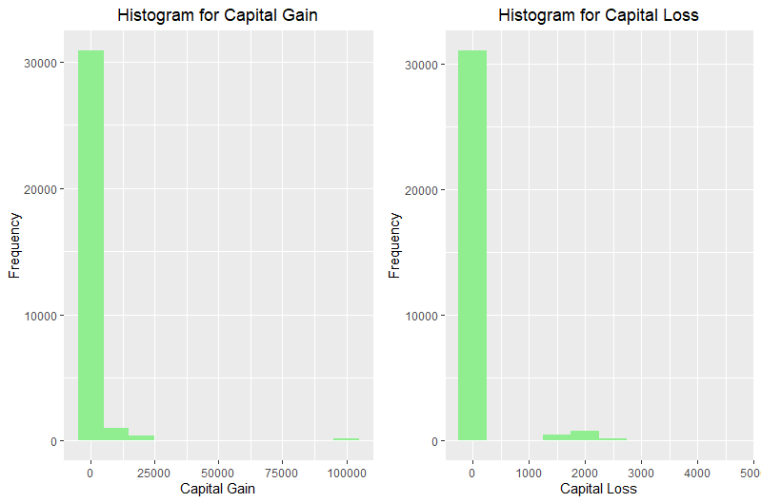
Capital Gain & Capital Loss
Most of the individuals do not have income other than salary.
Very few of them gained something or in loss through other income.

Slide 9
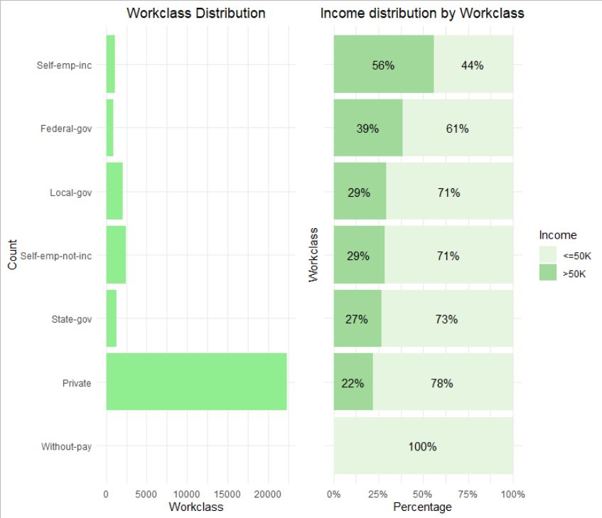
Work class vs Income
  Mostly work for Private sector.
  % of Federal govt employee, & self employed earning more than 50K is large compared to others.

Slide 10
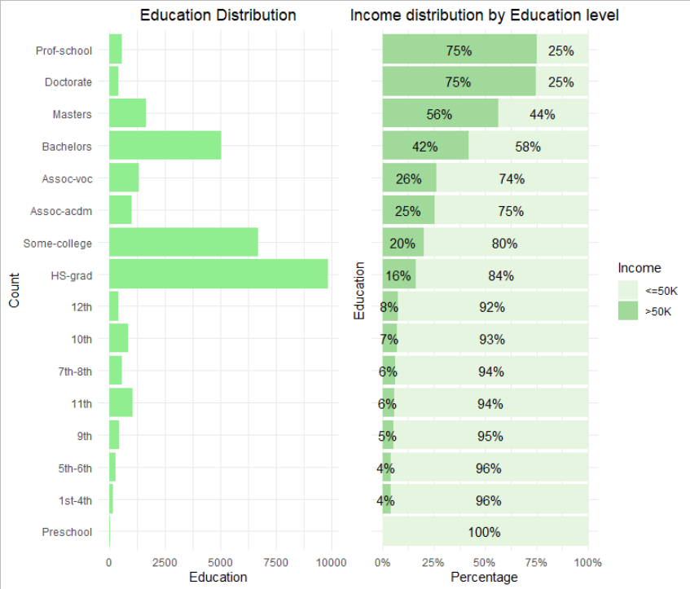
Education vs Income
Most respondents have HS and some college education level.
Higher education level contributes in earning more.

Slide 11
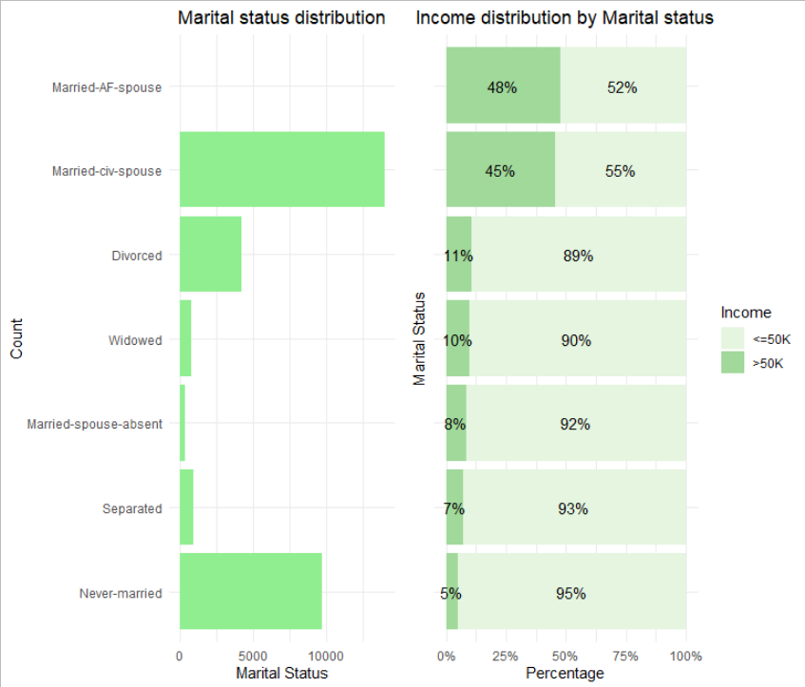
Marital status vs Income
Most of the respondents are Married civilians or Never married.
Married people are likely to earn more as compared to non-married ones.

Slide 12

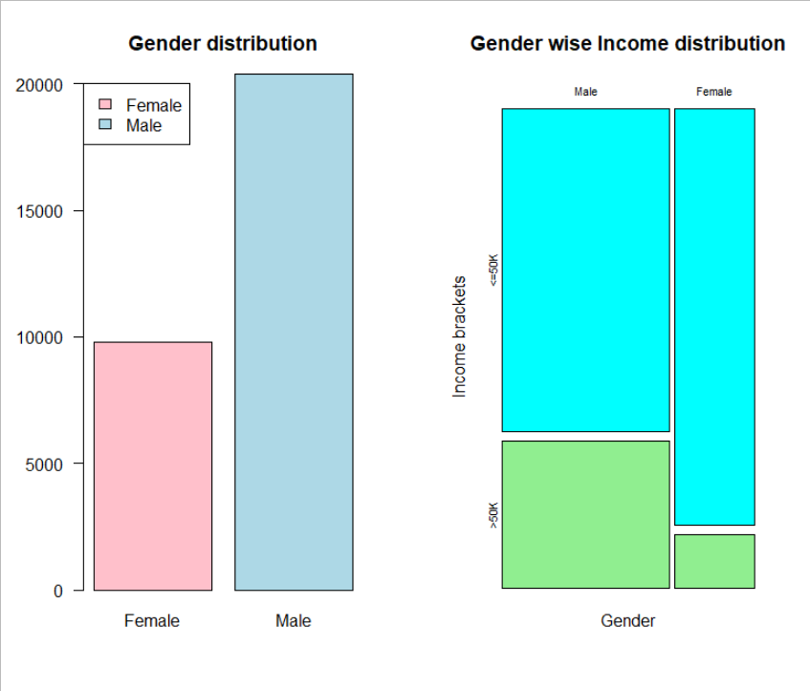
Gender vs Income
Out of total Male population:
69% Male earn <= 50K
31% Male earn >50K
Out of total Female population:
89% Female earn <=50K
11% Female earn >50K

Slide 13
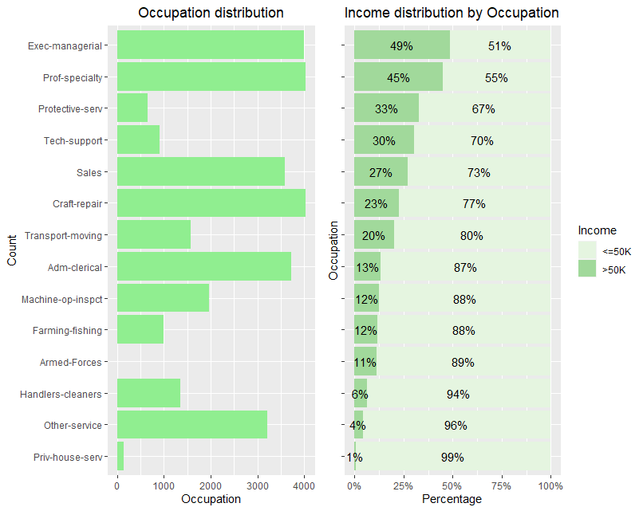
Occupation vs Income
Individuals at a position of Executive management and Professional specialty are likely to earn a large amount.

Slide 14
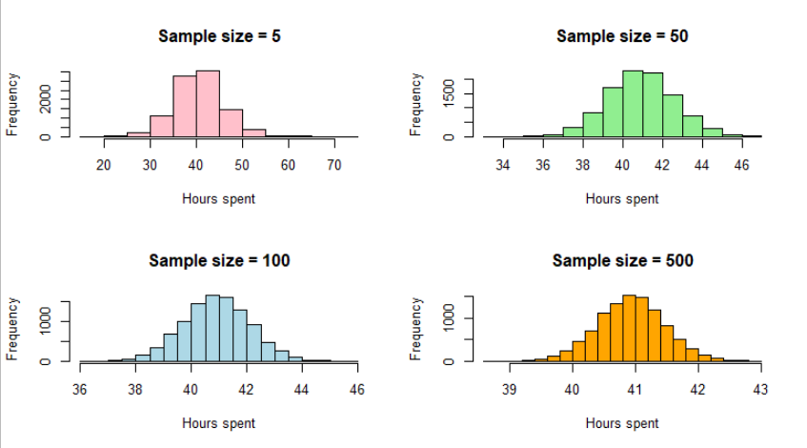
Central Limit Theorem

Slide 15
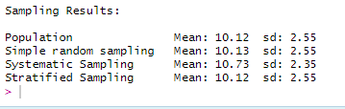
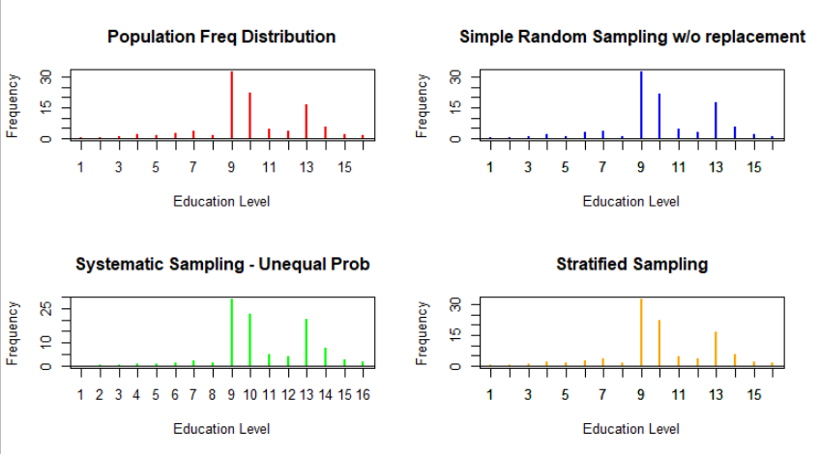
Sampling
Stratified sampling gave a much closer approximate of population.

Slide 16
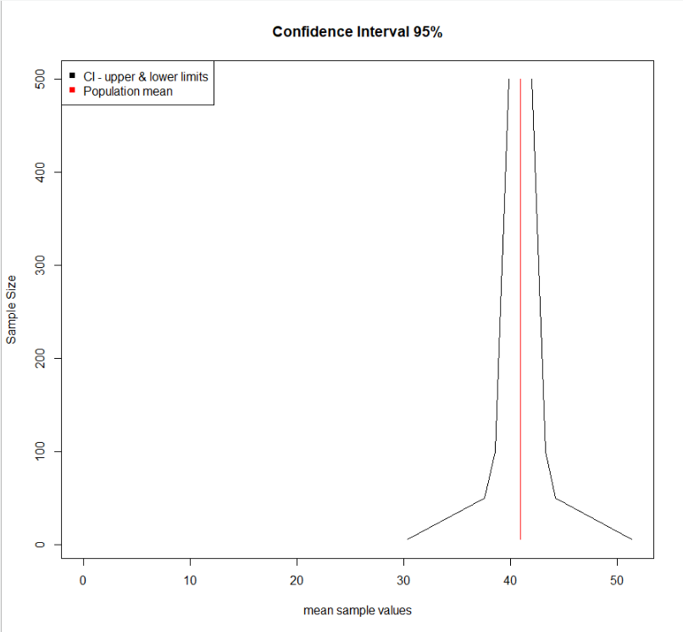
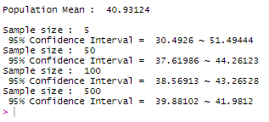
Confidence Interval

Slide 17
Conclusion
Exploratory analysis of various Categorical and Continuous variables.
Age, Education, Working class, Hours per week and Gender are good feature values if we want to predict the income of an individual.
CLI theorem explored using different sample sizes.
Stratified Sampling gave close approximation of population.
Population mean falls inside 95% Confidence Interval. Higher the sample size, narrower is the area between which population mean will fall.

Slide 18
Thank You !!!

