Slide 1
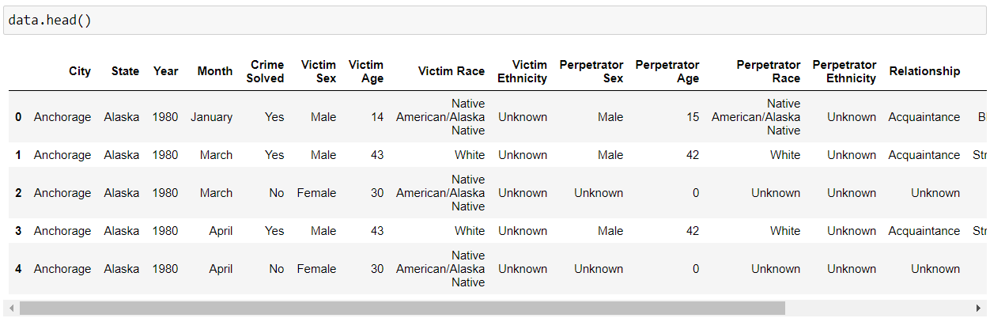
A snippet of the first 5 rows of the dataset

Slide 2
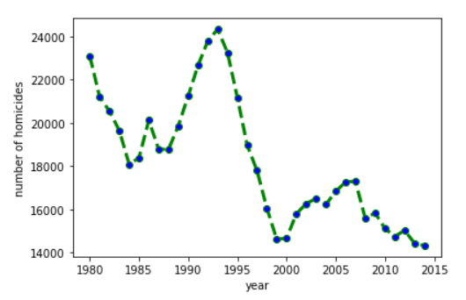
OBSERVATION 1 Contrary to the problem statement, we observed from our data set that the number of homicides in the US considerably decreased over the past few decades

Slide 3
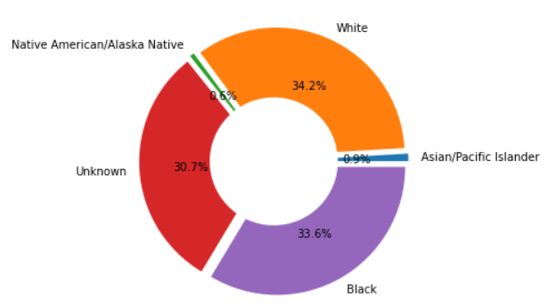
A pie chart showing proportions of perpetrators over the years
OBSERVATION 2 Here, we plotted pie charts to help observe the proportions of both perpetrators and victims race-wise. We see from the graph that a large portion of perpetrators are either from the “Black” or “White” communities

Slide 4
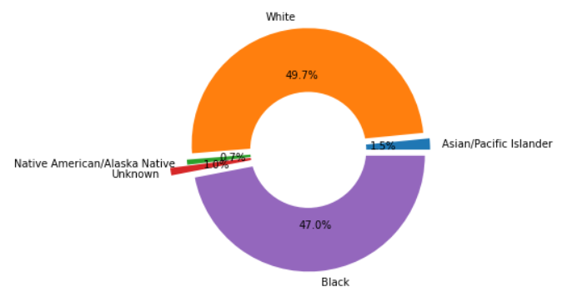
Heres the pie chart depicting victims of the homicides, race-wise
OBSERVATION 2 (contd.) From these two graphs, we see that the 2 communities gravely affected here are the “Whites” and the “Blacks”. We can conclude that this could be a direct result of the ever-prevalent racism issues in the US.

