Slide 1
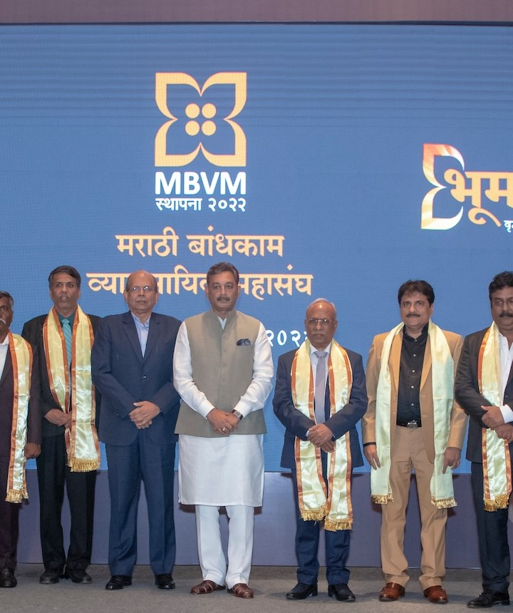

मराठी बांधकाम
व्यावसायिक महासंघ
MBVM DIGITAL
PLATFORM
A statewide digital front door for the Marathi construction community
CLIENT PRESENTATION | WEBSITE • MEMBERSHIP • ASSOCIATION NETWORK
महाराष्ट्रातील मराठी बांधकाम व्यावसायिकांना जोडणारे व्यासपीठ
MBVM | CLIENT PRESENTATION
01

Slide 2
THE PURPOSE
One platform. One connected community.
Bring local builders together and connect district-level associations to a statewide federation.
Local association
Statewide federation
Digital access
Organize developers by district, city or taluka and give local issues a shared voice.
Coordinate common priorities, represent shared concerns and support affiliated associations.
Make information, registration, member discovery and opportunities easier to reach.
From individual interest → local organization → collective representation
संघटन • सहकार्य • सामूहिक प्रतिनिधित्व
MBVM | CLIENT PRESENTATION
02

Slide 3
THE MEMBER JOURNEY
A clear path from interest to affiliation
The website supports the first steps; federation-led meetings and legal formation complete the association journey.
01
Register interest
02
Build local numbers
03
Reach the threshold
Online member form
Group by district / taluka / city
15 registrations trigger a milestone
04
Connect & convene
05
Form locally
06
Affiliate
MBVM outreach and first meeting
Committee, registration and documents
MoU and federation connection
Target milestone in the application: 15 members per district.
MBVM | CLIENT PRESENTATION
03

Slide 4
PLATFORM OVERVIEW
A public website connected to member services
The current application combines public information pages with registration, sign-in and member directory tools.
DISCOVER
JOIN
CONNECT
Home and federation introduction
Association process and governance
Trustees, representatives and activity updates
Online developer registration
District / taluka / city selection
Email verification and member access
Member directory and filters
District registration counts
JV / JD and sponsored listing experience
Public pages explain the federation; authenticated tools support member and administrative workflows.
MBVM | CLIENT PRESENTATION
04

Slide 5
MEMBER ONBOARDING
Membership registration captures the right context
A structured profile helps the federation understand who is joining and where local demand is emerging.
PERSON
BUSINESS
15
Name • mobile • email
Company • business type • MahaRERA (optional)
DISTRICT MILESTONE
LOCATION
CONSENT
The threshold is currently defined as 15 registrations in a district.
District • taluka • city • address
Contact consent • business details / website (optional)
Form validation and consent are part of the current member registration flow.
MBVM | CLIENT PRESENTATION
05

Slide 6
DISTRICT OPERATIONS
A measurable milestone for local organizing
A district-level count turns registrations into a practical signal for follow-up.
Track
Follow up
15
See district counts and whether the target is reached.
A one-time district notification is recorded when the threshold is first met.
MEMBERS IN A DISTRICT
Find
Organize
Milestone reached → admin email alert
Search or filter member records by district, taluka, city and profile.
Use the list to support outreach and first-meeting planning.
MBVM | CLIENT PRESENTATION
06

Slide 7
ACCOUNTS & ADMINISTRATION
Member access with email verification
Authentication and role-aware screens separate public registration from member and administrator tasks.
1
Create account
2
Verify email
3
Sign in
4
Access tools
→
→
→
Name, email, password
6-digit OTP; 5-minute expiry
Verified email + password
Member list / admin functions
MEMBER
Authenticated access to the member directory.
ADMIN
Additional user management and administrative actions.
Operational email delivery and production account policies should be confirmed before launch.
MBVM | CLIENT PRESENTATION
07

Slide 8
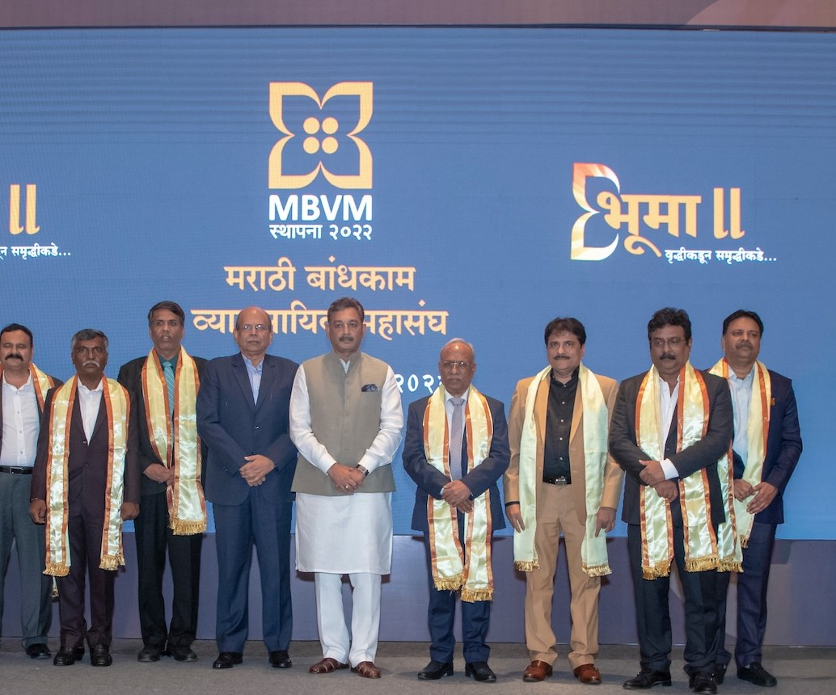
BUSINESS OPPORTUNITIES
JV / JD opportunities and sponsored listings
A dedicated experience describes opportunities and advertising placements for construction professionals.
Opportunity listings
Project advertising
Type, location, size, date and short proposal summary.
Sponsored cards and a space for administration-defined rates.
Submission experience
Applicant and company • contact details • district / taluka • property location and area • map link • proposal • attachments • terms.
CURRENT STATUS: sample opportunity listings and a front-end form; storage, moderation, payment and publishing workflow are not yet connected.
MBVM | CLIENT PRESENTATION
08

Slide 9
FEDERATION INFORMATION
Governance and content bring the network to life
The site is structured to explain who MBVM is, how associations form and where members can find official material.
LEADERSHIP
Trustees and executive committee sections
AFFILIATION
Associations and authorized representative information
DOCUMENTS
MoU and standard constitution access points
ACTIVITY
Federation work, updates and announcements
Client input needed: confirm names, roles, approved photographs, documents and association records before publication.
MBVM | CLIENT PRESENTATION
09

Slide 10
TECHNOLOGY
Built on a maintainable Laravel foundation
A server-rendered web application with established framework components for data, authentication and email.
APPLICATION
Laravel 13 • PHP 8.3
PRESENTATION
Blade templates • Bootstrap-based UI
DATA
Eloquent models • SQLite default configuration • MySQL-compatible configuration
IDENTITY
Password hashing • session authentication • email OTP verification
OPERATIONS
Role-aware admin screens • district notification emails
Final hosting, database, mail delivery and backup choices are deployment decisions.
MBVM | CLIENT PRESENTATION
10

Slide 11
DELIVERY STATUS
What is implemented—and what needs a decision
Separating working application flows from sample content makes the client review concrete and actionable.
IN THE APPLICATION
CLIENT / NEXT-PHASE INPUT
Member registration, validation and database save
District milestone counts and one-time notification logic
Email OTP verification and authenticated member directory
Directory search, location filters and admin user list
Public federation, process and activity pages
Approve official copy, contacts and leadership data
Supply approved photos and association / document records
Confirm production database, hosting and email configuration
Define opportunity moderation, pricing and payment requirements
Review and sign off before launch
The JV / JD listings and submission form are currently sample / front-end content—not a live marketplace workflow.
MBVM | CLIENT PRESENTATION
11

Slide 12
CLIENT DISCUSSION
Suggested next steps for a confident launch
A short sequence to turn the current application into a production-ready public platform.
1
Confirm content
Brand, contacts, leadership, photos, documents and translations
2
Close workflow gaps
Opportunity intake, review, fees, payment and notifications (if required)
3
Prepare production
Hosting, database, email, backup, access and privacy decisions
4
UAT & go-live
Client walkthrough, acceptance, launch checklist and ownership
DISCUSSION: Which launch priorities and opportunity features should be included in phase one?
MBVM | CLIENT PRESENTATION
12

