Slide 1

End -To-End AI Driven Recruitment Pipeline
In the guidance of:
Mr. Vishal Chakravarthi
Submitted by:
Neha Bhardwaj

Slide 2
Introduction
Objective:
Develop an AI-driven recruitment pipeline.
Automate resume screening to shortlist candidates for interviews.
Generate interview questions using AI (Llama).
AI or non-expert interviewers conduct interviews.
AI determines candidate selection/rejection and sends automated emails to HR/Manager.

Slide 3
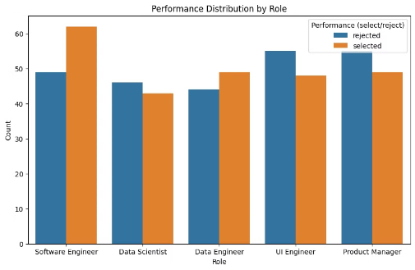
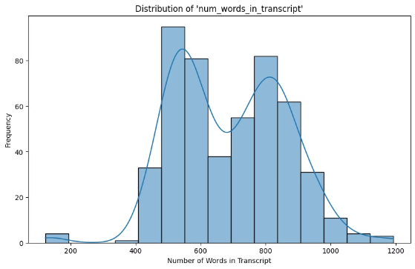
Plots: Exploratory Data Analysis
Distribution of performance by roles in dataset.
Word count distribution in transcripts.

Slide 4
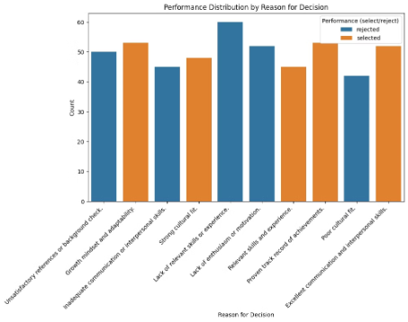
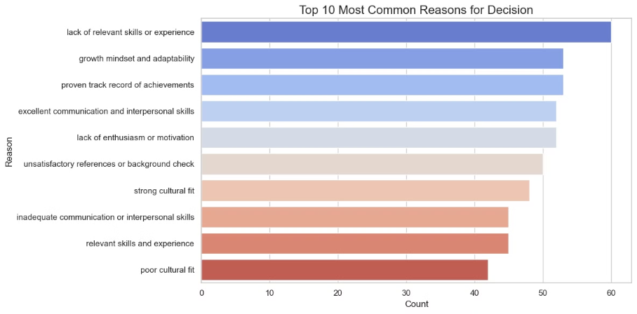
Exploratory Data Analysis (EDA)
Performance distribution by reason for decision.
Common reasons for decision.

Slide 5
Model Training - Classical ML (Part-1)
Input variables: Resume text, transcript, job description, etc.
Output variable: Selection (Yes/No).
Feature Engineering: TF-IDF, similarity scores, transcript length, etc.
Models Tried: KNN, SVM, Random Forest.
Performance Metrics: Accuracy, ROC AUC.
SVM Accuracy: 0.8346
SVM ROC AUC: 0.9213
Random Forest Accuracy: 0.8299
Random Forest ROC AUC: 0.9324
KNN Accuracy: 0.7213
KNN ROC AUC: 0.7908

Slide 6
Model Training - Classical ML (Part 2)
Model comparison table (Accuracy,Precision, Recall, F1-score, AUC-ROC).
Model
Accuracy
Precision
Recall
F1-Score
AUC-ROC
SVM
83.46%
86% / 79%
88% / 77%
87% / 78%
92.13%
Random Forest
82.99%
81% / 87%
94% / 65%
87% / 75%
93.24%
Best model selected - SVM.

Slide 7
Model Training - Deep Learning
Used BERT embeddings to train model and extract features.
Random Forest - Accuracy: 0.7984251968503937
Random Forest - ROC AUC Score: 0.9120363939436033
Built a Neural Network for classification.
ANN - Accuracy: 0.8251968503937008
ANN - ROC AUC Score: 0.9303127418490663
Performance by combining the models.
Combined Model - Accuracy: 0.8062992125984252
Combined Model - ROC AUC Score: 0.9314339293155796
Here’s a complete model comparison table for Classical ML models and Deep Learning (ANN):
Model
Accuracy
AUC-ROC
SVM
83.46%
92.13%
Random Forest
82.99%
93.24%
KNN
72.13%
79.08%
ANN (Deep Learning)
82.52%
93.03%

Slide 8
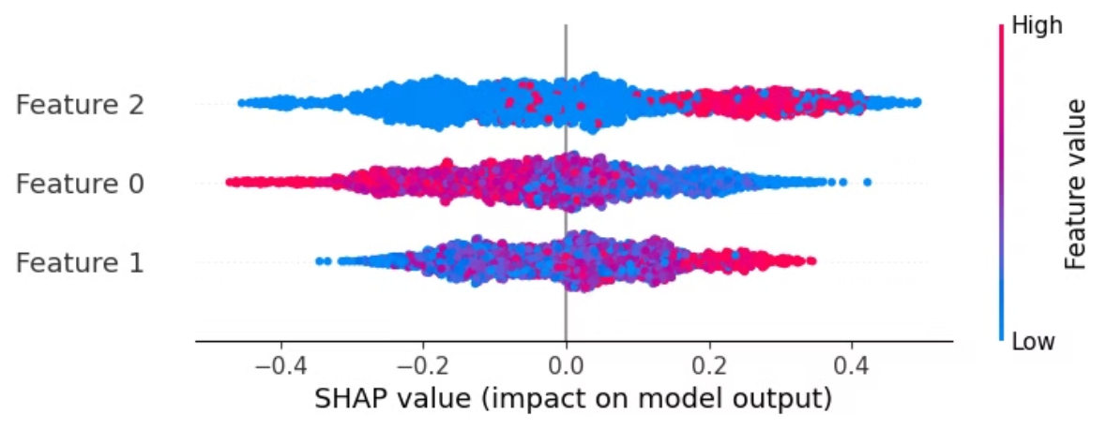
SHAP Analysis (Post-Model Analysis)
SHAP summary plot: Feature importance visualization.
Key influencing factors in candidate selection.
Feature 0 - Transcript_length
Feature 1 - Resume_length
Feature 2 - Job_Description_length

Slide 9
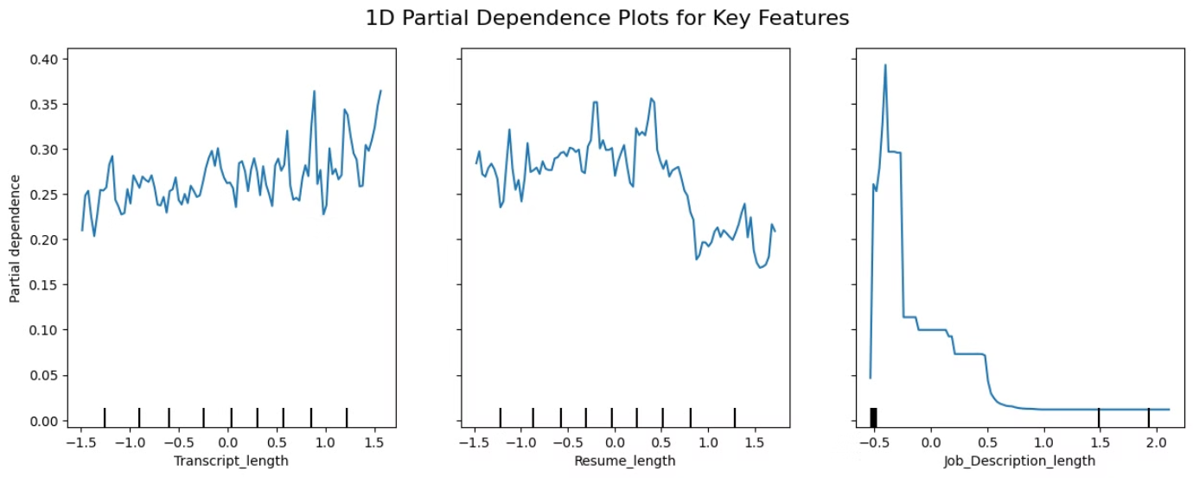
SHAP Analysis: Key Findings
Partial Dependence Plots (PDPs) to show feature impact.
Interpretation of model decisions
Key Observations:
Higher resume similarity scores strongly correlate with selection.
Shorter interview transcripts negatively affect selection probability.

Slide 10
Resume Screener Technique
Steps:
Extract key skills and experience from resumes.
Compare with job description using similarity scores.
Assign a screening score for shortlisting.
Example visualization: Resume score distribution.

Slide 11
Prediction and Automated Email
Workflow:
Model predicts candidate selection.
Automatically generates an email with the decision.
Sends the email to candidates.
Example Email Format (Automated):Dear [Candidate], We are pleased to inform you… / We regret to inform you…

Slide 12
Conclusion & Future Work
Conclusion
Collect Resume → AI extracts details.
Screen Resumes → AI shortlists candidates.
Generate Interview Questions → Llama AI generates questions.
Conduct Interview → AI or human interviewer.
Decision Making → AI selects or rejects.
Send Email Notification → Automated email sent to HR/Manager.
Future Work
AI-driven talent search.
Enhance model accuracy with additional features.
Develop AI video detection for candidate verification.
Implement real-time candidate feedback mechanisms.

Slide 13
THANK YOU

