Slide 1

Predicting Health Outcomes Using Nutritional Intake, Socioeconomic Factors,
and Sleep Data
Huy Duc Pham
Hanush Kumar
Neha Anil Chede

Slide 2

Introduction
This study aims to develop a model for disease prediction using NHANES data.
It applies PCA analysis and association rule mining to identify patterns and classifies individuals into risk groups.

Slide 3
Why?
Enhanced Health Predictions: Improves the ability to predict health outcomes and identify at-risk individuals.
Data-Driven Insights: Uncovers hidden relationships between health factors.
Public Health Impact: Identifying health trends and risk factors helps shape public health initiatives and policies.
Personalized Healthcare: Grouping individuals by risk levels allows for optimized treatment.

Slide 4
The Dataset: NHANES 2013-2014 (National Health and Nutrition Examination Survey)
NHANES 2013-2014 is a nationally representative survey conducted by the CDC (Centers for Disease Control and Prevention) to assess the health and nutritional status of the U.S. population.
It combines interviews, physical examinations, and laboratory tests to collect data on a wide range of topics, including chronic conditions, dietary habits, physical activity, and environmental exposures.
The datasets are broken into 6 different categories.

Slide 5
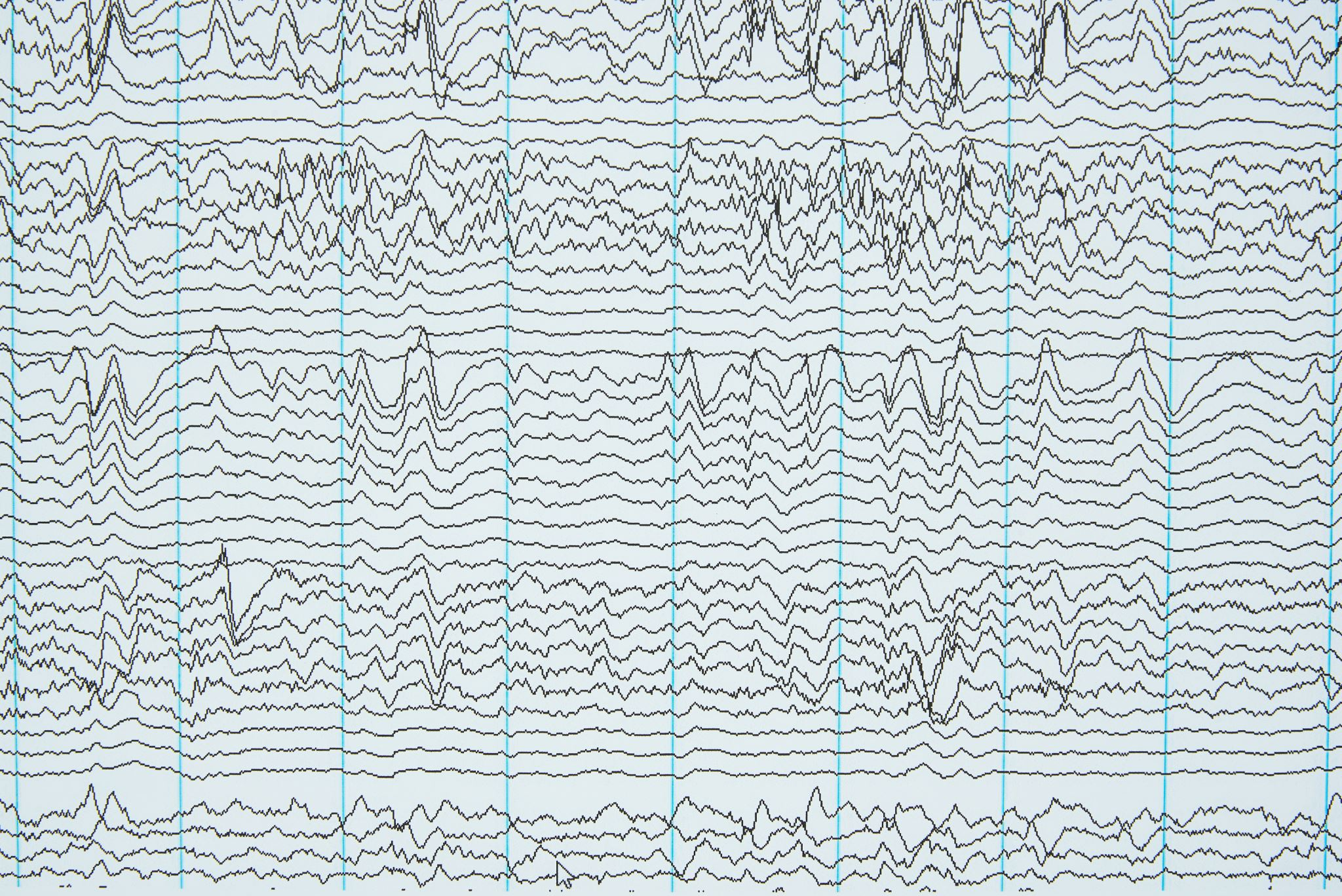
Data Categories and Key Variables (Part 1)
Demographics:
Age, gender, race, education, and household structure.
Data Types: Categorical, Continuous
Dietary:
Nutrient intake (e.g., sodium, B12), meal patterns, and food frequency.
Data Types: Continuous, Categorical
Examination:
Blood pressure, weight, height, BMI, and body dimensions (e.g., waist, leg, arm measurements).
Data Types: Continuous, Categorical

Slide 6

Data Categories and Key Variables (Part 2)
Laboratory:
Blood and urine tests, including cholesterol, glucose, and iron levels.
Data Types: Continuous
Medications:
Prescription drug use and primary/secondary diagnoses.
Data Types: Categorical
Questionnaire:
Alcohol and Smoking Habits: Frequency and quantity of use.
Health Conditions: Diagnoses of chronic illnesses (e.g., asthma, hypertension).
Physical Activity and Sedentary Time: Daily minutes reported.
Socioeconomic Factors: Monthly family income.
Data Types: Continuous, Categorical

Slide 7
Analysis Performed
Association Analysis
Principal Component Analysis
Classification

Slide 8
Association Analysis (Ex. Using the Medication and Examination Datasets)
Association Analysis Process
Data Loading and Preprocessing:
Categorize continuous variables (e.g., blood pressure, BMI) into discrete bins (e.g., Low, Medium, High, Very High).
Data Transformation:
Convert continuous and categorical variables into binary formats.
Merge medication and examination data on a common identifier (SEQN).
Frequent Itemset Mining (Apriori):
Identify frequent itemsets with a minimum support level.
Association Rule Generation:
Generate association rules based on the frequent itemsets with minimum lift of 1.0
SEQN | BPXSY1 | BPXDI1 | BPXSY2 | BPXDI2 | BPXSY3 | BPXDI3 | BMXWT | BMXHT | BMXBMI
73557 | 122 | 72 | 114 | 76 | 102 | 74 | 78.3 | 171.3 | 26.7
73558 | 156 | 62 | 160 | 80 | 156 | 42 | 89.5 | 176.8 | 28.6
73559 | 140 | 90 | 140 | 76 | 146 | 80 | 88.9 | 175.3 | 28.9
73560 | 108 | 38 | 102 | 34 | 104 | 38 | 32.2 | 137.3 | 17.1
73561 | 136 | 86 | 134 | 88 | 142 | 86 | 52 | 162.4 | 19.7
73562 | 160 | 84 | 158 | 82 | 154 | 80 | 105 | 158.7 | 41.7

Slide 9
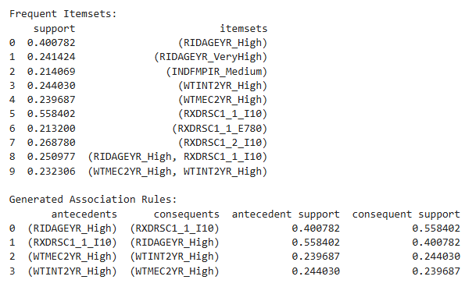
Association Analysis Results (Truncated Example)
WTMEC2YR = Weightage, WTINT2YR = Interview weightage
RXDRSC1= Medication disease code for having diabetes
RIDAGEYR = Age

Slide 10
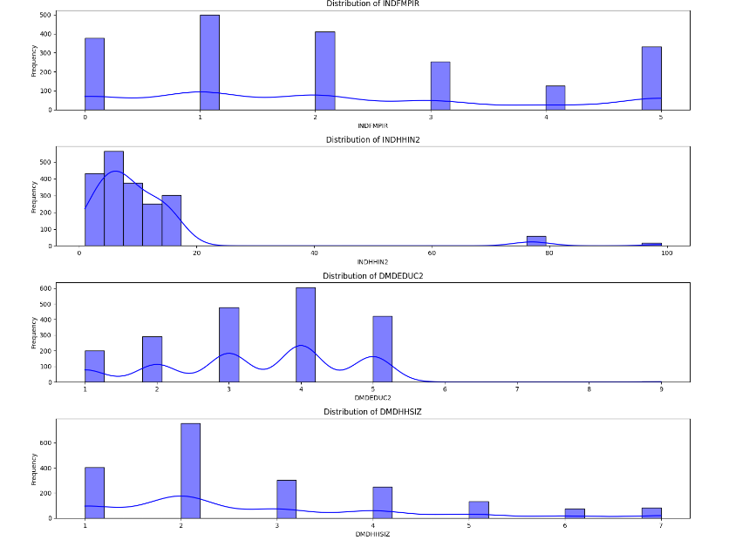
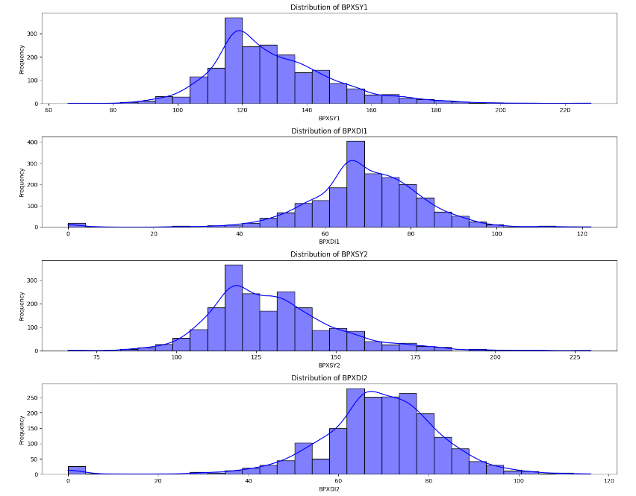
Distribution Analysis for PCA
Standardization is performed for PCA
Box-cox was performed for skewed

Slide 11
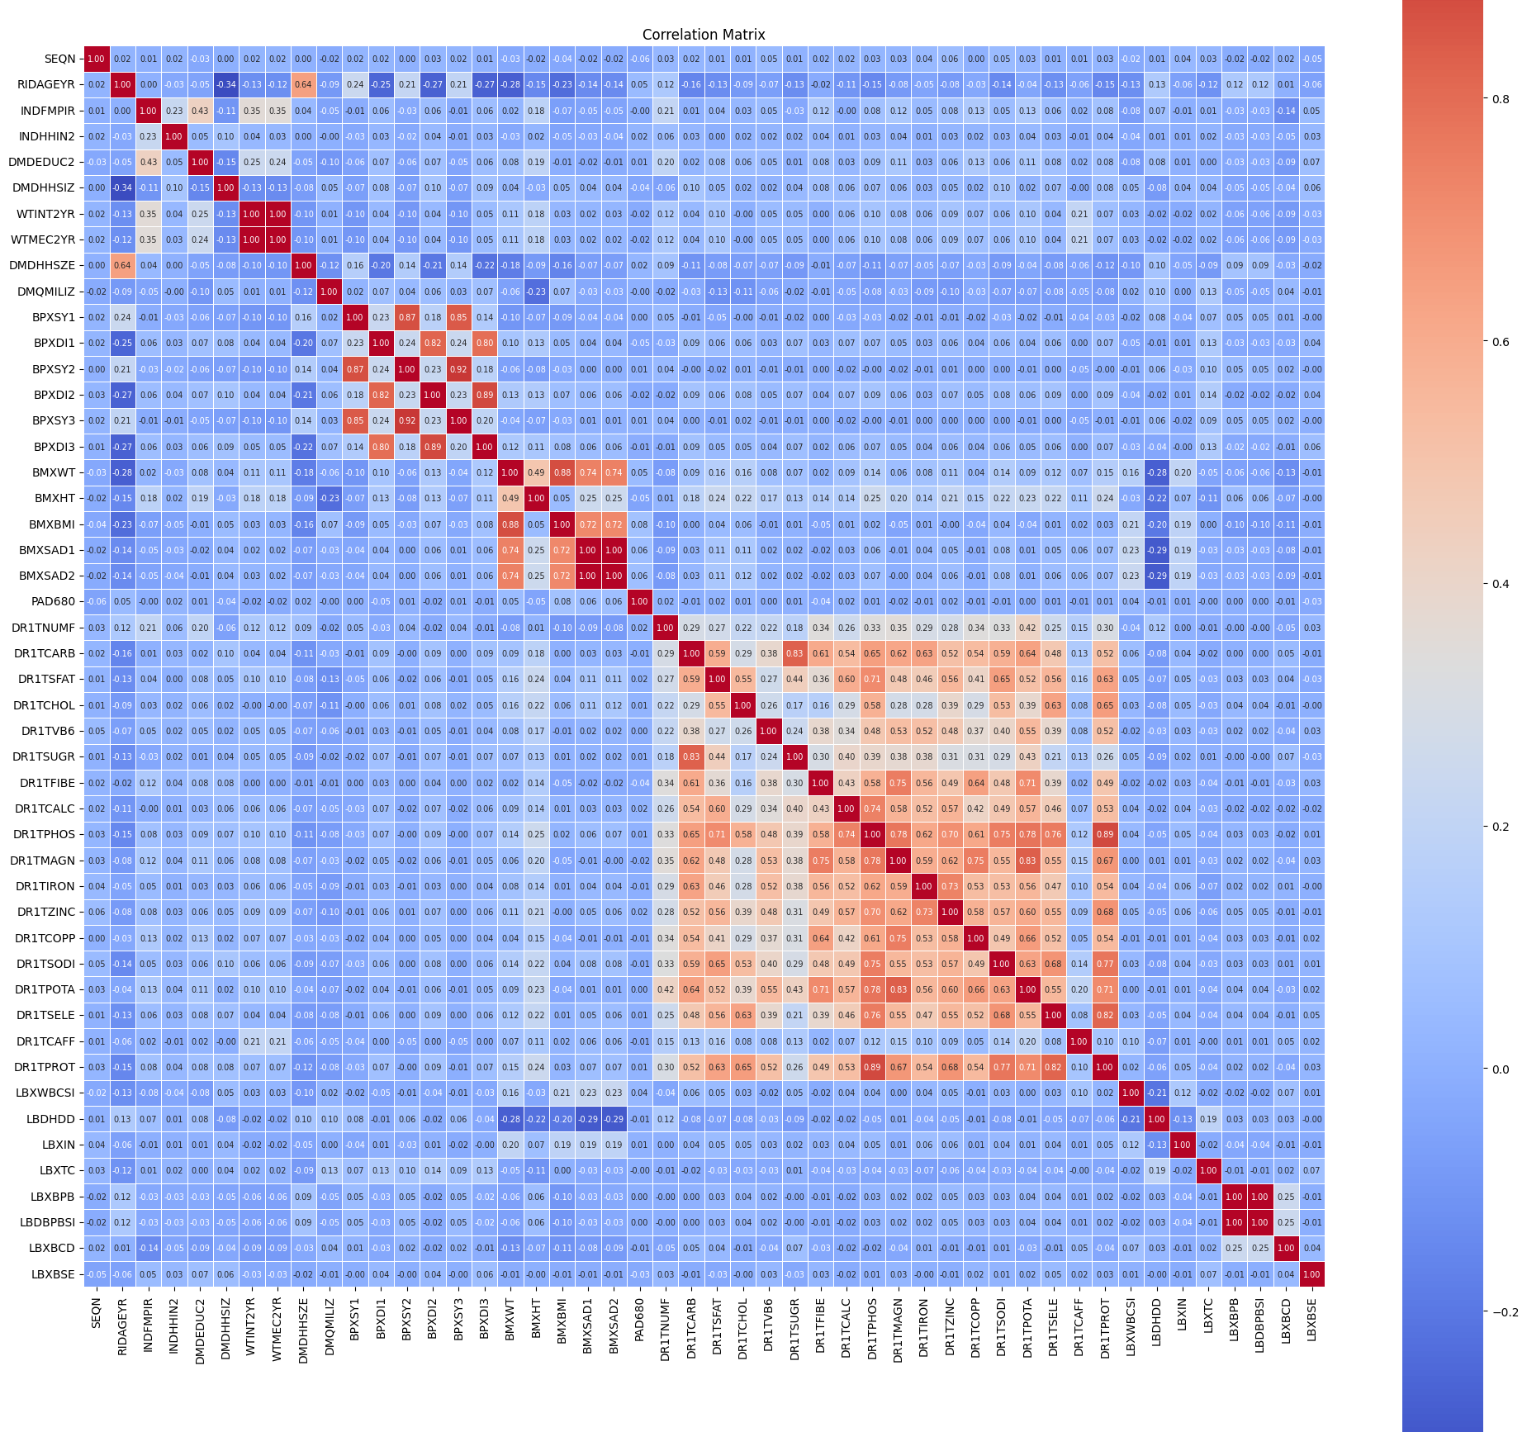
Correlation Matrix PCA Contd.
Dropping Features using Association analysis & Correlation matrix -
'WTINT2YR', 'RIDEXPRG_3.0', 'BPXSY2', 'BPXSY3', 'BPXDI2', 'BPXDI3', 'BMXBMI', 'BMXSAD1', 'BMXSAD2', 'DR1TSUGR', 'DR1TPROT', 'LBDBPBSI'

Slide 12
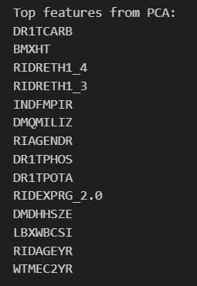
PCA Output
Total carbohydrate intake
Body measurement—height
Race/Ethnicity
Family income-to-poverty ratio
Military service status
Gender
Dietary intake of phosphorus and potassium.
Pregnancy status
Household size
White blood cell count
Age in years
Full sample 2-year MEC exam weight.

Slide 13
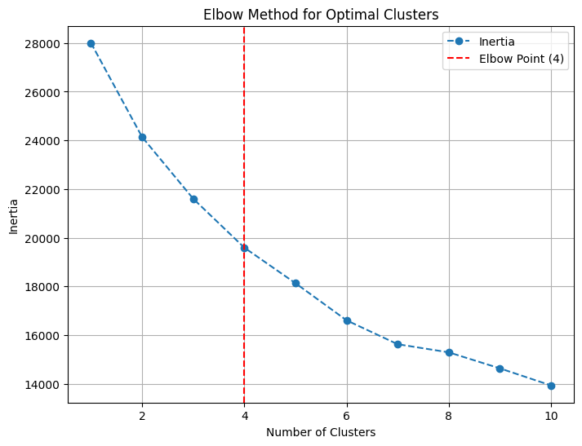
Cluster Optimization PCA Contd

Slide 14
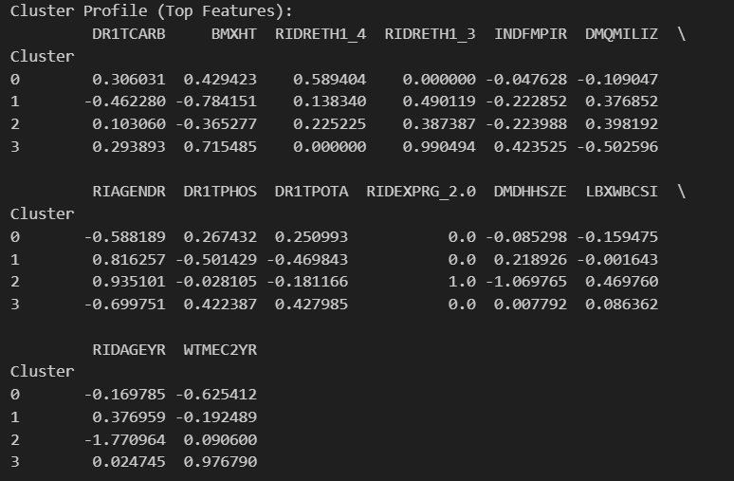
Cluster Profile (PCA Contd)
Cluster 0: higher DR1TCARB, high BMXHT, RIDRETH1_4, below-avg INDFMPIR, negative DMQMILIZ, RIDAGEYR below mean
Cluster 1: Lower DR1TCARB, low BMXHT, Below-average INDFMPIR, Positive DQMILIZ, Majority RIAGENDR_0, Higher RIDAGEYR
Cluster 2: Moderate DR1TCARB, Below-average BMXHT, Predominantly RIDEXPRG_2.0, negative DMDHHSZE, High LBXWBCSI, negative RIDAGEYR
Cluster 3: Higher DR1TCARB, high BMXHT, Predominantly RIDRETH1_3. Above-average INDFMPIR, Negative DQMILIZ, Majority RIAGENDR_1, Average RIDAGEYR

Slide 15
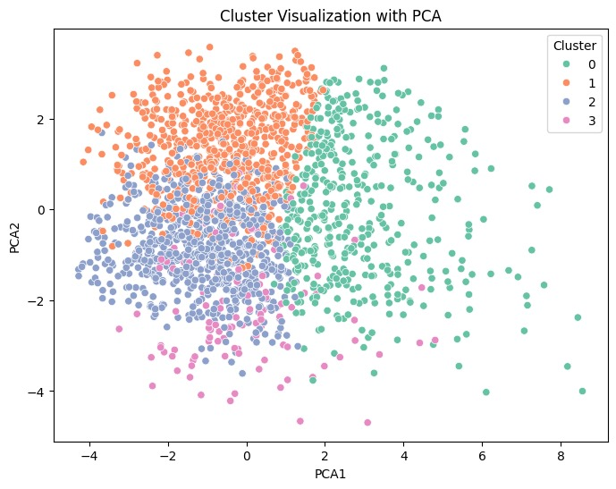
PCA Cluster
Cluster 0: This cluster likely represents younger Black females who are taller than average.
Cluster 1: This cluster likely consists of older males from diverse racial and ethnic backgrounds.
Cluster 2: This cluster primarily represents young pregnant females with smaller household sizes.
Cluster 3: This cluster likely represents White females of average age with higher income levels.

Slide 16
Classification (process)
Objective: Classify the target variable RXDRSC1 using a Random Forest classifier.
Dataset: Mention key features, missing values handled by median imputation, and target variable encoding.
Challenge: Address class imbalance and evaluate multi-class performance.
Model 1 – Baseline Random Forest:
A Random Forest classifier was trained with n_estimators=100 and random_state=42.
Key Metrics:
Accuracy: 65%.
Classification Report: Poor recall and F1-scores for minority classes.
Confusion Matrix: Predictions were biased toward the majority class (class 3).
Feature Importance: Top predictors included DR1TSUGR (sugar intake), LBXTC (total cholesterol), and DR1TCALC (calcium intake).
Model 2 – Random Forest with Class Balancing:
Addressed class imbalance using class_weight='balanced'.
Key Metrics:
Accuracy: Remained at 65%.
Classification Report and Confusion Matrix: Slight improvements in recall and F1-scores for minority classes.
Feature Importance: Top predictors shifted slightly, with DR1TVB6 (vitamin B6 intake), DR1TSFAT (saturated fat intake), and LBDHDD (HDL cholesterol) emerging as significant.

Slide 17
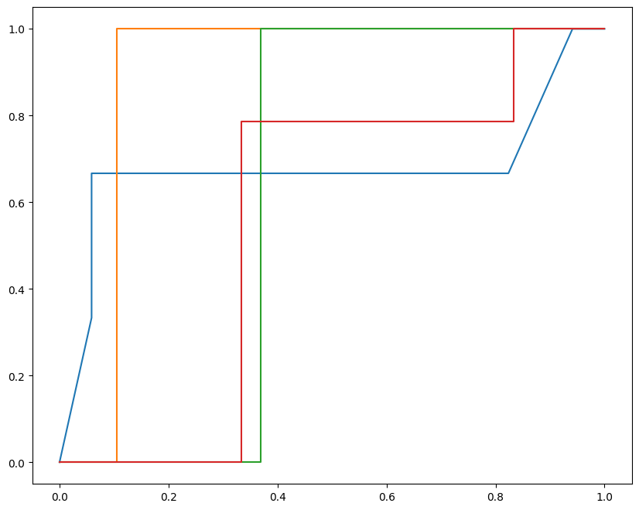
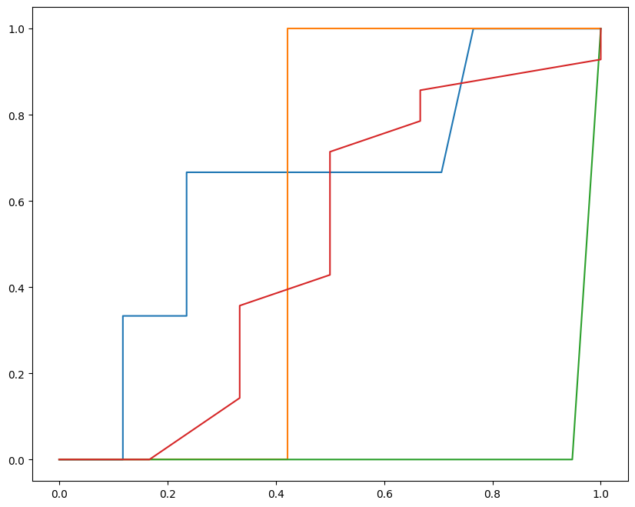
ROC Curves
(Model 1) ROC Curve Observations:
Abrupt and irregular transitions in the ROC curves indicate inconsistent performance for some classes.
AUC values suggest low predictive power for minority classes.
(Model 2) ROC Curve Observations:
Smoother and more consistent curves compared to Model 1.
Higher AUC values for minority classes, indicating improved performance..

Slide 18
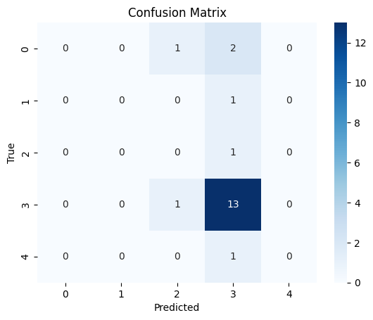
Classification Results
Confusion Matrix:

Slide 19

References
1. Centers for Disease Control and Prevention (CDC). National Health and NutritionExamination Survey (NHANES), 2021-2023;https://wwwn.cdc.gov/nchs/nhanes/continuousnhanes/default.aspx?Cycle=2021-2023
2. Ambika Satija, Edward Yu, Walter C Willett, Frank B Hu Understanding NutritionalEpidemiology and Its Role in Policy 2015; 10.3945/an.114.007492
3. Sareen S Gropper The Role of Nutrition in Chronic Disease 2023; 10.3390/nu15030664
4. Kimokoti R.W., Millen B.E. Nutrition for the Prevention of Chronic Diseases. Med. Clin.N. Am. 2016;100:1185–1198. doi: 10.1016/j.mcna.2016.06.003
5. Colten HR, Altevogt BM, editors. Sleep Disorders and Sleep Deprivation: An UnmetPublic Health Problem. Washington (DC): National Academies Press (US); 2006
6. Cátia Reis , Sara Dias , Ana Maria Rodrigues , Rute Dinis Sousa , Maria João Gregório ,Jaime Branco , Helena Canhão , Teresa Paiva Sleep duration, lifestyles and chronicdiseases: a cross-sectional population-based study 2018; 10.5935/1984-0063.20180036

