Slide 1

Process Mining Virtual Internship
by
Neha C
Roll No. 214G1A3268
Department of Computer Science and Engineering (Data Science)
Srinivasa Ramanujan Institute of Technology
(Affiliated to JNTUA & Approved by AICTE) (Accredited by NAAC with ‘A’ Grade & Accredited by NBA (EEE, ECE & CSE)
Rotarypuram Village, B K Samudram Mandal, Ananthapuramu – 515701.
2023 - 2024

Slide 2

Contents
Course Objective
Introduction
Technology
Applications
Modules
Real Time applications
Learning outcomes
GitHub Link
Queries

Slide 3
Course Objective
The course objective for process mining is to teach students how to analyze and improve business processes by utilizing data extracted from various information systems.
This involves learning how to discover, monitor, and optimize processes using techniques such as data extraction, process modeling, performance analysis, and identifying areas for enhancement. The aim is to enable students to make informed decisions based on insights gained from real-world process data.

Slide 4
Introduction
We have done this internship under Eduskills in association with AICTE.
The process mining was done in the platform of Celonis website, it helps companies achieve process excellence through its platform by eliminating operational friction with their Intelligent Business Cloud .

Slide 5
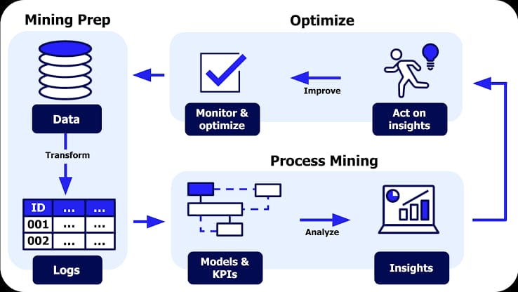
Contd…
Process Mining is a process management technique.This technique is designed to discover, monitor and improve real processes by using available knowledge from the event logs of information systems.
The main use of this process mining technique is to find deviations and weak points in business processes.

Slide 6
Technology
Process mining typically involves the use of various technologies such as data extraction, data transformation, and data analysis. Commonly used technologies include event log extraction tools, data processing platforms, process discovery algorithms, and visualization tools.
Examples of these technologies include ProM, Disco, Celonis, and various machine learning and data analytics frameworks.

Slide 7
Applications
Business Process Improvement: Process mining helps identify inefficiencies, bottlenecks, and areas for improvement within business processes. By analyzing actual process data, organizations can optimize their workflows, reduce costs, and enhance overall efficiency.
Manufacturing and Production : By analyzing manufacturing processes, process mining can identify production bottlenecks, optimize equipment utilization, and reduce production cycle times.

Slide 8
Contd…
Healthcare Optimization : In healthcare, process mining can analyze patient treatment processes, hospital workflows, and resource utilization to enhance patient care,
reduce waiting times, and improve resource allocation.

Slide 9
Modules
Stages of process mining.
How process mining works.
What is needed for implementing
Main components of process mining.
How to start a project in process mining.
Cross-industry use of process mining.
Benefits of process mining.
Applications of process mining.
Best process mining software.
Software providers of process mining.

Slide 10
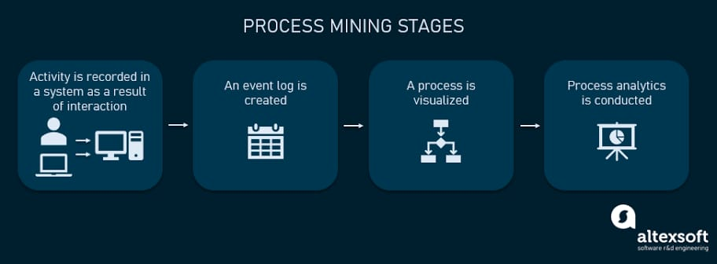
Contd…
Stages of process mining
Main Stages of Process Mining.
1)Interaction
2)Event Log
3)Visualized
4)Process Analysis

Slide 11
Contd…
How process mining works
Collecting Data
Creating Event Logs
Visualizing Processes
Finding Patterns
Identifying Bottlenecks
Discovering Deviations
Making Improvements
Predicting Future Steps
Continuous Improvement

Slide 12
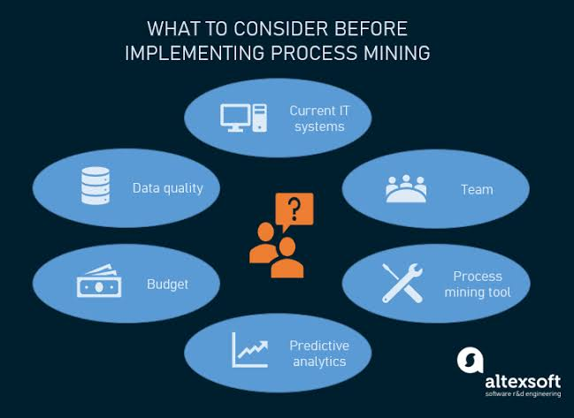
Contd…
What is needed for Implementing

Slide 13


Contd…
Main components of Process Mining
The mining algorithm determines how process models are created ,the best known categories are
Deterministic algorithms
Heuristic algorithms
Genetic
algorithms
Deterministic algorithms: This alogrithm always delivers the same result for the same input and this algorithm used to perform specific tasks in process mining with predictable results

Slide 14
Contd…
Heuristic Algorithms: Heuristic mining also uses deterministic algorithms. However, this algorithm is used to derive information from event data in a practical and efficient manner.
Genetic Algorithms: They use an evolutionary approach that mimics the process of natural evolution. They are not deterministic.

Slide 15




Contd…
Cross-industry use of process mining
Process mining can be used for business process management and process improvement in any application and any industry.
Production: In the manufacturing industry, timely and accurate delivery to a customer is the goal. When a company has multiple factories in different regions, there are usually differences between the reliability of deliveries.
Banking and Finance: In the financial sector, it is important to comply with rules and regulations and to be able to provide evidence of this.
Telecommunication: Telecommunications is a highly competitive sector worldwide. The ability to improve operational processes is key to success and profitability.
This will also functions in Scale, Service, Healthcare fields .

Slide 16
Contd…
Benefits of process mining
The Process mining save time and increase work capacity that growing demand for efficiency and the ability to clearly present results requires modern technologies.
Finding process bottlenecks which are difficult to uncover through BPM and process mapping workshops.

Slide 17







Coutd…
Software providers of process mining

Slide 18
Real Time Applications
Healthcare Patient Flow : Hospitals can apply process mining to monitor the real-time flow of patients through different departments. This allows healthcare providers to identify bottlenecks in patient care, optimize resource allocation, and enhance the overall patient experience.
E-Commerce Order Fulfillment : In an online retail setting, process mining can track the real-time journey of an order, from placement to delivery. It helps identify any delays, inefficiencies, or errors in the fulfillment process, enabling quick corrective actions.

Slide 19
Learning Outcomes
Gain an overall understanding of basic Process Mining concepts.
Become familiar with Mining core services and tools.
Learn the architectural principles of the process Mining.
Understand and be able to explain Process Mining and compliance measures.

Slide 20
Any Queries?

Slide 21
Thank You!!!

