Slide 1
Intelligent Routing Protocol
Routing that picks paths from live network conditions, not just distance
BCSE308P Computer Networks Lab · Fall Semester 2026-27 · Slot F2 · Team 18
24BCE2430 · Thipireddy Bhuvana Kruthi
24BCE2431 · Neha Damani
24BCE2514 · Afreen Faizal
School of Computer Science and Engineering
Notes:
Introduce the project in one line: a routing protocol that looks at how the network is actually behaving right now (delay, packet loss, bandwidth, failures) and picks the best path, instead of always taking the shortest one.

Slide 2
Problem and motivation: shortest is not always best
20 ms · 15% loss
Shortest-path routing (OSPF, RIP)
B
Picks A → B → D because it is 15 ms faster, and loses 15 of every 100 packets.
A
D
Our protocol
Picks A → C → D. 15 ms of extra delay is a small price for not losing packets.
C
35 ms · 1% loss
Classic protocols use a fixed metric (distance or hop count) and only react when a link fully goes down.
Notes:
Explain with the diagram. OSPF and RIP choose paths using a fixed number (configured delay or hop count). They do not notice that a link is dropping packets or is congested. They only react when a link completely fails. Here the top path is shorter but loses 15% of packets, so it is actually worse for users.

Slide 3
Existing approach (baseline) and its gap
OSPF (link-state)
RIP (distance-vector)
Latency-only dynamic
Static cost per link; Dijkstra picks the shortest path.
Reacts only when a link is declared down by the dead timer.
Gap: keeps using links that are lossy, congested or flapping.
Hop count only: every link costs 1.
Ignores delay, bandwidth and loss.
Gap: blind to link quality and slow to converge.
Re-routes on measured delay and queueing.
Handles delay spikes and congestion.
Gap: misses packet loss and flapping, which do not raise delay.
Main baseline: OSPF-like static routing. All policies share the same probes and dead timer, so only the routing logic differs.

Slide 4
Proposed novelty: four live measurements per link
1
2
3
4
Delay
Packet loss
Free bandwidth
Stability
How long packets take, including queueing delay when the link is busy
What fraction of packets are being dropped on the link
How much spare capacity is left for our traffic
Has the link gone up and down recently (flapping)?
These four are combined into one cost per link. Dijkstra's algorithm then finds the cheapest path. When conditions change, costs change and the route is recalculated automatically.
Notes:
Every link gets a score built from four things we can measure: delay, loss, free bandwidth, and how stable the link has been. Lower score is better. We then run Dijkstra, the same shortest-path algorithm OSPF uses, but on our smarter score.

Slide 5
Architecture: measure, score, choose, stay stable
1
2
3
4
5
Network
Link Monitor
Cost function
Dijkstra
Stability checks
Simulated routers and links. Faults happen here (delay spikes, loss, failures)
Probes every link every 0.5 s and smooths the noisy readings
Turns delay, loss, bandwidth and stability into one number per link
Finds the cheapest path from source to destination
Only switch if the new path is clearly better (avoids flip-flopping)
Realistic by design: the routing engine never sees the true network state, only what the monitor measures. Its information is noisy and slightly late, as on a real network.
Notes:
Walk left to right. The simulator is the real network. The monitor sends probes every half second and averages them (EWMA) so one bad reading does not cause panic. The cost function combines the four metrics. Dijkstra picks the cheapest path. Then stability rules decide whether switching is worth it. Point out that the engine only sees measurements, never the true state, so the test is fair and realistic.

Slide 6
Algorithm: one cost per link, in effective milliseconds
cost = delay + 300 × loss penalty + bandwidth penalty + 25 × flap penalty
Delay
Loss penalty −ln(1 − p)
Measured delay plus the expected queueing delay if our traffic is added to the link.
Turns loss into something that adds up along a path, so Dijkstra minimises total loss exactly.
Bandwidth penalty
Flap penalty
100 ÷ free Mb/s. A nearly full link becomes expensive before we send traffic onto it.
Each time a link goes down it gets a penalty that fades with a 20 s half-life.
Example from the A-B-D diagram: link B-D scores 60.5 (49 of it from loss) while A-C and C-D score 20.8 each, so A → C → D wins.
Notes:
Everything is measured in 'effective milliseconds' so the parts can be added. Delay is already in ms. Loss is weighted heavily (300) because lost packets hurt users a lot. The minus-log form is a maths trick: delivery probability multiplies along a path, and taking the log turns that product into a sum, which is what Dijkstra needs. The weights are hand-tuned and can be changed in the dashboard.

Slide 7
Algorithm: adapting fast without flip-flopping
15%
Hysteresis
3 s
Hold-down
Switch only if the new path is at least 15% cheaper.
At most one cost-driven change every 3 seconds. Failures skip this wait.
20 s
Flap damping
1 probe
Early failure detection
A link that keeps failing gets a penalty that fades over time, so traffic stays away from it.
A missed probe counts as packet loss, so traffic leaves a dying link after 1 missed probe instead of 3.
A flow also ignores its own traffic when judging a link, so it does not run away from congestion it caused itself.
Notes:
A protocol that reacts to everything would keep jumping between paths (route flapping), which is bad. These four rules keep it calm: a minimum improvement, a minimum time between switches, a memory of links that keep failing, and early detection of failing links. The last line is a subtle bug many adaptive designs have: a flow sees the load it created and runs away from itself.

Slide 8
Implementation setup
Tools and platform
Code structure (Python package irp/)
Python 3.14; the protocol core uses only the standard library
pandas, SciPy, Matplotlib, Plotly, Streamlit, pytest
macOS on Apple M4, 16 GB RAM; VS Code and Git
Simulator: 100 ms ticks, probes every 0.5 s, 60 s runs
topology.py routers, links, queue model
monitor.py probes, EWMA, dead timer
policies.py IRP cost + 3 baselines
engine.py Dijkstra, hysteresis,
hold-down, change reasons
simulator.py 100 ms ticks, fault events
scenarios.py mesh8 topology, 9 tests
evaluation.py 10 seeds, CIs, t-tests
dashboard/ Streamlit app
tests/ 29 pytest tests
Run it
python -m irp evaluate
python -m irp dashboard

Slide 9
Scenarios and metrics
9 experiments
Steady network (no faults)
Latency spike: 10 → 150 ms
Bandwidth drop: 100 → 15 Mb/s
Packet loss rises to 12%
Link failure
Congestion build-up
Flapping link (down 2 s every 4 s)
7 random faults
Lossy shortcut (A-B-D example)
B
E
A
C
F
H
D
G
Metrics: delivery ratio, throughput, mean / p95 latency, recovery time, time degraded, route changes. Baselines: OSPF-like, latency-only, hop count. 10 seeds each, Welch's t-test.
8 routers, 13 links. Test flow A → H at 40 Mb/s plus competing traffic C → E. Faults hit at 15 s and clear at 40 s.
Notes:
Built a simulator with an 8-router mesh. The highlighted path A-B-E-H is the shortest. We inject nine kinds of problems and compare our protocol against three standard approaches. Each experiment is repeated with 10 random seeds and checked with a statistical test, so the differences are not luck.

Slide 10
Results: headline numbers vs OSPF-like routing
9×
99.6%
0 s
2 vs 12
faster recovery from a link failure
packets delivered when bandwidth drops
of degraded service during congestion
route changes on a flapping link
0.13 s vs 1.15 s
vs 86.7% for OSPF
vs 19.5 s for OSPF
OSPF loses ~6% of traffic
Statistically significant gains in every fault scenario (p < 0.05), and exactly the same as OSPF on a healthy network, so adapting costs nothing when there are no faults.
Notes:
These are the four numbers to remember. Recovery from failure is about nine times faster because we move after one missed probe instead of three. In the bandwidth and congestion cases OSPF keeps sending traffic into a link that cannot carry it. On a flapping link OSPF keeps jumping back; we stay put. And on a healthy network both behave identically.

Slide 11
Results: baseline vs proposed (mean ± SD, 10 seeds)
Scenario | Metric | OSPF-like (baseline) | IRP (proposed) | Improvement
Bandwidth drop | Delivery ratio | 0.867 ± 0.001 | 0.996 ± 0.001 | +14.9 %
Packet loss increase | Time degraded (s) | 23.58 ± 0.48 | 0.10 ± 0.23 | +99.6 %
Link failure | Recovery time (s) | 1.15 ± 0.15 | 0.13 ± 0.14 | +88.7 %
Congestion build-up | Mean latency (ms) | 57.2 ± 0.1 | 23.9 ± 0.3 | +58.2 %
Flapping link | Route changes | 12.0 ± 0.0 | 2.0 ± 0.0 | +83.3 %
Lossy shortcut | Delivery ratio | 0.924 ± 0.001 | 0.994 ± 0.000 | +7.6 %
Steady state | Delivery ratio | 0.997 ± 0.000 | 0.997 ± 0.000 | same
Packet loss increase | Mean latency (ms) | 20.1 ± 0.0 | 23.6 ± 0.2 | -17.1 %
Improvement is positive when IRP is better. All delivery-ratio gains in fault scenarios are significant (Welch's t-test, p < 0.05). The last row is the deliberate latency trade-off.

Slide 12
Results: time with degraded service during a 25 s fault
What this shows
OSPF keeps using a link that is slow, lossy or full for almost the whole fault.
Our protocol moves away in under a second in every case.
Latency spike: neither loses throughput, but ours cuts delay from 49 to 24 ms.
Notes:
Degraded means the test flow was getting less than 90% of its normal throughput. The fault lasts 25 seconds. Orange bars near 25 mean OSPF was degraded almost the entire time. Our bars are all under one second.

Slide 13
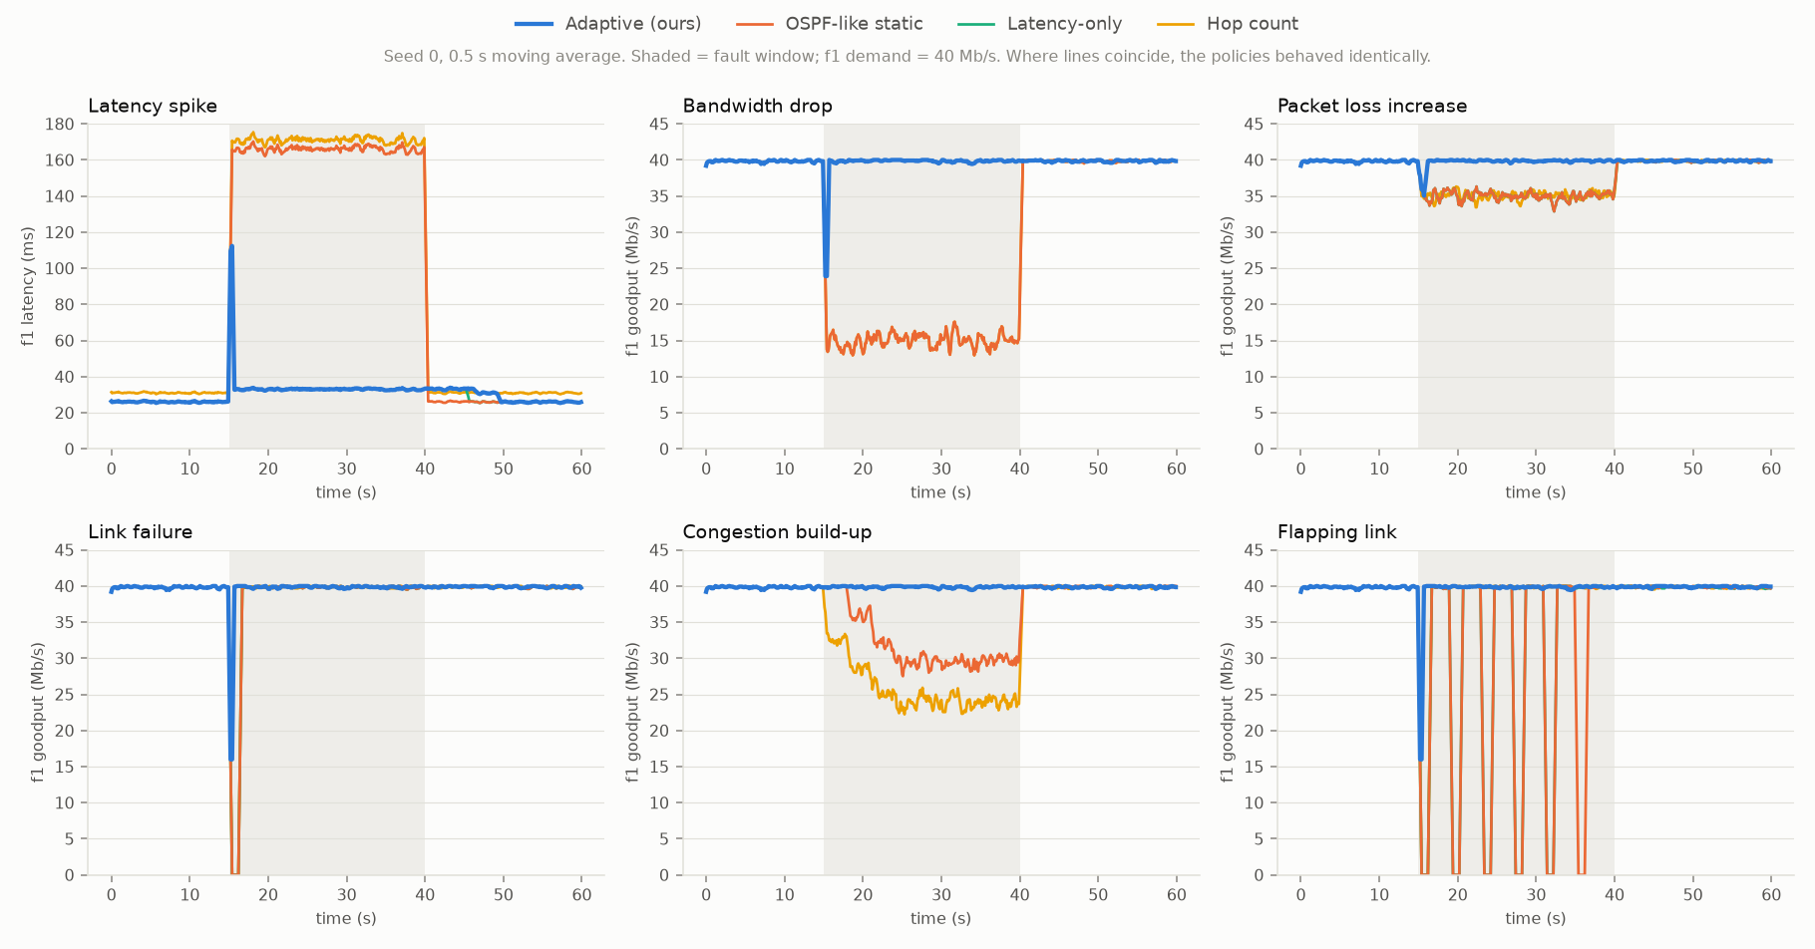
Results: what the test flow actually experienced
Blue = our protocol, orange = OSPF-like. Grey band = fault window. Blue stays at the full 40 Mb/s while the others drop.
Notes:
Each panel is one experiment over 60 seconds. The flow wants 40 Mb/s. Blue (ours) dips for a moment when the fault starts, then goes straight back to 40. Orange (OSPF) stays down for the whole fault in bandwidth drop and congestion, and keeps crashing to zero on the flapping link.

Slide 14
Analysis: every route change is explained
Interactive dashboard
Route-change log: link B-E fails at 15 s
See the topology and the chosen route
Watch link health change during a fault
Inject your own faults on any link
Change the cost weights and see the effect
Compare against any baseline
Our protocol
15.3 s A-B-E-H => A-C-F-H
loss on B-E ~30%, 73% cheaper path
59.3 s A-C-F-H => A-B-E-H
better path available (16% cheaper)
OSPF-like
16.3 s A-B-E-H => A-C-F-H
link B-E declared down (3 missed probes)
Run it
python -m irp demo
python -m irp dashboard
Notes:
This is real output from the demo. Our protocol noticed loss on B-E one second before OSPF declared the link dead, and it records why it switched. If time allows, open the dashboard (python -m irp dashboard) and inject a failure live.

Slide 15
Analysis and limitations
Trade-off
Limitations
When it does not help
Pays a few ms of extra latency in 4 scenarios to avoid loss (e.g. 23.6 vs 20.1 ms).
This is deliberate and controlled by the weights.
Flow-level simulator, not packet-level (no TCP behaviour).
Routes use global link-state knowledge; message flooding is not modelled.
Weights are tuned by hand.
All paths degraded equally: nothing better to switch to.
Faults shorter than one probe interval (0.5 s).
Pure delay faults: latency-only routing does as well.
The weights set the balance: raise the latency weight to favour speed, or the loss weight to favour reliability.
Notes:
Be honest about the trade-off: avoiding loss sometimes means a slightly longer path. Limitations are about the simulator, which is a simplification. Future work: learn the weights instead of hand-tuning, test on a packet-level emulator, and turn it into a real distributed protocol.

Slide 16
Conclusion, future work and references
Conclusion
Future work
References
Same as OSPF on a healthy network.
Higher delivery in all 7 fault scenarios (p < 0.05).
9× faster failure recovery; 2 vs 12 route changes on a flapping link.
Learn the weights automatically (Bayesian optimisation).
Packet-level validation in Mininet or ns-3.
Distributed version: routers flood their measurements.
J. Moy, "OSPF Version 2," RFC 2328, 1998.
C. Hedrick, "Routing Information Protocol," RFC 1058, 1988.
A. Khanna, J. Zinky, "The revised ARPANET routing metric," SIGCOMM 1989.
D. De Couto et al., "A high-throughput path metric for multi-hop wireless routing," MobiCom 2003.
S. Kandula et al., "Walking the tightrope," SIGCOMM 2005.
Full IEEE reference list in the report. Code: github.com/nehadamani0909/F2_Team18

Slide 17
Routing that reacts to how the network really behaves
Same as OSPF when the network is healthy. Far more reliable when it is not.
Thank you. Questions?
Notes:
Close with the one-line takeaway, then take questions.

